Slide 1
We Value Nature
Training session
Integrating biodiversity into a natural capital assessment
1 December 2021
(13:30 - 16:00 CET)
Notes:
Katia to welcome everyone and begin the presentation

Slide 2
We Value Nature Campaign
We Value Nature is a campaign supporting businesses and the natural capital community to make valuing nature the new normal for business across Europe, by:
Sharing research, resources & best practices;
Identifying barriers & opportunities for adopting a natural capital approach;
Providing practical support to help business improve their risk management, communication & stakeholder engagement;
Reinforcing & boosting the work of the Natural Capital Coalition.
Notes:
KB to introduce the WVN campaign – show that the training is being given as part of the campaign – explain what it is, its purpose, objectives and partners involved:
The We Value Nature Campaign is a €2 million EU-funded campaign supporting businesses and the natural capital community across Europe with the aim of making valuing nature the new normal for business. As we will have a chance to explore during today’s training, by valuing nature, businesses can make smarter decisions that benefit themselves, society and the planet as a whole.
The campaign is coordinated by the Institute of Chartered Accountants in England and Wales (ICAEW), World Business Council for Sustainable Development (WBCSD), The International Union for Conservation of Nature (IUCN) and Oppla. And it is supporting the Natural Capital Coalition, which has recently merged with the Social & Human Capital Coalition to become now the ‘Capitals Coalition’.
The campaign will aim to increase the uptake of the natural capital approach (including: natural capital assessment, natural capital accounting, nature-based solutions and green infrastructure) by identifying barriers and opportunities, providing practical support to business through activities (such as webinars, helpdesk calls, etc.) and training such as this one, as well as by inspiring businesses to adopt the NCP.
Take this opportunity to also thank the different stakeholders that supported the training (if relevant).

Slide 3
Acknowledging contributors
We Value Nature’s biodiversity training material is based on the Natural Capital Protocol and WVN’s module 2 training, developed with Little Blue Research Ltd.
The training content and material were developed in collaboration with
UNEP-WCMC

Slide 4
A few “house rules”
Please change your username to your full name and (organization)
E.g. John Doe (WBCSD)
Please submit comments or questions in the chat function
Make sure to be joining us through Zoom app or computer
We invite you to turn on your camera if possible
Ensure that you are on mute when not taking part in discussions
Be prepared for some interactivity: We’ll be using polling Qs., breakout rooms & live Google doc.

Slide 5
Who is your support team for today?
Katia Bonga
Hannah Nicholas
Julie Dimitrijevic
Notes:
KB to introduce the support team for today
Introductions for those who are presenting the session (virtual or in person)

Slide 6
Agenda
Time (CET) | Session
13:30 – 13:45 | Welcome – Agenda, objectives & introductions
13:45 – 13:50 | Setting the scene
13:50 – 14:00 | Understanding natural capital, biodiversity & linkages with other concepts
14:00 – 14:25 | Scoping a first assessment
14:25 – 14:35 | Coffee break
14:35 – 15:05 | Introduction to measuring natural capital & biodiversity
15:05 – 15:35 | Group exercise
15:35 – 15:50 | Brief presentation of valuation methods and tools
15:50 – 16:00 | Wrap-up & key takeaways
16:00 | End of session
Notes:
#'{

Slide 7
The Natural Capital Protocol as a basis for the training content
p. 2 & 6 in the NCP, p. 17 in the workbook
The Natural Capital Protocol is a standardized framework for business to identify, measure and value its direct and indirect impacts and dependencies on natural capital
Link to the Protocol here
Notes:
The Natural Capital Coalition is a collaborative space to harmonize approaches to natural capital
The network represents over 300 organizations across all parts of society and around the world
Purpose: To mainstream the inclusion of natural capital in decision making, harmonizing approaches and getting them to scale, quickly
The Protocol aims to support better decisions by taking into account how business interacts with natural capital in decision making. Until now, natural capital has for the most part and still is, being excluded from decisions.
So it is to be understood as a Framework that was really designed to help generate trusted, credible and actionable information that business managers need to inform decisions by identifying, measuring and valuing impacts and dependencies on natural capital.
The Protocol builds upon many approaches already used within business.
It acts as an overarching globally accepted framework to build and expand this information into robust natural capital assessments.
STRUCTURE of the Protocol:
4 overarching stages of frame (why), scope (what), measure and value (how) and apply (so what) and 09 logical steps. It should be easy to follow and should be suitable for any business across any sector or geography.
The stages and steps are iterative so expect that you may need to revisit a previous step.
Important to note that the NCP as an overarching framework, won’t give you actual results and need to therefore use the Nat Cap toolkit to get tools.
Highlight that while we will briefly cover tools and approaches for stages of ‘Measure & Value’ – the aim of the training will mainly focus on first two stages of the Protocol and that going into measurement and valuation technical details, requires a separate training.

Slide 8
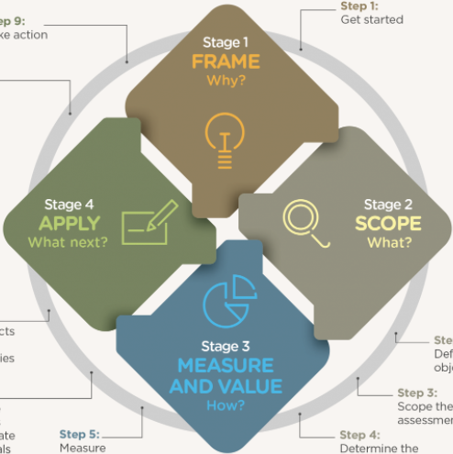
The Protocol’s steps & stages as a basis for the training content
Module 1
Variety of business stories, testimonial videos & mountain interactive tool
Module 2
Module 3

Slide 9
Training material
Executive summary
Full version
Full version
Notes:
Mention that they should all have a ‘Participant workbook’ and explain that its purpose is to use it throughout the training. We have included in there some of the slides from the training but also additional information. There is space for them to regularly take notes as well as write down their key learnings through each chapter. The aim is that at the end of the training they have a useful resource to look back to when wanting to get started on the natural capital journey.

Slide 10
We Value Nature training is open
You are free to:
Share — copy and redistribute the material in any medium or format
Adapt — remix, transform, and build upon the material for any purpose, even commercial
Under the following terms:
Attribution — You must give appropriate credit, link to the licence & indicate if changes were made (but not suggest endorsement).
No additional restrictions — You may not legally restrict others from doing anything the license permits.
CC BY 4.0 Creative Commons Attribution 4.0 International
If any images are more restricted this is noted on caption.
Notes:
We have a Creative Commons Attribution license which means that you are free to share and adapt your own organization and industry to make it more relevant. To make it targeted to your audience, we’d love to know how you’ve adapted them.

Slide 11
Getting to know you

Slide 12
Introductions
Please tell us more about you by sharing:
Who are you (role) and where are you joining us from?
What are you most curious to learn about today?

Slide 13
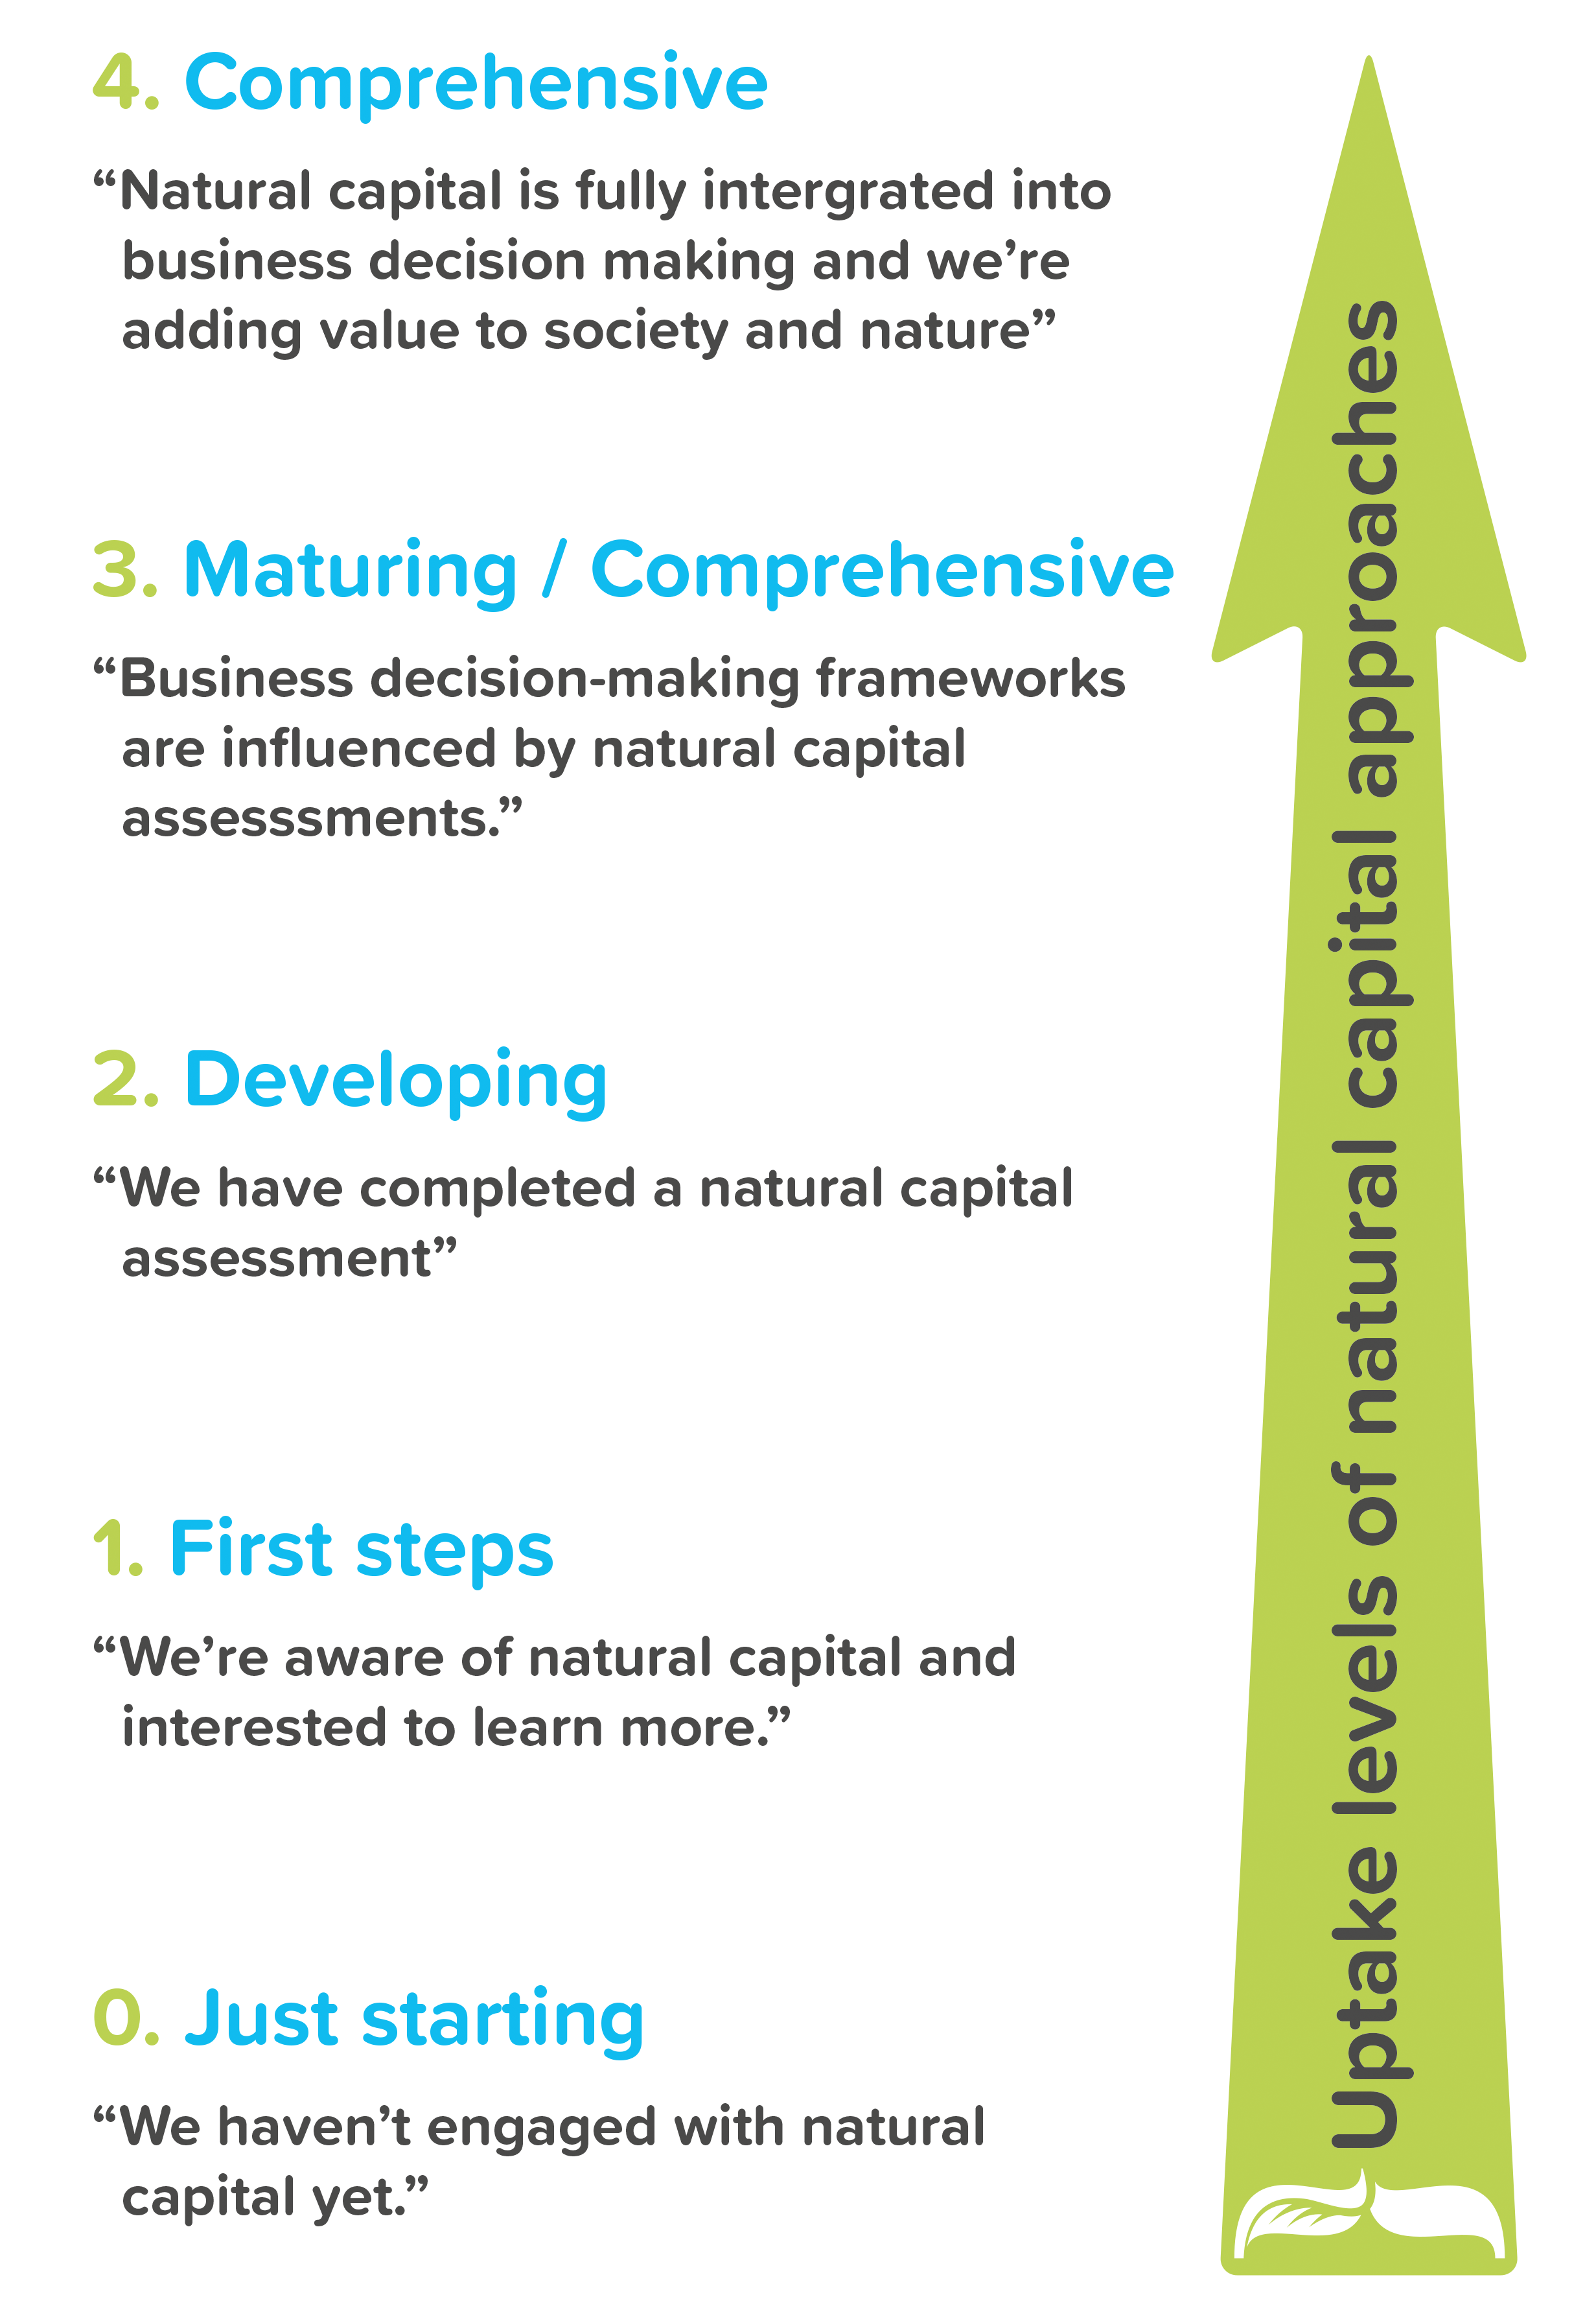
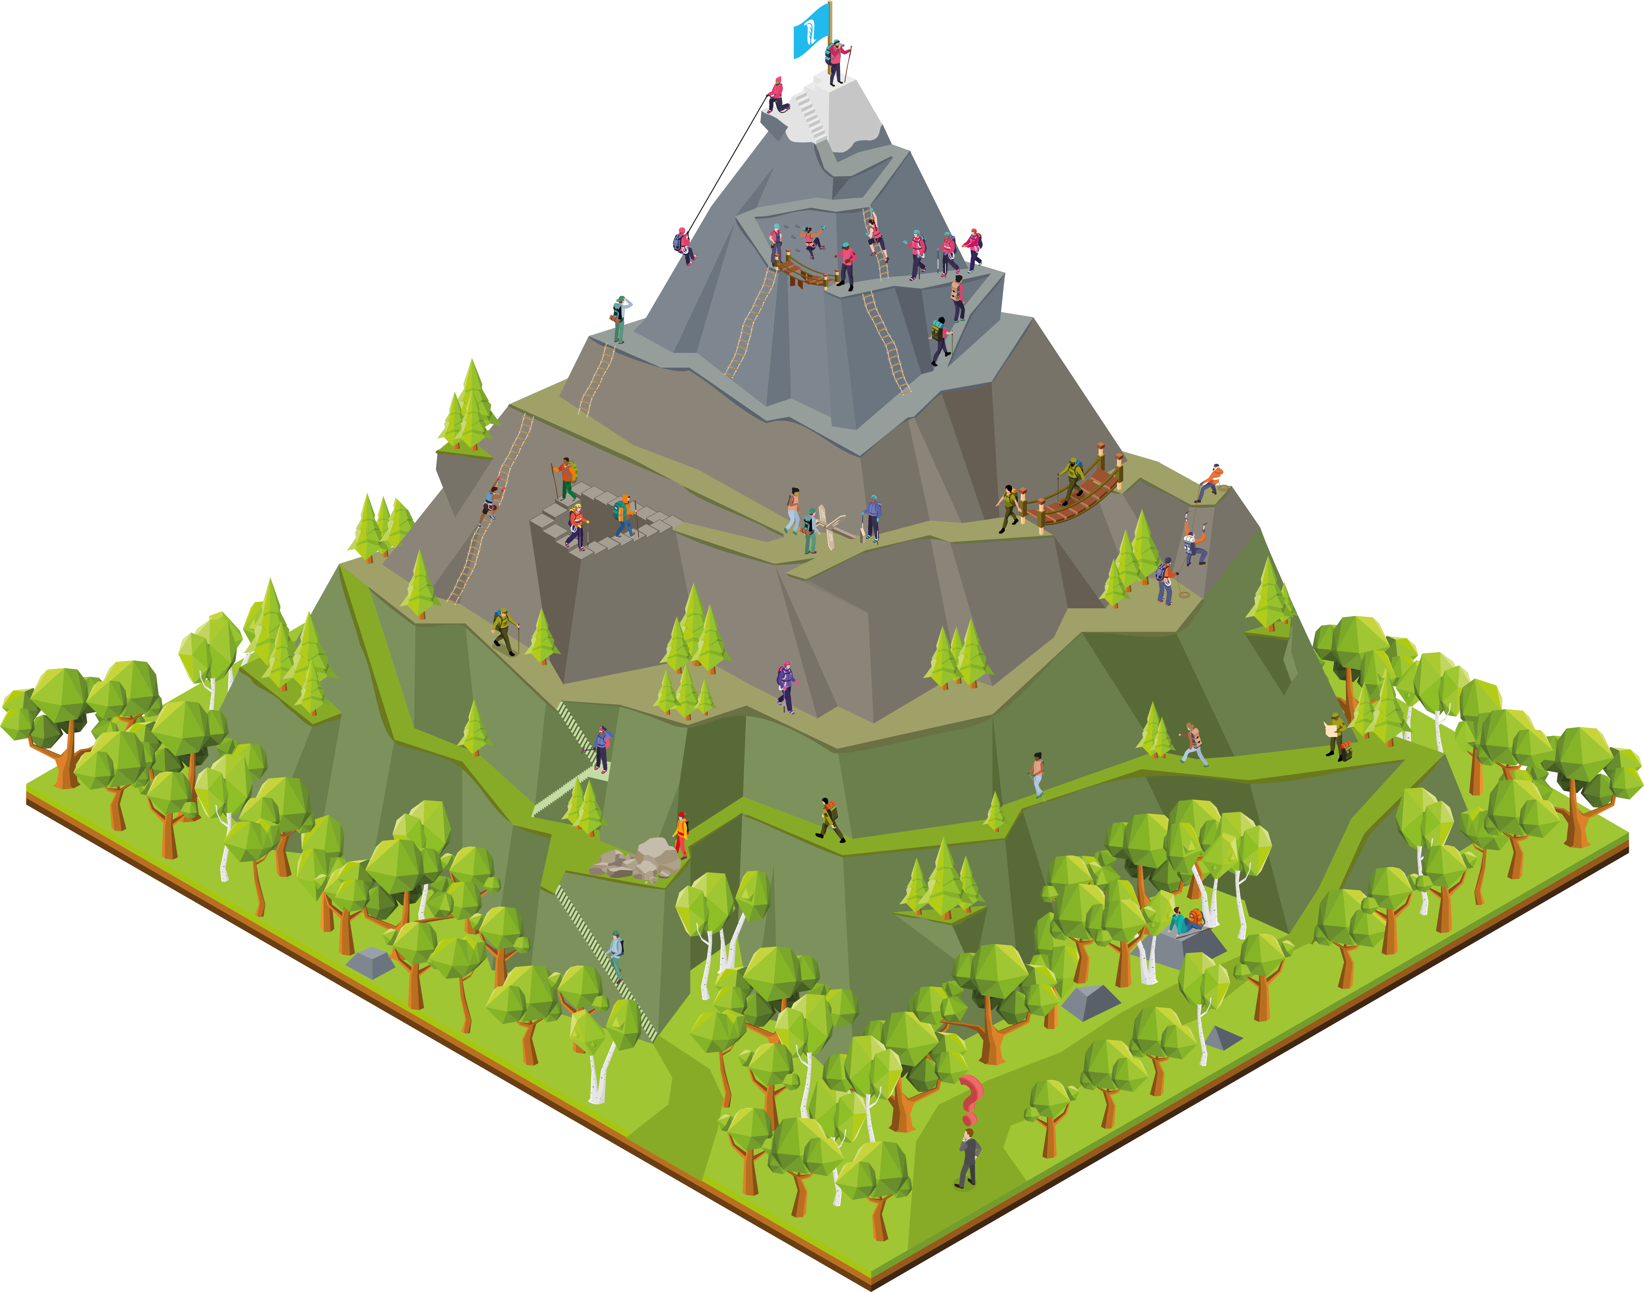
Where are you on your Journey?

Slide 14
Warm-up poll
Where are you on your natural capital journey?
Notes:
Q. 1
Yes
No
Q. 2
I never or rarely engage with business on biodiversity
I have engaged business on biodiversity a few times
I engage business on biodiversity on a regular basis

Slide 15
How to use Mentimeter
1
Go to www.menti.com
2
Enter this code: 8352 2114
3
Submit your answer
15

Slide 16
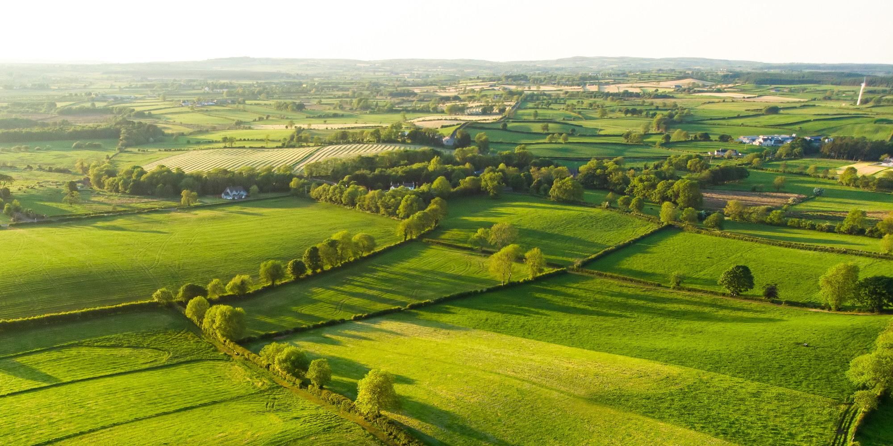
Setting the scene Katia Bonga, WBCSD
Notes:
Presenter to introduce the section on ‘setting the scene and a brief re-cap on natural capital’

Slide 17
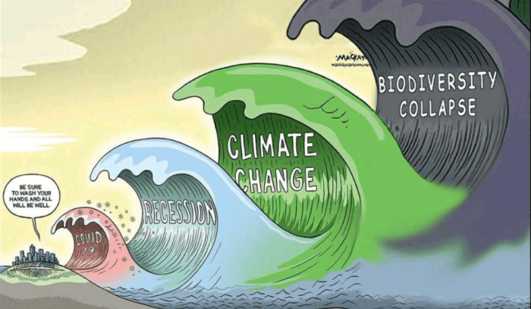
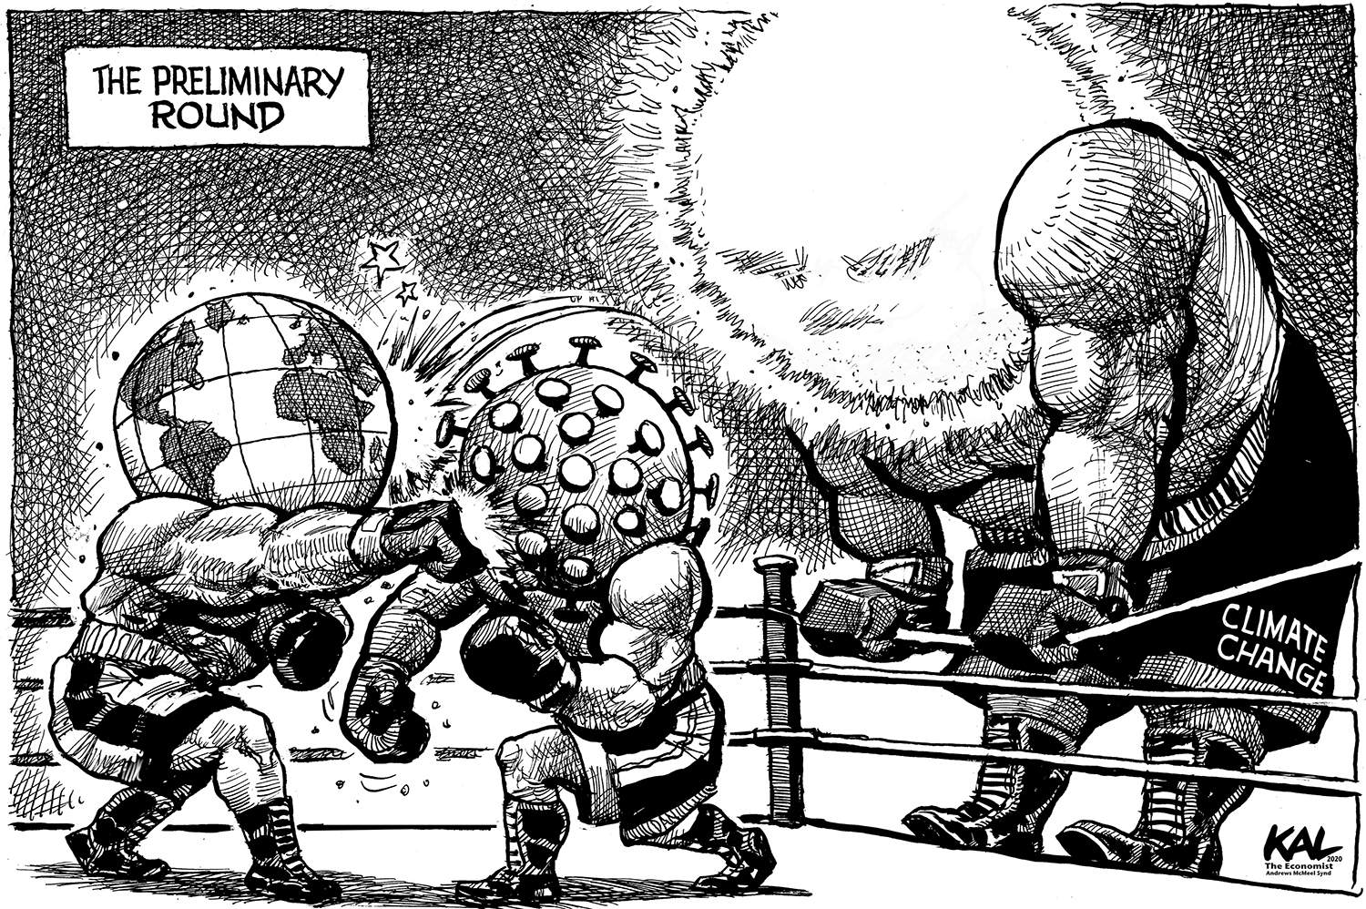
The scale of the challenge ahead…
By Graeme MacKay
By Kal, The Economist

Slide 18
The global risk landscape has changed
2010 | 2011 | 2012 | 2013 | 2014 | 2015 | 2016 | 2017 | 2018 | 2019 | 2020 | 2021
Asset price collapse |  |  |  |  |  |  |  |  |  |  | Extreme weather
Slowing Chinese economy (<6%) |  |  |  |  |  |  |  |  |  |  | Climate action failure
Chronic disease |  |  |  |  |  |  |  |  |  |  | Human-made environmental disasters
Financial crisis |  |  |  |  |  |  |  |  |  |  | Infectious diseases
Global governance gap |  |  |  |  |  |  |  |  |  |  | Biodiversity
Asset price collapse |  |  |  |  |  |  |  |  |  |  | Infectious diseases
Retrenchment from globalization (developed) |  |  |  |  |  |  |  |  |  |  | Climate action failure
Oil price spike |  |  |  |  |  |  |  |  |  |  | Weapons of mass destruction
Chronic disease |  |  |  |  |  |  |  |  |  |  | Biodiversity loss
Fiscal crises |  |  |  |  |  |  |  |  |  |  | Natural resources crises
Top 5 Global Risks: likelihood
Top 5 Global Risks: impact
Source: WEF 2020
Economic Environmental Geopolitical Societal Technological
Notes:
Some you might be familiar with this graphic, this is the WEF Global Risk Report. This puts the world’s risk every year into a global context, look how much it has changed since 2010. Aside from the obvious addition of Infectious disease from COVID-19 which has changed the world’s priorities drastically. But the Environment risk are still very significant in terms of likelihood and impact.
This shows the real crisis that we are in and that we need to act now

Slide 19
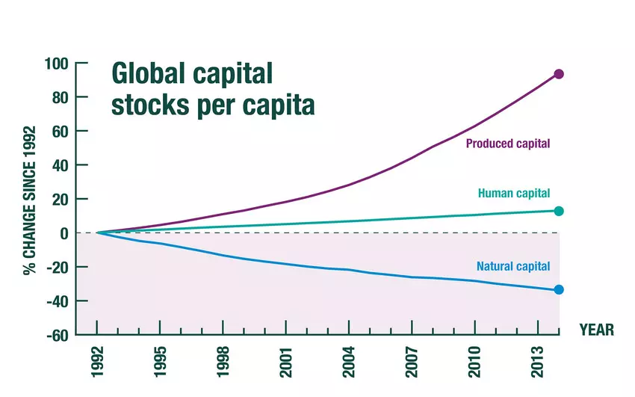
What have we learnt from the pandemic?
Institutions urging a green recovery from covid-19
"Business as usual" is vulnerable to a range of outside influences, not just market forces
Release of the Dasgupta review shows how economic change must encompass natural capital
Understanding stakeholder values is important for decision making
Notes:
Presenter to give a re-cap on natural capital in relation to the current context on covid-19, using the notes below – this slide should be adapted to the specific country in which training is being given and as the global context changes.
Number of organisations have considered the impact and how to ensure sustainability remains on the agenda
The crisis may help senior managers to realize that "business as usual" is vulnerable to a range of outside influences, not just market forces.
The crisis has highlighted more than ever, the need for business to take into consideration all capitals
[Explain graph]: Natural capital has been being depleted for many years, as human and produced capital has increased. Nature has been used, and exploited, to support economic growth, and the Dasgupta review has highlighted how this needs to change to secure long-term and sustainable development of economics and human wellbeing.
The crisis has also further emphasized the need for business to shift from shareholder value to stakeholder focused business models – Stakeholder Capitalism
The crisis shows why understanding stakeholder values into account for decision making is important i.e. understanding the wider implications of decisions
Presenter to give an example of institutions action on the environment currently the slide is focused on responses to COVID 19 and those urging a green recovery from the crisis, this will need to be updated by presenters as the context changes. An example of this is Christine Lagarde's introductory statement at the Hearing at the Committee on Economic and Monetary Affairs of the European Parliament:
Christine Lagarde is pushing to include climate change considerations in a review the central bank is due to hold into the way it conducts monetary policy:
"The transition towards a greener economy is a crucial part of economic recovery. We have the opportunity to step up the EU’s efforts to achieve its sustainability objectives by including climate change and sustainability considerations in the financial response to the COVID-19 pandemic:
Sustainable finance will be key to the transition to a carbon neutral economy. Today, we published our reply to the Commission’s public consultation and reaffirmed our readiness, in line with our mandate, to support the efforts of governments, public institutions and the private sector
Moreover, our forthcoming report on the international role of the euro finds that the euro was the main currency of denomination for the issuance of green bonds in 2019"
This move comes alongside moves by the European Parliament to declare a climate emergency and moves from the European Commission, to promise an imminent "green new deal" in their strategy
Potential VO outputs from these moves:
Forces people to think differently and be more creative (boost innovation, not just resilience).
Switching to digital meetings has opened up possibilities for (more) colleagues joining in without cost-increases otherwise related to travelling.
More motivated than ever before to energise the inclusion of the nature agenda in restarting.
Take the crisis as an opportunity to communicate on the links health/biodiversity
The crisis may get senior managers realize that "business as usual" is vulnerable to a range of outside influences, not just market forces.
The crisis has opened up access to technology and free training materials (new opportunities).
Sources: https://www.ecb.europa.eu/press/key/date/2020/html/ecb.sp200608~4225ba8a1b.en.html

Slide 20
Why is biodiversity important?
Biodiversity: ‘The variability among living organisms from all sources including, inter alia, terrestrial, marine, and other aquatic ecosystems and the ecological complexes of which they are a part; this includes diversity within species, between species, and of ecosystems’ (Art 2, CBD 1992).
Notes:
Biodiversity can be defined as ‘The variability among living organisms from all sources including, inter alia, terrestrial, marine, and other aquatic ecosystems and the ecological complexes of which they are a part; this includes diversity within species, between species, and of ecosystems’ (Art 2, CBD 1992).
This definition is used in the Biodiversity Guidance, and can be found on page 10.

Slide 21
Understanding natural capital, biodiversity & linkages with other concepts Julie Dimitrijevic, UNEP-WCMC

Slide 22
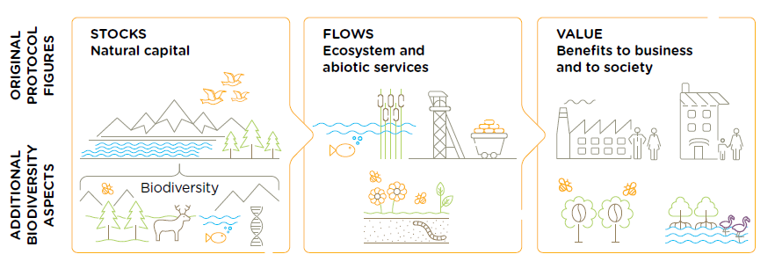
Natural Capital Definition
Refer to p.12
of the
Natural Capital Protocol
Natural capital is the stock of renewable and non-renewable natural resources, (e.g. plants, animals, air water, soils, minerals) that combine to yield a flow of “services” to people. In turn, these flows provide value to business and society.
Biodiversity underpins both stocks and ecosystem services
Source: Biodiversity Guidance
Notes:
Read definition of natural capital on slide and refer to page 12 of the Protocol
Stocks refer to the natural resources available to society
While the flows refer to the different benefits people receive from ecosystems such as:
Timber, pollination, water regulation, climate regulation, etc.
Abiotic services are benefits to people that do not depend on ecological processes but arise from fundamental geological processes
Including the supply of minerals, metals and oil and gas

Slide 23
Biodiversity and Natural Capital
Refer to p.12
of the
Biodiversity Guidance
Biodiversity can be an indicator of the condition and resilience of natural capital stocks
Higher levels of biodiversity generate a greater quantity and quality of goods and services, and more resilience to change.
Source: Biodiversity Guidance
Notes:
In this training, we will demonstrate ways in which biodiversity underpins all stocks and ecosystem services
Biodiversity is part of the stocks of natural capital and is considered critical to the health and the stability of nature
For example, a biodiverse rgion will be more resiliant to natural disasters like floods and droughts
Biodiversity all supports fundamental processes such as carbon and water cycling and soil formation
Because biodiversity underpins stocks and ecosystem services, business impacts and dependencies on biodiversity are often hard to measure, and can remain hidden in many cases.
To truly measure and value business impacts on biodiversity, you need to understand the causal relationships between your business activities, the changes in biodiversity and the associated changes in ecosystem services.

Slide 24
Ecosystems Services
Refer to p.12 & p.111 of the
Natural Capital Protocol
Ecosystem services are the benefits to people from ecosystems
(e.g. climate regulation, water purification, soil biodiversity, pollination,
timber, recreation, mental health). These services can be categorised into:
Provisioning
Regulating
Supporting
Cultural
Consider: If ecosystem services are included in an assessment, does that mean biodiversity is automatically included?
Source: Natural Capital Protocol
Notes:
An ecosystem is defined as the interaction between plants, animals and microorganisms and their non-living environment
Ecosystems services are the benefits to people from ecosystems
Examples include recreation, fostering wellbeing etc.
Ecosystem services can be classified into provisioning, regulating, cultural and supporting services
Biodiversity is important for the provision/maintenance and resilence of these ecosystem services.

Slide 25
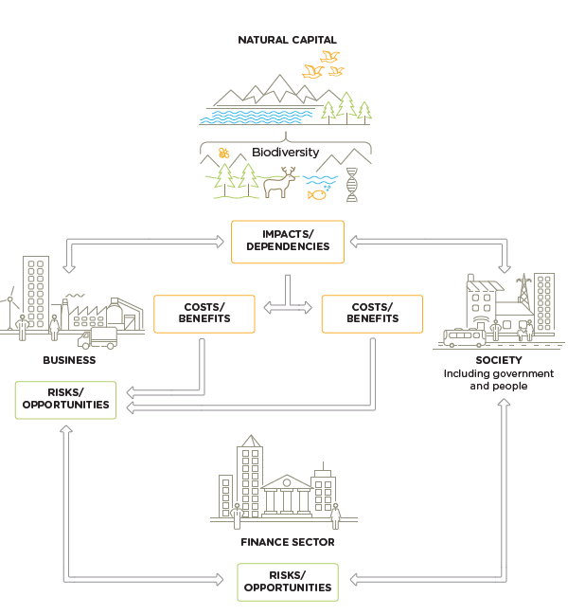
Business depends on & impacts natural capital
Refer to p.15
of the
Biodiversity Guidance
1
All businesses impact and depend on natural capital and biodiversity.
2
This results in economic costs and benefits for business and society
Integrating natural capital & biodiversity allows you to identify R&Os that might otherwise be hidden or missed.
3
Source: Biodiversity Guidance
Added biodiversity element and updated figure (previously it was only natural capital)
Notes:
All businesses impact and depend upon natural capital and biodiversity
Natural capital and the benefits that flow from it sustains us all: individuals, families, companies, and society as a whole.
Our individual or collective actions can build or degrade natural capital
Every business will experience risks and/or opportunities associated with those impacts and/or dependencies
Biodiversity describes the variety of life and is the living component of what can be thought of as natural capital stocks.
The terms “capital” and “stocks” are used as metaphors to help describe the role of nature within the economy.
The presence of, and interactions between, natural capital stocks generate a flow of goods and services; these goods and services create value through the benefits they provide to business and society.
It is important to note that biodiversity is not an asset, rather a descriptive feature of assets we call natural capital.
In this figure we can see that natural, social and economic issues are fundamentally interconnected and cannot be separated from one another.
Natural capital underpins all the other capitals and without it we would not have social and human or financial capital.

Slide 26
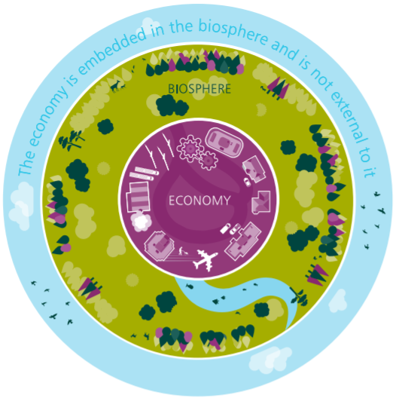
Biodiversity & the current economic system
The economy is embedded within the biosphere
Value of biodiversity needs to be embedded within economic thinking
Demand to embed nature and biodiversity into decision-making exists from multiple stakeholders:
International policy drivers (e.g. post-2020 biodiversity framework, SDGs)
Finance (e.g. Taskforce on Nature-related Financial Disclosures​)
Standard setters (e.g. Global Reporting Initiative)
Consumers wanting increased transparency
Source: Economics of Biodiversity: Dasgupta Review. 2020. HM Treasury
Notes:
Natural capital stocks underpin the functioning of the economy, which is embedded within the biosphere:
The benefits humans receive from ecosystem services are complementary to one another.
If one benefit changes or weakens (e.g. through overuse) it will affect the ecosystems around it.
An example of complementary ecosystem services are ‘regulating and maintenance services’
The current economy does not recognise that growth/development must have materials that balance from ‘source’ to ‘sink’.
For example, we often recognise that persistent organic pollutants such as plastics, and toxic chemicals add to our ecological footprint – but we must also recognise the ‘invisible’ materials such as biodegradable waste
Recognising ecosystems are bounded and complimentary leads us to the conclusion that the speed society is able to convert it’s goods and services to produced goods and services is ALSO bounded, and limited by it’s regenerative rate.
“This means that humanity is embedded in Nature” and relates to the concept of Planetary Boundaries

Slide 27
Anticipated private sector inclusion within the post-2020 biodiversity framework
DRAFT* Target 15:
“All businesses (public and private, large, medium and small) assess and report on their dependencies and impacts on biodiversity, from local to global, and progressively reduce negative impacts, by at least half and increase positive impacts, reducing biodiversity-related risks to businesses and moving towards the full sustainability of extraction and production practices, sourcing and supply chains, and use and disposal.”
Source: Convention Biological Diversity, 2021
* Target still to be negotiated at CBD COP in 2022. Current draft signals the inclusion of the private sector with a specific mention of businesses.
Notes:
Presenter to explain policy drivers leading to increased disclosure on biodiversity/natural capital impacts.
The Convention of Biological Diversity is currently negotiating the terms of the post-2020 biodiversity framework
Like the Paris Agreement, there is hope that this will provide goals and targets to decrease the rate of biodiversity loss on our planet
Unlike the Paris Agreement we will NOT be able to determine a common indicator (e.g. limiting global temperature rise to below 2°C).
This is due to the multi-dimensional of biodiversity requiring multiple indices of measurement
The current DRAFT includes Target 15 - which specifically mentions the private sector (including business and finance).
In it, there is a SMART target of reducing negative impacts by half and increasing positive impacts
This points in the direction of quantified measurement and disclosure on impacts and dependencies to biodiversity which can be accomplished through an assessment using the Natural Capital Protocol or a similar framework

Slide 28
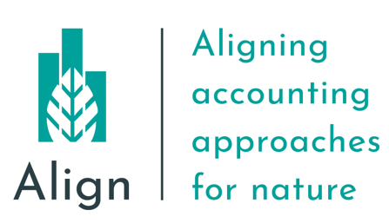
Anticipated drivers for increased disclosure
Standard setters updating frameworks to include biodiversity
Mixture of voluntary (e.g. TNFD, GRI, CDSB) and mandatory (e.g. CSRD/EFRAG) incentives
Anticipate mandatory reporting requirements to increase with time (International Sustainability Standards Board supports this shift)
Notes:
Complimenting this, standard setters are currently updating their frameworks to better include biodiversity
This includes a mixture of voluntary disclosure bodies such as the Taskforce on Nature-related financial disclosures, the Global Reporting Initiative and the Climate Disclosures Standards Board
As well as mandatory upcoming mandatory policy incentives within the EU, which is the Corporate Sustainability Reporting Directive, to be developed by EFRAG (the European Financial Reporting Advisory Group)
It is anticipated that mandatory reporting requirements are likely to increase with time

Slide 29
Identifying impacts & dependencies on natural capital & biodiversity Hannah Nicholas, UNEP-WCMC
Notes:
We will now begin to think about natural capital impacts and dependencies, and why they are important for your natural capital assessment

Slide 30
Natural capital impacts
Refer to p.16
of the
Natural Capital Protocol
Impact: The negative or positive effect of business activity on natural capital
Business impacts on biodiversity may be direct, indirect, and/or cumulative
Source: Natural Capital Protocol
Notes:
Firstly we can look at natural capital impacts
The Natural Capital Protocol defines a natural capital impact as: The negative or positive effect of business activity on natural capital.
These impacts can arise either directly as a result of your business operations, or indirectly from the use of products and services. Impacts on biodiversity and natural capital may also be cumulative, meaning that impacts arise from the combined impacts of your operations and those of other organizations, as well as other background pressures. This means that relatively small impacts of each individual activity can add up to a large overall impact. Your business impacts on biodiversity, particularly your indirect and cumulative impacts, may often be non-linear and difficult to predict.
The figure on the slides shows examples of how business can impact natural capital. For example, if a business undertakes poor land management practice, this may cause the degradation of natural ecosystems - hence posing an operational risk by reducing resilience to natural hazards. However, positive land management could pose an operational opportunity if a business were to invest in sustainable land management. Hence reducing costs by protecting against natural hazards.
Further examples to draw upon if needed:
Waste/Site based impacts (e.g. development of an open cast mine may lead to a reduction in total vegetation cover and complexity).
This could pose a risk to the structural integrity of the mine due to an increased likelihood of flood (from the loss of provisioning services provided by the local habitat) and it would pose a reputational risk depending on the location of the mine
Uncontrolled leakage from tailing ponds (e.g. selenium) could lead to acute and chronic impacts on surrounding flora and fauna, which could affect local livelihoods and cause trophic cascades/decrease in population of local species
This may pose a reputational risk if there is negative publicity about the business’ impacts on natural capital
Groundwater discharge e.g. wastewater
Thinking of the example above, groundwater discharge may pose risks to biodiversity
This may pose financial risks if social conflict over polluted water adds to security costs
This may also pose societal opportunities if businesses use managed water catchments to improve water quality for local communities

Slide 31
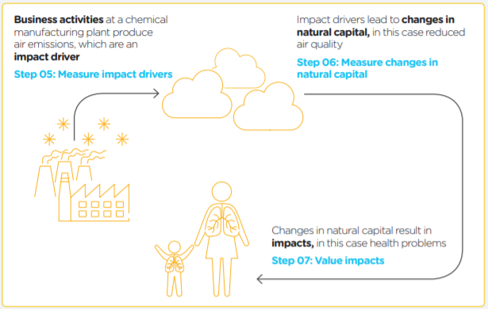
Impact drivers
Refer to pp.44-55 of the
Natural Capital Protocol
Impact drivers are:
Measurable quantities of a natural resource used as an input to production
(e.g. fresh water)
Or:
Measurable non-product output of a business activity
(e.g. water discharge)
Figure: Generic steps in impact pathways (Natural Capital Protocol)
Notes:
As well as impacts, we also need to consider impact drivers
An impact driver is a measurable quantity of a natural resource that is used as an input to production (e.g., volume of fresh water used)
OR
An impact driver may also be a measurable non-product output of a business activity (e.g. kilograms of emissions released by a manufacturing facility).
Impact drivers are generally expressed in quantitative units (e.g., kilograms or hectares).
The figure on the slides helps us to think about impact drivers and impacts, and the difference between them.
It illustrates the impact pathway for air pollution, which is a classic example of a non-product output of industry.
In this example, the business activity is the manufacture of industrial chemicals, which results in the emission of certain pollutants. We can see these emissions as the impact driver.
The impact driver then leads to changes in natural capital, in this case through reduced air quality.
This change in natural capital has a resulting impact – in this case, this could be the impact on local people and the environment.

Slide 32
Natural capital dependencies
Refer p.34
of the
Natural Capital Protocol
Dependency: A business reliance on or use of natural capital
Source: Natural Capital Protocol
Notes:
As well as thinking about our impacts on natural capital, we also need to consider our dependencies.
All businesses depend on natural capital and associated ecosystem services, either directly or indirectly. For example, businesses depend on natural capital for critical production inputs such as land, raw materials, and water, and energy. Businesses also depend indirectly on many regulating ecosystem services, such as natural filtration of water, pollination, or protection from flood damage.
These natural capital dependencies can pose different risks and opportunities for businesses. For example, a dependency on timber may pose a societal risk if timber sourcing begins to impact on access to forests for local communities in sourcing regions. This dependency could pose a societal opportunity if local communities start to benefit from good forestry management
Further examples to draw upon if needed:
Pollination e.g. regulating service critical in agriculture
This may pose an operational risk for agricultural sectors if pollinator populations decline
Land use change may lead to a decrease in local pollinator-supporting habitats. This could reduce yield and create unpredictable changes in supply. Pollination of surrounding habitats could also decrease, leading to a reputational risk to your business and a societal risk to the local community (through a decrease in livelihoods).
Materials e.g. reliance on timber
This may pose a societal risk if timber sourcing begins to impact on access to forests for local communities in sourcing regions
This may pose a societal opportunity if local communities start to benefit from good forestry management
The creation of timber based products could be affected by climate change, leading to unpredictable growth rates. Climate change is a driver of biodiversity loss

Slide 33
Dependency pathways
Refer to p.46
of the
Natural Capital Protocol
Business activities can be dependent on specific features of natural capital and biodiversity
A dependency pathway can identify how changes in specific features of natural capital and biodiversity can affect these activities
Knowing how changes affect business activities helps you identify the cost of doing business
Source: Natural Capital Protocol
Notes:
Just as we looked at impact pathways, we can also consider dependency pathways
A dependency pathway shows how a particular business activity depends upon specific features of natural capital and biodiversity. It identifies how observed or potential changes in natural capital may affect the costs or benefits of doing business.
The figure illustrates a dependency pathway using the pollination of coffee plants as an example. Business activities at a coffee production factory have a dependency on the pollination of coffee plants. In this scenario, a decline in the populations of wild pollinators (due to deforestation) results in lower yields. This means that the coffee company are forced to rely on commercial pollinating services, importing domestic pollinators.

Slide 34
What may be the most material natural capital impact and dependency for your business?
Individually reflect on what would be your business’ natural capital impacts & dependencies
Write down 1 impact & 1 dependency that seem most material to your business at the moment
Notes:
Having briefly run through natural capital impacts and dependencies, we’d now like you to start to think about applying this to your own business context
If you could all think of one impact and one dependency that is material to your business – that’s one aspect of natural capital or biodiversity that your business has an impact on – and one area of natural capital that your business depends on
We will go to Menti to share your answers

Slide 35
Mentimeter
What do you think is your company’s main impact or dependency on biodiversity?

Slide 36
How to use Mentimeter
1
Go to www.menti.com
2
Enter this code: 8352 2114
3
Submit your answer
36

Slide 37
Agenda
Time (CET) | Session
13:30 – 13:45 | Welcome – Agenda, objectives & introductions
13:45 – 13:50 | Setting the scene
13:50 – 14:00 | Understanding natural capital, biodiversity & linkages with other concepts
14:00 – 14:25 | Scoping a first assessment
14:25 – 14:35 | Coffee break
14:35 – 15:05 | Introduction to measuring natural capital & biodiversity
15:05 – 15:35 | Group exercise
15:35 – 15:50 | Brief presentation of valuation methods and tools
15:50 – 16:00 | Wrap-up & key takeaways
16:00 | End of session

Slide 38
Scoping a first assessment Hannah Nicholas, UNEP-WCMC
Notes:
Now that we have a basic understanding of how businesses impact and depend upon natural capital and biodiversity, we can start thinking about scoping a natural capital assessment

Slide 39
Project ambition: scoping an assessment
Refer to p.42
of the
Natural Capital Protocol
Refer to p.46
of the
Natural Capital Protocol
Determine the organizational focus | Corporate / product / project
Determine the value-chain boundary | Upstream / direct operations / downstream
Specify whose value perspective | Business / society / both
Decide on assessing impacts and/or dependencies | Impacts / dependencies / both
Decide which types of value you will consider | Qualitative / quantitative / monetary
Source: Natural Capital Protocol
Notes:
When planning a natural capital assessment, there are some key considerations to be aware of, that may affect the assessment result.
In order to scope your assessment. you will need to carry out the actions as shown in the table on the slide. This includes:
Determining the organizational focus and the value-chain boundary
Specifying whose value perspective to consider (i.e. the business or societal values of natural capital and biodiversity)
Decide on whether to assess impacts, dependencies or both
Decide which types of value you will consider
Note: these points represent the ambition for the project and not all of the practicalities
It is worth looking at existing practice in your business, and noting that some of the terms used here may be referred to as something else within your business, for example parts of the value chain may be referred to as suppliers and customers rather than upstream and downstream.
Based upon the business application you have chosen, you may decide to have a broad and shallow approach (i.e., assessing multiple impacts across the entire company or value chain) or you may choose a narrow and deep approach (i.e., fewer issues and a tighter scope with more detailed analysis). Setting a broad or deep scope from the start might require more time and resources.
Additional points to draw from if needed:
The organizational focus is where the assessment will focus, e.g. will the focus be on the corporate level (the whole company), product level (one product or a site), or project level?
Organizational focus: the part or parts of the business to be assessed (e.g., the company as a whole, a business unit, or a product, project, process, site, or incident). For simplicity, these are grouped under three general levels as below:
Corporate: assessment of a corporation or group, including all subsidiaries, business units, divisions, different geographies or markets, etc.
Project: assessment of a planned undertaking or initiative for a specific purpose, and including all related sites, activities, processes, and incidents.
Product: assessment of particular goods and/or services, including the materials and services used in their production.
Presenter to explain that to determine the value-chain boundary, you need to decide where in the value chain the assessment will take place:
For example, a clothing company may decide that the assessment should take place across all upstream operations (e.g. cotton farming and clothes manufacture).
Value-chain boundary: The part or parts of the business value chain to be included in a natural capital assessment. For simplicity, the Protocol identifies three generic parts of the value chain: upstream, direct operations and downstream. An assessment of the full lifecycle of a product would encompass all three parts.
Upstream (cradle-to-gate): covers the activities of suppliers, including purchased energy.
Direct operations (gate-to-gate): covers activities over which the business has direct operational control, including majority owned subsidiaries.
Downstream (gate-to-grave): covers activities linked to the purchase, use, re-use, recovery, recycling, and final disposal of the business’ products and services.
Presenter to explain that the value perspective identifies the potential values that the assessor wishes to be measured as part of the assessment i.e. the value to business, the value to society, or both:
Value perspectives: the perspective or point of view from which value is assessed; this determines which costs or benefits are included in an assessment.
Business value: The costs and benefits to the business, also referred to as internal, private, financial, or shareholder value.
Societal values: The costs and benefits to wider society, also referred to as external, public, or stakeholder value (or externalities).
The types of value to be considered include qualitative, quantitative and monetary (see slide in introduction section).
In addition to these considerations there are further questions that a potential assessor should ask including: the time and budget available, and the decision for which the assessment will help to inform.

Slide 40
Identifying stakeholders
Refer to p.26-27
of the
Natural Capital Protocol
Examples of Internal Stakeholders: | Examples of External Stakeholders:
Senior executives and directors | Investors
Heads of sustainability, environment etc. | Suppliers
Human resources or auditing and compliance | Government, regulators, customers etc.
Employees and contractors | Experts (e.g., academics, engineers etc.)
Departments like finance, strategy, marketing, public affairs etc. | Community and affected stakeholders (local residents, schools, farmers etc.) and civil society
Source: Natural Capital Protocol
Notes:
Your assessment is likely to be more relevant, reliable, and useful in the long term if you are able to consult and involve the right internal and external stakeholders from the outset. To do so, you may want to identify and engage with people who may be affected by the results of the assessment.
Stakeholders to target may include people who can provide information to help undertake the assessment, people whose views may help to influence the assessment, or those who can help verify and validate the assessment (e.g., experts).
The table shows examples of internal and external stakeholders that you may want to consult. Different stakeholders can contribute in different ways - Internal stakeholders may be able to provide considerable insights, for example knowledge of the value chain. External stakeholder input can provide greater robustness and credibility to results.
To help identify relevant stakeholders, you may want to undertake some form of stakeholder analysis or mapping exercise.
Additional information if needed:
Internal stakeholders are those directly and or financially involved in the operations – they may provide better insight
External stakeholders are entities not within the business itself but who care about or are affected by its performance – they may provide greater robustness and credibility as well as necessary insight into the impact of your business on natural capital

Slide 41
Case study example – Hugo Boss
Hugo Boss is one of the leading companies in the premium segment of the global apparel market
Around 17% of Hugo Boss products in total are produced at their own factories in Germany, Poland, Turkey, and Italy
83% of their finished products and a majority of the refined raw materials are sourced from suppliers all over the world
Source: Hugo Boss, Natural Capital Evaluation
Notes:
We can look at Hugo Boss as a case study example, to show how a natural capital assessment may be undertaken, and subsequently implemented to inform more sustainable practice.
Hugo Boss is one of the leading global companies in premium clothing
Only around 17% of Hugo Boss products are produced at their own factories – the rest they source from suppliers all over the world
This means that along the entire value chain at HUGO BOSS, important natural resources are used, along with chemical and energy inputs – from the extraction of raw materials and production to shipment of finished products. This will have an impact on natural capital, biodiversity and ecosystems.
Sources:
https://group.hugoboss.com/en/responsibility/we-vision-strategy/natural-capital-evaluation
https://group.hugoboss.com/fileadmin/media/pdf/sustainability/2018-05-31_3rd_White_Paper_EIV.pdf

Slide 42
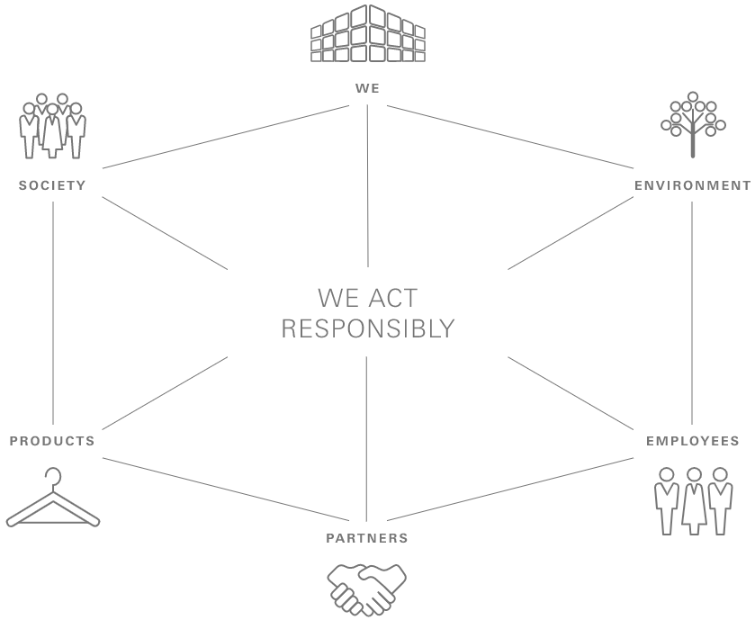
Case study example – Hugo Boss
Implemented the Protocol in 2016 to conduct monetary valuation
Sustainable responsibility sits with Hugo Boss CEO, but the Managing Board handles sustainability topics along the value chain
Assessment objective is to provide the foundation for Hugo Boss to implement measurable targets to increase sustainable production and distribution of products
Source: Hugo Boss, Natural Capital Evaluation
Notes:
Presenter to explain the Hugo Boss case study using the notes on the slide
Sources:
https://group.hugoboss.com/en/responsibility/we-vision-strategy/natural-capital-evaluation
https://group.hugoboss.com/fileadmin/media/pdf/sustainability/2018-05-31_3rd_White_Paper_EIV.pdf
Started using the Protocol in 2016 to conduct monetary valuation
Overall responsibility for sustainability lies with the CEO of Hugo Boss, but the Managing Board handles sustainability topics along the value chain and approves the standards that apply Group-wide.
The objective of the assessment is to provide the foundation for Hugo Boss to implement targeted measures to achieve more environmentally-friendly production and distribution of its products.

Slide 43
HUGO BOSS’ Natural Capital evaluation
They have conducted LCAs since 2009 to determine the environmental impact of their clothing products
Implemented the Protocol in 2016 to conduct monetary valuation
Allows Hugo Boss to compare impacts
The greatest environmental impacts arise during production
They have now set special targets in these areas to reduce their impact
Source: Hugo Boss, Natural Capital Evaluation
Notes:
With this in mind, Hugo Boss wanted to know about the impacts of their entire value chain on natural capital.
HUGO BOSS have conducted life cycle assessments since 2009, to examine the environmental impacts of the individual clothing product categories. However, the environmental impacts found in these life cycle assessments – such as water consumption, land requirements, and CO2 emissions, for example – were not directly comparable, because they are measured in different units such as kilograms and litres.
They therefore started using the Natural Capital Protocol in 2016 to help them with monetary valuation – by using standardised monetary values, they were able to compare different environmental impacts.
The natural capital evaluation allowed them to identify the stages in the value chain that cause the greatest environmental impacts. They found that the greatest environmental impacts arise during the production stages. These findings provided the foundation for Hugo Boss to implement targeted measures to achieve more environmentally-friendly production and distribution of their products. They have since become involved in relevant initiatives, such as the Better Cotton Initiative (BCI) and the Leather Working Group (LWG).
Sources:
https://group.hugoboss.com/en/responsibility/we-vision-strategy/natural-capital-evaluation
https://group.hugoboss.com/fileadmin/media/pdf/sustainability/2018-05-31_3rd_White_Paper_EIV.pdf

Slide 44
Case Study Example – Hugo Boss
Refer to p.42
of the
Natural Capital Protocol
Determine the organizational focus | Corporate / product / project
Determine the value-chain boundary | Upstream / direct operations / downstream
Specify whose value perspective | Business / society
Decide on assessing impacts and/or dependencies | Impacts / dependencies / both
Decide which types of value you will consider | Qualitative / quantitative / Monetary
Objective = provide the foundation for Hugo Boss to implement targeted measures to achieve more environmentally-friendly production and distribution of its products.
Notes:
Q&A: The exercise can be modified to focus on just one question using polling if conducting a shorter training course.
Presenter will now explain the scoping assessment exercise – using menti to provide multiple choice answers to determine e.g. organizational focus and value-chain boundary
Presenter to remind them what the categories in the table mean, using the notes below:
The organizational focus is where in the company the assessment will focus, e.g. will the focus be on the corporate level, product level, or project level?
Value-chain boundary: The part or parts of the business value chain to be included in a natural capital assessment. For simplicity, the Protocol identifies three generic parts of the value chain: upstream, direct operations and downstream. An assessment of the full lifecycle of a product would encompass all three parts.
The types of value to be considered include: qualitative, quantitative and monetary.
Value perspectives: the perspective or point of view from which value is assessed; this determines which costs or benefits are included in an assessment.
Natural capital impacts are defined as the negative or positive effect of business activity on natural capital. For example, businesses may extract a lot of water, depleting natural reserves and natural capital dependencies are defined as a business reliance on or use of natural capital. For example, businesses may be dependent on pollination as a regulating service in agriculture
Presenter to then read the context below to help the delegates with the scoping exercise:
The objective of the Hugo Boss LCA is to provide the foundation for Hugo Boss to implement targeted measures to achieve more environmentally friendly production and distribution of its products.
They have been conducting LCAs since 2009 to help determine the environmental impact of their clothing products

Slide 45
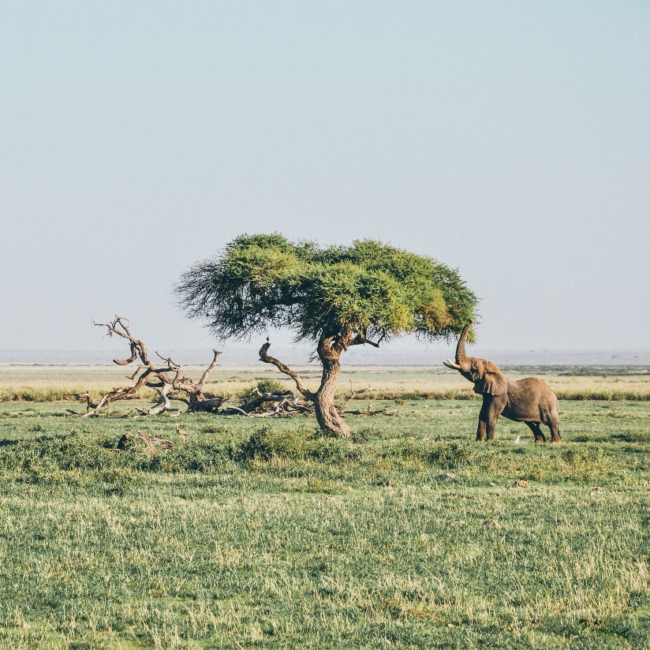
What could the scope of work look like for Hugo Boss based on the information we have?
Refer to p.42
of the
Natural Capital Protocol
Refer to p.46
of the
Natural Capital Protocol
Determine the organizational focus | ?
Determine the value-chain boundary | ?
Specify whose value perspective | ?
Decide on assessing impacts and/or dependencies | ?
Decide which types of value you will consider | ?
Notes:
Having considered the Hugo Boss case study, we can think about what the scope of their natural capital assessment looked like.
For example: have a think about whether Hugo Boss were assessing impacts or dependencies, and post your answer in the chat

Slide 46
What could the scope of work look like for Hugo Boss based on the information we have?
Refer to p.42
of the
Natural Capital Protocol
Refer to p.46
of the
Natural Capital Protocol
Determine the organizational focus | Corporate but move to detailed analysis for products (latest silk ties and wool suits)
Determine the value-chain boundary | Upstream, direct operations & downstream – the entire value chain
Specify whose value perspective | Value looks to be a mix of social and business
Decide on assessing impacts and/or dependencies | Impacts
Decide which types of value you will consider | Monetary (making environmental impacts comparable)
Notes:
Respond to answers from the previous slide.
We can now understand that HUGO BOSS' focus was on a corporate level, looking at the entire value chain. They also took into account both business and social perspectives on the value of natural capital and biodiversity.
The assessment focused on impacts – wanting to understand how the production and distribution of their products impact on nature, rather than how they depend on it.
Finally, they used monetary valuation methods in order to make different environmental impacts comparable.

Slide 47
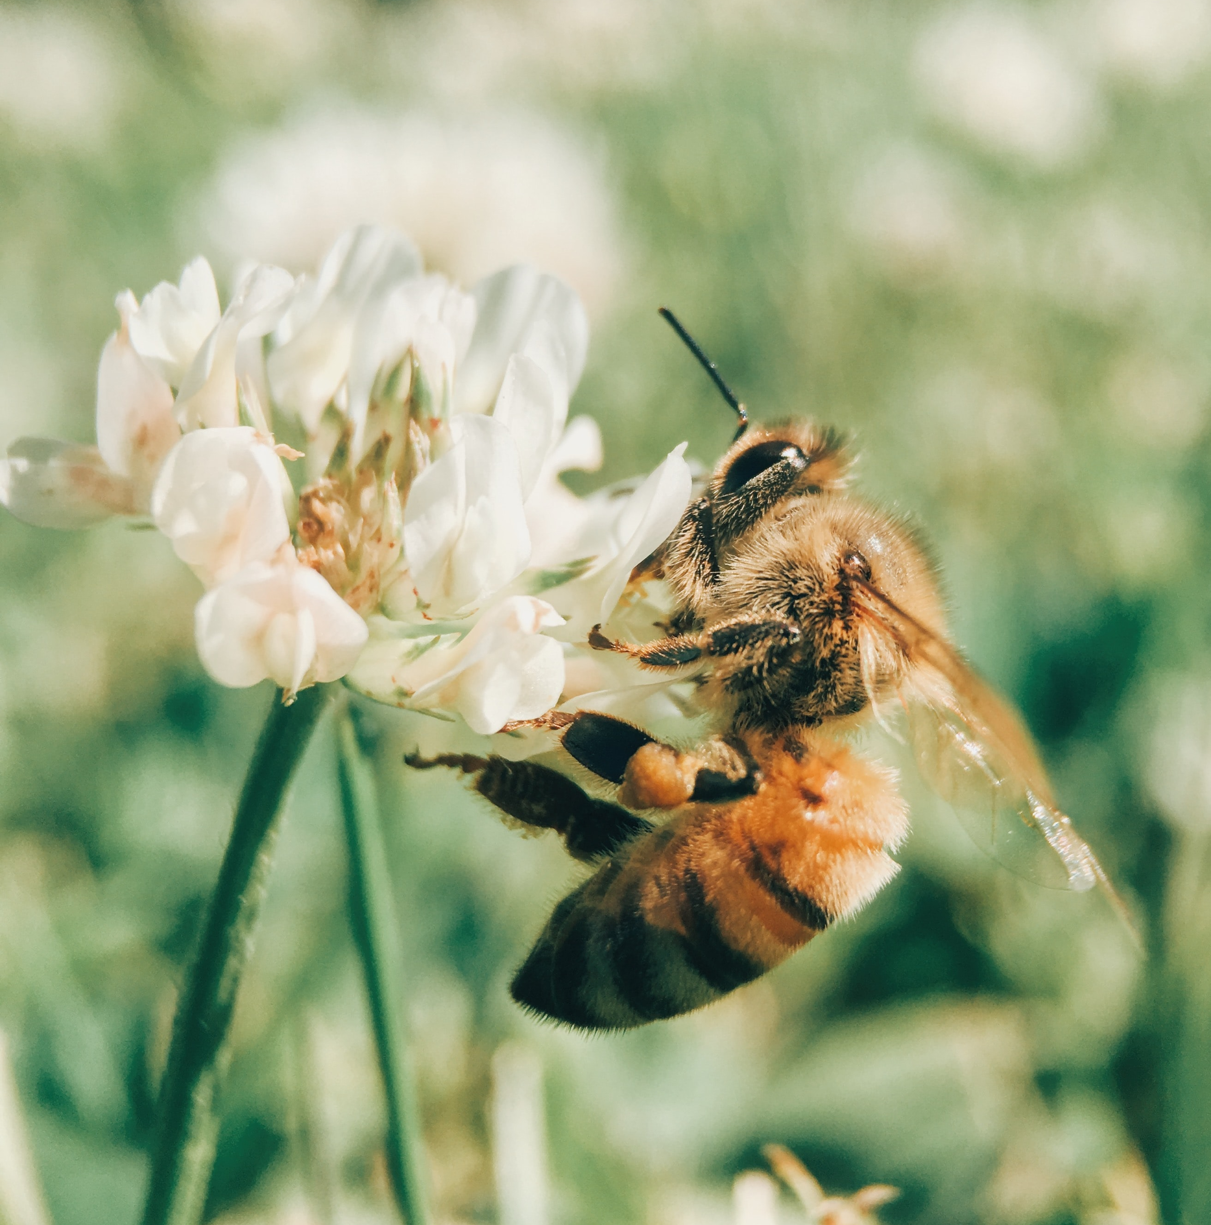
What have we learnt in integrating biodiversity?
Actions to take | Biodiversity considerations
Determine the organizational focus | Influenced by the decisions a company is trying to inform in relation to biodiversity
Determine the value-chain boundary | Biodiversity impacts and dependencies can affect both downstream and upstream value chain
Specify whose value perspective | Both business and societal value should be considered when incorporating biodiversity
Decide on assessing impacts and/or dependencies | Both should be included, due to the relationship between biodiversity and ecosystem services
Decide which types of value you will consider | Address any stakeholder concerns with valuing biodiversity Intrinsic value is difficult to capture
Notes:
Having thought about the steps required to scope an assessment, we also need to consider how biodiversity influences each different action.
For example, the organizational focus will be influenced by the decisions a company is trying to inform in relation to biodiversity. In respect to the value chain boundary, biodiversity dependencies and impacts can affect both downstream and upstream value chain
When it comes to incorporating biodiversity, both the business and societal value should be considered. Similarly, both impacts and dependencies should be included, due to the relationship between biodiversity and ecosystem services
Before proceeding with valuation, you should address any stakeholder concerns with valuing biodiversity.

Slide 48
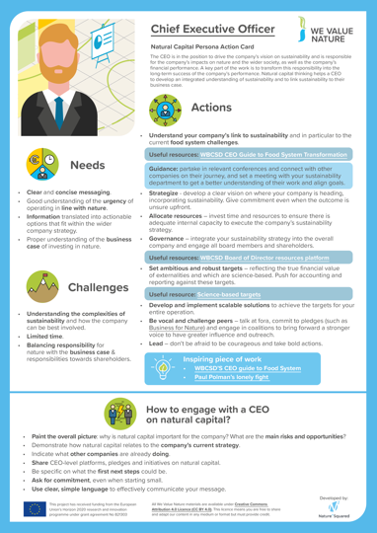
The importance of obtaining buy-in
Refer to p.26-27
of the
Natural Capital Protocol
Buy-in can be achieved by:
Identifying individuals with an interest in the project
Identifying vulnerable company operations
Identifying opportunities that fit within the remit of department leaders
Demonstrating how the outputs of an assessment can help with decision making
Knowing how to adapt your language for the relevant department
Notes:
It is important to secure buy-in and receive internal support for the natural capital assessment process
To build this support, it can help to identify individuals with an existing interest in the project, and ask them to champion the project.
You will also want to clearly demonstrate the importance of the assessment, and how it may help the business and its decision-making processes.
You should also think about how to adapt your language to different departments. To help with this, on We Value Nature’s website, you can find action cards describing useful actions for different roles. These cards have been developed for roles including CEO, risk officer, supplier, farmer etc. – each card explains the persons role in the value chain, their needs, the challenges in getting them to engage with nature. The cards also outline key actions that these people can take – and practical tips on how best to engage with that actor and obtain buy in.
You can find a link to these cards in your participant workbook.

Slide 49
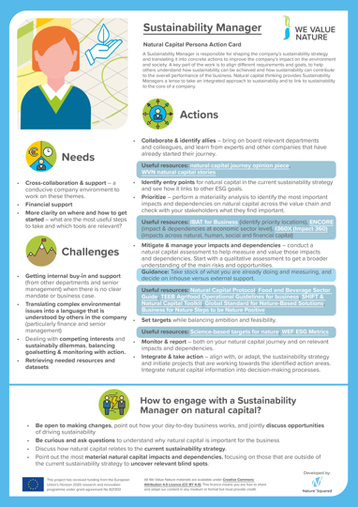
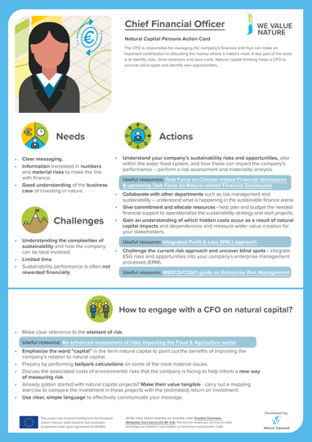
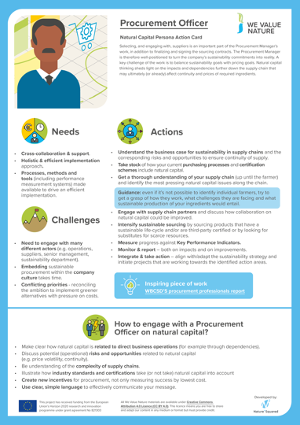
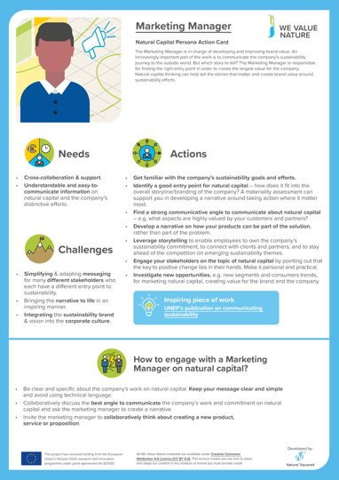
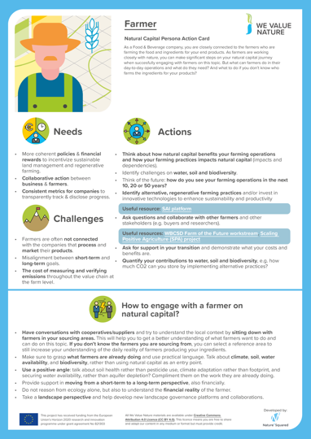
Creating an inducive company environment for integrating natural capital
Find a personas action card for each identified role through We Value Nature’s digital media library
Notes:
Sustainability Manager
Actions
Collaborate & identify allies
Identify entry points
Mitigate & manage your impacts and dependencies
Set targets
Monitor & report
Integrate & take action
Needs
Cross-collaboration & support
Financial support
More clarity on how and where to get started
Barriers
Getting internal buy-in and support
Translating complex environmental issues into a language that is understood by others
Retrieving needed resources and datasets
How to engage?
Be open to making changes
Be curious and ask questions
Discuss how natural capital relates to the current sustainability strategy
Point out the most material natural capital impacts and dependencies
CEO
Actions
Understand your company’s link to sustainability
Strategize and allocate resource
Governance
Set ambitious goals and targets
Develop and implement scalable solutions
Be vocal and challenge peers
Lead
Needs
Clear and concise messaging
Good understanding of the urgency and business case
Information translated into actionable options
Barriers
Understanding the complexities of sustainability
Limited time
Balancing responsibility for nature with responsibilities towards shareholders
How to engage?
Paint the overall picture of why NC is important to the company
Show how NC related to the current strategy
Indicate what other companies are already doinng
Ask for commitment, even when starting small
All cards can be retrieved through: LINK FORTHCOMING

Slide 50
Q&A
Notes:
Allow a few minutes for questions.
Invite participants to raise a hand and unmute themselves, or post questions in the chat.

Slide 51
10’

Slide 52
Agenda
Time (CET) | Session
13:30 – 13:45 | Welcome – Agenda, objectives & introductions
13:45 – 13:50 | Setting the scene
13:50 – 14:00 | Understanding natural capital, biodiversity & linkages with other concepts
14:00 – 14:25 | Scoping a first assessment
14:25 – 14:35 | Coffee break
14:35 – 15:05 | Introduction to measuring natural capital & biodiversity
15:05 – 15:35 | Group exercise
15:35 – 15:50 | Brief presentation of valuation methods and tools
15:50 – 16:00 | Wrap-up & key takeaways
16:00 | End of session

Slide 53
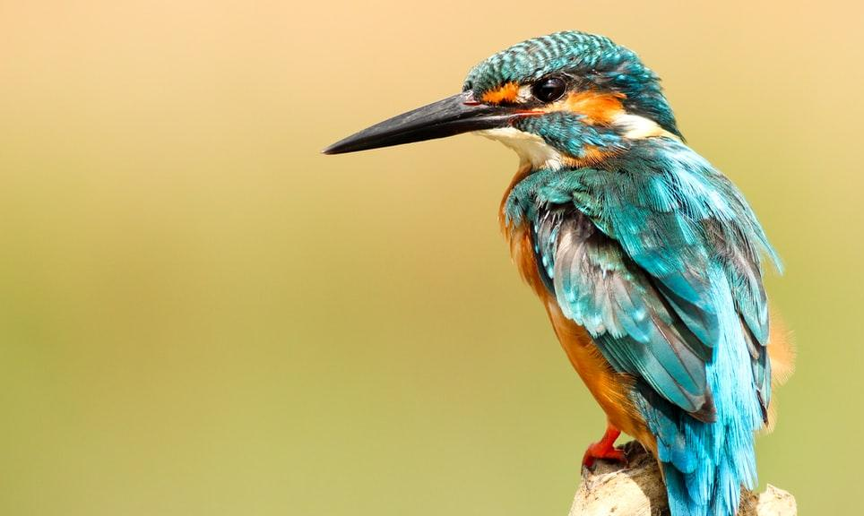
Introduction to measuring changes to natural capital & biodiversity Julie Dimitrijevic, UNEP-WCMC

Slide 54
Measuring & valuing natural capital
Refer to p.82
of the
Natural Capital Protocol
To measure ≠ to value
To measure: determine the amounts, extent and condition in physical terms
e.g. m³, tons, number of injuries, number of jobs
To value: estimate the relative importance, worth, or usefulness of natural / social / human capital to people (or to a business), in a particular context.
Qualitative
Quantitative
Monetary
Costs and benefits to the business, and to society
Notes:
For the second part of this training, we will discuss ways to measure and to value changes in the state of natural capital based on your business activities.
It’s important to recognize the difference between these two concepts.
Measuring changes to natural capital requires you to think about the amount, extent and condition of biodiversity stocks in physical terms
For example, you can think about the tonnes of soil required for farming, or the litres of water required for watering crops
Valuing changes to natural capital stocks involves an assessment on the relative importance, worth or usefuleness in a particular context.
Note that we will discuss various modes of valuation towards the end of the training as well.

Slide 55
Steps to complete during measurement
Identify changes in the state of natural capital to be measured (what are you impacts/dependencies to be measured?)
Determine how you will measure changes to natural capital & biodiversity (i.e. your impacts & dependencies)
Understand the tools available and identify which are most applicable for your assessment
Determine if modelling is required to estimate changes
Consider the geographic & resourcing needs for your assessment
Undertake or commission measurement
Actions
Notes:
Before getting started, I wanted to run through the steps required to measure changs to natural capital stocks.
This requires you to:
Identify changes in the state of natural capital to be measured (what are you impacts/dependencies to be measured?)
Determine how you will measure the changes identified
Understand the tools available and identify which are most applicable for your assessment
Determine if modelling is required to estimate changes
Consider the geographic & resourcing needs for your assessment
Undertake or commission measurement

Slide 56
Identifying changes in the state of natural capital: Impact Drivers
Refer to p.69
of the
Natural Capital Protocol
Impact driver category | Change in natural capital, in a given location, resulting from the impact driver
Water use | Change in physical water resources
Biodiversity | Reduction in the number of species present in a given area.
GHG emissions | Change in CO₂e concentration and contribution to global climate change
Soil pollutants | Change in organophosphate concentration and reduction in invertebrate abundance
Refer to p.45
of the Biodiversity Guidance
Table: Examples of relevant changes in natural capital for different impact drivers (adapted from Natural Capital Protocol and Biodiversity Guidance)
Notes:
Thinking back to the impact pathway and the impact drivers that are material to your business, you will have to consider the impacts that will result and how they can best be measured.
For example, the development of a manufacturing facility in a forest my cause a reduction in the local number of species present in the area surrounding your facility.
Thinking through your impacts, natural capital assets will be measured in different ways.
For more discrete assets like water and carbon, there are standardised methods for completing measurement.
For more complex natural capital assets, like biodiversity, greater consideration is needed in determining which measurement approaches or method are most appropriate for your assessment.
The workbook provided will give you some additional resources for tool identification that you can use
Here we've provided a list of impact drivers and associated changes in natural capital, which requires different methodologies

Slide 57
Identifying changes in the state of natural capital: Dependencies
Refer to p.71
of the
Natural Capital Protocol
Dependencies | Change in natural capital influencing your business’ dependency
Energy | Siltation of a hydropower reservoir
Water | Diversion or desiccation of a river that provided a source of process water
Biodiversity | Change in the population of pollinator species
Materials | Forest fires destroying raw material (fibre) inputs
Regulation of physical environment | Loss of mangrove habitat resulting in reduced protection from extreme weather events
Knowledge | Loss of traditional knowledge about the uses of species
Refer to p.45
of the Biodiversity Guidance
Table: Examples of changes in natural capital influencing dependencies (adapted from Natural Capital Protocol and Biodiversity Guidance)
Notes:
Like the impact pathway, you will also need to consider the dependency pathways related to your business activities.
As before - we are looking to identify the change in natural capital based on the identified dependencies
For example, you may be producing fibre or cotton and in an area prone to forest fires, or you may require energy from a nearby water damn that could be susceptible to siltation.
It's really important to identify WHAT you want to measure before moving onto HOW to measure it.

Slide 58
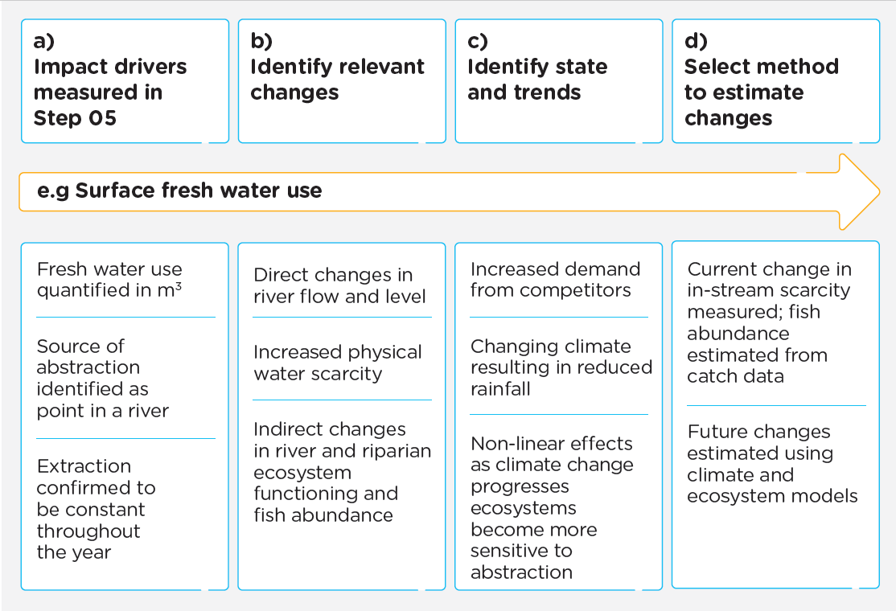
Measuring various aspects of natural capital: Examples
Refer to p.72
of the
Natural Capital Protocol
A business uses freshwater from a river (a), leading to a reduction in water availability.
The impact pathways identified key changes in natural capital associated with in-stream flows of water and associated changes in fresh water ecosystems of the river (b).
Water availability is predicted to decrease over the next few years, due to climate change and increased demand (c).
Hence the business wants to understand both current and future changes in business/private sector demand for natural capital, and climate change projections (d).
Figure: Example of how to identify natural capital changes related to impact drivers and external factors (Natural Capital Protocol)
Notes:
Here we have an example of a business identifying natural capital risks related to fresh water use from a river.
The figure shows methods to estimate the change in natural capital and attribute it to the impact driver of freshwater use.
As noted on the previous slide, where changes in natural capital are not directly observable or measurable, it is often possible to estimate changes using modelling methods.
For example, modelling may be used to estimate likely changes in natural capital associated with activities in your supply chain, where the precise location of those activities is not known.
In these instances, modelling also allows you to integrate local knowledge in your analysis, generating more relevant estimates of changes in natural capital.
For this example, water availability is predicted to decrease over the next few years, due to climate change and increased demand
This allows the business to understand current and future changes in private sector demand for natural capital

Slide 59
Measuring biodiversity
Refer to p.50
of the Biodiversity Guidance
Example Metric | Description | Data Used
Mean species abundance (MSA) | Indicator of biodiversity intactness (the average abundance of biodiversity in a given area, relative to baseline populations) | Often estimated using the GLOBIO model, which aims at assessing scenarios of human-induced changes in biodiversity
Potentially disappeared fraction of species (PDF) | Indicator of decline in species richness in an area over a time period | Often estimated using the ReCiPe model, which links economic activity to changes in biodiversity
Species and habitat diversity (richness and abundance) | On-the-ground monitoring/measurement of species and habitat determine species richness, abundance and trends over time | Direct measurement; Relies on local datasets
Species Threat Abatement and Recovery (STAR) | Assesses potential reduction in extinction risk gained from removal of threats (such as mining) in a given area | IUCN STAR layer (based on IUCN Red List data)
Table: Examples of underlying metrics within corporate biodiversity measurement approaches (adapted from Biodiversity Guidance)
Notes:
mean species abundance (MSA)
As mentioned earlier, measuring biodiversity is a bit more complicated, and context specific depending on the activity and geographic location
There are a numbr of metrics or indciators available to understand changes to the state of biodiversity which need to be explored and chosen based on the objective of your assessment (referred to as Business Applications within the Protocol) and your Organisational Focus area or area along the value chain.
A particular metric may be more applicable depending on the activity or impact driver that you want to assess
For example, metrics such as Mean Species Abundance – which is a general indicator of biodiversity intactness should not be taken as substitution for measuremnt on the ground, which remains preferable where possible.
It's also noted that these metrics do not capture changes to all aspects of biodiversity, such as genetic diversity.
This is a current data gap within biodiversity measurement approaches requiring innovation.
The table shows example metrics and their descriptions, as well as the data that they use.

Slide 60
Determining appropriate measurement methods
Refer to p.72
of the
Natural Capital Protocol
You must identify the most appropriate method(s) based on your business application (or objective) and area along the value chain
Consider the type of data you have or can obtain (primary vs. secondary)
This will influence if you can complete direct measurement or modelling based measurements
Different measurement methodologies will be needed for different natural capital assets (e.g. you will measure water impacts differently than measuring impacts to biodiversity)
Notes:
To measure changes in the state of natural capital, you will need to select the most appropriate method(s) for measuring or estimating the relevant changes in natural capital for different impact and dependency pathways.
As mentiond, you will need to consider your business application or objective and area along the value chain
Considerations on the type of data needed for measurement is important (here we often refer to primary data which is collected by the company itself) or secondary data which often refers to global datasets.
There are many different methods available for measuring and estimating changes in natural capital and it is likely multiple approaches will be required.

Slide 61
Considerations when choosing a methodology
Refer to p.74
of the
Natural Capital Protocol
In some cases, changes cannot be directly measured but must be estimated/modelled. Changes in natural capital may be unobservable due to:
Time lags: it may take several years before any results are observable.
Distance: for example, upstream impacts in the supply chain may be out of sight, but they are still important to consider.
Confounding factors: attributing changes to an impact driver with multiple influencing factors can be difficult
Notes:
Understandably, there are some cases where changes in natural capital cannot be measured or observed directly and instead rely on estimated or modelled changes.
Some examples of unobservable changes that will need to be modelled or estimated include:
Time lags – for example, planting trees can reduce soil erosion , but it may take several years before any results are observable.
Distance – an example of this is, plastic waste can harm marine organisms many kilometers away from a wastewater effluent pipe. , where those conducting an assessment may not have a presence or be aware of their impacts. The challenge of distance also applies to impacts and should be considered.
Confounding factors – changes may be difficult to attribute to a particular impact driver where there are multiple influencing factors that cannot easily be disentangled. This includes many of the drivers for species decline such as habitat loss and fragmentation, illegal harvest and climate change.

Slide 62
Geographic & resourcing considerations
Regulatory requirements of the country/area you are working in as this will influence what you need to measure (voluntary vs. mandatory requirements)
Collaboration with local NGOs, universities, or research institutions
Data availability in your activity locations (data rich vs. data poor areas)
You may have combination of primary and secondary data
Practicalities:
Level of detail required
Time
Resources
Geographic scope
Notes:
In addition, the geographic location of the activities need to be understand, and consideration on the resources available fo rmeasurement. Some additional considerations to include would be:
Regulatory considerations of the area a business is working. For example, an international company working in many regions will need to be aware of the environmental and policy regulations for eachregion (In this scenario air quality regulations may differ between Indonesia and India)
Collaboration with local stakeholders will improve data collection and modelling completed
There may be discrepancies in data availability in your activity locations (for example some areas may be data rich while some may be data poor areas)
You may find that you have combination of primary and secondary data available and that is ok!
Finally some very simiple practicalities include the consideration of the level of detail required to complete assessment, the time and resources, geographic scope of assessment

Slide 63
Discussion – 10 minutes
What do you anticipate challenges of implementation to be, and how can they be overcome?
Notes:
Julie to introduce the discussion question.
Katia to moderate and bring speakers to mute/unmute.
Presenter to introduce discussion on the challenges on implementation

Slide 64
Practicalities on data collection & available datasets Julie Dimitrijevic, UNEP-WCMC
ADD HIDDEN SLIDES ON DATA AND TOOLS TO WORKBOOK
Notes:
Presenter to explain that we will now consider practicalities on data collection, as well as presenting some available datasets to help with this process

Slide 65
Introduction to data needs for an assessment
Refer to p.42
of the
Biodiversity Guidance
Data collection is required to complete a natural capital assessment
Companies can utilise existing data - this will help determine which measurement approaches are applicable for your assessment
Likely that new data will need to be acquired and can consist of:
Primary data: Internal business data; site-level impact driver data; supplier/customer data
Secondary data: Published, peer-reviewed, and grey literature; publicly available datasets (e.g. FAOSTAT Crops); productivity models; mass balance models, etc.
Notes:
Presenter to introduce data needs, using the points on slides and notes below:
The availability of existing data and the ability to leverage biodiversity specific published literature are planning considerations not only for measurement and valuation but also when scoping your natural capital assessment. For biodiversity, there are a number of resources for measuring and valuing including guidelines, frameworks, and measurement tools.
To measure an impact driver and or dependency, you need to determine the type of data required. Many data sources exist and are described in detail within the Protocol (page 60). To measure biodiversity impact drivers and/or dependencies, there are generally two forms of data to consider acquiring and/or collecting. Each is described below with examples.
Primary data: • Internal business data • Site-level impact driver data collected through field surveys and sampling • Data collected from suppliers or customers
Secondary data: • Published, peer-reviewed, and grey literature (for example, life-cycle impact assessment (LCIA) databases; industry, government, or internal reports)
• publicly available datasets (e.g. FAOSTAT Crops) • Estimates derived using modelling techniques, including: • Environmentally extended input-output (EEIO) models. Many EEIO initiatives exist, including the commonly used EXIOBASE, EORA and GTAP. • Productivity models • Mass balance models • Past natural capital assessments

Slide 66
How to go about collecting data
Refer to p.42
of the
Biodiversity Guidance
Which data/datasets will be used will depend on the business application, time/resources available, and the measurement technique to be applied.
It is recommended that the measurement technique and the associated impact driver data needed be identified BEFORE data collection begins.
Refer p.60
of the
Natural Capital Protocol
Tip* Collaborating with departments across a company is recommended as there may be data available for use within an assessment that has already been collected
Notes:
Presenter to discuss collecting data, using the points on the slide. Presenter to make clear that it is an iterative process.

Slide 67
Data considerations
Data isn’t always numerical (quantitative). It can also be descriptive (qualitative)
In most cases, you will want to select a metric/indicator that you can use in the next step of your assessment
For example, number of ‘x’ hectares of forest, ‘x’ litres of water
Individual indicators can be aggregated to create ‘composite’ indicators to understand the condition/integrity of an ecosystem assessment.
Tip* The IUCN Guidelines for planning and monitoring corporate biodiversity performance describes available datasets and how to consider aggregation of biodiversity data.
Notes:
Presenter to highlight key data considerations, using the points on slides and the notes below:
Data isn’t always numerical (quantitative). It can also be descriptive (qualitative)
In most cases, you will want to reach a metric/indicator that you can use in the next step of your assessment. It is good to understand what measurement approach you are working towards before you collect data, so that you collect the correct data needed for your assessment
For example, your desired data could be number of ‘x’, hectares of forest, litres of water
Metrics are systems or standards of measurement, whilst indicators are what we are measuring. Metrics and indicators are important for the Natural Capital Protocol, as they help us to measure material impact drivers and/or dependencies
Data collection techniques are highly variable and often dependent on location, project, and area of the value chain being assessed. For this reason, one technique may not be practical or well suited across multiple applications (however techniques should be compatible to ensure consistency and comparability as far as possible). For example, a site-level project (e.g., an environmental assessment for a prospective mine) may involve habitat surveys to assess area of habitat that would be lost, whereas data collection for a wholesaler looking at impact drivers related to commodity sourcing may require information provided by individual farmers through a survey. Both techniques result in the collection of primary data.
Data should be collected and organized in a consistent manner, so that the various data collected are compatible with each other and with the scope of analysis, and are easily comparable, shareable, and interoperable across sites, countries, time, and organizations (where applicable).
The Protocol provides more detail on the limitations and considerations when collecting and using primary or secondary data to measure impact drivers.
Pg. 60 of the protocol:
You may find that the data required to measure impact drivers and dependencies are frequently the same.... processing of raw materials requires water inputs. Data on the use of water can be used for defining the level of dependency on water, at the same time the use of water is also the impact driver, and can be used to calculate the scale of the impact on other users. You may also be interested in the impact on fresh water ecosystems, which is another related category of impact driver. Caution is required in how these data are accounted for in calculations to avoid double counting data on impact drivers with dependency data
Aggregated indicators are most commonly used in ‘x’ scenarios

Slide 68
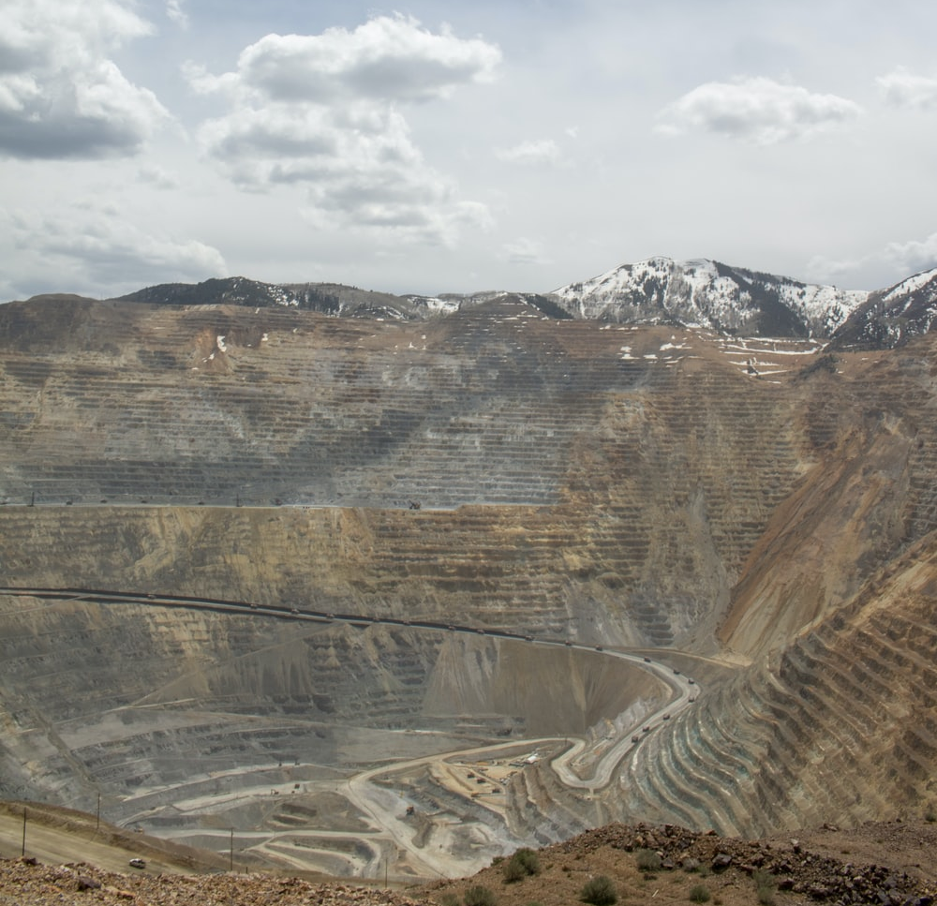
Determining data sources
Refer to p.43
of the Biodiversity Guidance
Activity | Impact driver | Data source
Site-level impact: mining for ore | Land-use change (i.e. habitat loss) | Primary data: Direct collection, observations
Product-level impact: manufacturing leather shoes | Direct exploitation (i.e. species lost from sourcing materials) | Secondary data: Global datasets, local/regional datasets
Portfolio- or sector-level impact: food production | Land-use change (i.e. biodiversity footprint of a food industry portfolio) | Secondary data: Public data (annual reports), private databases (fee required), and internal data collected (at global level)
Table: Examples of business activities that result in an impact driver, and associated data sources (adapted from Biodiversity Guidance)
Notes:
Presenter to identify how to measure impact drivers and/or dependencies, through primary vs. secondary data collection
To measure an impact driver and or dependency, you need to determine the type of data required. Many data sources exist and are described in detail within the Protocol. The table on the slides shows examples of business activities and their associated impact drivers, indicators, and data sources required. The right hand column is showing what needs to be measured/how it can be measured (qual vs. quant).
Users should consider how impact driver data, and the various assessments undertaken, may need to be compared over time when selecting data and methods that are compatible. The Protocol provides more detail on the limitations and considerations when collecting and using primary or secondary data to measure impact drivers. This includes the use of intermediate indicators.
In the case of a business’s dependencies on biodiversity, once these are identified they will need to be measured in a standardized way. Currently, changes to the stocks (i.e., the impacts on biodiversity) and flows (i.e., impacts to ecosystem services) are relatively well understood. However, the relationship between stocks and flows are poorly understood and hard for businesses to quantify.
There are some tools such as ENCORE (focused on identifying impact and dependency pathways for financial institutions). Currently, standardized corporate measurement approaches to quantify biodiversity dependencies are very limited and this is an area which will require innovation. Meanwhile, you can use the approach of the Natural Capital Protocol to incorporate dependencies on biodiversity as part of your assessment.

Slide 69
Example indicators for identified impact drivers
Refer p.61
of the
Natural Capital Protocol
Impact driver category | Example quantitative indicators (for a given location and over a given period of time)
Water use | Cubic meters of water abstracted from surface water
Terrestrial ecosystem use | Hectares of degraded land converted to agricultural land
Fresh water ecosystem use | Kilowatt-hours (kWh) or megawatt-hours (MWh) of hydropower energy produced
Marine ecosystem use | Hectares of mangrove protected and/or restored
Water pollutants | Kilograms of arsenic released to surface water
Soil pollutants | Kilograms of organophosphate pesticide discharged to soil
Table: Example indicators for different impact drivers (adapted from Natural Capital Protocol)
Notes:
Presenter to discuss the data needs for measuring impact drivers
When mapping impact drivers and dependencies, you will need to consider the data required for this process. In ideal cases, an impact driver or dependency can be measured or estimated directly (e.g., the volume of water consumed or the mass of solid waste). In other cases, intermediate or proxy indicators are required. These provide a useful shortcut, which must then be combined with other information to measure or estimate the impact driver or dependency. For example, energy- or fuel-use data can indicate the volume of GHG and other emissions to air. Various published guides are available which provide emission factors (or conversion factors) to translate kilowatt hours (kWh) of electricity consumed or litres of fuel used into grams of emissions.
The table presents sample indicators for different categories of impact driver. This is relevant for impacts on your business and your impacts on society only.

Slide 70
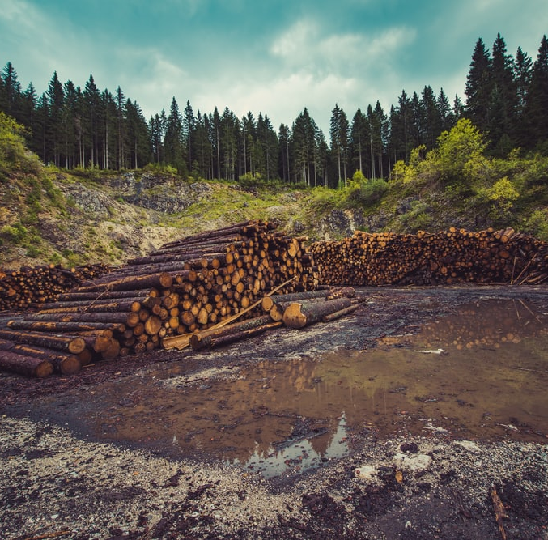
Example indicators for identified dependencies
Refer p.62
of the
Natural Capital Protocol
Dependencies | Example quantitative indicators (for a given location and over a given period of time)
Energy | Kilowatt hours of energy
Water | Cubic meters or turbidity of water
Nutrition | Joules of energy consumed
Materials | Tons or cubic meters of wood
Regulation of physical environment | Hectares of habitat providing water filtration; cubic meters /day of water filtered by vegetation
Regulation of waste and emissions | Grams of pollutant assimilated per kilometre of river
Table: Example indicators for different dependencies (adapted from Natural Capital Protocol)
Notes:
Presenter to discuss the data needs for measuring dependencies
Following the discussion on the pervious slide, this table presents sample indicators for different dependency categories. The indicators for dependencies that are business inputs (e.g., water) will often be the same as indicators for impact driver inputs. This is relevant if your business dependencies are part of your analysis. Selecting appropriate indicators to assess dependence on regulating services is more challenging. Relevant indicators may relate to the area and quality of habitats that provide the service (e.g., 10 hectares of mature forest providing a water filtration service), or they may be more specific to the service itself (e.g., 8 million litres of water filtered per year).

Slide 71
Tools & useful resources Julie Dimitrijevic, UNEP-WCMC
Notes:
Presenter to explain that we will now look at some useful tools and resources that can help to get you started

Slide 72
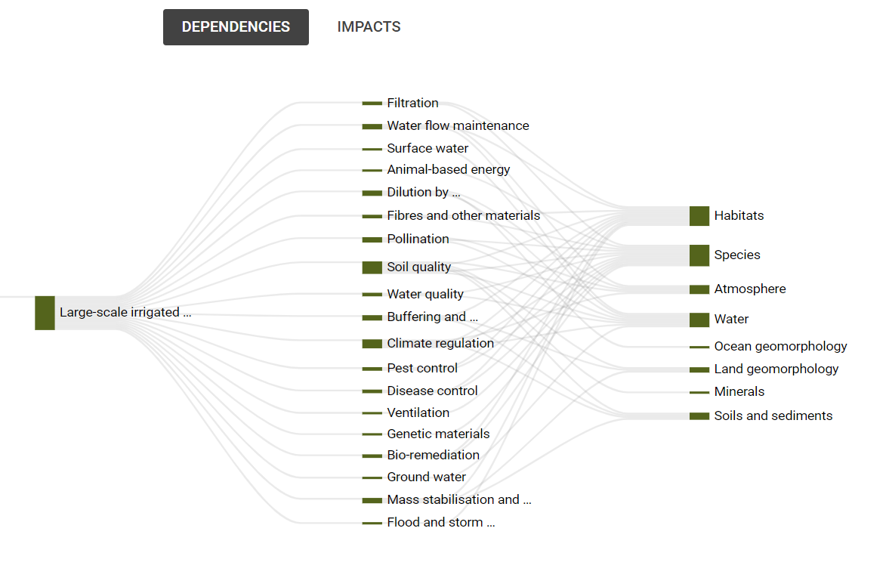
ENCORE: A tool to help identify impacts and dependencies
ENCORE (Exploring Natural Capital Opportunities, Risks and Exposure)
Synthesises large body of literature on natural capital
Helps users build understanding of dependencies and impacts
Provides a foundation for further detailed analyses
Figure: Agricultural products industry dependencies (ENCORE)
Notes:
Presenter to explain that there are a number of tools that can be used to help identify material activities to your business, based on your sector. One example of this is ENCORE.
ENCORE can help with identification of impact drivers and dependencies that you will need to think about for measurement.
ENCORE stands for Exploring Natural Capital Opportunities, Risks and Exposure. This web-based tool was launched in November 2018 and was the first of its kind to synthesise a large body of literature on potential natural capital dependencies and impacts of all economic activities.
ENCORE was primarily developed for a finance sector audience, but the information it contains can be used by other audiences as well
It is a tool that helps users understand links between economic activities and natural capital based on associated potential dependencies and impacts. It can answer questions like:
How do businesses depend and impact on nature?
How does environmental change affect dependencies?
What can be measured to gain insight on nature-related risk?
The knowledge base from ENCORE can serve, and has already served, as a basis for more refined types of analyses.
Once users have registered a free account, they can log in and visualise how economic activities potentially depend on nature, using flow diagrams shown here. Data is available for various sub-industries and production processes. The data shows how both dependencies and impacts for the production processes link to ecosystem services and the natural capital assets that underpin those services. The tool also provides a qualitative rating called a materiality rating, that denotes the importance of each ecosystem service for each production process. Flow diagrams can be produced for both dependencies and impacts.
The figure on the slides for example shows the aagricultural products industry dependencies on ecosystem services and natural capital assets, for the production process of large-scale irrigated arable crops. We can see these processes are dependent on 19 ecosystem services (out of 21 identified). ENCORE then shows which elements of nature (or natural capital assets) underpin the ecosystem services that these agricultural processes depend on. In this example, habitats and species are two key natural capital assets for this sector. The loss of key habitats could lead to loss of up to 11 ecosystem services that these production processes depend on. Similarly, the loss of key species could compromise up to 12 ecosystem services. This could have devastating consequences for the business. For example, if a key pollinator species is lost, this could result in major yield losses, or increased costs associated with alternative pollination methods.

Slide 73
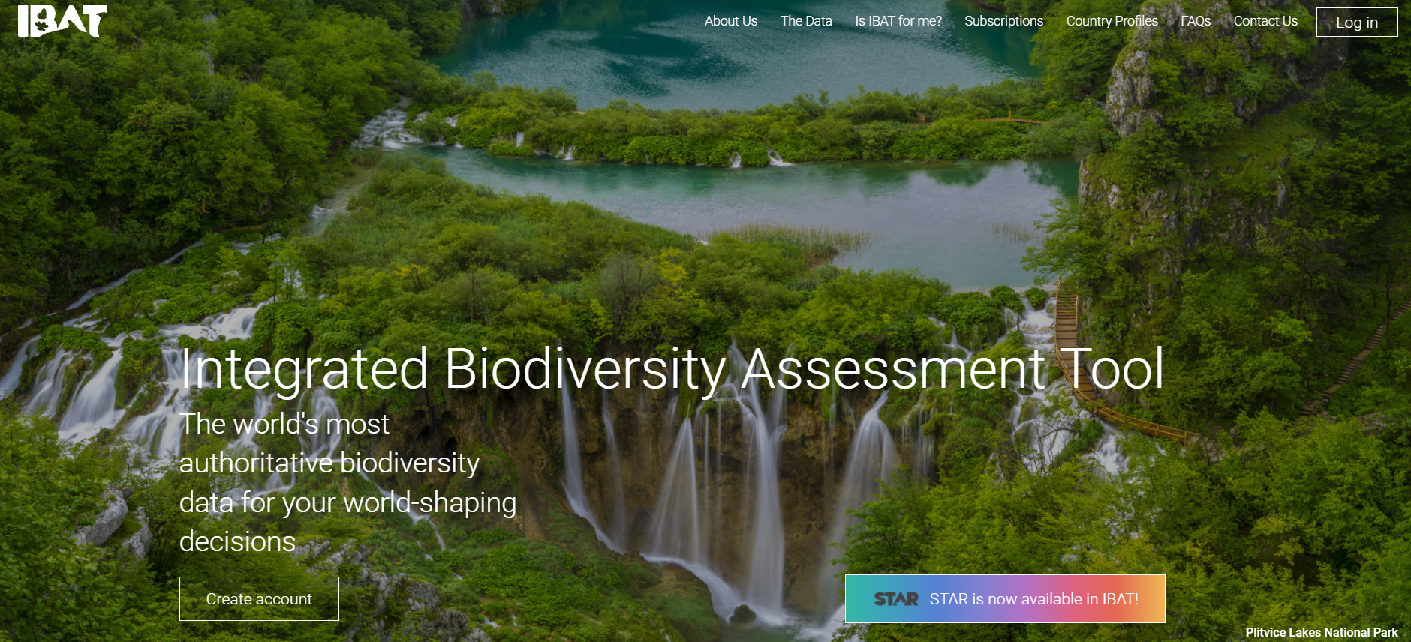
IBAT: A tool to help identify priority sites for measuring
Provides access to:
Protected Areas
Key Biodiversity Areas
IUCN Red List of Species including the STAR Layer
https://www.ibat-alliance.org/
Notes:
Presenter to consider tools available to help with measurement: IBAT
Presenter to explain that IBAT could be a useful tool to identify priority sites (i.e. based on proximity to Key Biodiversity Areas and/or red listed species) for a natural capital assessment. This could be completed during the materiality/scoping part of the assessment to prioritise locations for consideration (e.g. those in closet proximity to Key Biodiversity Areas and/or with the most threatened/endangered species).
Another helpful tool is IBAT. As previously mentioned, the Integrated Biodiversity Assessment Tool (IBAT) provides authoritative global biodiversity data. Users can import raw data on locations and create reports and map files. IBAT host and maintain 3 global biodiversity datasets; IUCN Red List of Threatened Species, World Database on Protected Areas, World Database of Key Biodiversity Areas. Additionally, the STAR metric is now available in IBAT. (this will be discussed later in this training)

Slide 74
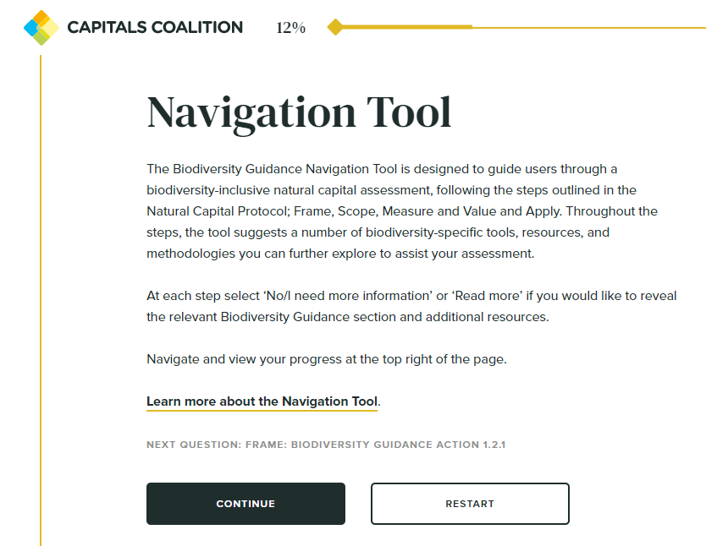
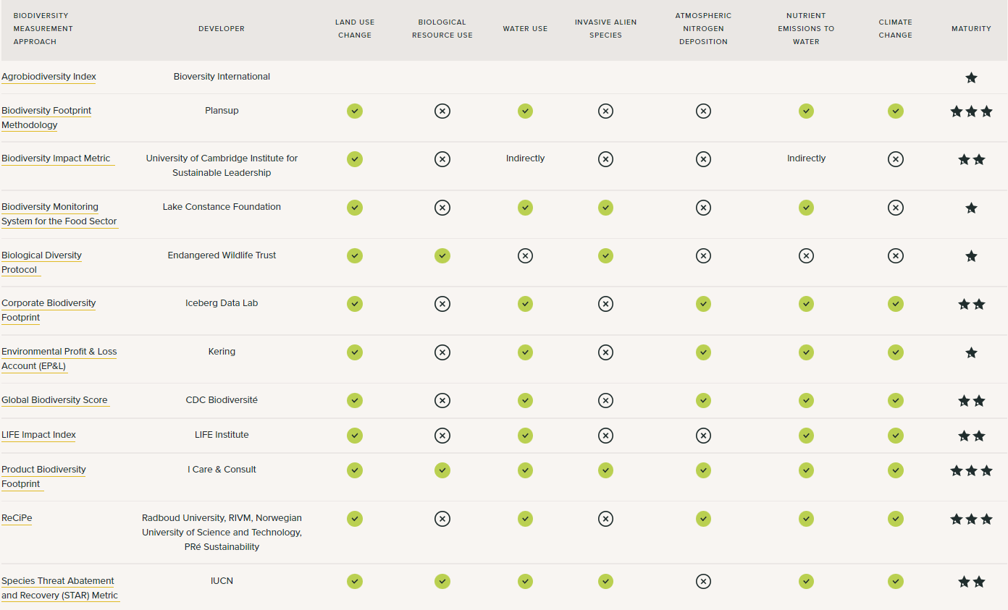
Glancing ahead: biodiversity data needs
Biodiversity Guidance Navigation Tool: https://capitalscoalition.org/tools/navigation-tool/
Notes:
Presenter to outline the biodiversity guidance navigation tool and its role in supporting natural capital assessments.
The navigation tool recognises that you may need to work iteratively through the Protocol e.g. you go to Step 6 to determine the methods to quantify change in state of the natural capital assets, then go back to the impact drivers you have identified as material and determine how these can be measured
We would recommend doing a first run through the navigation tool to see all the questions and consider how you would answer them. You can then choose an approach to fit the data you already have, or describe the data you need to collect.
Currently there is no standardised way of measuring biodiversity (but Align project coming)

Slide 75
Q&A
Notes:
Do you have any experience with case studies that you can share?

Slide 76
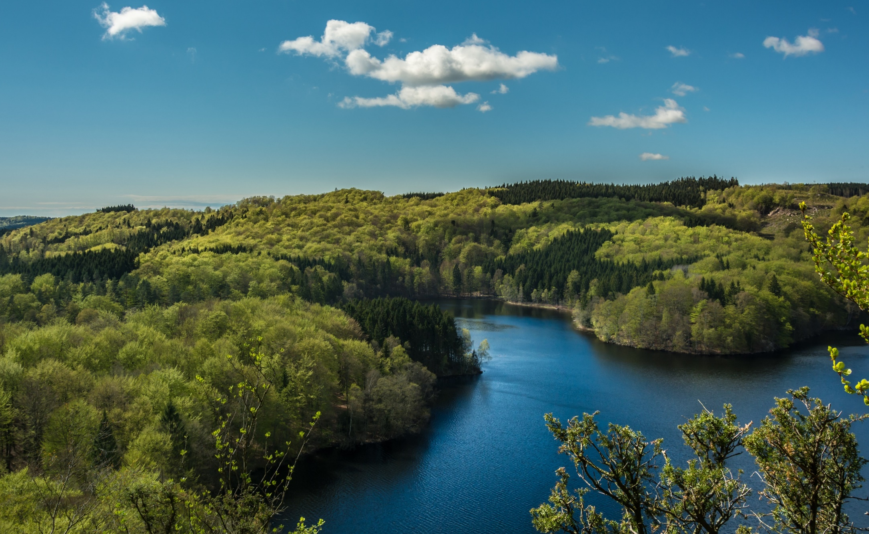
Group Exercise Julie Dimitrijevic, UNEP-WCMC

Slide 77
Exercise: Soy farm, Brazil
Imagine you are a soy company in Brazil that has acquired 1,000 acres of land to convert to produce soy.
You are wanting to understand your impacts on natural capital, including biodiversity, in the process of developing the farmland and producing soy.
To do this, you will need to think through your impact and dependency pathways, and how they may be measured.
Notes:
Presenter to introduce the case study for this exercise.
Presenter to describe a Brazilian soy company that has acquired 1,000 acres of land to convert to produce soy. The company is wanting to understand their impacts on natural capital, including biodiversity, in the process of developing the farmland and producing soy.
To do this, you will need to think through your impact and dependency pathways, and how they may be measured.

Slide 78
Exercise: Soy farm, Brazil
Soy farm key impact drivers, impacts and dependencies
Business Activity | Does this activity result in an input or an output? | What is the measurable quantity of this input or output (i.e. what is the impact driver)? | What is the change on natural capital (i.e. what is your impact)? | How do you measure the impact driver and impact? | Does this business activity depend on specific areas of natural capital (i.e. what are your dependencies)? | How do you measure the dependency?
Land acquisition/ farm set up (Land use change)
Soy production (through irrigation)
Combine harvesting of soy product
Natural Capital Impact Driver:
A measurable quantity of a natural resource that is used as an input to production, or a measurable non-product output of business activity
Natural Capital Impact:
The negative or positive effect of business activity on natural capital (e.g. water extraction)
Natural Capital Dependency:
Business reliance on or use of natural capital (e.g. pollination)
Notes:
Presenter to introduce the table for the exercise: The table should be filled out by the participants, discussing each business activity, and the associated input or output, impact driver, impact, and dependency (if applicable). 4
Participants not expected to complete entire table. Suggest completing 1 row at a time
It is important to be aware that impacts and dependencies do not exist in a loop. Impacts don't cause dependencies, as dependencies don't cause impacts. Whilst sometimes the two are related, this is the case in the minority, rather than the majority.
To get this process started, we would like you to:
Identify the business activities required to complete this process, from farm set up to soy harvest.
For each activity, you are required to identify if the activity results in an input or an output (i.e. would the activity require the use of a natural resource, or the output of a product, that would affect the state of natural capital surrounding the farmland?)
You will identify what impact this results in, and if there are any associated dependencies.
Presenter to read out the definitions of impact driver, impact and dependencies:
An impact driver is a measurable quantity of a natural resource that is used as an input to production (e.g., volume of sand and gravel used in construction) or a measurable non-product output of business activity (e.g., a kilogram of NOx emissions released into the atmosphere by a manufacturing facility).
Natural capital impacts are defined as the negative or positive effect of business activity on natural capital. For example, businesses may extract a lot of water, depleting natural reserves.
Natural capital dependencies are defined as a business reliance on or use of natural capital. For example, businesses may be dependent on pollination as a regulating service in agriculture.
Presenter to ask participants to discuss in breakout sessions/at their tables, what impacts, or dependencies result from the business activities. Presenter to explain that the list of activities on the slide are not exhaustive but rather a list of examples. If time allows, presenter could encourage members to identify additional activities and pathways, in addition to those on the slide.

Slide 79
Group exercise in breakout rooms
We will now split into breakout rooms
Max 4 per group
You will work through a table to identify impact drivers, impacts and dependencies for a soy farm in Brazil
You will have 15 minutes to discuss in your group
You will be notified when you have 5’ of the time left
Each group will have one of the support team members to take notes
One member per group will be asked to feedback in plenary on the main points & reflections that came out
Notes:
Katia to manage breakout rooms
Presenter to read the points on the slide, explaining how the breakout rooms will work, for the virtual session.

Slide 80
Share your highlights!
What key points came out from your discussions?
Notes:
Asking a few breakout rooms to share reflections from their group.
Not looking for the detail of the table, but it is interesting to hear what was difficult/unsure of
Katia to volunteer rooms if needed

Slide 81
Example: Soy farm, Brazil
Soy farm key impact drivers, impacts and dependencies
Business Activity | Does this activity result in an input or an output? | What is the measurable quantity of this input or output (i.e. what is the impact driver)? | How do you measure the impact driver? | What is the change on natural capital (i.e. what is your impact)? | Does this business activity depend on specific areas of natural capital (i.e. what are your dependencies)? | How do you measure the dependency?
Land acquisition/farm set up (Land use change) | Input | Terrestrial ecosystem use | Hectares of habitat conversion | Decrease in natural habitat | Soil quality (required for viable farm) | Chemical analysis of soil fertility
Soy production (through irrigation) | Input | Freshwater use | Litres of water used | Decrease in local freshwater reserve | Water quality and availability | Average rainfall patterns (if using rainwater for irrigation)
Combine harvesting of soy product | Output | Air emissions | Kg of emissions of particulates per ton of soy produced | Reduction in air quality | Regulation of biological environment for a successful crop yield | Climate change modelling to estimate future climatic conditions for viable crop yield
Notes:
Highlight useful points and practical way of determining the answers – attach to example, think through steps (to scoping etc.)
Presenter to introduce the idea of a business identifying an impact and dependency pathway, based on their activities (whilst considering points from modules 1 & 2 on scoping, boundaries etc. of their assessment).
Can see that each pathway will require different methodologise to meausre the impacts and dependencies. Some will require primary data (volume of water) vs. Modelled data (climate change modelling)

Slide 82
Agenda
Time (CET) | Session
13:30 – 13:45 | Welcome – Agenda, objectives & introductions
13:45 – 13:50 | Setting the scene
13:50 – 14:00 | Understanding natural capital, biodiversity & linkages with other concepts
14:00 – 14:25 | Scoping a first assessment
14:25 – 14:35 | Coffee break
14:35 – 15:05 | Introduction to measuring natural capital & biodiversity
15:05 – 15:35 | Group exercise
15:35 – 15:50 | Brief presentation of valuation methods and tools
15:50 – 16:00 | Wrap-up & key takeaways
16:00 | End of session
Notes:
#'{

Slide 83
Valuing natural capital & biodiversity Julie Dimitrijevic, UNEP-WCMC

Slide 84
What is the value of your natural capital impacts and/or dependencies?
Refer to p.84
of the
Natural Capital Protocol
Valuation: The process of determining the importance, worth, or usefulness of something in a particular context.
Understanding the social, environmental, and/or economic context is essential
“Value transfer” involves using the results of previous assessments, rather than collecting primary data
Valuation techniques differ for qualitative, quantitative, and monetary values
Choice of valuation technique depends on which natural capital impact drivers or dependencies you wish to assess
Notes:
Valuation is the process of determining the importance, worth, or usefulness of something in a particular context.
Valuation involves taking figures from your measurement, and trying to provide a societal perspective on their value.#
This can help you to understand the value of natural capital to your company.
A popular valuation shortcut is “value transfer”. This involves using the results of previous assessments, rather than collecting primary data for a new analysis. This allows businesses to value using data the already have.
For each cost and/or benefit identified, you will need to select an appropriate valuation technique
The choice of valuation technique depends on which natural capital impact drivers or dependencies you wish to assess,

Slide 85
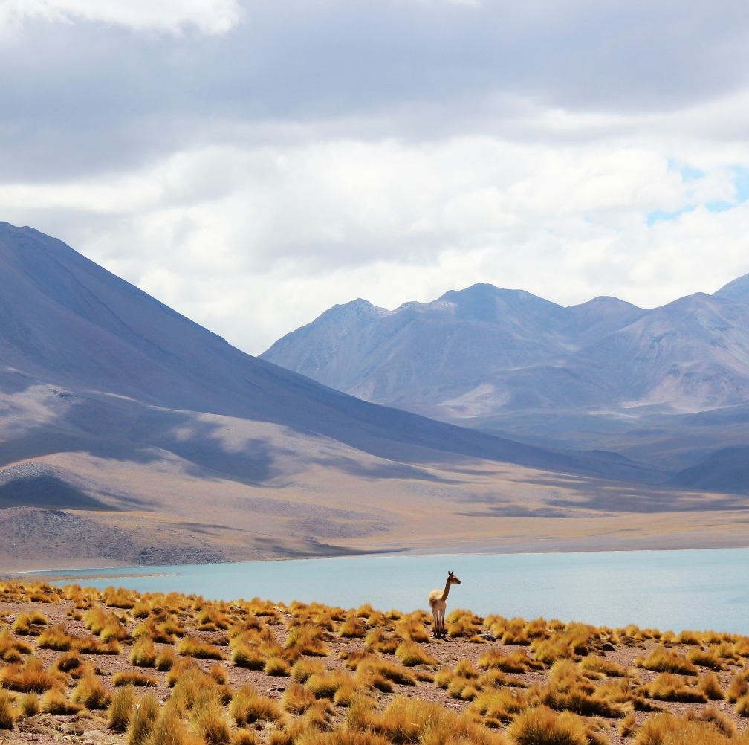
What is the value of your natural capital impacts and/or dependencies?
Refer to p.84
of the
Natural Capital Protocol
Common valuation techniques include:
Net Present Value (NPV) – commonly applied across businesses to analyse projected impacts/products & losses of a specific project
Example: Kering Environmental Profit and Loss (EP&L) accounting
To measure, monetize and manage their environmental impacts in their own operations, and across the entire supply chain
EP&L analysis helps Kering find effective solutions to mitigate their footprint
EP&L revealed that 93% of their impacts lie in the supply chain and, with only 7% of impacts from their own operations
Kering shifted focus to finding innovative solutions and leveraging changes across the supply chain
Notes:
A common valuation technique is 'Net Present Value' (NPV)
Kering, which is a fashion company, has created Environmental Profit and Loss (EP&L) accounting to measure, monetize and manage their environmental impacts in their operations across the supply chain.
Anaylsis revealed that 93% of their impacts lie in the supply chain.
Most impacts were from the production and processing of raw materials which represented 72% of the total footprint.
Their own operations represent only 7% of the impacts.
Kering then shifted focus to finding innovative solutions and leveraging changes across the supply chain

Slide 86
Selecting a method to commission valuation
Qualitative
Quantitative
Monetary
Non-numerical
Opinion surveys
Deliberative approaches
Relative valuation
Numerical
Structured surveys
Requires indicators
Multicriteria analysis
Common currency
Market prices
Financial prices
Production function
Notes:
There are different way to value changes to natural capital
This can involve qualitative, quantitave and monetary valuation techniques
The technique chosen will depend on the data available, the questions looking to be answered and the application of the results
For example, qualitative opinion surveys are designed to represent the view of stakeholders through a series of questions or semi-structured interviews.
Monetary valuation, however, includes approaches that estimate the cost or price paid for goods and services that are traded in markets such as timber or carbon.

Slide 87
Strengths and limitations of monetary valuation
Refer to p.35-38
of the
Natural Capital Protocol
Strengths | Limitations
Uses common unit of measure Can measure social preferences Used to determine overall value for money of a project (i.e. whether it should go ahead or not; do the benefits exceed the costs?) Can be used to measure risks and mitigate them before these are quantified by others | Unable to quantify everything in monetary terms (e.g. biodiversity) Is often time consuming and expensive, depending on technique or approach used Requires attention to avoid double counting Cultural and ethical concerns with placing value on nature
Table: Key considerations for monetary valuation (adapted from Natural Capital Protocol)
Notes:
Often when we think of valuation we immediately think of monetary valuation, which works by by translating quantitative estimates of costs and/or benefits into a single common currency
It is important to think of the rationale for completing a monetary valuation before gettings started and the strengths/weaknesses for doing so.
Strengths of monetary valuation include:
The use of a common unit of measuret
Allows you to measure social preferences in a uniform way
Allows you to determine the value for money a projct offers (this can be used in a decision context)
It allows you to measure risks and mitigate them
There are limitations to monetary valuation, however, which need to be recognised:
A business will be unable to quantify everything, particularly biodiversity
It is often time consuming and expensive, requiring specialist knowledge
There are cultural and ethical concerns, particularly when trying to value the ecosystem services provided by natural capital stocks (e.g. the sense of place provided by a forest).

Slide 88
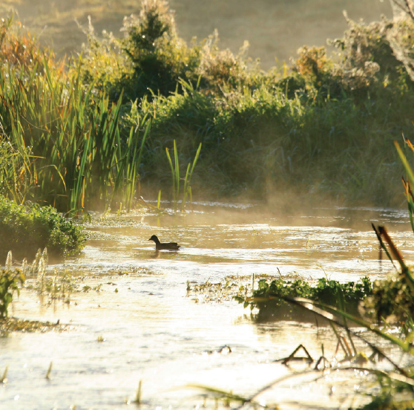
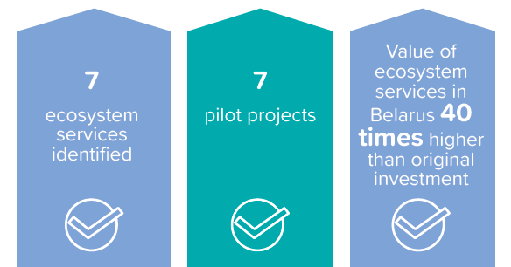
Case study: Coca-Cola’s natural capital story
Coca-Cola Case Study
The Coca-Cola Company quantified ecosystem services related to freshwater sources
A natural capital assessment was initiated to monetize the ecosystem services in order to identify opportunities and maximize impact
Found that water restoration projects can enhance a range of other ecosystem services
Coca-Cola are now exploring how to further integrate natural capital into decision-making processes
See further examples of Natural Capital stories at: https://wevaluenature.eu/natural-capital-stories
Notes:
Here we wanted to provide a quick case study highlighting the use of the Natural Cpaital Protocol.
The Coca-Cola Company quantified ecosystem services related to freshwater sources to capture the impacts of water community projects
Coca cola wnated to understand the variety of benefits that these community projects provided people and society beyond water volumes.
A natural capital assessment was initiated to monetize the ecosystem services and identify opportunities to maximize impact.
This resulted in the conclusion tha twater restoration projects can enhance a range of other ecosystem services and they are now exploring how to further integrate natural capital into decision-making processes.

Slide 89
Measure and valuing in practice
Impact of habitat removal near manufacturing facility on biodiversity
Dependency on the regulation of the physical environment: Flood risk
Flow of ecosystem service: Loss of surrounding forest near manufacturing building leading to increased flood risks
Stock of biodiversity: Decrease in local mean species abundance of pollinators due to habitat degradation
What is happening?
Increased flood risk incurs cost to the business
Collect mean species abundance (MSA) data in-situ using field surveys
How do you measure?
Determine engineering costs of implementing green & hard infrastructure to maintain risk at an acceptable level
Conduct quantitative surveys with surrounding community to understand impacts of change in local species populations (e.g., affects to harvesting)
How do you value these changes?
Estimate replacement cost to the business over a 10-year period ($ USD)
Estimate cost of food insecurity to local community due to decreased pollination
Diagram: Hypothetical example of measuring and valuing in practice (adapted from Natural Capital Protocol, p78)
Notes:
Finally, we wanted to provide a hypothetical example that showcases how you measure and value in practice.
On the left hand side we have an example dependency that results from the development of a manufacturing building in a forest.
Building construction results in the loss of surrounding forests, which can lead to flood risks.
To measure this change in ecosystem service, the company completed an estimation of the costs to implement green and hard infrastructure to mitigate this new risk.
The risks were then valued using replacement costs over a 10-year period
For the same scenario, the manufacturing facility is likely to result in a change to the stock of biodviersity within the footprint of the building.
To understand this change, data was collected on MSA, using in-situ field surveys.
To value this change, quantitative surveys with the surrounding community were completed to undersatnd impacts of the change in local species population and potential affects to local harvesting
This was then used to estimate the cost of food insecuring to the local community.

Slide 90
Q&A

Slide 91
Wrap-up & next steps

Slide 92
Key take-aways / Closing word
See p. 46 in your workbook
Business impacts and depends on nature
Applying a natural capital approach helps make better & more informed decisions
There are many existing tools & resources
Assessments are like snowflakes – no two are alike
Companies can start to conduct an assessment themselves
Buy-in must extend beyond the sustainability team
92
Notes:
Business impacts and depends on nature – the NCP provides the framework to identify and assess impacts and dependencies,
Understanding, measuring and valuing natural capital (i.e. taking into account) will help business make better decisions,
There are many existing tools & resources to measure and value impacts and dependencies. The one you chose depends on the information you are aiming to get or the decision you are trying to inform,
Companies can start to conduct an assessment themselves by getting the project going, scoping the assessment and integrating natural capital considerations into internal processes,
For natural capital to become strategically important, buy-in must extend beyond the sustainability team.
ADDITIONAL BACKGROUND INFORMATION
How much will an assessment cost?
Some of the Protocol pilot testers - like our members Nestlé and Roche - estimated they spent about USD $50,000 on consulting services for their assessments over a six-month period. Some companies spend less, others spend more.
Dow, Kering and Natura have invested significantly more over a longer term, for in-depth assessments that contribute to their multi-year strategic ambitions
The Protocol can help companies navigate these kinds of situations by making sure the services required align with the assessment's objective.
Skills & data needed:
It's usually much more efficient to build on existing data that's readily available in-house, and the Protocol provides guidance on gathering and using that data too.
For example, many companies have data on their own GHG emissions, water, waste, and some also have results of product Life Cycle Assessments - this existing information can provide a really good starting point for a natural capital assessment. How applicable it is will depend on the objectives and scope of the assessment though, so it's important to find the balance between getting perfect data (e.g. from monitoring in the field) and using proxies that are not as accurate but can be more practical and still lead to better decisions.
Internal buy-in:
In many cases, natural capital assessments can be a bottom-up effort. Trying to drive natural capital assessments from sustainability, environment or health and safety departments is sometimes difficult, but nevertheless, the Protocol provides guidance on integrating the assessment into the business itself.
One way to facilitate engagement internally can be to show that "many companies are already doing natural capital assessments; they're just using different terminology and steps.
To support this engagement, it is important to look beyond those benefits that can be valued through the natural capital assessment itself, and acknowledge how a natural capital approach can motivate organizational change in support of broader business goals." This means that there will be more leadership from the top to better measure, value and then integrate natural capital into business.
The bottom line is that although carrying out a natural capital assessment is technical, it's also achievable. Not every assessment has to be a huge undertaking, so companies should start off with a scope that makes most sense to their situation. The Protocol will help you do this.
Finally, we must make sure the information obtained from the assessment is included in core business decision-making. This will ensure you have the best possible impact on your business, and on the environment.

Slide 93
Practical tips from leading businesses
Analyze your company’s environmental risks and opportunities. This can inform a new way of measuring return on investment
Start small. Define your circle of influence and focus on what you can do
Connect natural capital thinking with business outcomes. Reflect on material natural capital elements and key business activities and connect these where possible
Do not start with monetization too early. First understand your impacts and dependencies qualitatively and then, quantitatively
Connect to people’s agendas. Find the right entry point, understand people’s needs and concerns and translate natural capital benefits to areas that matter most to them
Don’t get discourage by challenges around data. There are useful tools to deal with this such as the data use in natural capital assessment

Slide 94
Support business in identifying & overcoming barriers
The Natural Capital Journey Interactive Tool
Check out here We Value Nature’s interactive tool

Slide 95
Mentimeter closing questions
What is your 1 key learning from the training?
Share 1 concrete next action you will take after this training

Slide 96
How to use Mentimeter
1
Go to www.menti.com
2
Enter this code: 8352 2114
3
Submit your answer
96

Slide 97
Upcoming opportunities
REGISTER HERE
REGISTER HERE

Slide 98
Thank you!
Provide your feedback: Survey
We want to learn too – how have we helped?

