Slide 1
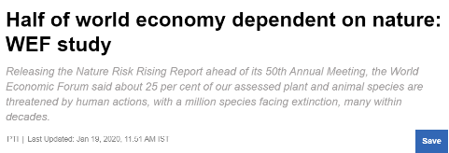
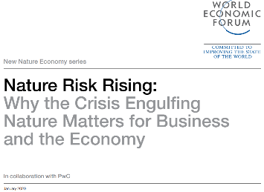
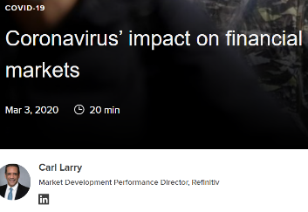
Notes:
2020- Releasing the Nature Risk Rising Report ahead of its 50th Annual Meeting, the World Economic Forum said about 25 per cent of our assessed plant and animal species are threatened by human actions, with a million species facing extinction, many within decades. China, the EU and the US have the highest absolute economic value in nature-dependent industries. https://economictimes.indiatimes.com/news/international/business/half-of-world-economy-dependent-on-nature-wef-study/articleshow/73371574.cms?from=mdr
2016- RIO TINTO CLOSED DIAMOND PROJECT- It was said that the mining project undermined the wildlife in Navardehi Wildlife Sanctuary and Panna tiger Reserve. The project was said to be dangerous after the Ministry of environment sought to limit mining only to 76.43 hectares while the total area for the project was 971 hectares. https://www.financialexpress.com/industry/rio-tinto-to-close-diamond-project-in-madhya-pradesh-amid-environmental-concerns/352702/
2003- The largest Coca-Cola plant in India was accused of putting thousands of farmers out of work by draining the water that feeds their wells, and poisoning the land with waste sludge that the company claims is fertiliser. huge demand for water caused such damage to the local economy, that the village council demanded for plant’s closure. https://www.theguardian.com/environment/2003/jul/25/water.india
2015- UNILEVER has agreed to provide an undisclosed ex-gratia payment as part of deal to end dispute over poisoning allegations at factory in Tamil Nadu. Additionally, Hindustan Unilever Limited (HUL) was forced to shut its thermometer factory in 2001 after Tamil Nadu state authorities found the company was contaminating the environment by dumping tonnes of toxic waste. https://www.theguardian.com/environment/2016/mar/09/unilever-settles-dispute-over-mercury-poisoning-in-india India loses natural resources to economic growth: A report on environment accounts released by the Ministry of Statistics and Programme Implementation . 11 states have registered a decline in natural capital between 2005 and 2015. https://www.downtoearth.org.in/news/urbanisation/india-loses-natural-resources-to-economic-growth-report-61836

Slide 2
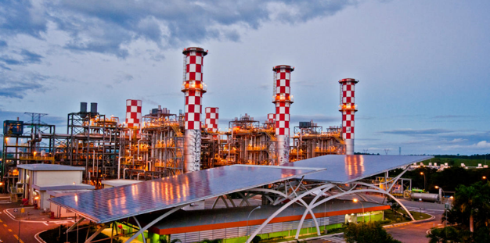
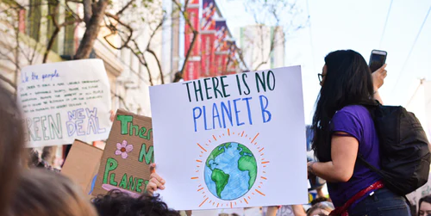
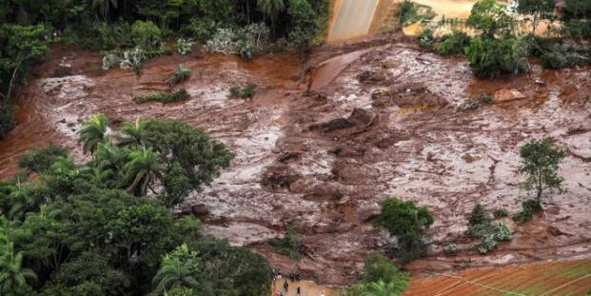
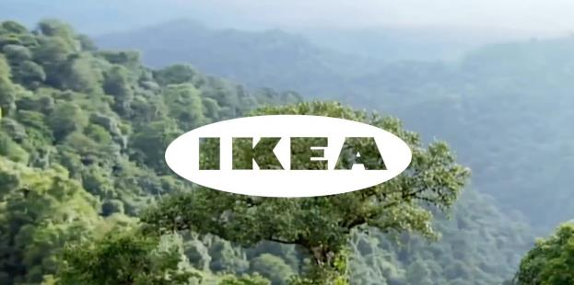
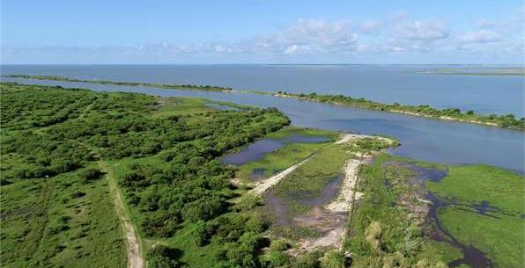
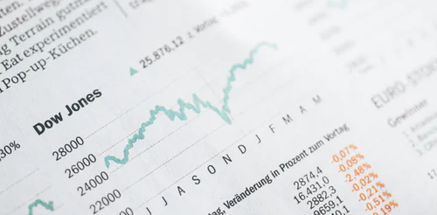
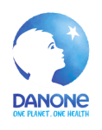
Reputational & Societal Opportunity
Operational Opportunity
Reputational & Societal Risk
Operational Risk
Risks & Opportunities for business
Financial Opportunity
Legal Opportunity
Financial Risk
Legal Risk
Financial Risk
Notes:
The Protocol highlights key types / categories of risks and opportunities – refer to p. 18 of the Protocol.
In years gone by, sustainability issues have sometimes taken business by surprise and companies have paid the cost. Companies are increasingly being impacted by the changing risk landscape discussed earlier (WEF report slide).
Operational risk- Bhopal Gas Tragedy
Reputational & Societal Risk- 2015- UNILEVER has agreed to provide an undisclosed ex-gratia payment as part of deal to end dispute over poisoning allegations at factory in Tamil Nadu. Additionally, Hindustan Unilever Limited (HUL) was forced to shut its thermometer factory in 2001 after Tamil Nadu state authorities found the company was contaminating the environment by dumping tonnes of toxic waste. https://www.theguardian.com/environment/2016/mar/09/unilever-settles-dispute-over-mercury-poisoning-in-india
Legal Risk- In 2011, NEERI assessed the impact of the spill on humans as “catastrophic” and ordered Rs 514 crore in damages to be paid for the spill that impacted an area of more than 120 sq km. Another case of oil spill, The cargo ship carrying 340 tonnes of fuel oil for Adani Enterprise Limited (AEL) sunk near the Mumbai coast in 2011, Rs. 5 crores were asked to pay to Government. http://timesofindia.indiatimes.com/articleshow/68174352.cms?utm_source=contentofinterest&utm_medium=text&utm_campaign=cppst
Financial Risk- Global recession due to current pandemic.
But good news is that, where there is risk, there is opportunity to:
Secure natural resources
Save costs
Manage future risks
Engage stakeholders
Operational opportunity – In the years 2015, 2016 and 2017 due to drought in Maharashtra state Mahindra & Mahindra, Igatpuri had to buy water at a higher cost by tankers for continuing operations. To address this risk, the site has undertaken various initiatives like Training employees on behavioral changes for water consumption, Adaptation technologies which require less water, 100% green area covered under micro irrigation, Increasing water storage in check dams and creation of new check dams within project boundary.
Reputation opportunity – IKEA to use only renewable and recycled materials by 2030 https://www.reuters.com/article/us-ikea-sustainability/ikea-to-use-only-renewable-and-recycled-materials-by-2030-idUSKCN1J31CD
Legal Opportunity-
Financial Risk- Biocare invested in a soil nutrition enhancement product BIOSIL. The major ingredients of BIOSIL are fly ash and humic acid. The addition of humic acid to fly ash helps in reducing heavy metal toxicity and provides support in absorption of micronutrients by plants. Use of BIOSIL when compared with chemical fertilisers, helps in minimising pollution in natural water bodies, reducing methane emissions, supports soil micro-organisms and enhances soil health.

