Slide 1
Finance Roundtable Discussion
Next Steps for Finance [Company Name] on Nature-related Issues
We Value Nature Campaign
We Value Nature Campaign
4th February 2021
X December 2021
Notes:
The presenter should know the names and job titles of the attendees, the number of attendees will determine the number of breakout groups (typically 3-5 people per group). The material has been used in sessions where as few as 6 in total and as many as 25 participants have been involved. The session is presented as if it is being presented to a single organisation, and will require minor adjustment if the session is more broad ranging.
Preparatory activities should also ensure that the videos can be accessed, issues have been encountered in linking directly from the presentation so it is recommended that the link to the videos is sent separately (eg via chat) and participants asked to view the videos via browsers and then return to the presentation. Check whether organisation allows access to YouTube
It should also be clarified at an early stage whether someone from the organisation is willing to talk through their existing activity, and indeed whether they want to include this element. The presenter can pick up the relevant slide if needed (its shown as an optional slide in the deck).
The breakout sessions have been successfully run when the participants have been asked to identify the next steps/priorities for the organisation. The aims and challenge could however be different and reflect a more focused aim eg supporting conversations with clients or looking at specific policies. This needs to be agreed at an early stage.
The majority of participants have been found to be at early stages of understanding of natural capital and biodiversity, probably reflective of the overall position in the finance sector. The appreciation and understanding of climate related risks was, on average, higher and stakeholders were generally of the view that approaches that align with and support existing climate related activity were most desirable. More specifically this informed the risk management approach in the presentation, linked to current or future regulatory requirements was (along with the opportunities afforded by support for natural capital informed finance). The presentation also focuses on impacts and dependencies associated with client activities where the great majority of nature-related impacts and dependencies are likely to be found. Nevertheless actions in relation to own properties and employee engagement/community should not be overlooked. The development of nature-related financial disclosures (TNFD) is likely to be significant, building on the momentum generated in climate-related disclosures (TCFD). In order to understand (and reduce as required) the exposure of the organisation they will need at some stage to engage directly with clients as well as developing approaches involving exclusions/restricting in lending/insuring/investing. A typical first step for a financial institution when facing a new issue is to undertake a prioritisation/ materiality assessment of client portfolio, and using that in subsequent client engagement to drive future action.
The material aims to provide both a risk and an opportunity perspective for financial institutions

Slide 2
Overview
Introduction to natural capital and biodiversity
Nature related risks and opportunities for finance
Taking action on nature
Presentation followed by breakout discussion
Please submit questions through the chat function
Notes:
Presenter highlights that this training is particularly targeted at finance sector businesses in the early stages of their natural capital journey wanting to understand where to get started / organisations that want to help businesses get started.

Slide 3
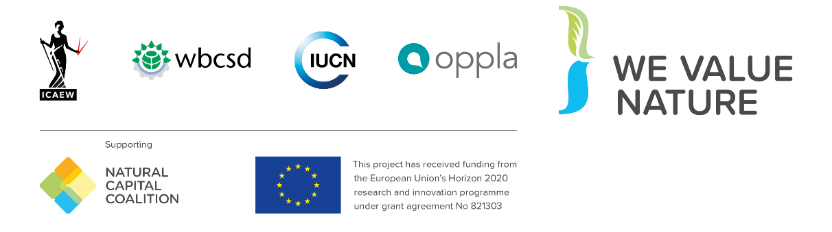
We Value Nature – Who are we?
We Value Nature is a campaign supporting businesses and the natural capital community to make valuing nature the new normal for business across Europe, by:
Sharing research, resources & best practices;
Identifying barriers & opportunities for adopting a natural capital approach;
Providing practical support to help business improve their risk management, communication & stakeholder engagement;
Reinforcing & boosting the work of the Natural Capital Coalition.
Notes:
Before kicking-off the training, presenter indicates that this training is being given as part of the We Value Nature Campaign and explain what it is, its purpose, objectives and partners involved.
The We Value Nature Campaign is a €2 million EU-funded campaign supporting businesses and the natural capital community across Europe with the aim of making valuing nature the new normal for business. As we will have a chance to explore during today’s training, by valuing nature, businesses can make smarter decisions that benefit themselves, society and the planet as a whole.
The campaign is coordinated by the Institute of Chartered Accountants in England and Wales (ICAEW), World Business Council for Sustainable Development (WBCSD), The International Union for Conservation of Nature (IUCN) and Oppla. And it is supporting the Natural Capital Coalition, which has recently merged with the Social & Human Capital Coalition to become now the ‘Capitals Coalition’.
The campaign will aim to increase the uptake of the natural capital approach (including: natural capital assessment, natural capital accounting, nature-based solutions and green infrastructure) by identifying barriers and opportunities, providing practical support to business through activities (such as webinars, helpdesk calls, etc.) and training such as this one, as well as by inspiring businesses to adopt the NCP.
The finance sector training is a development of, and complementary to , a range of existing materials.

Slide 4
We Value Nature training is open
You are free to:
Share — copy and redistribute the material in any medium or format
Adapt — remix, transform, and build upon the material for any purpose, even commercial
Under the following terms:
Attribution — You must give appropriate credit, link to the licence & indicate if changes were made (but not suggest endorsement).
No additional restrictions — You may not legally restrict others from doing anything the licence permits
CC BY 4.0 Creative Commons Attribution 4.0 International
Notes:
Presenter to read through the slide stating that the training is free to use under a creative commons licence

Slide 5
A few “house rules” - virtual
Please change your username to your full name and role
Please submit comments or questions in the chat function
Make sure to be joining us through Zoom app or computer
We invite you to turn on your camera if possible
Ensure that you are on mute when not taking part in discussions
Be prepared for some interactivity.
Notes:
Presenter to highlight house rules.

Slide 6
Agenda
Time | Session
1000 - 1015 | Welcome & introductions
1015 - 1020 | Video: Pitch for Nature
1020 - 1050 | Introduction to natural capital and finance
1050 - 1110 | Breakout Ideation Sessions:
1110 - 1130 | Reporting back and wrap-up
1130 | End of session
Notes:
Short session 1. 5 hours Presenter runs through the programme for the session.

Slide 7
Introductions
SHORT
Notes:
Support team to introduce themselves and then ask each attendee to introduce themselves, with larger numbers this should be kept simple -name and function, with fewer attendees they can be asked whether they have anything specific they want to be included in the session.

Slide 8
Who is your support team for today?
insert picture of trainer
insert picture of trainer
insert picture of trainer
Name
Name
Name
[insert logo of organisation]
[insert logo of organisation]
[insert logo of organisation]
Notes:
Introductions for those who are presenting the session (virtual or in person)

Slide 9
Video 1
Video: Pitch for Nature
Notes:
Presenter to ask attendees to put teams on mute and then access the video directly from their computer.
A short (2.5 mins) youtube video produced by WBCSD.
https://www.youtube.com/watch?v=IyL272Q1N0s
This video has received very positive feedback, particularly on how it highlights the need to look along the value chain for mapcts and dependencies

Slide 10
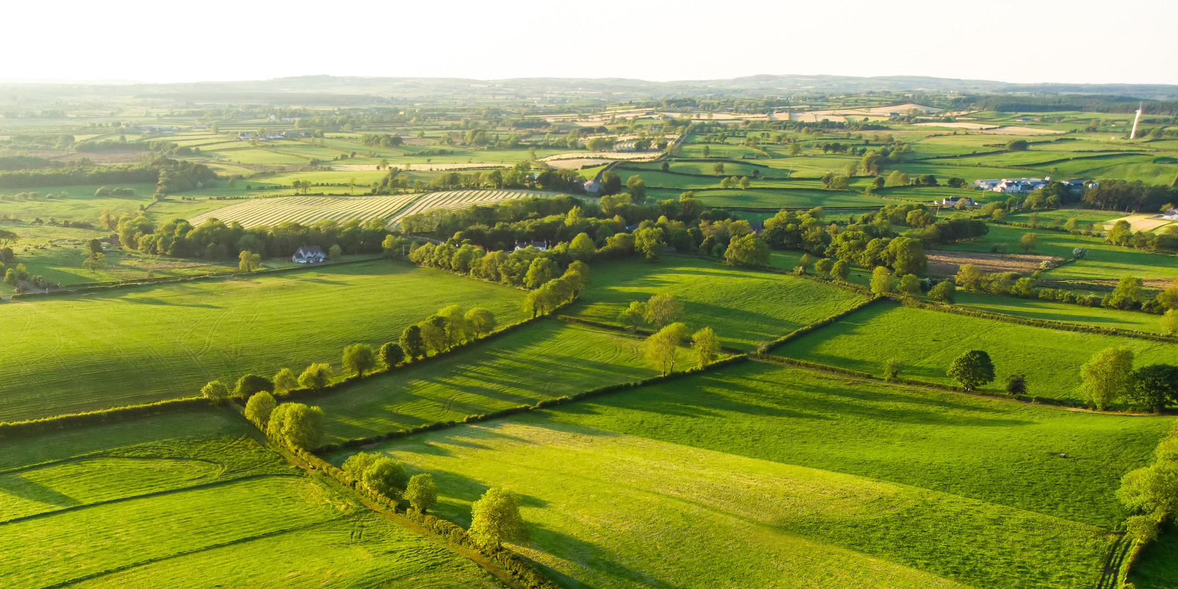
Introduction to natural capital
Notes:
Image source: Tim Swaan on Unsplash

Slide 11
The Natural Capital Protocol
Source: Natural Capital Protocol
The Natural Capital Protocol is a standardised framework for businesses to identify, measure and value their direct and indirect impacts and dependencies on natural capital.
Notes:
Presenter to introduce the Natural Capital Protocol and its development Connecting Finance and Natural Capital
The Natural Capital Protocol has been produced by the Natural Capital Coalition (a network of more than 300 organisations across research, science, academia, accountancy, reporting and many others…) in order to harmonize approaches to natural capital and help businesses get to grips with a crowded and confusing landscape.
The NCP builds upon many approaches and seeks to present a standardized, harmonized, global approach to applying natural capital and ultimately, supporting better and more informed decisions.
STRUCTURE of the Protocol:
There are four overarching stages of frame (why), scope (what), measure and value (how) and apply (so what) and 09 logical steps. It should be easy to follow and should be suitable for any business across any sector or geography. The stages and steps are iterative so expect that you may need to revisit a previous step.
The NCP is a framework – it lays out the steps, helps to structure your thinking and your research. However, in order to actually assess natural capital in your business, you will need to make use of specific methodologies or tools. The Protocol does not recommend any specific tools, because this is highly dependent on your particular business context and what you want to get out of your assessment. What the protocol does do is help you realise your business context, to frame your assessment and prepare you to select the right tools for your assessment. NCC also provides a toolkit, which we will share the link for after this presentation, which collates a few of these useful resources and tools in one place.

Slide 12
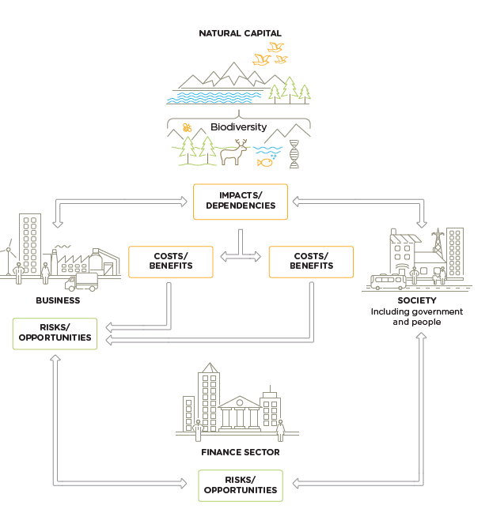
NCP Connecting Finance and Natural Capital
Considers both impacts and dependencies – a broader view of risk
Moves the discussion from measurement to valuation
Recognises interrelated issues.
Supports broader and better non-financial disclosure
Integrating natural capital & biodiversity allows identification of risk and opportunities that might otherwise be hidden or missed.
Notes:
Presenter to discuss the business case for a natural capital assessment: showing how all businesses impact and depend upon natural capital and biodiversity.
For a finance sector audience it should be made clear that financial activity sits behind operations (investees, borrowers and insureds) with major impacts and dependencies and hence represents both a risk and an opportunity for the sector.
Natural capital thinking provides financial institutions with more in-depth understanding of the interconnections and trade-offs between all environmental issues. The concept of natural capital broadens the conversation to include dependencies, as well as impacts, and considers value, in addition to measurement alone. Understanding the value of both natural capital impacts and dependencies helps financial decision makers to understand the significance of these issues to their institution, and therefore make more informed decisions. This leads to greater insight on the reliability and resilience of financial returns, and the associated natural capital risks and opportunities for the institution.
Entities serviced by the finance sector impact and depend on natural capital. These impacts and dependencies deliver both costs and benefits to the entities (e.g., via operational production inputs, regulated emissions, licence to operate) and to society (e.g., via recreational utility of landscapes, positive or negative health impacts, loss or preservation of species). In turn, these costs and benefits create risks and potential opportunities, which are transferred to the financial sector through banking, insurance products, and investments such as corporate bonds, stocks, and financial derivatives.
For example, a bank may lend money to an agricultural business. The agri-business may take actions to reduce soil erosion on its land (positive impact), leading to increased yield (benefit), thus enhancing the ability of the business to service its debt. This, in turn, improves the credit quality of the bank’s portfolio (lower risk). A further example relating to soft commodities and natural capital risk can be found in box 1.3.
As the conceptual model shows, the finance sector also interacts with and depends on society, which includes government and people. Society provides the foundational enabling conditions necessary for the finance sector to exist, the social license to operate, to which finance responds by providing support and services (such as retail banking)
to society. Government plays an important role in framing the enabling conditions for
a stable economy by setting regulations and directing finance through the creation of market incentives which can stimulate the integration of natural and social capital into market decisions. Government also has the potential to influence market distortions which can affect financial decision making, These societal and policy-making factors are very important, but they are outside of the scope of this Supplement, which focuses on financial services provided to entities.
When assessing an individual entity or portfolio, decide whether to include impacts, dependencies, or both, and a preliminary list of impacts and dependencies to include (later you will decide which are material for the analysis). This decision will be informed by assessment objectives.
• Impacts: You may wish to identify, measure, and value the natural capital impacts of the entity/portfolio(s) because they can create direct and indirect risks and/or opportunities for you. The impacts can have consequences both on the entity/portfolio(s) and on society. Examples of impact with consequences for the entity/portfolio might include changes in your investee companies’ costs, income, or asset values due to changes in regulations, with implications for company valuations, insurance premiums, dividends, or financing costs. Examples of impacts with consequences for society might include people displaced due to hydro dam construction or the positive recreational value for local communities following a mine site rehabilitation program.
• Dependencies: You may wish to identify, measure, and value the natural capital dependencies of the entity/portfolio(s) to evaluate how dependencies can affect financial viability. For example, you might assess portfolio exposure to water scarcity in a particular region, or reliance on food supply chains which could be affected by large loss of pollinator populations. Costs (or benefits) associated with changes in regulation and/or fiscal measures (e.g., taxes, subsidies), such as higher input prices resulting from subsidy removal, are also factors to consider in a natural capital assessment.
To decide whether you will be focusing on impacts or dependencies or both, it is helpful to understand the underlying concepts of impact drivers, impact pathways, and dependency pathways. These concepts, new to many institutions, are integral to understanding the additional benefits of a natural capital approach.
An impact driver is a measurable quantity of a natural resource that is used as an input, or generated as an output, by an entity that you are financially supporting. Impact drivers are generally expressed in quantitative units (e.g., kilograms, m3, hectares) and are the standard metrics for most ESG analysis. An impact driver is not the same as an impact. An impact is a change in the quantity or quality of natural capital that occurs as a consequence of an impact driver. A single impact driver may therefore be associated with multiple impacts. These concepts are illustrated in box 2.1.
Impact pathways describe how impact drivers result in changes in natural capital and ultimately affect different stakeholders. This approach is an extension of standard ESG analysis. The impact pathway is a concept adopted by several initiatives and organizations when identifying science-based natural capital boundaries or targets and is also used to define sustainable scenarios (such as low-carbon transition scenarios). Dependency pathways serve the same purpose for dependencies; again, the dependency pathway concept is an extension of standard ESG analysis and allows the user to understand and track the consequences of their natural capital
Additional value of natcap
Impact and dependencies
A natural capital approach importantly includes a consideration of dependencies (e.g., fiber, minerals, seafood, pollination, climate regulation, water regulation, wind), to provide a holistic view of risks and opportunities.
Focus on valuation
A natural capital approach provides an understanding of what these inputs and outputs mean in terms of value to society and value to businesses and financial institutions in relation to associated impacts and dependencies. This progression from measurement to valuation is critical in understanding the extent of risk, exposure, and opportunity to better inform decision-making.
Broader range of issues
Able to consider a much wider range of natural capital impact drivers and dependencies, including those which might vary depending on context. Provides increased coverage of regulating services and cultural values. From this broader range, users are then equipped with better information to identify which are the most material.
nterrelated system
Able to treat natural capital as a set of interrelated issues, considering trade-offs and net positions.

Slide 13
Key terms
Natural capital
is the stock of renewable and non-renewable natural resources, (e.g. plants, animals, air water, soils, minerals) that combine to yield a flow of “services” to people. These flows provide value to business and society
Ecosystem services
“the benefits people obtain from ecosystems” often divided into four categories: Provisioning, Regulating, Cultural, Supporting
Biodiversity
The variability among living organisms including terrestrial, marine, and other aquatic ecosystems and the ecological complexes of which they are part; this includes diversity within species, between species, and of ecosystems. Higher levels of biodiversity generate a greater quantity and quality of goods and services, and more resilience to change
.
Source: Natural Capital Protocol
Notes:
Presenter to emphasis that natural capital is not the same as biodiversity, although that term is sometimes used as a catch-all
They are usually divided into four categories. Provisioning services are tangible products of ecosystems, such as food, timber and cotton. Regulating services are the benefits of the regulating processes, such as animal pollination, air and water treatment, and soil fertility. Cultural services are the non-material benefits of ecosystems, such as their contributions to education, recreation and tourism. Finally, nature provides supporting services, such as the nutrient cycle, soil conservation and habitat creation, which actually support the other three categories of ecosystem services.
Framing nature as ‘natural capital’ is a way of looking at the environment from an economic perspective, with living and non-living elements of the environment seen as a ‘stock’ or an ‘asset’ from which numerous benefits flow in the form of ecosystem services. Recognising these benefits allows values, sometimes financial, to be associated with them. Whilst a wholly anthropocentric way of looking at the environment, this approach can be useful for influencing decisions driven largely by economic thinking (as most decisions in business and government are) as it allows some of the values of nature to be represented in equivalent terms.
The Natural Capital Protocol sets out guidelines for businesses to help better understand, measure, and value their inter-dependencies with natural capital and use the results for better management. However, one of the key challenges the Protocol highlights is how to incorporate ‘biodiversity’.
Biodiversity, the diversity of all living things, is a fundamental component of natural capital that underpins or influences almost every product or service we value, as well as having value in and of itself.
Its importance is often missed by organisations looking to understand and mitigate their impacts on the natural environment. Instead, biodiversity is frequently listed as just one of many concerns, alongside (and increasingly behind) greenhouse gas emissions or water consumption and other benefits that flow from natural capital.
Biodiversity values tend to be missed or hidden in natural capital assessments, particularly when the focus is on current flows of benefits for the following reasons:
While the values we attribute to our appreciation of nature are of fundamental importance to many, the economic techniques to quantify and monetise these values are inadequate to develop robust estimates. As a result these values tend to be missing.
Biodiversity plays a fundamental role in ecosystem functioning and therefore underpins the delivery of all ecosystem benefits. Its role is hidden within a natural capital account, but not explicit, and therefore these values of biodiversity are not adequately visible.
Biodiversity provides nature’s insurance, helping adapt to shocks and stresses, such as climatic change and disease. An assessment that only considers the flow of benefits provided today will overlook the likelihood of benefits being supported into the future, and therefore these values are also missing.
�Information and data on biodiversity and its interdependencies with business also needs further investment and is often not easily available, which can also lead to values being missed.
Many of the problems of these hidden and missing values of biodiversity can be avoided by focussing on the stock of biodiversity as the asset which generates the benefits, rather than the flow of benefits themselves. This also provides a less complex and more credible approach to thinking about biodiversity in the context of both natural capital accounting and consequent decision-making around the natural capital management.
Why is biodiversity important?
Once considered a separate issue to climate change, biodiversity loss is now regarded as an equally urgent crisis, and its connection to climate adaptation and mitigation are increasingly understood. Biodiversity builds resilience against climate change, supports communities and livelihoods, and fundamentally underpins our broader society and global economy. Business are beginning to recognise this and are looking for ways to understand the value of their impacts and dependencies on biodiversity.
What is biodiversity and how does it relate to natural capital?
Biodiversity describes the variety of life and is the living component of what can be thought of as natural capital stocks. It plays an important role in the provision of the services we receive from nature. The presence of, and interactions between, natural capital stocks generate a flow of goods and services; these goods and services create value through the benefits they provide to business and society.
Viewing biodiversity through a natural capital lens can help businesses to recognise previously unseen values that underpin all goods and services, providing a clear business case for protection of and investment in the health of biodiversity. It also allows an integrated approach to environmental issues management that recognises the links and synergies between issues such as climate, water, sustainable development, equity and biodiversity.
The Guidance
The Biodiversity Guidance was developed as a stepwise approach to incorporate biodiversity into natural capital assessments. It guides companies through the process of including the value of biodiversity in their natural capital assessments and how to operationalize this information in internal decision making.
Ecosystem services:
“the benefits people obtain from ecosystems” often further categorised into four categories:
• Provisioning: Material outputs from nature (e.g., seafood, water, fibre, genetic material).
• Regulating: Indirect benefits from nature generated through regulation of ecosystem processes (e.g., mitigation of climate change through carbon sequestration, water filtration by wetlands, erosion control and protection from storm surges by vegetation, crop pollination by insects).
• Cultural: Non-material benefits from nature (e.g., spiritual, aesthetic, recreational, and others).
• Supporting: Fundamental ecological processes that support the delivery of other ecosystem services (e.g., nutrient cycling, primary production, soil formation).

Slide 14
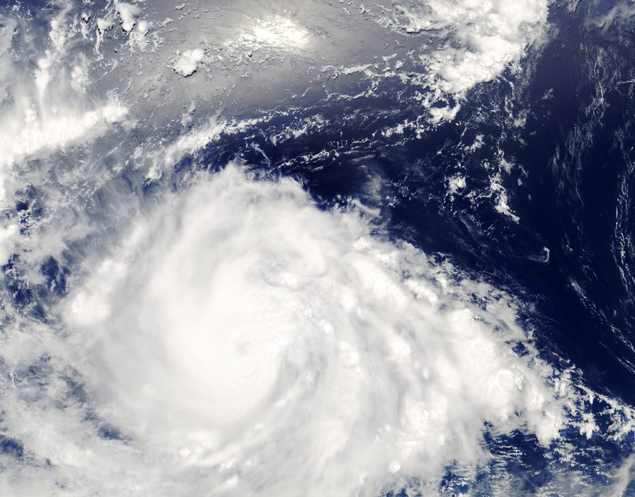
Why is natural capital important?

Slide 15
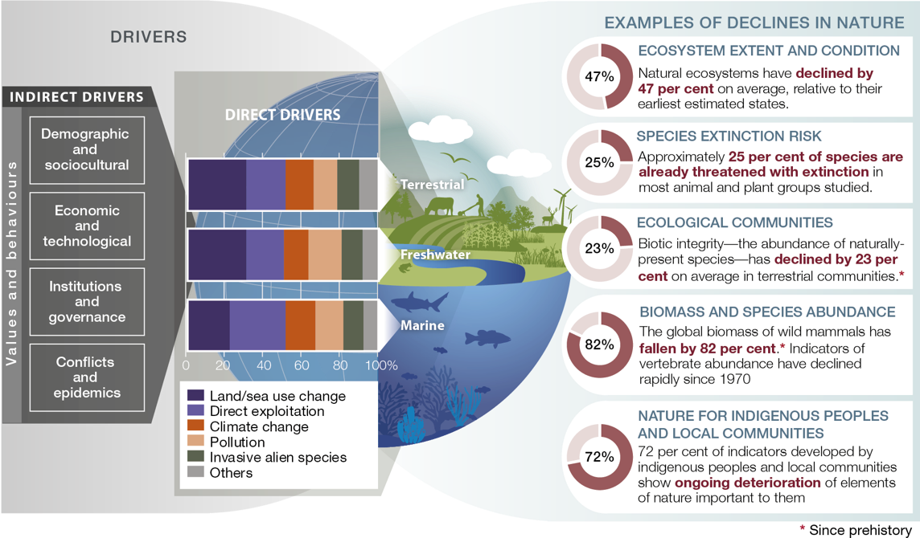
The decline in nature and its drivers
High impact direct drivers of change in nature
changes in land and sea use
direct exploitation of organisms
climate change
pollution
invasion of alien species
‘Humans have transformed the majority of the world’s ecosystems, destroying, degrading and fragmenting terrestrial, marine and other aquatic habitats, and undermining the services they provide’. OECD 2019
Source: IPBES Global Assessment Report 2019
Dasgupta Review and UN Biodiversity Conference (CBD COP 15) are key 2021 developments
Notes:
Presenter introduces IPBES as authoritative information reference review and how drivers (both direct and indirect) lead to declines in nature.
The Intergovernmental Science-Policy Platform on Biodiversity and Ecosystem Services (IPBES) is an independent intergovernmental body established to strengthen the science-policy interface for biodiversity and ecosystem services for the conservation and sustainable use of biodiversity, long-term human well-being and sustainable development. It was established in 2012 by 94 Governments and is an authoritative source of natural capital and biodiversity information.
The IPBES assessment of 2019 highlighted that the drivers of environmental loss have been accelerating over the last 50 years – and there is no indication that these will slow without dedicated societal effort. Drivers include:
Land use change – particularly for agriculture
Declining freshwater resources – nitrogen and phosphorous cycles due to agricultural run-off contributing to ocean acidification; pollution and over utilization of freshwater resources
Species and biodiversity loss due to habitat loss and rampant deforestation
All contributing to the degradation of ecosystems (almost half of all global ecosystems are impacted) – and the subsequent reduction and loss in ecosystem goods and services – which underpin our economic activities
The direct drivers of change in nature with the largest global impact have been (starting with those with most impact): changes in land and sea use; direct exploitation of organisms; climate change; pollution; and invasion of alien species. Those five direct drivers result from an array of underlying causes – the indirect drivers of change – which are in turn underpinned by societal values and behaviours that include production and consumption patterns, human population dynamics and trends, trade, technological innovations and local through global governance. The rate of change in the direct and indirect drivers differs among regions and countries.
Currently, land degradation has reduced productivity in 23 per cent of the global terrestrial area, and between $235 billion and $577 billion in annual global crop output is at risk as a result of pollinator loss. Moreover, loss of coastal habitats and coral reefs reduces coastal protection, which increases the risk from floods and hurricanes to life and property for the 100 million to 300 million people living within coastal 100-year flood zones. Seventy-five per cent of the land surface is significantly altered, 66 per cent of the ocean area is experiencing increasing cumulative impacts, and over 85 per cent of wetlands (area) has been lost. While the rate of forest loss has slowed globally since 2000, this is distributed unequally. Across much of the highly biodiverse tropics, 32 million hectares of primary or recovering forest were lost between 2010 and 2015. The extent of tropical and subtropical forests is increasing within some countries, and the global extent of temperate and boreal forests is increasing. Approximately half the live coral cover on coral reefs has been lost since the 1870s, with accelerating losses in recent decades due to climate change exacerbating other drivers. The average abundance of native species in most major terrestrial biomes has fallen by at least 20 per cent, potentially affecting ecosystem processes and hence nature’s contributions to people; this decline has mostly taken place since 1900 and may be accelerating. In areas of high endemism, native biodiversity has often been severely impacted by invasive alien species.
Quote source is OECD (2019), Biodiversity: Finance and the Economic and Business Case for Action, report prepared for the G7 Environment Ministers’ Meeting, 5-6 May 2019.

Slide 16
COVID-19 and nature
The number of new infectious diseases has quadrupled in the last 60 years (WEF, 2020)
Natural habitats are being diminished, causing wild animals to live in closer quarters to one another and to humans. While the origin of the COVID-19 virus is yet to be established, 70% of emerging infectious diseases originate from wildlife (WEF, 2020)
Supporting biodiversity is vital for avoiding the next pandemic - land use change and wildlife exploitation are important drivers of infectious disease emergence (OECD, 2020).
The pandemic has seen continuing increasing interest in sustainability in the finance sector, primarily around climate change but with nature-related issues also becoming more prominent.
‘The COVID-19 pandemic has shone a light on the domino effect that is triggered when one element in interconnected systems is destabilized. Altering nature without fully understanding the consequences can have devastating implications for humans’. (WEF, 2020)
‘
.
Notes:
Presenter to highlight connections between Covid and nature including closer contact between humans and animals (linked to habitat loss)
Sources:
OECD Coronavirus Policy Response (2020)
NGFS Network for Greening the Financial System (NGFS) Guide for Supervisors Integrating climate-related and environmental risks into prudential supervision May 2020
McKinsey Reduced Dividends on Natural Capital (2020)
Fortunately, the pandemic has had little impact on the momentum for safeguarding biodiversity that’s been generated over the past year or so. Rather, the pandemic has reminded the world of the health consequences of our destruction of nature and therefore, it has brought new interest and support for halting biodiversity loss’. Elizabeth Maruma Mrema, Executive Secretary, UN Convention on Biological Diversity
June 2021 interview with Elizabeth Maruma Mrema, Executive Secretary of the UN Convention on Biological Diversity
https://www.thegef.org/news/we-need-do-better-and-certainly-we-can?utm_source=Master+List&utm_campaign=1024d3df7b-July+August+2021+Newsletter&utm_medium=email&utm_term=0_388f7ef156-1024d3df7b-222474558
WEF The COVID-19 recovery must focus on nature, April 2020
https://www.weforum.org/agenda/2020/04/covid-19-nature-deforestation-recovery/
This pandemic is also a stark reminder of our dysfunctional relationship with nature. The current economic system has put great pressure on the natural environment, and the unfolding pandemic has shone a light on the domino effect that is triggered when one element in this interconnected system is destabilised.
Intact nature provides a buffer between humans and disease, and emerging diseases are often the results of encroachment into natural ecosystems and changes in human activity. In the Amazon, for example, deforestation increases the rates of malaria, since deforested land is the ideal habitat for mosquitoes. Deforested land has also been linked to outbreaks of Ebola and Lyme disease, as humans come into contact with previously untouched wildlife.
While the origin of the COVID-19 virus is yet to be established, 60% of infectious diseases originate from animals, and 70% of emerging infectious diseases originate from wildlife. AIDS, for example, came from chimpanzees, and SARS is thought to have been transmitted from an animal still unknown to this day. We have lost 60% of all wildlife in the last 50 years, while the number of new infectious diseases has quadrupled in the last 60 years. It is no coincidence that the destruction of ecosystems has coincided with a sharp increase in such diseases.
J R Soc Interface. 2014 Dec 6; 11(101): 20140950. doi: 10.1098/rsif.2014.0950
Global rise in human infectious disease outbreaks
Katherine F. Smith,Michael Goldberg, Samantha Rosenthal, Lynn Carlson, Jane Chen, Cici Chen,and Sohini Ramachandran
Photo: Unsplash.com

Slide 17
Nature and climate change connections
Climate change is currently responsible for between 11% and 16% of biodiversity loss. This share is expected to increase, and it has the potential to trigger irreversible biome-scale ecosystem disruptions, making the decarbonisation of the economy essential to limiting longer-term nature loss (WEF, 2020)
Climate models show that we are approaching a tipping point: If current trends in habitat conversion and emissions do not peak by 2030, then it will become impossible to remain below 1.5°C It has become clear that beyond 1.5°C, the biology of the planet becomes gravely threatened because ecosystems literally begin to unravel
Tropical deforestation is turning forests from carbon sinks to carbon emitters, accounting for around 10% of our global greenhouse gas emissions, the second-largest source of CO2 emissions behind fossil fuel combustion. Commercial agriculture is responsible for over 70% of deforestation due to demand for palm oil soy, timber and cattle
Healthy ecosystems contribute to resilience by enabling the adaptation to conditions caused by climate change that are already taking place, such as higher temperatures, rising seas, fiercer storms, more unpredictable rainfall and more acidic oceans
TCFD offers a blueprint for considering natural capital risks and opportunities -Taskforce for Nature-related Financial Disclosures (TNFD) launched in June 2021, framework planned for 2023.
.
‘…mitigating against the worst effects of climate change will have significant benefits for biodiversity, and avoiding biodiversity loss will have a positive effect on climate change.’ Dasgupta Review 2021
Notes:
Presenter to highlight two way connections between nature and climate change – climate change acting to increasing stress on nature and ecosystems capability of providing solutions to climate issues. Note that climate oriented approach of TCFD is being extended to address nature-related risk as TNFD.
NGFS Guide for Supervisors Integrating climate-related and environmental risks into prudential supervision May 2020
For supervisors and financial institutions it is also important to be aware of potential greater impacts due to the combined effects of climate-related and environmental risks, as these may reinforce each other through a negative feedback loop.’
Coral reefs are particularly vulnerable to climate change and are projected to decline to 10 to 30 per cent of former cover at 1.5°C warming and to less than 1 per cent of former cover at 2°C warming
A Global Deal For Nature: Guiding principles, milestones, and targets E. Dinerstein et al, Science Advances 19 Apr 2019: Vol. 5, no. 4, eaaw2869
https://advances.sciencemag.org/content/advances/5/4/eaaw2869.full.pdf
WEF New Nature Economy Report, The Future Of Nature And Business 2020
McKinsey Reduced Dividends on Natural Capital, 2020.
The Dasgupta Review February 2021
https://www.gov.uk/government/publications/final-report-the-economics-of-biodiversity-the-dasgupta-review
Annex 4.1 Biodiversity Loss and Climate Change
Climate change and biodiversity loss are intimately related. It is predicted that climate change could overtake land-use change as the leading cause of biodiversity loss by 2070 (Newbold, 2018). Biodiversity loss will in turn have huge implications for climate change: enormous amounts of carbon are locked within animal life and vegetation. The Amazon contains an amount of carbon equivalent to a decade of global human emissions (Lovejoy and Hannah, 2019). Therefore, mitigating against the worst effects of climate change will have significant benefits for biodiversity, and avoiding biodiversity loss will have a positive effect on climate change. As the climate changes, people will need to adapt to new conditions, and employ strategies that deliver for humanity, biodiversity, and the climate simultaneously.
A Taskforce for Nature-related Financial Disclosures (TNFD) is expected to be launched in 2022, which should support companies disclosing their dependencies and impacts on nature (nature-related risks) by 2023 and beyond.
https://tnfd.global

Slide 18
Global Framework for Nature (CDB COP 15 and COP26)
UN Biodiversity Conference (COP15) to the Convention on Biological Diversity (CBD)), in Kunming, China held in two parts (11 -15 October 2021 and 25 April – 8 May 2022
COP 15 focuses on the adoption of post-2020 global biodiversity framework including putting biodiversity and ecosystems on path to recovery by 2030
Draft framework includes four long term goals to 2050 and 21 urgent targets to 2030 eg all business to report on their impacts and dependencies on biodiversity, increase financial resources to $200 billion /year.
COP 26 acknowledged connection between climate and nature including Glasgow Leaders’ Declaration on Forests and Land Use commitment to halt and reverse forest loss and land degradation by 2030
More than 30 financial institutions committed to eliminate investment in activities linked to agricultural commodity driven deforestation by 2025 (soy, cattle products, palm oil, timber, pulp and paper)
Notes:
Presenter to highlight recent developments around the COPs in late 2021. COP15 will involve the adoption of the global post 2020 framework for biodiversity and ecosystems. COP 26 focused on climate including a declaration by finance sectors to eliminate deforestation in their activities.
https://ukcop26.org/glasgow-leaders-declaration-on-forests-and-land-use/
02.11.2021
GLASGOW LEADERS’ DECLARATION ON FORESTS AND LAND USE
Through the COP26 World Leaders Summit ‘Action on Forests and Land Use’ over 130 leaders, accounting for more than 90% of the world’s forests, committed to work together to halt and reverse forest loss and land degradation by 2030 in the Glasgow Leaders’ Declaration on Forests and Land Use.
’We therefore commit to working collectively to halt and reverse forest loss and land degradation by 2030 while delivering sustainable development and promoting an inclusive rural transformation’.
CEOs from more than 30 financial institutions with over $8.7 trillion of global assets have committed to eliminate investment in activities linked to agricultural commodity driven deforestation, alongside the billions of private finance mobilised to support the forest economy through three flagship initiatives.
The associated Roadmap recommends the key steps needed for financial institutions to eliminate commodity-driven deforestation, conversion, and associated human rights abuses from their portfolio by 2025.
Roadmap with tools for mapping risk
https://guidance.globalcanopy.org/wp-content/uploads/2021/11/DFF_Roadmap-Report_Final.pdf
The UN Biodiversity Conference (Fifteenth meeting of the Conference of the Parties (COP-15) to the Convention on Biological Diversity (CBD)), in Kunming, China is being held in two parts. Part one took place virtually and in-person, from 11 to 15 October and included a High-Level Segment from 12 to 13 October. Part two will be an in-person meeting in Kunming, from 25 April to 8 May 2022.
The conference will see the adoption of the post-2020 global biodiversity framework. The framework provides a strategic vision and a global roadmap for the conservation, protection, restoration and sustainable management of biodiversity and ecosystems for the next decade.
The main objective of the Conference is to adopt the post-2020 global biodiversity framework that would put biodiversity on a path to recovery by 2030 at the latest, towards the full realization of the 2050 Vision of “Living in Harmony with Nature.” . Draft One of the framework, released in July 2021, builds on lessons learned from the Strategic Plan for Biodiversity 2011-2020 and its Aichi Biodiversity Targets. It recognizes that urgent policy action globally, regionally and nationally is required to transform economic, social and financial models so the trends that have exacerbated biodiversity loss will stabilize by 2030 and allow for the recovery of natural ecosystems, with net improvements by 2050.
Key elements needed for a successful post-2020 framework include: the mainstreaming of biodiversity across all decision-making; phasing out and redirection of harmful subsidies; strengthen the rule of law; recognizing the full and effective participation of indigenous peoples and local communities and ensuring an effective mechanism to monitor and review progress; among others.
FIRST DRAFT OF THE POST-2020 GLOBAL BIODIVERSITY FRAMEWORK
The Framework comprises 21 targets and 10 ‘milestones’ proposed for 2030, en route to ‘living in harmony with nature’ by 2050.
Target 15 (by 2030) . All businesses (public and private, large, medium and small) assess and report on their dependencies and impacts on biodiversity, from local to global, and progressively reduce negative impacts, by at least half and increase positive impacts, reducing biodiversity-related risks to businesses l.
.

Slide 19
Future requirements - the regulatory framework cascade
High level developments by central banks and supervisors indicate likely future requirements
European Central Bank supervisory expectations included biodiversity loss as potential risk driver (November 2020)
NGFS exploring relationship between biodiversity loss and financial stability (June 2021)
TNFD will adopt TCFD-like four-pillar approach, governance, strategy, risk management, metrics and targets seeking to align with global CBD framework
Sustainable Finance Disclosure Regulation will impose phased entity and product level disclosure requirements around biodiversity for asset managers
..the understanding and integration of nature-related risks into the policies and practices of central banks and financial supervisors remains embryonic at best’ WWF 2021
19
Notes:
Presenter to highlight that this slide is intended to show that a forward look of likely requirements coming to the finance sector can be obtained by looking at emerging guidance aimed at sector regulators. WWF has also published related research focused on the role of central banks.
WWF Nature’s next stewards Why central bankers need to take action on biodiversity risk, July 2021
This report sets out the case for central banks to consider biodiversity risks and impacts noting ‘Critically, they need to assume that environmental degradation (including biodiversity loss) poses financial risk unless it can be shown not to be the case. However, unlike the important advances in the integration of climate-related risks in financial regulation), the understanding and integration of nature-related risks into the policies and practices of central banks and financial supervisors remains embryonic at best. These deteriorating ecosystems can have negative economic impacts. A few sectors are directly dependent on ecosystem services: agriculture and forestry, clothing, brewers, electric utilities and other power producers and, to a lesser extent, tourism and consumer goods.
NGFS Occasional Paper Biodiversity and financial stability: exploring the case for action June 2021
https://www.ngfs.net/en/biodiversity-and-financial-stability-exploring-case-action
NGFS and INSPIRE established a joint Study Group on Biodiversity and Financial Stability, with the aim of understanding the potential implications of biodiversity loss for financial stability.
In addition to increasing awareness of the impacts of economic activities on biodiversity, some central banks and financial supervisors are starting to recognise the potential of biodiversity loss as a threat to their core mandates for financial and monetary stability.
Biodiversity loss could pose risks to the financial system through complex feedback loops, externalities and tipping points, including transition risks (e.g. incompatibility between financial institutions’ exposures and government measures) and physical risks (e.g. declining performance of assets or economic activities that depend upon biodiversity).
The study group will explore whether and how central banks and supervisors can play a role in addressing the challenge of biodiversity loss itself and the knowledge gaps around it, from assessment and monitoring of the relationship between biodiversity loss and financial stability to considering if central bank portfolios should include conservation goals.
Applying a ‘double materiality’ approach to biodiversity loss could be particularly insightful. Nature- related hazards can affect companies and financial institutions, but companies and financial institutions can also affect biodiversity and the climate. This suggests that a comprehensive approach to risk management should account for how financial institutions are exposed to biodiversity-related financial risks, but also how they contribute to such risks.
The EU Sustainable Finance Disclosure Regulation (SFDR) came into force in 2021 aims to avoid greenwashing of financial products and financial advice in the EU by increasing transparency to investors. It applies to asset managers and other financial market participants (including those providing advice) includes guidelines for reporting at both the entity level and the product level It relies on the disclosure of Principle Adverse Impacts (PAI) of investment decisions on sustainability including ‘negatively affecting biodiversity-sensitive areas’.

Slide 20
Opportunities - Nature Based Solutions
Nature Based Solutions (NbS) solutions can provide 37% of cost-effective GHG mitigation needed by 2030 to stabilise global warming to below 2°C (WBCSD, 2020)
Restoring 46% of the world’s degraded forests could provide $7-30 in benefits for every dollar spent. In general, preventing the degradation and loss of an ecosystem is more cost-effective than restoring it (OECD, 2019)
In the Gulf of Mexico NbS flood adaptation measures (including oyster reef or wetland restoration) compared favourably with engineered solutions with average benefit-cost ratios of above 3.5 (Dasgupta, 2021)
Forestry projects most popular with water-based projects expected to experience greatest growth (Nature Conservancy, 2019)
UNEP identified annual finance for nature-based solutions needs to triple by 2030 (currently $133bn)
Notes:
Presenter to highlights investment opportunities around need for increasing finance and, addressing concerns about the quality, impacts and scalability of nature lreated projects, the new IUCN standard is a significant development.
IUCN Global Standard for Nature-based Solution July 2020
Implementers of NbS can use the Global Standard, its user guide and self-assessment tool to consistently design effective NbS projects.
The standard consists of eight criteria and their associated indicators, which address the pillars of sustainable development (biodiversity, economy and society) and resilient project management.
NbS are defined as “actions to protect, sustainably manage and restore natural or modified ecosystems that address societal challenges effectively and adaptively, simultaneously providing human well-being and biodiversity benefits.” These can include:
Protecting, managing, and restoring forests
Adopting regenerative approaches to agriculture
Building artificial wetlands within cities to reduce flooding
Managing watersheds to provide clean water
Restoring mangroves to mitigate storm damage
If delivered appropriately, NbS can significantly contribute to addressing multiple societal challenges. For example, NbS have the potential to supply up to 37% of our climate change mitigation needs. They can also reduce the negative effects of the climate crisis on people and nature by decreasing the impact of disasters and providing resilience to communities. Mangroves alone, if healthy and sustainably managed, could reduce annual flooding for more than 18 million people globally, averting flood damage totalling up to US$ 57 billion in China, India, Mexico, US and Vietnam each year. NbS can also help address biodiversity loss, for example through forest landscape restoration.
UNEP State of Finance of Nature https://www.unep.org/resources/state-finance-nature May 2021
The report tracks global trends in public and private investment in nature-based solutions, aiming to improve data quality and identify opportunities for governments, businesses and financiers. The 2021report calls for investments in nature-based solutions to triple by 2030 and to increase four-fold by 2050 from the current level. While an increase in public funding would help plug some of the gap, it identifies that there needs to be a significant increase in private sector investment in Nature-based solutions. If the world is to meet the climate change, biodiversity, and land degradation targets, it needs to close a USD 4.1 trillion financing gap in nature by 2050. The current investments in Nature-based solutions amount to USD 133 billion – most of which comes from public sources.
OECD (2019), Biodiversity: Finance and the Economic and Business Case for Action, report prepared for the G7 Environment Ministers’ Meeting, 5-6 May 2019.
Tobin-de la Puente, J. and Mitchell, A.W. (eds.), 2021. The Little Book of Investing in Nature, Global Canopy: Oxford.
Investing in Nature. Survey by Nature Conservancy 2019.
The report is based on a global survey of asset owners, asset managers and financial intermediaries (including banks, investment advisors, consultancies and NGOs).
The survey confirmed that a growing number of private sector investors are factoring environmental concerns into their investment decisions, in response to stakeholder pressure, government guidance and regulatory changes. To date, the focus has largely been on greenhouse gas (GHG) emissions but, increasingly, attention is turning to natural assets from which humans derive a wide range of goods and services. Resilience against climate change' was the most commonly cited driver of current and future investments in natural capital. This is in line with studies showing that nature-based approaches to climate change adaptation can effectively bring down the total costs of resilience investments. Among the largest investors, however, 'reputation' was considered even more important. To date, forestry has received the most attention among nature-based solutions to climate change, as deforestation is estimated to be responsible for about 20% of global GHG emissions. Increasingly, however, investors are turning their attention to other nature-based investments, such as sustainable agriculture, peatland and the oceans.According to the survey respondents, nature-based projects to improve the quality and supply of water are expected to see the greatest increase in investment over the next five years, albeit from a relatively low level. The survey revealed a wide range of approaches to investing in natural capital, including purchases of real assets such as forests or agricultural land, private and listed equity, mitigation offsets for water, biodiversity and GHGs and various green debt instruments.
Green bonds are rapidly becoming popular for making sustainable investments, but few of them help finance the conservation of natural capital. However, this market is proving increasingly attractive to large mainstream investors and new standards are being developed to give the market clearer visibility about which of these bonds support nature-based projects.
Other innovative debt instruments used to channel private finance to natural capital projects include sustainability-linked loans, in which the interest paid depends on the environmental performance of the borrower.
WBCSD Dec 2020 Accelerating business solutions for Climate and Nature
Report I: Mapping nature-based solutions and natural climate solutions
https://www.wbcsd.org/Programs/Food-and-Nature/Nature/Nature-Action/Resources/Accelerating-business-solutions-for-climate-and-nature-Report-I-Mapping-nature-based-solutions-and-natural-climate-solutions

Slide 21
Our Action on Nature
Our policy - what it covers and what we consider to be the key issues
Our position on specific natural capital concerns eg on sourcing activities to avoid deforestation
Our action on connected issues such as climate change
Our support for specific nature focused projects and programmes
Our partnerships – who we are working with across the finance sector and beyond
Our targets and objectives including future commitments
Our disclosures – what we say about natural capital
Notes:
Optional slide to be populated with information specific to the organisation hosting the training. This may be delivered by the presenter or by the host organisation.
It can be helpful to explain to participants what is already happening around nature-related issues in the organisation, so the breakout sessions can focus on what they think are next steps and priority areas.
This aspect could be covered by someone from the host organisation or by the presenter.

Slide 22
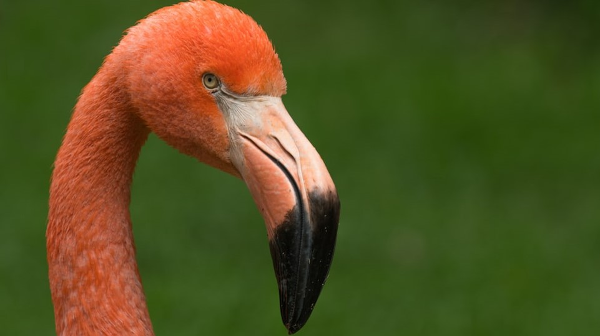
Taking Action and Useful Tools
Notes:
Presenter to explain that this session will involve the types of action that financial organisations can take and tools to support their programmes.

Slide 23
Taking Action
‘The financial system can both contribute to the depletion of biodiversity and promote its conservation and sustainable use’ NGFS June 2021
Collaboration, target setting and disclosure commitments eg Finance for Biodiversity Pledge
CISL Handbook describes a TCFD–like approach linked to financial risks
Identifying impacts and dependencies – focusing on priority sectors and building on existing action eg on climate and commodities
Source: UNEP FI Guidance for banks: Biodiversity Target-setting. Principles for Responsible Banking (June 2021)
Notes:
Presenter to highlight that the finance sector can have a positive impact and its not just about minimising negative aspects. The Finance for Biodiversity pledge is an example of the range of actions that could be appropriate for organisations early in the natural capital journey. The CISL Handbook describes an approach that aligns with climate risk management practice evolving through TCFD. Given the portfolio nature of impacts an early action is likely to involve identifying hotspots/areas of concern in their financing activities.
The Finance for Biodiversity Pledge, https://www.financeforbiodiversity.org launched in 2020 is a commitment financial institutions to call on global leaders and to protect and restore biodiversity through their finance activities and investments with 75 signatories at November 2021. The Pledge involves five areas of action
Collaborating and sharing knowledge
Engaging with companies
Assessing impact
Setting targets
Reporting publicly on the above before 2025
CISL Handbook for Nature-related Financial Risks 2021
The main audience for this handbook are financial practitioners with limited prior knowledge of biodiversity loss, land degradation or how the decline of nature can put their institution at financial risk.
It follows a TCFD type approach which should already be familiar to may financial institutions indicating that nature loss becomes a financial risk when physical, transition and liability risk manifest, causing negative impacts upon:
Companies and governments, to which financial institutions are exposed via loans, debt and/or equity holdings and/or revenues from financial services;
Financial markets, including commodity and money markets, to which finance companies have exposure through investments or financial services (e.g. derivatives).
The operations or property of financial institutions e.g. a lack of green space in cities can lead to fast water runoff
UNEP FI Beyond 'Business as Usual': Biodiversity Targets and Finance. Managing biodiversity risks across business sectors 2020
The report said that financial institutions should focus on target setting for the priority sub-industries below (in alphabetical order):
1. Agricultural Products (priority from both impacts and dependencies perspective)
2. Apparel, Accessories & Luxury Goods (priority from dependencies perspective)
3. Brewers (priority from dependencies perspective)
4. Distribution (priority from impacts perspective)
5. Electric Utilities (priority from dependencies
perspective)
6. Independent Power Producers & Energy Traders
(priority from dependencies perspective)
7. Mining (priority from impacts perspective)
8. Oil & Gas Exploration & Production (priority from
impacts perspective)
9. Oil & Gas Storage & Transportation (priority from
impacts perspective)

Slide 24
Metrics and Tools
ENCORE a variety of tools:
Explore potential impacts and dependencies (visualised) on natural capital
To what extent can a portfolio potentially reduce global extinction risk (STAR)
To what extent does a portfolio potentially impact ecological integrity (CISL)
Generate bespoke biodiversity risk screening reports based on asset locations (IBAT)
Explore supply chain links via companies and finance institutions to deforestation (TRASE)
Biodiversity Footprint for Financial Institutions (BFFI)
Measures biodiversity impacts using country-specific sector average data (EXIOBASE)
Environmental pressures (resource use, emissions, etc) linked to impact on biodiversity using ReCiPe model
Results are expressed in terms of potentially disappeared fraction of species in an area of a given size, over a given time period (PDF/m2/yr)
EU Business @ Biodiversity Platform undertakes critical reviews of measurement approaches
Notes:
Optional slide that gives an overview of ENCORE and its wider capabilities and the BFFI tool as an example of biodiversity measurement (aimed specifically at the finance sector)
ENCORE (Exploring Natural Capital Opportunities, Risks and Exposure) is a tool to help users better understand and visualise the impact of environmental change on the economy. It guides users in understanding how businesses across all sectors of the economy potentially depend and impact on nature, and how these potential dependencies and impacts might represent a business risk.The ENCORE biodiversity capability uses IUCN’s ‘Species Threat Abatement and Restoration’ (STAR) metric. The metric assesses the potential abatement in extinction risk that would be gained from eliminating threats to species in a given area. STAR is broken down into the threat categories found within the IUCN Red List. They are also summed to produce the overall ‘Total’ STAR layer.
Biodiversity Footprint Financial Institutions (BFFI) July 2021
https://www.government.nl/documents/reports/2021/07/29/biodiversity-footprint-for-financial-institutions
The approach provides a biodiversity footprint of economic activities in which a financial institution invests. It allows calculation of the environmental pressures and the biodiversity impact of investments within an investment portfolio, at the level of a portfolio, an asset class, a company, or a project.
The BFFI approach involves creating an overview of the economic activities in which the financed portfolio including types of activity and location. The Exiobase input-output database is then used to assess what land use, water use, emissions, etc. (pressures) are linked to the economic activities (unless more accurate data -like company data) is available. Then the ReCiPe model is used to calculate the environmental pressures (eg climate change resulting from CO2 emissions) and to calculate the resulting impact on ecosystem quality or biodiversity. This latter step is based on science based ‘pressure-response‘ relations(eg the effect of a 1 degree temperature rise on biodiversity). This results in an impact on terrestrial, fresh water and marine biodiversity. The unit used to express the impact on biodiversity is PDF /ha/yr, the Potentially Disappeared Fraction of species per hectare (per cubic meter for aquatic biodiversity) per year. The result is then used to calculate the biodiversity footprint in m2 per Euro invested (for each investment category) and the total footprint in m2 for all investments.
Associated case studies showed that climate change and land-use are by far the most important drivers of biodiversity loss.
This means that policies by financial institutions to reduce the carbon footprint of investments will also benefit the biodiversity footprint, unless such carbon policies lead to trade-offs between different drivers of biodiversity loss. For example, a shift from fossil based fuels to biofuels may result in a trade of between climate change and land-use. Both are key drivers of biodiversity loss.

Slide 25
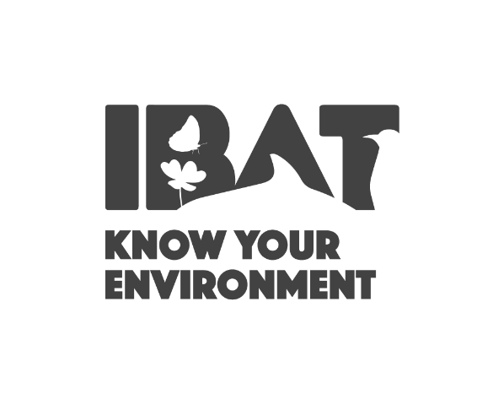
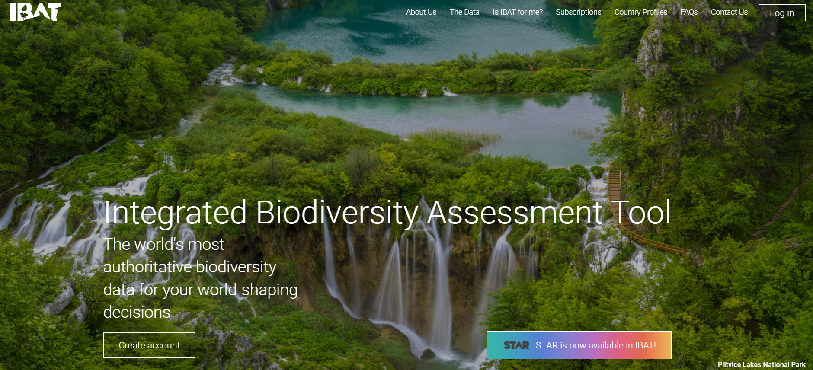
IBAT: A tool to help identify priority sites for measuring
Provides access to:
Protected Areas
Key Biodiversity Areas
IUCN Red List of Species including the STAR Layer
https://www.ibat-alliance.org/
Notes:
Presenter to consider tools available to help with measurement: IBAT
Presenter to explain that IBAT could be a useful tool to identify priority sites (i.e. based on proximity to Key Biodiversity Areas and/or red listed species) for a natural capital assessment. This could be completed during the materiality/scoping part of the assessment to prioritise locations for consideration (e.g. those in closet proximity to Key Biodiversity Areas and/or with the most threatened/endangered species).
The Integrated Biodiversity Assessment Tool (IBAT) provides authoritative global biodiversity data. Users can import raw data on locations and create reports and map files. IBAT host and maintain 3 global biodiversity datasets; IUCN Red List of Threatened Species, World Database on Protected Areas, World Database of Key Biodiversity Areas. Additionally, the STAR metric is now available in IBAT.

Slide 26
Science-based Targets for Nature (SBTN)
SBTN builds on Science Based Targets initiative (SBTi) where companies commit to GHG reduction targets in line with climate science
Nature targets will align to high level post-2020 global biodiversity framework (when finalised)
Process starts with sector level materiality analysis (eg using ENCORE)
Draft guidance identifies initial target setting areas including: climate (SBT), land use change (deforestation), resource use (water) and ecosystem integrity
Notes:
Presenter to explain Science-based Targets For Nature (SBTN) - reflectin a developing understanding of how rigorous science based targets might be set by organisations, incorporating developments in the post-2020 global biodiversity management framework.
SBTN. Initial Guidance For Business: Executive Summary September 2020
The SBTN initiative builds on the momentum of the Science Based Targets initiative (SBTi),which has spurred t companies to commit to greenhouse gas emissions-reduction targets in line with climate science. SBTN extending this approach to SBTs beyond climate with an initial emphasis on nature. The current Post-2020 Global Biodiversity Framework draft is structured around high-level goals for the key features of species (extinction risk, abundance) and ecosystems (extent and condition, integrity), as well as nature’s contributions to people and the equitable sharing of these contributions. While the ambition of these goals is still under discussionSBTN has moved forward to suggest the following global goal for nature: “Nature-positive” which requires no net loss of nature from 2020, a net- positive state of nature by 2030 , and full recovery by 2050. They draw heavily on the Natural Capital Protocol, existing practices in land conversion- free supply chains, and life cycle assessment (LCA). A recommend early step is a sector level materiality analysis eg using ENCORE
They indicate that companies can start setting targets on:
Climate change, through the Science Based Targets initiative,
Land use change, specifically deforestation and conversion, using the Accountability Framework Initiative, and IFC Performance Standard 6
Resource exploitation, specifically water withdrawal and consumption, using contextual targets for water
Ecosystem integrity, specifically on working lands using regenerative agricultural practices in line with guidance from the European Commission.

Slide 27
Engaging Employees and Clients on Nature
Include nature (visibly) in existing climate/sustainability policies Connecting nature and other environmental and social issues. Working with stakeholders including NGOs to identify and manage issues. Providing financial support to external initiatives eg through conservation finance or biodiversity offsets. Making the connection between minimising waste, reducing GHG emissions, improving resource efficiency and benefits for nature. Ensure existing target setting frameworks eg for SDGs consider nature
Greening own premises Surveys to identify habitats and species. Choose plants that offer food and shelter to birds and insects (bushes, wild herbs, flowering fields, hedgerows, orchards, copses etc.) Allow meadows or parts of meadows to grow without mowing.
Employee engagement (including communications) Include nature in environmental campaigns including volunteering - tree planting, urban greening, installing nesting boxes for birds and bats. Restaurant based campaigns - promote regional and seasonal food, lower meat consumption, certified products (eg MSC for fish) IUCN France has produced a guide on how to engage employees on biodiversity
Procurement Consider certification for consumer products such as soy and palm oil. Seek supplier assurance on deforestation etc
Notes:
Presenter to explain that while the most significant nature-related impacts associated with the finance sector are the activities in the client portfolios, operational aspects and employees should not be neglected. Engaging employees can be important in developing and implement an effective corporate strategy.
This would involve effective communication of biodiversity policies and actions and how they link to other activities such as climate and community action, offering opportunities for personal development . It should also connect to actions around the organisations’s own properties and land.
Materials supporting employee engagement and communication might also be used in supporting conversations with clients to promote natural capital action.
Biodiversity on Good Company
https://www.business-and-biodiversity.de/en/topicsactivities/information-modules-basic-knowledge/
This is a series of short, cross-industry information modules promoted by the German Federal Agency for Nature Conservation and the German Federal Ministry for the Environment. adapted for international use. The modules offer guidance, suggestions and advice, helpful not only for large, but also smaller busines
Module 1 General Introduction: "Biodiversity and ecosystem services – this is the business of business"
Module 2: "Greening company premises – Going into action on your own doorstep"
Module 3: "Biodiversity in the value and supply chains – Overview of the challenges"
Module 4: "Green, greener, greenest? Biodiversity as a topic for credible corporate communications"
Module 5: "In good shape for the natural environment: working with the workforce to protect biodiversity"
Sensibiliser et mobiliser les salaries d’entreprises en faveur de la biodiversite 2018
https://uicn.fr/wp-content/uploads/2018/06/uicn-france.mobilisation-des-entreprises-web.2018.pdf
IUCN France and its Business and Biodiversity working group, brought together 70 participants to produce case studies on engaging employees in biodiversity across a range of organisations (including success factors and challenges). Elements considered included the senior level commitments and their communication, implementation of workplace actions, organisation of events (conferences, biodiversity days etc) and training The study showed that the actions generated a variety of benefits. For the employee, integrating biodiversity into routine professional activities can be a source of personal development and offer the opportunity to support community engagement.

Slide 28
DNB finance sector assessment of biodiversity risk (2020)
Assessed the biodiversity risk exposure of the Dutch financial sector (physical and transition risk) using the ENCORE tool giving a sector –based dependence score. 36% of portfolio dependent/highly dependent on ecosystem services.
Calculated the current (baseline) global biodiversity footprint for the sector as the loss of species/populations compared with pristine situation using GLOBIO model (intactness as a mean species abundance (MSA) indicator)
Identified company locations operating in current and potential future protected areas. Potential exposure rises from €15bn (current) to €28bn (30% protected).
Financing of businesses in MSCI ESG controversies database explored as an indicator of reputation risk, identified pollination-dependent crops crucial to food production (and the extent to which they are being financed).
Notes:
Presenter to explain that he Dutch National Bank (DNB) have taken a leading role in exploring how the finance sector is linked to nature. It used a variety of approaches and tools in its 2020 Indebted to Nature report to consider how finance can consider current and forward looking risks.
DNB Indebted to Nature Exploring biodiversity risks for the Dutch financial sector June 2020
The research showed Dutch financial institutions depends indirectly on ecosystem services. Using ENCORE the business processes are first linked to economic sectors. Next, the exposure of Dutch financial institutions to those sectors through shares and corporate bonds and loans was determined. Finally, the ecosystem services were identified on which these business processes are highly or very highly dependent. Of investments by Dutch financial institutions, a total of EUR 510 billion was highly or very highly dependent on one or more ecosystem services. This represents 36% of the portfolio
Financial institutions run a transition risk as well as a reputational risk through financing companies that operate in protected or valuable areas. A transition risk exists when governments decide to designate new areas as protected areas. In that case, business activities in those locations have to be adjusted or even moved, which involves additional costs for the companies involved. DNB explored how companies financed institutions operate in protected or valuable areas using the FourTwentySeven database. Each business location was assigned to one of the following four areas: protected area; valuable area in the 24% scenario; valuable area in the 30% scenario; or non-protected and non-valuable area. The Dutch financial sector has EUR 15 billion in exposure to companies that are active in already protected areas. In the 30% scenario, this amount rose to EUR 28 billion Financial institutions run a reputational risk if they finance companies that engage in controversial activities

Slide 29
BNP Paribas
BNP Paribas has been integrating biodiversity through operational charters and operational roadmaps with financing and investment policies governing its activities since 2012 in biodiversity sensitive sectors: agriculture (palm oil, paper pulp, mining, unconventional oil and gas - extending its coal exit policy to all OECD countries in May 2020)
Their Position on Biodiversity (May 2021) outlines their future action on major change factors of change which affect nature:
Changes in land and sea use: focusing on the fight against deforestation and the artificial use of soil
Excessive consumption of resources and the protection of the oceans (building on its 2019 position on ocean protection)
Climate change: a priority for the Group since 2011
Pollution: acting in particular on pollution related to plastics and cigarette butts.
Associated commitments include :
€3 billion in financing linked to the protection of terrestrial biodiversity (positive impact loans, green bonds, etc)
Investment package of €250 million by 2025 for start-ups in the ecological transition
Assess by 2025 all corporate customers on criteria linked to biodiversity
Dialogue with relevant clients requiring their commitment to combating deforestation
Training programmes for 199,000 employees;
BNP have piloted a range of biodiversity measurement approaches, concluding that combining approaches to address gaps in all existing approaches is required.
Notes:
Presenter to discuss the range of actions being taken by BNP, including their overarching position on biodiversity and an extensive range of commitments.
Reducing client impacts BNP Paribas has been working to gain a better understanding of and help reduce the negative impacts on biodiversity associated with the activities of its customers and the companies in which the Group invests. It does so through the inclusion, since 2012, of criteria relating to non-deforestation and biodiversity in the financing and investing policies that govern BNP Paribas' activities in sectors considered sensitive from a biodiversity point of view: agriculture (including cattle breeding and forestry), palm oil, paper pulp, agriculture and mining.
Supporting clients efforts Beyond the criteria described above, BNP Paribas seeks to support its clients and investees in their efforts to preserve biodiversity. The Group therefore discusses these subjects with its clients and offers them a variety of products and services to facilitate and encourage their actions in this area including: financing tools with criteria related to biodiversity (eg green bonds and sustainability-linked loans etc) and voluntary carbon credits from projects implementing nature-based solutions (NBS).
Orienting investments towards preservation of biodiversity: As an investor and asset manager, the Group ensures financial flows are progressively directed towards companies and activities that contribute to the achievement of the UN Sustainable Development Goals (SDGs), in particular to the preservation of aquatic (SDG 14) and terrestrial (SDG 15) biodiversity. This involves: directing savings towards funds that include investments in the protection of biodiversity, developing savings products for individuals which include investments in social enterprises fighting for the preservation of biodiversity; investing in funds directly linked to the preservation of biodiversity and developing equity funds targeting companies that have positive impacts on the preservation of the environment.
Develop innovative financing tools, combining public and private financing to promote agroecology and agroforestry in emerging countries: Rural areas in emerging countries are particularly affected by climate change, deforestation and biodiversity loss. BNP Paribas accordingly develops innovative financing systems to facilitate the implementation of projects that tackle these problems. In conjunction with public and private partners, the Group develops programmes based on both public and private funding (blended finance) to support projects reconciling the preservation of biodiversity, mitigation and adaptation to climate change and support for local communities in emerging countries.
Preserve biodiversity at the Group's sites: BNP Paribas' most significant impacts on biodiversity are those linked to its activities with its customers and with the companies in which the Group invests, however it also has direct impacts on biodiversity. Even though these direct impacts might be quantitatively less important than its indirect (financing related) impacts, action is considered important particularly as it this reflects the growing expectations of current and future employees.
Staff training
BNP Paribas has launched an internal training programme for all of its 200,000 employees worldwide to help raise their awareness of the environmental, financial and social issues resulting from climate change Dubbed We Engage, there are six episodes in the training programme each of which includes a 10 min video and a quiz.
https://group.bnpparibas/en/news/we-engage-sustainable-finance-internal-training-social-environmental-challenges
BNP Foundation
The BNP Paribas Foundation is also a powerful source of support for the Group’s commitments, through research and raising awareness among the general public about the challenges of biodiversity. BNP Paribas Foundation has been funding research on climate change since 2010, through an international philanthropy program.
Climate change is also a major driver of biodiversity erosion, threatening the natural development of all our planet’s ecosystems, as 11 of the 18 projects funded by the Foundation attest. Armed with that knowledge, the program is now called “Climate & Biodiversity Initiative”. In 2019 a new call for projects was launched. https://group.bnpparibas/en/hottopics/climate-biodiversity-initiative

Slide 30
Ideation discussion in breakout rooms
Splitting into groups to discuss
Support team members will help facilitate the discussion
One representative from each group to briefly report back
Notes:
Before the session the presenter will have discussed the composition of the breakout groups, ideally getting a range of functions/levels in each. Typical numbers in a breakout group would be 3-6. Presenter to explain that each group will be expected to report back on their discussion. Presenter and support staff can enter individual discussion groups sequentially to check/prompt and answer queries as required.

Slide 31
Breakout room discussions
Developing Our Policy on Nature
What should our natural capital /biodiversity policy address?
What are next steps – including metrics and targets?
Any feedback on the We Value Nature training materials
.
.
20 mins
Notes:
Presenter(s) to visit each breakout group periodically to check on progress, giving prompts if necessary. Ensure each group has someone taking notes and delegates someone to feed back their findings verbally.

Slide 32
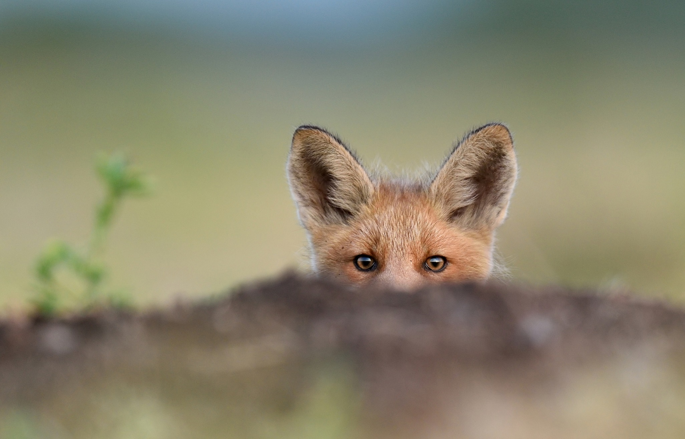
Reporting back and wrap-up
Notes:
Breakout groups take turns to present their findings, ask other groups for observations if necessary– do they align, did they think differently? Why?

Slide 33
We are here to help!
Deep-dive webinars
In-person training
Helpdesk calls
Virtual office hour/
Q&A
Online training
Train-the-trainer
Keep in touch & sign-up: https://wevaluenature.eu/
Exchange with peers (Linkedin group):
We Value Nature - Natural Capital uptake support group
Provide your feedback: Survey
We want to learn too – how have we helped?
Notes:
Presenter to point the delegates towards other resources that they can explore.
What else would you need? What support would you need?
Sign-up for in-person day training
If want support, need to fill out survey (Google form survey)
Refining training further, keen to know how have used this training and catch-up via call (if don’t want to, let us know)

Slide 34
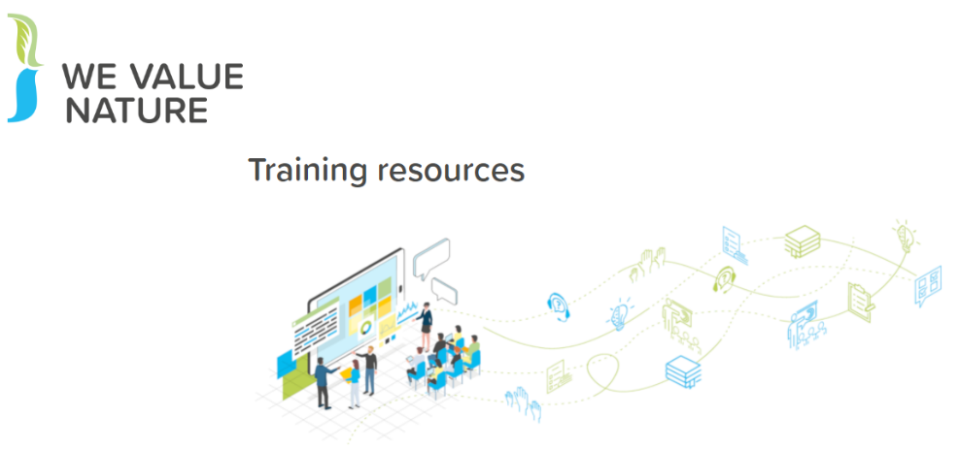
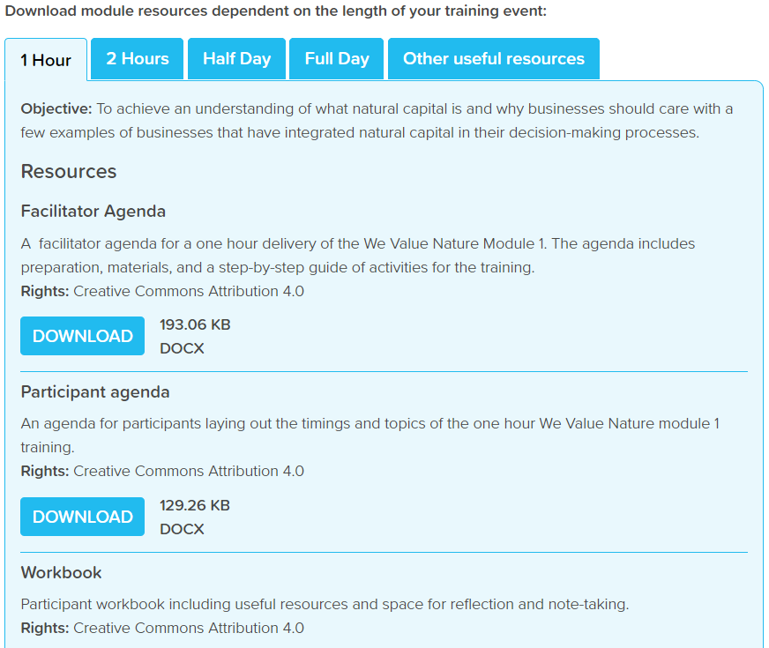
Eager to get started?
Check out NCC’s interactive training videos
Make use of WVN’s training resources
Notes:
Presenter to explain the NCP training videos, using the notes below:
The Capitals Coalition has recently launched a set of training videos that will guide you in an interactive way through a light natural capital assessment to explore just how much can be achieved with limited resources. Interested to learn more? Check out these videos here: https://naturalcapitalcoalition.org/protocol-training/

Slide 35
Notes:
Presenter to conclude the presentation
Disclaimer: The information contained in this report is based on a review of Natural Capital training material in May 2020. The information contained herein is of a general nature and is not intended to address the circumstances of any particular individual or entity. Although we endeavour to provide accurate and timely information, there can be no guarantee that such information is accurate as of the date it is received or that it will continue to be accurate in the future. No one should act on such information without appropriate professional advice after a thorough examination of the particular situation. The We Value Nature Network hereby expressly disclaim all warranties of originality, accuracy, completeness, merchantability or fitness for a particular purpose with respect to any of this information and in no event shall the parties have any liability for any damages of any kind. The citing of trade names, reports, websites does not constitute endorsement. The We Value Nature Network and Little Blue Research Ltd. do not accept any liability for damage arising from the use of these speakers notes and make no representation regarding the advisability or suitability of this to specific business or training needs.

