Slide 1



We Value Nature
Module 2 training
Food & Beverage sector
Scoping a natural capital assessment
2 hour training session
DATE
Notes:
Image source: https://www.pexels.com/nl-nl/foto/akkerland-azie-boer-bouwland-235731/

Slide 2

We Value Nature – Who are we?
We Value Nature is a campaign supporting businesses and the natural capital community to make valuing nature the new normal for business across Europe, by:
Sharing research, resources & best practices;
Identifying barriers & opportunities for adopting a natural capital approach;
Providing practical support to help business improve their risk management, communication & stakeholder engagement;
Reinforcing & boosting the work of the Natural Capital Coalition.
Notes:
Before kicking-off the training, introduce that this training is being given as part of the We Value Nature Campaign and explain what it is, its purpose, objectives and partners involved:
The We Value Nature Campaign is a €2 million EU-funded campaign supporting businesses and the natural capital community across Europe with the aim of making valuing nature the new normal for business. As we will have a chance to explore during today’s training, by valuing nature, businesses can make smarter decisions that benefit themselves, society and the planet as a whole.
The campaign is coordinated by the Institute of Chartered Accountants in England and Wales (ICAEW), World Business Council for Sustainable Development (WBCSD), The International Union for Conservation of Nature (IUCN) and Oppla. And it is supporting the Natural Capital Coalition, which has recently merged with the Social & Human Capital Coalition to become now the ‘Capitals Coalition’.
The campaign will aim to increase the uptake of the natural capital approach (including: natural capital assessment, natural capital accounting, nature-based solutions and green infrastructure) by identifying barriers and opportunities, providing practical support to business through activities (such as webinars, helpdesk calls, etc.) and training such as this one, as well as by inspiring businesses to adopt the NCP.
Take this opportunity to also thank the different stakeholders that supported the training (if relevant).

Slide 3

Module 2 training development – Acknowledging contributors
We Value Nature’s Food & Beverage module 2 training is based on the Natural Capital Protocol and WBCSD’s BET training material.
Module 2 training content and material was developed
in collaboration with Nature^Squared & Little Blue Research Ltd.
Notes:
Natural Capital Protocol: https://capitalscoalition.org/capitals-approach/natural-capital-protocol/?fwp_filter_tabs=training_material
Business Ecosystems Training (BET) training material: https://www.wbcsd.org/Programs/Redefining-Value/Business-Decision-Making/Assess-and-Manage-Performance/BET/Business-Ecosystems-Training
Nature^Squared: https://www.nature-squared.org/
Little Blue Research Ltd.: https://www.littleblueresearch.com/

Slide 4

We Value Nature training is open
You are free to:
Share — copy and redistribute the material in any medium or format.
Adapt — remix, transform, and build upon the material for any purpose, even commercial.
Under the following terms:
Attribution — You must give appropriate credit, link to the licence & indicate if changes were made (but not suggest endorsement).
No additional restrictions — You may not legally restrict others from doing anything the license permits.
CC BY 4.0
Creative Commons Attribution 4.0 International
We Value Nature module 2 (We Value Nature, Nature^Squared and Little Blue Research, Ltd., YEAR) and licensed under CC BY 4.0
Notes:
We Value Nature: https://wevaluenature.eu/
Creative Commons: https://creativecommons.org/licenses/by/4.0/

Slide 5

A few “house rules” – virtual training
Please rename (under Participants) to have your full name and organization.
Put yourself on mute when not taking part in discussions.
But please do feel free to use your camera even when not speaking.
Use "speaker mode" to help focus your attention.
Resist the urge to multi-task and be prepared to engage!
Notes:
Explain that for now are all muted but will unmute when open floor for Qs & discussion – will be flexible with time
Encourage to participate – the more discussions, the more beneficial the VO
Make sure to explain that will be able to write down their Qs directly in the google document
NOT FORGET to mention that we will then share with them the live document, as well as recording

Slide 6
A few “house rules” – in person training
Taking part in discussions but respect people’s views and session timings.
Chatham house rules will apply.
We will be using some quizzes during the session.
Please ask any questions during the presentations and exercises.
Contribute and share your experiences – we can all learn from one another!

Slide 7
We Value Nature’s business training on natural capital – link to M1
Module 1
Understanding natural capital and the relationships with business decision-making & risk management
Module 2
Acquiring the resources & understanding needed to scope a first natural capital assessment
Today’s training
  Understand the concept of natural capital and related risks & opportunities
  Linkages with business decision-making & risk management
  Introduction to a few key approaches
  Identify and measure impact drivers and/or dependencies
  Practical considerations
  Introduction to valuation techniques
Notes:
Module 1 focused on understanding natural capital and the relations with decision-making & risk management.
Module 2 will focus on acquiring the resources & understanding needed to scope a first natural capital assessment. An introduction to valuation techniques is also included in this training.

Slide 8

Learning objectives of module 2
Refer to p. 6 of your workbook
The aim of today’s training is:
To understand how to identify natural capital impacts and dependencies that are important to your business
Acquire the necessary tools, resources and understanding to scope your own assessment
To be introduced to the key practical considerations and steps to take when undertaking a first natural capital assessment as well as some tools to help undertake an assessment
Notes:
The objectives for today are…
Mention that due to limited time, won't go through materiality and valuation but that these are normally included in full version of training.

Slide 9
Agenda – 2 hour training
TO ADAPT
Time (xxx) | Session
15 | Welcome – Agenda, objectives, material & introductions
10 | Setting the scene and a brief re-cap on natural capital
5 | Engaging the supply chain on natural capital
5 | Identifying natural capital impacts & dependencies
30 | Group exercise
10 | Coffee Break
20 | Scoping an assessment – Key steps to take
15 | Practical considerations – Planning an assessment
20 | Optional: Case study presentation
10 | Wrap-up – Key take-aways, wrapping-up

Slide 10
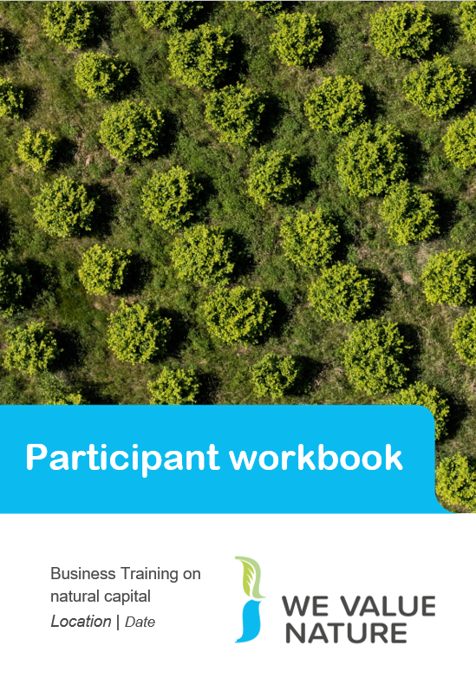




Training material
Take notes!
Executive summary
Full version
Full version
Full version
Notes:
Mention that they should all have a ‘Participant workbook’ and explain that its purpose is to use it throughout the training. We have included in there some of the slides from the training but also additional information. There is space for them to regularly take notes as well as write down their key learnings through each chapter. The aim is that at the end of the training they have a useful resource to look back to when wanting to get started on the natural capital journey.

Slide 11


Introductions

Slide 12
Who is your support team for today?
insert picture of trainer
insert picture of trainer
insert picture of trainer
Name
Name
Name
[insert logo of organization]
[insert logo of organization]
[insert logo of organization]

Slide 13

Introductions – who are you?
Please tell us more by sharing :
  Role
  Any specific expectation(s) for today?

Slide 14
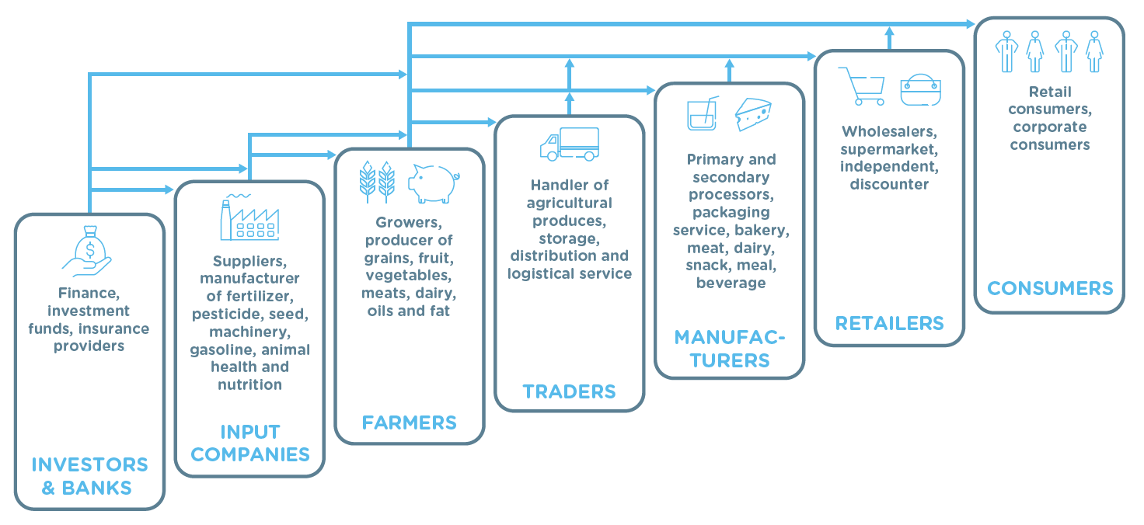
Introductions – who are you?
Please tell us more about you by sharing your:
  Role in the supply chain

Slide 15
Who is in the room?
NAME Company | NAME Company | NAME Company

Slide 16

Introductions
Ice breaker
  Please introduce yourselves by sharing your name, company, role and why you are interested in scoping a natural capital assessment

Slide 17
Agenda – 2 hour training
TO ADAPT
Time (xxx) | Session
15 | Welcome – Agenda, objectives, material & introductions
10 | Setting the scene and a brief re-cap on natural capital
5 | Engaging the supply chain on natural capital
5 | Identifying natural capital impacts & dependencies
30 | Group exercise
10 | Coffee Break
20 | Scoping an assessment – Key steps to take
15 | Practical considerations – Planning an assessment
20 | Optional: Case study presentation
10 | Wrap-up – Key take-aways, wrapping-up

Slide 18
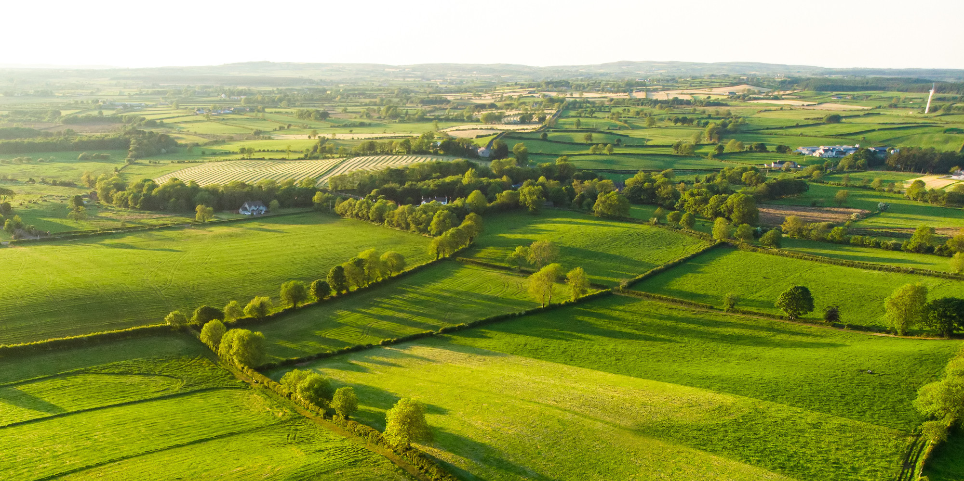
Setting the scene and a brief re-cap on natural capital

Slide 19



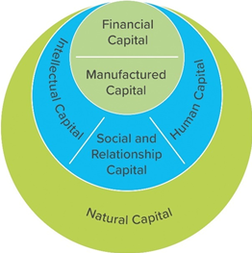





Integrating approaches and linking with other capitals
Refer to p. 7 of your workbook
Business depends on
Natural capital | Social capital | Human capital
Stock of renewable and non-renewable natural resources, (e.g. plants, animals, air water, soils, minerals) that combine to yield a flow of benefits to people | Networks together with shared norms, values and understanding that facilitate cooperation within and among groups. | The knowledge, skills, competencies and attributes embodied in individuals that facilitate the creation of personal, social and economic well-being.
Source: IIRC, Capitals background paper, 2013
Business impacts on
Notes:
Presenter to explain that natural capital should not be approached in isolation and that it is closely interlinked with other capitals (incl. social and human capital).
The International Integrated Reporting Council’s (IIRC) categorization of six capitals.
https://integratedreporting.org/wp-content/uploads/2013/03/IR-Background-Paper-Capitals.pdf
Sustainable development is composed of different ‘’spheres’’ including the natural environment, society and economy. The Stockholm Resilience Institute (2016) represents nature – and natural capital – as the basis of the other development goals. Without a strong natural base, we will not be able to contribute to a resilient economy and just society.
https://www.stockholmresilience.org/research/research-news/2016-06-14-how-food-connects-all-the-sdgs.html
The Natural Capital and Social & Human Capitals Coalition recognized the important linkages between social, human and natural capital, and united their efforts under the Capitals Coalition (2020). The Capitals Coalition works towards transforming the way decisions are made by including the value provided by nature, people & society.
Natural Capital Protocol: https://capitalscoalition.org/capitals-approach/natural-capital-protocol/?fwp_filter_tabs=training_material
Social & Human Capital Protocol: https://capitalscoalition.org/capitals-approach/social-human-capital-protocol/

Slide 20

Knowledge check
How do you define natural capital?

Slide 21
How to use Mentimeter
1
Go to www.menti.com
2
Enter this code: XXXXXX
3
Submit your answer

Slide 22
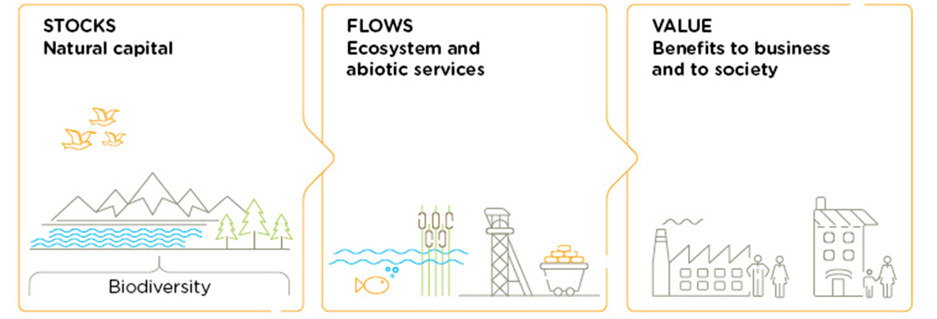
Natural Capital Definition
Refer to p. 8 of your workbook & p. 12 of the Natural Capital Protocol
Natural capital is the stock of renewable and non-renewable natural resources, (e.g. plants, animals, air, water, soils, minerals) that combine to yield a flow of “services” to people. In turn, these flows provide value to business and society.
Biodiversity underpins both stocks and ecosystem services
A rich diversity of plants, bacteria and animals provides a good habitat for bees.
Bees pollinate 87 of the leading food crops worldwide.
Insect pollination can increase crop yield by a quarter.
Notes:
Biodiversity: the variety of plant and animal life in the world or in a particular habitat, a high level of which is usually considered to be important and desirable.
We have started thinking about natural resources an agricultural producer relies and impacts on but what do we mean when we talk about natural capital?
Well in fact, everything you have discussed through the previous example is natural capital is some form or another. Whether it is the assets/resources it represents (such as water and soil you have identified as needed for the farm) or the services it brings.
From climate adaptation to ecosystem services, the environmental jargon is everywhere. What is important, is not to remember all the terminology used, but rather that these are all connected to the value of nature and that people have different entry points and priorities and will use one or another terminology based on that. But fundamentally, we are all speaking about the same things, just in different ways.
This is the definition according to the Natural Capital Protocol. Refer to p. 12 of Natural Capital Protocol.
The stocks refer to the natural resources available to us (biodiversity, plants, animals, water, soils and minerals) while the flows refer to the different benefits people receive from ecosystems such as:
Pollination
Water regulation & purification
Pest control
Climate regulation
Erosion regulation
Nutrient retention
Ecotourism
Abiotic services are benefits to people that do not depend on ecological processes but arise from fundamental geological processes e.g. – supply of minerals, metals and oil and gas, as well as geothermal heat, wind, tides, etc.
In the Protocol biodiversity (part of stocks) is considered to be critical to the health and also the stability of natural capital in so much that it provides resilience to shocks like:
Floods
Droughts
As well as supports fundamental processes such as:
carbon and water cycles
soil formation
Examples of values are fresh water and agriculture (food).
Bee example:
Bees pollinate 87 of the leading food crops worldwide. Insect pollination can increase crop yield by a quarter. (FAO, 2018)
http://www.fao.org/3/i9527en/i9527en.pdf

Slide 23
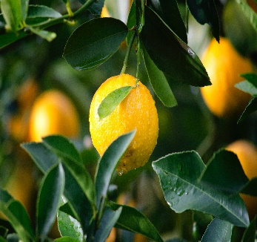


Refer to p. 7 of your workbook
& p. 12 & p. 111 of the
Natural Capital Protocol
Ecosystem Services
Refer to p. 9 of your workbook
& p. 111 of the
Natural Capital Protocol
Ecosystem services are the benefits to people from ecosystems
(e.g. climate regulation, water purification, soil biodiversity, pollination,
timber, recreation, mental health). These services can be categorized into:
Provisioning
Regulating
Supporting
Cultural
Notes:
Presenter to explain ecosystem services using the notes below and referring to p. 12 /111 of the Natural Capital Protocol:
Provide examples of ecosystem services that are relevant to F&B sector (water purification, soil biodiversity, pollination). Provide examples for provisioning, regulating, supporting, and cultural services.
Ecosystems services are the benefits to people from ecosystems, where an ecosystem is defined as the interaction between complex plants, animals and microorganisms and their non-living environment
Examples of ecosystem services include pollination, water regulation & purification, soil biodiversity, pest control, climate regulation, erosion regulation, nutrient retention
Ecosystem services can be classified into provisioning, regulating, cultural and supporting services
Provisioning: material outputs from nature (e.g. fresh water, food) – the F&B sector is highly dependent on water and food to produce their final products.
Regulating: indirect benefits from nature generated through regulation of ecosystem processes (e.g. Erosion prevention and maintenance of soil fertility, pollination, biological control) – processes such as pollination and prevention of erosion improve soil fertility and can positively impact crop quality and yield.
Cultural: non-material benefits from nature (e.g. recreational, ecotourism, educational, spiritual, ethical) – while the benefits of cultural ecosystem services may not always be directly visible, they are part of the larger system around food & beverage production. While these benefits are strongly interlinked, we have provided a dotted line for the services that are most discussed in the F&B sector.
Supporting: fundamental ecosystem processes that support the delivery of other ecosystem services (e.g. nutrient cycling, water cycling) – without these services, the F&B sector would not benefit from the other services provided by the ecosystem such as pollination and fresh water.
Ecosystem services – key distinction between:
Supporting services: fundamental ecological processes that support the delivery of our ecosystem services
Regulating services: indirect benefits from nature generated through regulation of ecosystem processes e.g. – mitigation of climate change through carbon sequestration, water filtration by wetlands, erosion control and protection from storms
There are many classification schemes for ecosystem services including the CICES and the FEGS-CS which measure ecosystem outputs that are directly consumed or used by beneficiaries

Slide 24
Ecosystem Services
Refer to p. 6 of your workbook
Refer to p. 9 of workbook & p. 13
of the Natural Capital Protocol
Provisioning
Goods produced or provided by ecosystems
Food
Fresh water
Timber
Fiber
Biochemicals
Natural medicines
Regulating
Natural processes regulated by ecosystems
Pollination
Climate regulation
Water purification, flow regulation & waste treatment
Erosion regulation
Air quality regulation
Cultural
Intangible benefits obtained from ecosystem services
Recreation
Ecotourism
Spiritual & religious values
Educational
Ethical values
Supporting
Functions that maintain all other services
Nutrient cycling
Water cycling
Primary production
Photosynthesis
Notes:
This slide describes the four categories of ecosystem services and provides examples for each of the categories. The green line highlights the ecosystem services that are particularly relevant for the F&B sector.
Ecosystems services are the benefits to people from ecosystems, where an ecosystem is defined as the interaction between complex plants, animals and microorganisms and their non-living environment
Examples of ecosystem services include pollination, water regulation & purification, soil biodiversity, pest control, climate regulation, erosion regulation, nutrient retention
Ecosystem services can be classified into provisioning, regulating, cultural and supporting services
Provisioning: material outputs from nature (e.g. fresh water, food) – the F&B sector is highly dependent on water and food to produce their final products.
Regulating: indirect benefits from nature generated through regulation of ecosystem processes (e.g. Erosion prevention and maintenance of soil fertility, pollination, biological control) – processes such as pollination and prevention of erosion improve soil fertility and can positively impact crop quality and yield.
Cultural: non-material benefits from nature (e.g. recreational, ecotourism, educational, spiritual, ethical) – while the benefits of cultural ecosystem services may not always be directly visible, they are part of the larger system around food & beverage production. While these benefits are strongly interlinked, we have provided a dotted line for the services that are most discussed in the F&B sector.
Supporting: fundamental ecosystem processes that support the delivery of other ecosystem services (e.g. nutrient cycling, water cycling) – without these services, the F&B sector would not benefit from the other services provided by the ecosystem such as pollination and fresh water.
There are many classification schemes for ecosystem services including the CICES and the FEGS-CS which measure ecosystem outputs that are directly consumed or used by beneficiaries

Slide 25
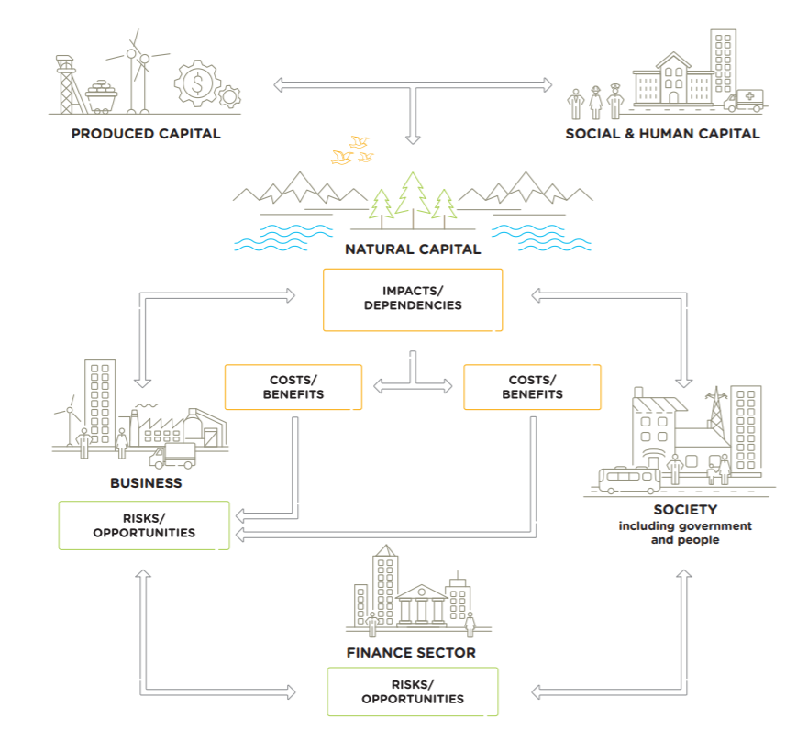
Business depends on & impacts natural capital
Refer to p. 10 of your workbook & p. 15 of the Natural Capital Protocol
All businesses impact and depend upon natural capital.
This relationship delivers costs and benefits back to themselves and to society.
1
These in turn lead to risks and opportunities to the business
2
3
Source: Natural Capital Protocol Food and Beverage Sector Guide, 2016
Notes:
Natural Capital Protocol Food and Beverage Sector Guide, 2016
https://capitalscoalition.org/natural-capital-protocol-food-and-beverage-sector-guide/
All businesses impact and depend upon natural capital
Example impacts: harmful substances used in packaging (waste, greenhouse gas emissions, discharges to soil and water, water extraction)
Example dependencies: health of workers (energy, climate regulation, pollination, materials, erosion and soil regulation, water)
2. This relationship delivers costs and benefits back to themselves and to society.
Example costs: consumers get ill
Examples benefits: increased productivity due to a program of health checks
3. These in turn lead to risks and opportunities to the business
Example risks: operational, reputational and financial risk (Increased raw material or resource costs, New regulations or license fees, Changing customer values)
Example opportunities: operational opportunity (Reduce the costs of resource inputs (e.g. through efficiency gains or switching suppliers), Reduce environmental fees and charges, Growing demand for credibly certified products)
What the examples show (rice example below) is that natural, social and economic issues are fundamentally interconnected and cannot be separated from one another. It also illustrates how natural capital underpins all the other capitals and without it we would not have social and human or financial capital.
Example: rice
1. All businesses impact and depend upon natural capital
Example impacts: water pollutants
Example dependencies: water to flood the rice fields
2. This relationship delivers costs and benefits back to themselves and to society.
Example costs: poor water quality can affect the quality of the rice produced / poor water quality can impact the health of downstream water users
Example benefits: higher quality rice/less absence of employees due to an improved wastewater treatment system
3. These in turn lead to risks and opportunities to the business
Example risks: This may pose operational risks if social conflict over polluted water adds to security costs
Example opportunities: This may also pose societal opportunities if businesses use managed water catchments to improve water quality for local communities

Slide 26
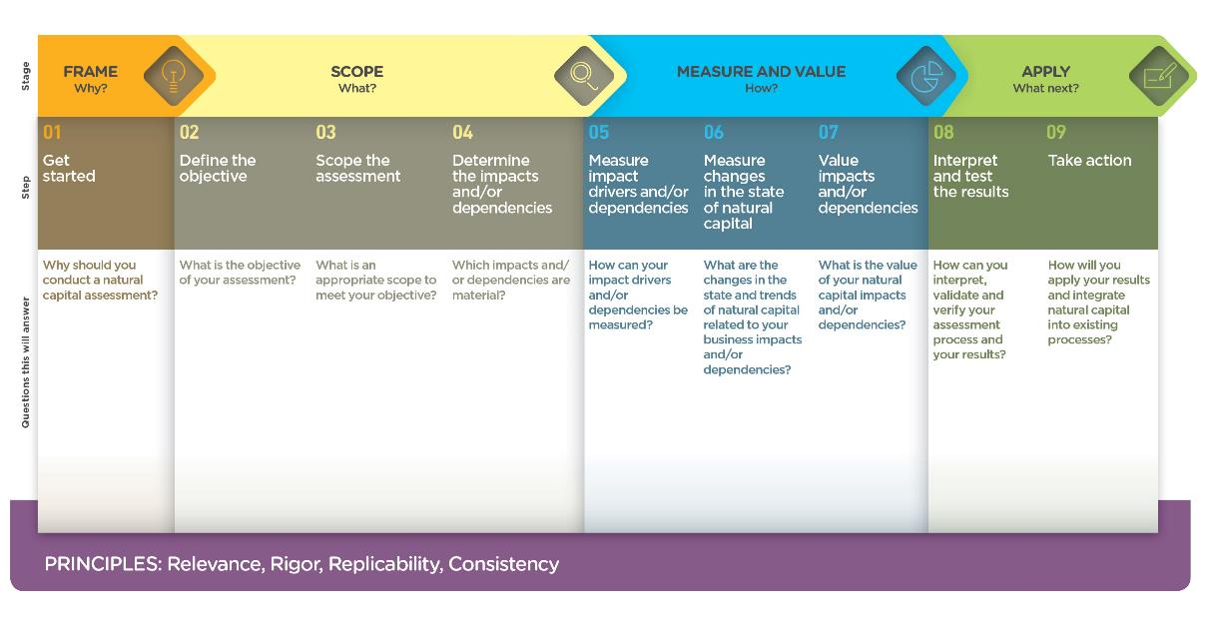
What is the Natural Capital Protocol & how does it work?
Refer to p. 11 of your workbook p. 2 & 6 of the Natural Capital Protocol
The Natural Capital Protocol is an internationally standardized decision-making framework that enables organizations to identify, measure and value their direct and indirect impacts and dependencies on natural capital.
Harmonizing approaches with the goal to
mainstream natural capital into decision-making
processes as to support better informed decisions
and to deliver benefits to employees, society, the
broader economy, and the natural world.
4 stages and 9 steps
Build upon 4 key principles
  Relevance
  Rigor
  Replicability
  Consistency
Notes:
The Natural Capital Coalition is a collaborative space to harmonize approaches to natural capital.
The network represents over 300 organizations across all parts of society and around the world.
Purpose: To mainstream the inclusion of natural capital in decision making, harmonizing approaches and getting them to scale, quickly.
The Natural Capital Protocol: https://naturalcapitalcoalition.org/natural-capital-protocol/
The Protocol aims to support better decisions by taking into account how business interacts with natural capital in decision making. Until now, natural capital has for the most part and still is, being excluded from decisions.
So it is to be understood as a Framework that was really designed to help generate trusted, credible and actionable information that business managers need to inform decisions by identifying, measuring and valuing impacts and dependencies on natural capital.
The Protocol builds upon many approaches already used within business.
It acts as an overarching globally accepted framework to build and expand this information into robust natural capital assessments.
STRUCTURE of the Protocol:
4 overarching stages of frame (why), scope (what), measure and value (how) and apply (so what) and 9 logical steps. It should be easy to follow and should be suitable for any business across any sector or geography.
The stages and steps are iterative so expect that you may need to revisit a previous step.
4 principles:
Relevance: Ensure that you consider the most relevant issues throughout your natural capital assessment including the impacts and/or dependencies that are most material for the business and its stakeholders (adapted from CDSB 2015 and WRI and WBCSD 2004).
Rigor: Use technically robust (from a scientific and economic perspective) information, data, and methods that are also fit for purpose.
Replicability: Ensure that all assumptions, data, caveats, and methods used are transparent, traceable, fully documented, and repeatable. This allows for eventual verification or audit, as required (adapted from GRI 2013).
Consistency: Ensure the data and methods used for an assessment are compatible with each other and with the scope of analysis, which depends on the overall objective and expected application (adapted from WRI and WBCSD 2004 and IIRC 2013).

Slide 27
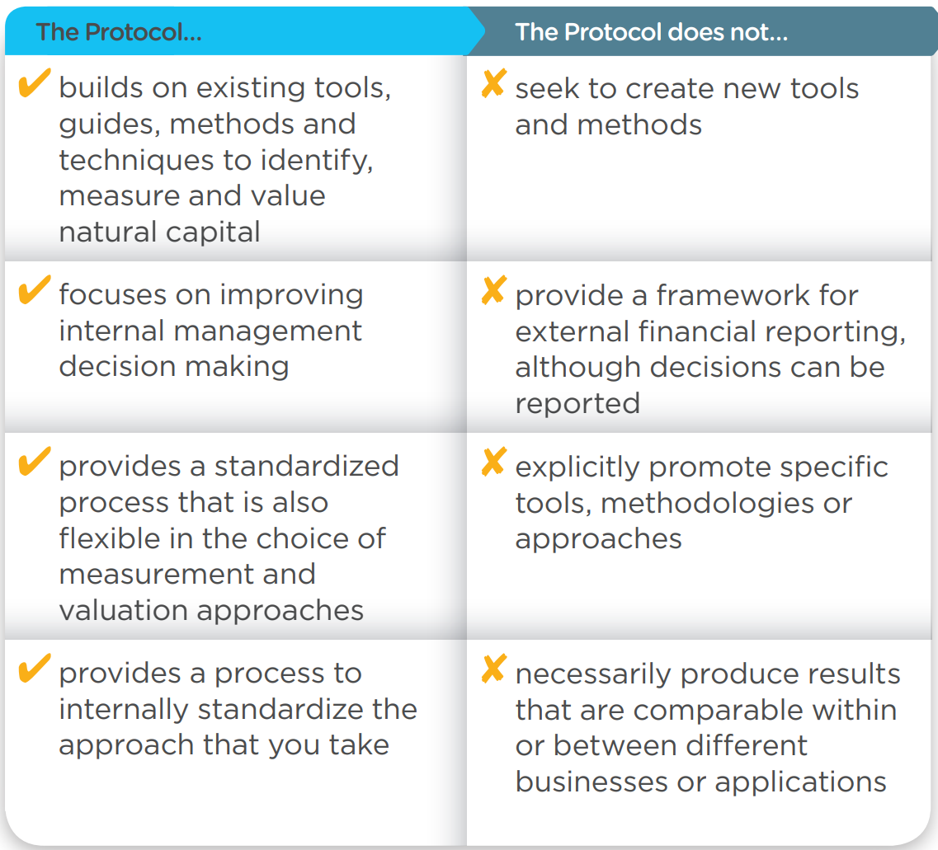
The Natural Capital Protocol
Refer to p. 12 of your workbook
What is it and what is it not?
Principles for undertaking integrated capitals assessments
Principle 1 — Consider all forms of capital and include all relevant capitals
Principle 2 — Take into account the surrounding system and its inter-connections
Principle 3 — Apply an appropriate level of attribution based on your degree of influence
Principle 4 — Present values at an appropriately granular level for the decision being made
Principle 5 — Specify and address key differences in impacts and dependencies amongst all stakeholders
Source: Natural Capital Protocol. A primer for business, 2016
Notes:
Important to note that the NCP as an overarching framework won’t give you actual results. You therefore need to use the Nat Cap toolkit to get tools.
https://naturalcapitalcoalition.org/wp-content/uploads/2016/07/NCC_Primer_WEB_2016-07-08.pdf
Highlight that the aim of the training will focus on the second and third stage of the Protocol: going into measurement and valuation technical details.
Principle 1 — Consider all forms of capital and include all relevant capitals
You should take into account all potentially relevant capitals, based on your organization’s business model, and where any are deemed not relevant, you should state that they are not relevant, and why. This evaluation of relevance should be achieved through undertaking some form of materiality assessment that considers the significance of an issue to your organization and its stakeholders.
Principle 2 — Take into account the surrounding system and its inter-connections
To be recognized as an integrated capitals assessment, adopting a systems-based approach is essential. The relevant system(s) should be considered, in particular the material inter-connections within, and between, the different capitals. This exercise should be initiated in the Frame and Scope Stages of a capitals assessment. Systems in this context include for example landscapes, river basin catchments, the broader working conditions within countries of operation, the networks and stakeholders that may be able to help devise or deliver a solution and the inter-connections between nature, people and organizations within these boundaries.
Principle 3 — Apply an appropriate level of attribution based on your degree of influence
Identifying what you are fully or partially responsible for and the correct level of attribution is challenging but extremely important. There will be some impacts and dependencies that you are clearly responsible for and others where you may only have a limited degree of influence. To understand the extent to which your organization has actually contributed to a particular impact you should consider what would have happened anyway in the absence of your activity (i.e. a counterfactual scenario).
Levels of attribution: direct, partial direct, indirect, enabling
Principle 4 — Present values at an appropriately granular level for the decision being made
The aim of this principle is to ensure that information provided through an assessment is presented at the right level of detail to be useful in decision making. This means showing positive and negative values both for each capital, and within each capital, at a suitably granular level.
Principle 5 — Specify and address key differences in impacts and dependencies amongst all stakeholders
When deciding alternative courses of action, there will inevitably be some form of trade-off between and within the different capitals. The extent of relevant stakeholder groups becomes broader when more than one capital is part of an assessment, so a more comprehensive stakeholder mapping across all capitals is needed.

Slide 28
What parts of the Natural Capital Protocol will we cover?
Module 1
Module 2
Introduction in module 2
Source: Natural Capital Protocol
Notes:
Highlight that the aim of the training will focus on the second (scope) and third stage (measure and value) of the Protocol: going into measurement and valuation technical details.
The Natural Capital Protocol: https://naturalcapitalcoalition.org/natural-capital-protocol/

Slide 29

Why assess your impacts & dependencies? The business case…
p. 13 of your workbook
Many natural capital risks and opportunities are becoming increasingly visible, and businesses need a way to understand and manage these.
Understand relationships with nature in a structured way
Challenge your business model
Mitigate risks
Increased competitive advantage
Create opportunities
Inform decisions that are really important to your business
Access to finance
Recruitment & retention of staff
Source: Natural Capital Protocol
Notes:
There are evidently a lot of pertinent risks around nature and the environment facing businesses today. Where does natural capital come into this - how can it help you manage these risks?
To assess natural capital is to assess your company’s impacts and dependencies on nature.
It provides information that will help you to understand your relationship with nature. By focusing on impacts and dependencies, natural capital provides structure to this understanding.
Once you have a better understanding of your relationship with nature, you can use this to challenge your business model, mitigate risks and create opportunities. Natural capital can also be a valuable tool for broadening the conversation to include all parts of your business, including the finance team.

Slide 30
Linkages with other key concepts
Refer to p. 14 of your workbook
A lot of synergy exists between various concepts and efforts can often be aligned to contribute to several goals.
Natural capital can be seen as an additional lens which allows you to uncover important issues for your organizations sustainability journey and connect the dots between various ongoing sustainability efforts.
Download through WeValueNature - Digital media library
Notes:
UNDERSTANDING NATURAL CAPITAL
A lot is happening on sustainability and that can be overwhelming. Luckily, a lot of synergy exists between various concepts and efforts can often be aligned to contribute to several goals. In this infographic we aim to illustrate how natural capital is linked to many sustainability concepts that your company may already be working on.
Even if natural capital is a relative new concept to you or your organizations, you will find it is closely linked to other things you are already familiar with. Natural capital can be seen as an additional lens which allows you to uncover important issues for your organizations sustainability journey and connect the dots between various ongoing sustainability efforts. This infographic explains for each concept, goal, methodology, scheme or framework what it is and how it is linked to natural capital.
The infographic can be downloaded on the We Value Nature – Digital media library: https://wevaluenature.eu/media-item/305

Slide 31
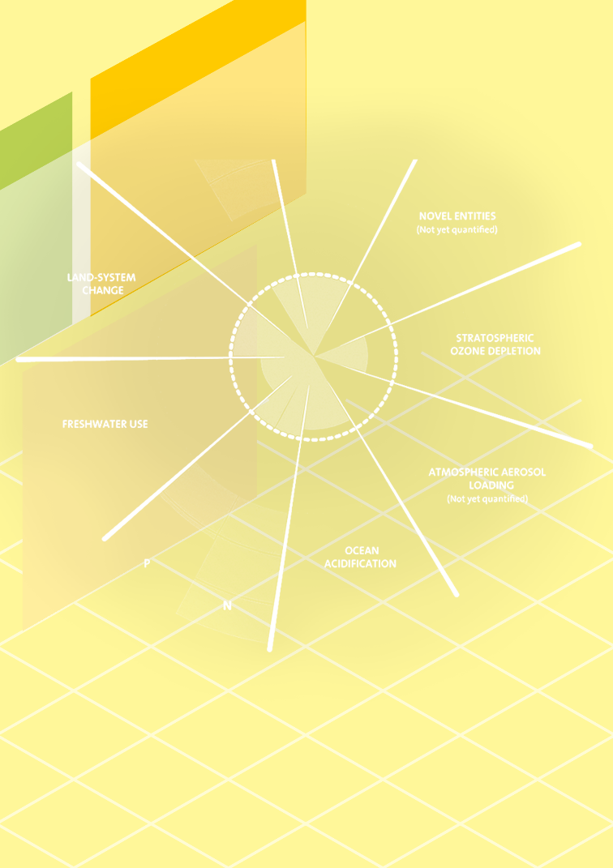
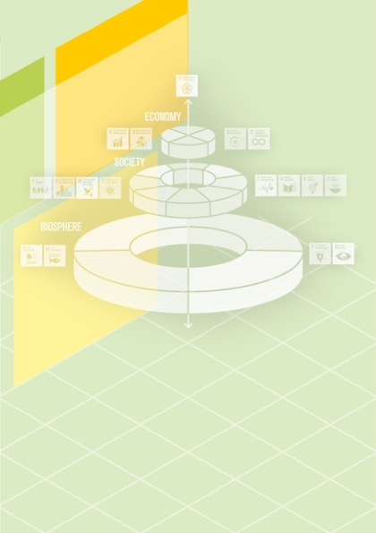

Linkages with other key concepts: examples
Find more quick reference cards through the We Value Nature’s digital media library
PLANETARY BOUNDARIES
SUSTAINABLE DEVELOPMENT GOALS
ACCOUNTING & REPORTING STANDARDS
Planetary boundaries are a concept developed by Rockström of the Stockholm Resilience Centre, stating that earth has natural boundaries within we must operate. Crossing these boundaries may be catastrophic because this may cause abrupt environmental change within continental-scale to planetary-scale systems. The largest overshoot of these boundaries is currently occurring on the nutrient cycle, biodiversity and climate change.
Natural capital assessments provide insight into how your company is performing against these ecological ceilings. If you are already reporting against indicators for the planetary boundaries, you already have performed at least a partial natural capital assessment.
The Wedding Cake Model orders the Sustainable Development Goals (SDGs) across three layers: the biosphere, the sociosphere and the economic sphere.
This model indicates the conditionality and hierarchy between the goals. The bottom layer (biosphere), consisting of Clear Water (6), Climate Action (13), Life Below Water (14) and Life on Land (15), forms a foundation for the layers above.
If your company is already committed to the SDGs, securing goals 6, 13, 14 and 15 is essential to achieve the other goals. By working on natural capital, you are contributing to these goals and the SDGs as a whole.
There is a wide variety of accounting and reporting standards that focus on the disclosure of information beyond financial information only. These standards help improve transparency and accountability and help generate value creation within the organization. A great number of accounting and reporting standards have emerged over the years. Some of these frameworks include various capitals such as the Global Reporting Initiative (GRI) framework (indicators on natural capital include G4-EN1 - G4-EN34), but also Integrated Reporting (IR) and Sustainability Accounting Standards Board (SASB), which will be merged into the new Value Reporting Foundation in the foreseeable future. Other standards are focused specifically on measuring natural capital such as the CDP and Accounting for Nature, or reporting on natural capital such as the Climate Disclosure Standards Board (CDSB) which equates natural capital with financial capital.
Notes:
These are three examples of concepts. All key concepts can be found via this link: https://wevaluenature.eu/media-item/305
Planetary Boundaries: Planetary boundaries are a concept developed by Rockström of the Stockholm Resilience Centre, stating that earth has natural boundaries within we must operate. Crossing these boundaries may be catastrophic because this may cause abrupt environmental change within continental-scale to planetary-scale systems. The largest overshoot of these boundaries is currently occurring on the nutrient cycle, biodiversity and climate change. Natural capital assessments provide insight into how your company is performing against these ecological ceilings. If you are already reporting against indicators for the planetary boundaries, you already have performed at least a partial natural capital assessment.
https://www.stockholmresilience.org/research/planetary-boundaries.html
Sustainable Development Goals: The Wedding Cake Model orders the Sustainable Development Goals (SDGs) across three layers: the biosphere, the sociosphere and the economic sphere. This model indicates the conditionality and hierarchy between the goals. The bottom layer (biosphere), consisting of Clear Water (6), Climate Action (13), Life Below Water (14) and Life on Land (15), forms a foundation for the layers above. If your company is already committed to the SDGs, securing goals 6, 13, 14 and 15 is essential to achieve the other goals. By working on natural capital, you are contributing to these goals and the SDGs as a whole.
https://www.stockholmresilience.org/research/research-news/2016-06-14-how-food-connects-all-the-sdgs.html
Integrated Reporting / SASB: Integrated Reporting is a reporting standard that considers several (financial, manufactured, human, intellectual, natural and social) capitals, and aims to provide an integrated overview of how companies create value. The SASB reporting standard connects businesses and investors on the financial impacts of sustainability. These frameworks will be merged into the new Value Reporting Foundation in the foreseeable future. Within this framework, Natural Capital is one of the key capitals to report on. Performing a natural capital assessment is a way to implement this framework on the element of natural capital.
https://integratedreporting.org/news/iirc-and-sasb-announce-intent-to-merge-in-major-step-towards-simplifying-the-corporate-reporting-system/

Slide 32
Agenda – 2 hour training
TO ADAPT
Time (xxx) | Session
15 | Welcome – Agenda, objectives, material & introductions
10 | Setting the scene and a brief re-cap on natural capital
5 | Engaging the supply chain on natural capital
5 | Identifying natural capital impacts & dependencies
30 | Group exercise
10 | Coffee Break
20 | Scoping an assessment – Key steps to take
15 | Practical considerations – Planning an assessment
20 | Optional: Case study presentation
10 | Wrap-up – Key take-aways, wrapping-up

Slide 33

Engaging the supply chain on natural capital
Notes:
https://www.pexels.com/photo/crop-ethnic-woman-with-basket-of-apples-5529527/

Slide 34
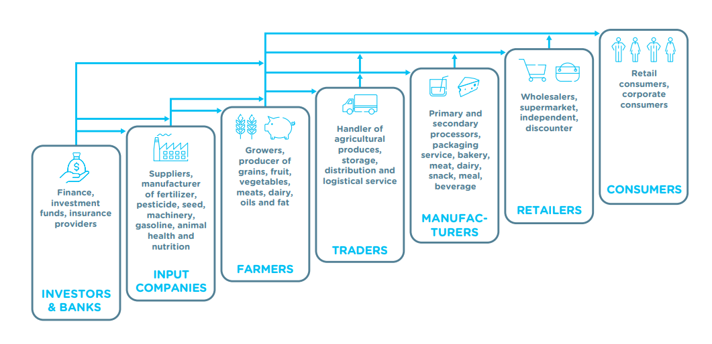
Engaging farmers towards a sustainable F&B sector
Refer to p. 15 of your workbook
Like in many other sectors, supply chains in the food & beverage sector can be complex.
Every actor in the supply chain has a role to play in realising a sustainable food & beverage sector.
Businesses in different parts of the supply chain do not operate independently from each other – they are strongly interlinked.
For most companies, engaging with farmers is key as they are important leverage points for becoming more sustainable.
Source: Capitals Coalition, TEEB for agriculture and food: operational guidelines for business, 2020
Notes:
Like in many other sectors, supply chains in the food & beverage sector can be complex.
Most supply chains are composed of a variety of actors, including input companies, farmers, traders, manufacturers, retailers and consumers.
Every actor in the supply chain has a role to play in realising a sustainable food & beverage sector.
E.g. farmers produce the raw materials which are consequently transformed into final products. On the end of the chain – downstream – are the consumers who buy the final products.
Businesses in different parts of the supply chain do not operate independently from each other – they are strongly interlinked.
Most supply chains are highly efficient: different actors along the supply chain work closely together, moving the product down through the chain up to the consumer.
For most companies, engaging with farmers and consumers is key as they are important leverage points for becoming more sustainable.
- Mouse click to make the blue arrows appear.
Source: Capitals Coalition, TEEB for agriculture and food: operational guidelines for business, 2020:
https://capitalscoalition.org/teebagrifood-operational-guidelines-for-business-launch/

Slide 35
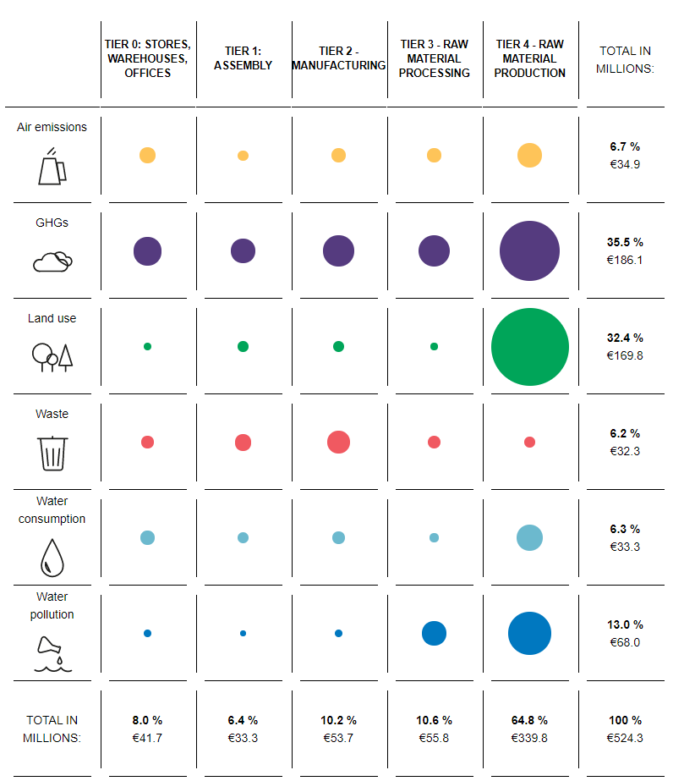
Why engaging with farmers on natural capital?
The food and beverage sector is highly dependent on healthy and productive farmlands for the continuity of supply.
When it comes to impact, the largest impact often occurs on the level of primary production (i.e. farming): Kering (2019), an industry leader in the textiles industry, published a ground-breaking report on the environmental impacts along their supply chain and found that the production and processing of raw materials together represent 76% of the total environmental impacts.
Source: Kering (2019)
Notes:
The food and beverage sector is highly dependent on healthy and productive farmlands for the continuity of supply.
- McKinsey & Company, 2016: https://www.mckinsey.com/business-functions/sustainability/our-insights/starting-at-the-source-sustainability-in-supply-chains
GrainCorp, a large Australian agriculture business, reported that a drought cut its grain deliveries by 23%, leading to a 64% drop in 2014 profits. Unilever estimates that it loses some €300 million per year as worsening water scarcity and declining agricultural productivity lead to higher food costs.
- Kering report 2019: https://kering-group.opendatasoft.com/pages/report-2019/
The figure shows how the Group's environmental impacts across the supply chain are distributed. We see that the Group's most significant impacts are generated in the supply chain (92%), and in particular from the production and processing of raw materials that together represent 76% of the total environmental impacts. Kering's own operations represent only 8% of the impacts.

Slide 36
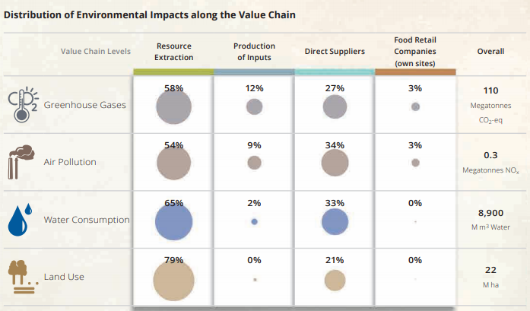
Why engaging with farmers on natural capital?
Refer to p. 16 of your workbook
Similar to the textiles sector, within the F&B sector the main impacts are also at the level of farmers.
  E.g. looking at greenhouse gasses, there is a high concentration at farm level.
Hence, there lies a huge opportunity for sustainable change at the level of agricultural production.
Source: Systain & Adelphi, Atlas on Environmental Impacts Supply Chains, 2017
Notes:
The story is not very different for the Food & Beverage sector. Environmental impacts are unequally distributed along the food chain with a high concentration at the level of agricultural production. This is the case for almost all food products (e.g. Beef, rice, coffee).
Source: Systain & Adelphi, Atlas on Environmental Impacts Supply Chains, 2017:
https://www.adelphi.de/en/publication/atlas-environmental-impacts-supply-chains
Ourworldindata, 2020: https://ourworldindata.org/environmental-impacts-of-food

Slide 37
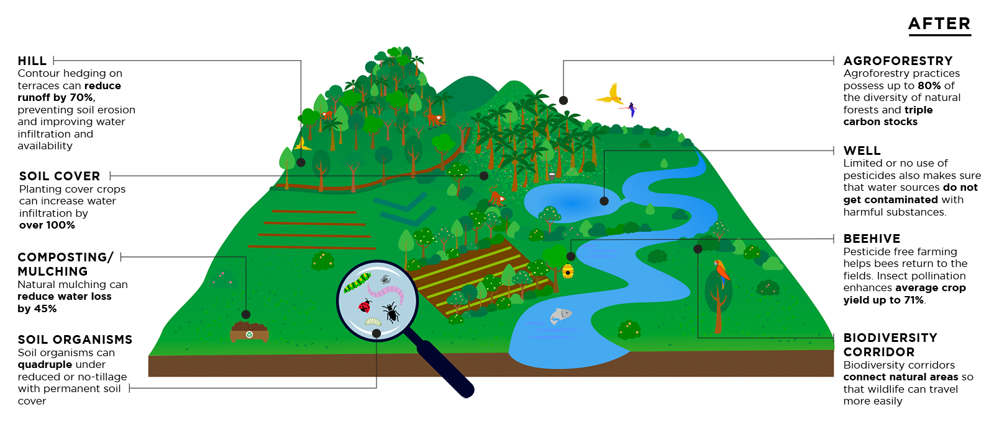
How does a sustainable production landscape look like?
Source: Nature^Squared
Notes:
An infographic that shows how a sustainable production landscape may look like, by visualizing practices that have a positive impact on i.e. soil, water, biodiversity, air and climate.
Source: http://www.nature-squared.org/

Slide 38
How to organize sustainable change at farm level?
Refer to p. 17 of your workbook
Cooperation and partnerships
Can be formed around specific commodities or themes.
Pre-competitive – focus on mutual learning and jointly addressing challenges through shared solutions.
Certification and standards
Third-party verification enhancing accountability.
Particularly beneficial for ‘’commodity’’ supply chains – indirect sourcing.
Implementing Sustainability Standards in your company’s supply chain
Exercising more control over your supply chain e.g. by changing your sourcing model, drafting sustainability supplier requirements, and providing support to farmers.
Notes:
Categorization based on SAI report (2015) Sustainable Sourcing of Agricultural Raw Materials: a Practitioner’s guide:
“https://saiplatform.org/wp-content/uploads/2019/04/sai-sustainable-sourcing-guide-_june-2015.pdf
The report is produced in collaboration with IMD, CSL, International Trade Centre, IDH the Sustainable Initiative with support from BSR, Sedex and the Sustainable Food Laboratory.
Strategies can also be combined.

Slide 39
How to engage with farmers on the topic of natural capital?
Refer to p. 17 of your workbook
Refer to p. 17 of your workbook
When discussing natural capital, it is key to bring farmers into the discussion. “Bring in the supply side companies to talk about challenges and solutions at farm level” (Ruth Thomas, director Global Agribusiness Alliance (GAA)). Also leverage their local knowledge of the area when addressing issues such as biodiversity, water, etc.
Natural capital may not be the best entry point for a conversation. Rather, focus on the day-to-day realities farmers face – what specific issues are they confronting? What is urgent to them? “Be specific. Talk about soil or water for example. Do not use jargon” (Jane Duncan, SAI Platform).
In a conversation, be clear about what natural capital is e.g. an integrated approach that includes so many areas that farmers are already working on. “You want to avoid is creating confusion by bringing in too many concepts” (Jane Duncan, SAI Platform). Start with practical on the ground issues that relate to other capital themes (e.g. biodiversity, air, climate).

Slide 40
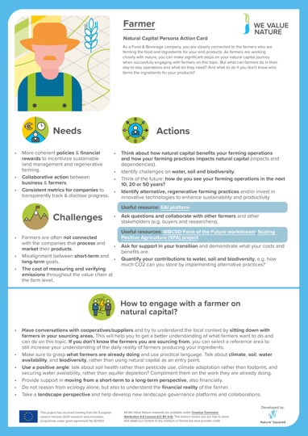
How to engage with farmers on the topic of natural capital?
On We Value Nature’s website, you can find action cards describing useful actions for a farmer & ways to engage others in the company on natural capital.
Notes:
All action cards can be retreived through: https://wevaluenature.eu/media-item/307

Slide 41

Mentimeter
Refer to p. 18 of your workbook
What top 2 risks at farm level have you identified for your company?
How does your business organize sustainable change at farm level?
Notes:
First ask respondents about the top 2 risks that they see for their company at farm level?
The next question revolves around how they organize sustainable change at farm level, using the categories as explained in the previous slides:
- Industry wide cooperation & partnerships
- Standards and certification
- Implementing sustainability requirements in company’s supply chain
- Other

Slide 42
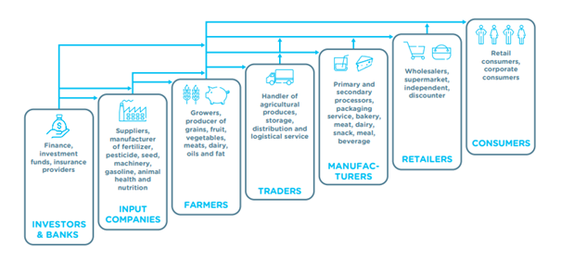
Moving to the other end of the supply chain: the consumer
Refer to p. 19 of your workbook
Moving downstream the supply chain, businesses engage with consumers who buy their food & beverage products.
Here is where the marketing of your sustainability efforts take place and where consumers reward your efforts by buying your products.
Source: Capitals Coalition, TEEB for agriculture and food: operational guidelines for business, 2020
Notes:
Presenter to explain why businesses should engage with consumers on the topic of natural capital.
Consumers are the actors in the supply chain who eventually buy the F&B products.
Finding a market for sustainably produced products is important for your business. It is therefore key to engage consumers on the topic of natural capital.
TEEB FOR AGRICULTURE AND FOOD: OPERATIONAL GUIDELINES FOR BUSINESS, 2020:
https://capitalscoalition.org/teebagrifood-operational-guidelines-for-business-launch/

Slide 43
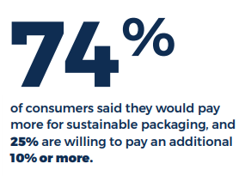
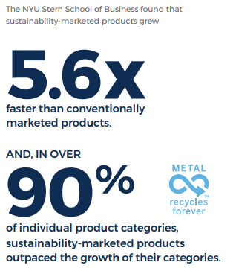
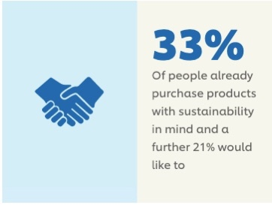
Relevant consumer trends
Refer to p. 19of your workbook
Refer to p. 19 of your workbook
Sustainability-marketed products grow faster than
conventionally marketed products, especially in the food sector:
  According to an EU retail survey (2019) food products showed the highest growth of sustainable product sales (18,3%) (in 5 years)
One in three consumers already purchase products with sustainability in mind.
Transparency is highly valued. The Transparency Imperative report (2018) found that the vast majority of consumers (69%) say it is (extremely) important that brands and manufacturers provide detailed information such as what is in their food and how it is made.
Although consumers mention that they’re willing to change their behavior, a gap between what people say and what people do still exists.
  A Harvard Business review survey (2019) showed that 65% said they want to buy purpose-driven brands that advocate sustainability, yet only about 26% actually do so.
Source: Trivium packaging (2020)
Source: Unilever (2020)
Notes:
Presenter to explain that there are positive consumer trends on natural capital.
Consumers find it increasingly important to buy products that are produced sustainably. The market for sustainable products is now growing faster than the market for conventional products.
However, we still see a mismatch in what people say and how they act (in the supermarket).
Harvard Business review 2019 survey
https://hbr.org/2019/07/the-elusive-green-consumer#:~:text=In%20one%20rec
The European Union market for sustainable products (2019)
https://www.intracen.org/publication/The-European-Union-market-for-sustainable-products/
FMI-Label Insight (2018):
https://www.fmi.org/blog/view/fmi-blog/2018/09/21/transparency-can-impact-the-bottom-line
Unillever (2020) – Consumers and sustainability
https://www.unilever.com/sustainable-living/our-strategy/consumers-and-sustainability/ent%20survey%2065,about%2026%25%20actually%20do%20so.&text=We%20have%20been%20studying%20how,marketing%2C%20economics%2C%20and%20psychology.
2020 Global Buying Green Report
https://triviumpackaging.com/sustainability/2020BuyingGreenReport.pdf

Slide 44




How to engage consumers on natural capital?
Useful resource:
WBCSD: Food & Agriculture Roadmap – Chapter on policy recommendations from a consumer perspective
Refer to p. 20 of your workbook
Third–Party Certification
Storytelling
Blockchain technology
True Cost Accounting
Useful mechanism to communicate wider sustainability efforts.
Helps build credibility towards consumers as the sustainability performance has been verified by an external party.
Labelling is an effective instrument to guide consumer choices if done in a clear manner.
Strong in communicating a narrative that helps to emotionally connect consumers to your product.
Particularly helpful to communicate about specific sustainability activities, above industry standards.
Often not externally verified.
Providing far-reaching transparency on the product’s supply chain.
Effective in communicating information on pricing and quality.
Its strong traceability helps create trust among consumers.
Strong in informing people about a wide range of sustainability aspects related to a product.
Putting a price on social and environmental issues to influence consumer choices.

Slide 45
Mentimeter
Refer to p. 20 of your workbook
What top 2 challenges do you face in marketing your sustainability efforts?
How does your business engage with consumers?
Notes:
First ask respondents about the top 2 risks that they face in marketing their sustainability efforts.
The next question revolves around how they engage with consumers, using the categories as explained in the previous slides:
Third party certification
Storytelling
Blockchain technology
True cost accounting
Other

Slide 46
Agenda – 2 hour training
TO ADAPT
Time (xxx) | Session
15 | Welcome – Agenda, objectives, material & introductions
10 | Setting the scene and a brief re-cap on natural capital
5 | Engaging the supply chain on natural capital
5 | Identifying natural capital impacts & dependencies
30 | Group exercise
10 | Coffee Break
20 | Scoping an assessment – Key steps to take
15 | Practical considerations – Planning an assessment
20 | Optional: Case study presentation
10 | Wrap-up – Key take-aways, wrapping-up

Slide 47
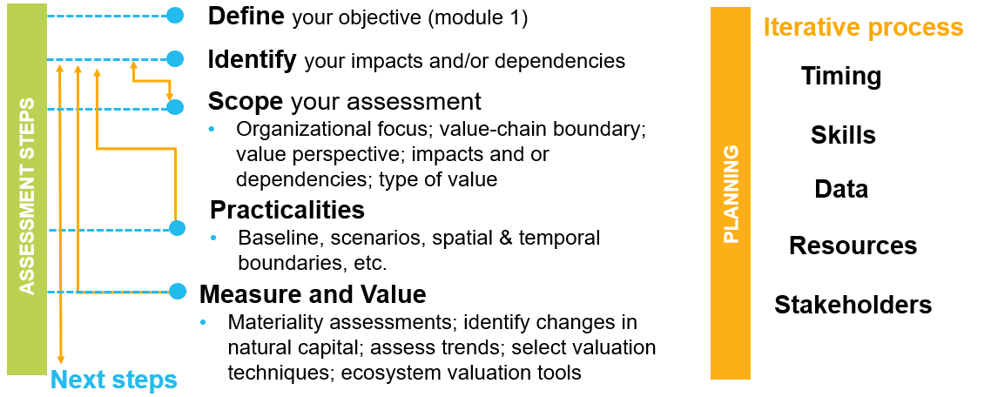
Concrete steps to undertaking a 1st natural capital assessment
Refer to p. 21 of your workbook
Notes:
Presenter to explain the steps to undertaking a 1st natural capital assessment using the diagram on the slide.

Slide 48

Identifying your natural capital impacts & dependencies
Impact drivers and dependency pathways

Slide 49
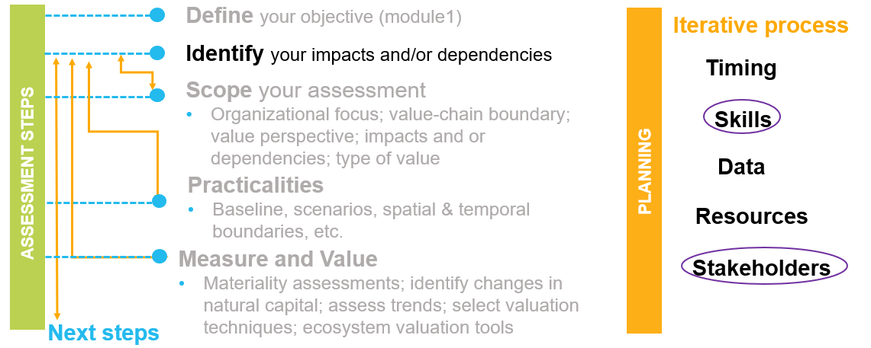
Concrete steps to undertaking a 1st natural capital assessment
Notes:
Presenter to explain the steps to undertaking a 1st natural capital assessment using the diagram on the slide. Presenter to explain that defining the objective has been explained in module 1. The next step is identifying your impacts and/or dependencies.
Collecting this information may involve:
• Seeking expert opinion and/or analysis, or leveraging existing information (e.g., results of an environmental impact assessment) and local knowledge of key issues;
• Consulting stakeholders (internal and/or external) (e.g., interviews, workshops, questionnaire surveys);
• Compiling publicly available information on specific issues (e.g., case studies from relevant locations, land-use maps, species threat assessments);
• Conducting a rapid assessment of value (e.g., what proportion of total sales revenue depends upon a specific ecosystem and/or abiotic service? What is the financial value of the production asset involved?); and, where available,
• Referring to dedicated sector guidance (e.g., sector guides accompanying the Natural Capital Protocol).
It is recommended to establish a panel of relevant people with a broad range of skills to complete the materiality assessment, and to ensure the panel is consistent throughout the assessment.

Slide 50
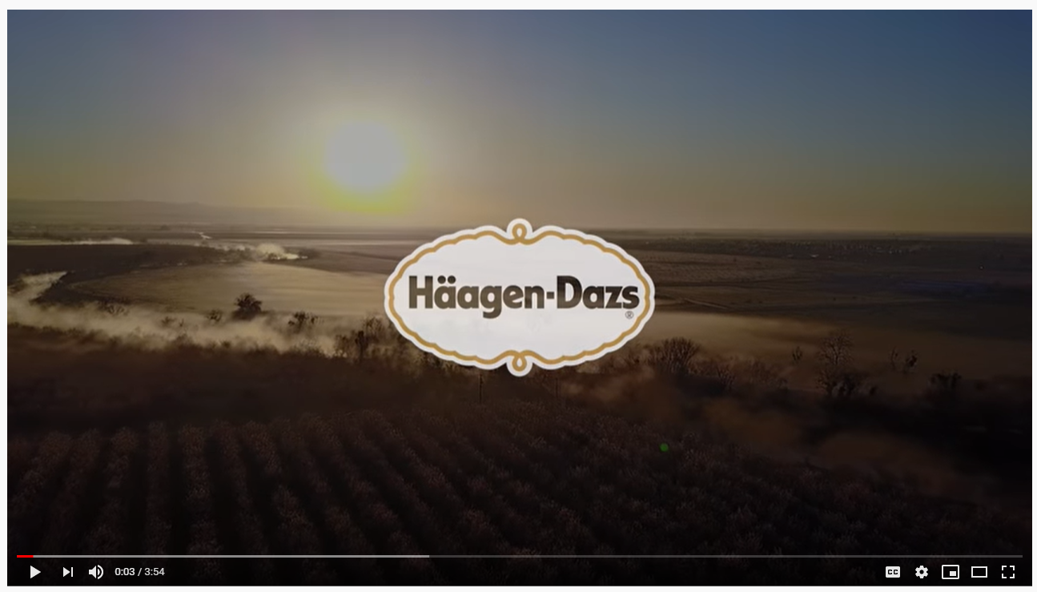
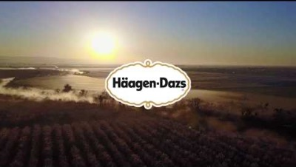
Optional video – practical example of impacts/dependencies
Source: example from Haagen-Dazs on their honeybees pollinator habitat project
https://www.youtube.com/watch?v=qtgm-3EQOU4
Notes:
Source: example from Haagen-Dazs on their honeybees pollinator habitat project
https://www.youtube.com/watch?v=qtgm-3EQOU4

Slide 51
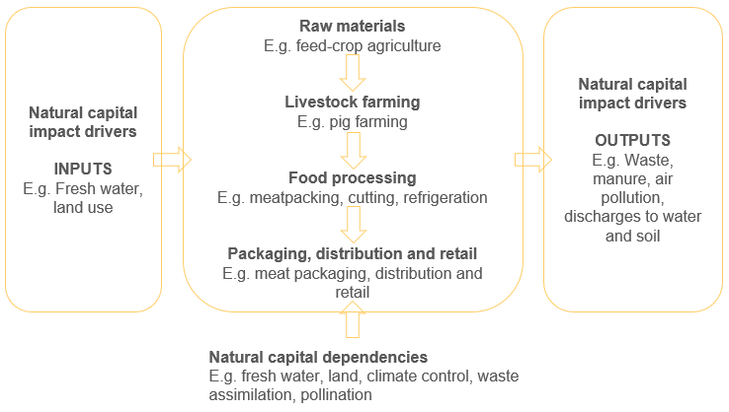
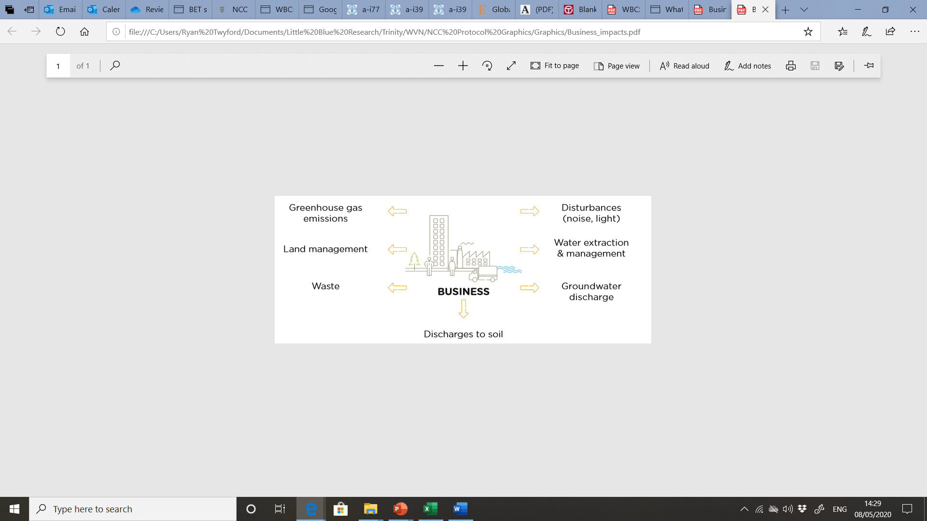
Natural capital impacts & impact drivers
Refer to p. 23-24 of your workbook & p. 16 of the Natural Capital Protocol
The negative or positive effect of business activity on natural capital
Notes:
Presenter to provide detail on natural capital impacts using the notes below and referring to p. 16 of the Natural Capital Protocol:
The Protocol defines a natural capital impact as: The negative or positive effect of business activity on natural capital. They can arise directly from business operations or indirectly from the use of products and services. As a result of your impact on natural capital you can generate impacts on your business as well as impacts on society.
Presenter to link natural capital impacts with the risks and opportunities material covered in M1, using the notes below. Presenter to elaborate on the business impact diagram, using some examples:
Thinking back to some of the content in M1, we can see how natural capital impacts can pose different risks and opportunities for businesses.
GHG emissions e.g. transportation, primary production
This may pose societal risks for businesses due to the health risks arising from the effect of air pollution on respiratory disease
On the other hand, this could pose a reputational and marketing opportunity due to new revenue streams offered in areas like carbon offsetting
Land management e.g. forest management
This may pose an operational risk by increasing natural hazard costs through degradation of natural ecosystems
This may also pose an operational opportunity if businesses invest in sustainable and green land management, reducing costs by protecting against natural hazards and contributing to tackling the loss of biodiversity
Waste e.g. post-consumer waste
This may pose legal and regulatory risks if new laws or license fees are established, charging more for waste disposal
This may also pose an operational opportunity for businesses if they minimise or add value to waste and recapture valuable materials otherwise discarded
Discharges to soil e.g. fertilizers & pesticides
This may pose a financial risk if the business’ sales fall due to negative publicity about the business’ impacts on natural capital
Groundwater discharge e.g. wastewater
This may pose operational risks if social conflict over polluted water adds to security costs
This may also pose societal opportunities if businesses use managed water catchments to improve water quality for local communities
Water extraction and management e.g. factory equipment cleaning
This may pose a financial opportunity if businesses alter the way in which they go about water extraction, thus attaining ”green funds” or investor interest in sustainability
Disturbances e.g. heavy machinery operation
This may pose societal issues again as wider society is impacted negatively from heightened noise and light
Links to risk – read one example from module 1
Reputation risk – increased public & consumer awareness of environmental and social damages + consumers are increasingly demanding assurance that the products they buy are produced in way that protect our environment (link to pollution)
Legal risk – California looks set to regulate groundwater for the first time
Source: https://www.theguardian.com/sustainable-business/2014/sep/03/california-drought-water-groundwater-regulation-bill-law-farm
Financial risk – Underlying all of these risks & opportunities are financial ones! As we have seen, these risks imply important financial costs. Oatly, the plant-based brand, is facing consumer backlash following a recent investment round led by Blackstone – a name muddied by alleged ties with deforestation in the Amazon.
Source: Food Navigator (2020) https://www.foodnavigator.com/Article/2020/09/04/Oatly-cancelled-Fans-pledge-boycott-over-contentious-shareholder-Blackstone?utm_source=copyright&utm_medium=OnSite&utm_campaign=copyright
Campaigners defeat Coca-Cola plant in South India because it would worsen the already existing water shortages in the area and bring more pollution into the area.
Source: The Ecologist (2015) https://theecologist.org/2015/apr/21/campaigners-defeat-coca-cola-plant-south-india
Links to opportunity
Operational opportunity – Adnams, a beer producing company in the UK, implemented rainwater harvesting and grey water recycling systems. The company uses around three pints of water for every pint of beer produced: that's almost half the industry average.
Source: https://www.theguardian.com/sustainable-business/localism-water-security-food-drink-industry (2012)
Reputation opportunity – Heineken’s goal is to be fully circular by 2030, with breweries that are completely climate neutral.
Source: https://www.foodbev.com/news/heineken-beer-in-the-netherlands-brewed-with-green-energy/ (2020)

Slide 52
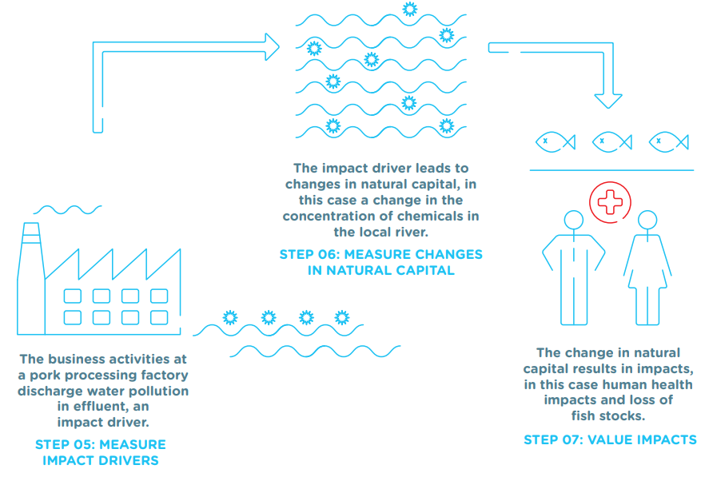
Impact pathway
Refer to p. 23
of the F&B Sector Guide
Notes:
Presenter to then walk through the sugarcane example using the notes below and referring to p. 24 of the F&B sector guide:
https://capitalscoalition.org/natural-capital-protocol-food-and-beverage-sector-guide/
Business activities at a sugarcane plantation have a dependency on water to irrigate the crops.
Changes in natural capital cause the availability of water to decline due to:
Sugarcane farming itself, for example over-abstraction of water
Natural changes such as drought
Human-induced changes including other local farms and businesses abstracting water for their own purposes
The company may be paying more for the water now, but at some point it may no longer have access to water in the area, no matter how much it costs - and this puts the company at risk, not just the cost of doing business.
Changes in natural capital affect business dependency (by paying more for water to out-compete other users), so water availability is important.

Slide 53
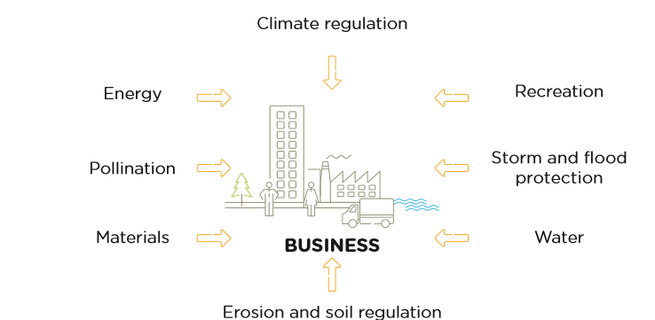
Natural capital dependencies
Refer to p. 22 of your workbook & p. 17
of the Natural Capital Protocol
A business reliance on or use of natural capital
Notes:
Presenter to provide detail on natural capital dependencies using the notes below and referring to p. 34 of the Natural Capital Protocol:
The protocol defines natural capital dependency as: A business reliance on or use of natural capital. This can occur in your direct operations or somewhere else in your value chain.
Presenter to link natural capital dependencies with the risks and opportunities material covered in M1, using the notes below. Presenter to elaborate on the business impact diagram, using some examples:
Again, thinking back to some of the content in M1, we can see how natural capital dependencies can pose different risks and opportunities for businesses. This is useful in establishing the value of natural capital dependencies in relation to other inputs and services that you rely on.
Energy e.g. energy as a critical production input in a factory
A reliance on energy may pose financial risks due to volatilities in the energy market which could impose higher costs on the business
This could also open up financial opportunities if “green funds” become available for more renewable energy sources
Pollination e.g. regulating service critical in agriculture
This may pose an operational risk for agricultural sectors if pollination services start to vary
Materials e.g. reliance on food crops
This may pose a societal risk if local communities start to experience reduced access to woodland or related ecosystem services as a result of business activities
This may pose a societal opportunity if local communities start to benefit from agriculture
Erosion and soil regulation e.g. essential for beverage companies
This may post legal and regulatory risk if businesses are faced with fines, penalties, compensation or legal cost from regulation efforts
Water e.g. reliance on water to produce beer
This may pose reputational and marketing risk if loyalty of key suppliers of business services in the water industry falls
Storm and flood protection e.g. local flood barriers
Reliance on flood barriers could pose increasing risk as climate change makes flooding more likely in certain regions
Investing in natural flood measures could provide wider benefits to local communities and thus benefit the business through reputation
Recreation e.g. for tourist attraction
If businesses rely on recreation such as tourist attractions to raise employee morale, they may be at risk of attracting and attaining their employees due to the volatility of the tourism industry – this could lead to higher recruitment and retention costs
Climate regulation e.g. natural filtration of water
This may provide an operational opportunity if businesses invest in green infrastructure like water filtration services, thus reducing overall costs

Slide 54
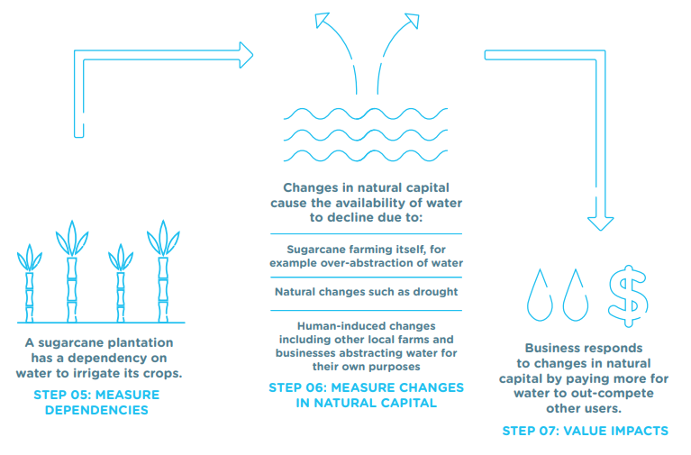
Dependency pathway
Refer to p. 24
of the F&B Sector Guide
Notes:
Presenter to then walk through the sugarcane example using the notes below and referring to p. 24 of the F&B sector guide:
https://capitalscoalition.org/natural-capital-protocol-food-and-beverage-sector-guide/
Business activities at a sugarcane plantation have a dependency on water to irrigate the crops.
Changes in natural capital cause the availability of water to decline due to:
Sugarcane farming itself, for example over-abstraction of water
Natural changes such as drought
Human-induced changes including other local farms and businesses abstracting water for their own purposes
The company may be paying more for the water now, but at some point it may no longer have access to water in the area, no matter how much it costs - and this puts the company at risk, not just the cost of doing business.
Changes in natural capital affect business dependency (by paying more for water to out-compete other users), so water availability is important.

Slide 55
Agenda – 2 hour training
TO ADAPT
Time (xxx) | Session
15 | Welcome – Agenda, objectives, material & introductions
10 | Setting the scene and a brief re-cap on natural capital
5 | Engaging the supply chain on natural capital
5 | Identifying natural capital impacts & dependencies
30 | Group exercise
10 | Coffee Break
20 | Scoping an assessment – Key steps to take
15 | Practical considerations – Planning an assessment
20 | Optional: Case study presentation
10 | Wrap-up – Key take-aways, wrapping-up

Slide 56

Business example – Los Fiordos
Refer to p. 25 of your workbook
Los Fiordos is a salmon farming company based in Southern Chile, specializing in the production of Coho and Atlantic salmon and producing a variety of goods as well as portions and filets.
Los Fiordos is a vertically integrated company: they supply their own fodder, eggs and juvenile fishes, own the largest salmon processing plant in Chile, and manage the fright of the produced goods.
Most of the company’s feedlot centers are located in Melinka and Puerto Cisnes, two high value conversation zones.
Source: An Ecosystem Services Review on Salmon Aquaculture in Chile – Los Fiordos (2016)
Notes:
Image source: https://www.pexels.com/photo/photo-of-person-holding-knife-3296280/
An Ecosystem Services Review on Salmon Aquaculture in Chile – Los Fiordos (2016):
http://www.wolfscompany.com/wp-content/uploads/2016/04/Business-dependence-on-ecosystem-services-Salmon-industry-Chile-Final....pdf

Slide 57




Business example – Los Fiordos (continued)
The majority of salmon produced by Los Fiordos is exported to foreign markets such as the US (23.3%), Japan (18.5%) and Brazil (16.4%).
The company’s main clients are supermarkets (42.4%), traditional markets (44.6%), food service (12.8%), and industrial clients (0.2%) (Agrosuper, 2014).
The company is a frontrunner in adopting sustainable practices and is part of different initiatives focused on the development of a sustainable aquaculture.
Los Fiordos is one of the largest aquaculture businesses in Chile.
Source: An Ecosystem Services Review on Salmon Aquaculture in Chile – Los Fiordos (2016)
Notes:
Agrosuper, 2014
https://issuu.com/agrosuperinternacional/docs/reporte_integrado_-_agrosuper_2014
An Ecosystem Services Review on Salmon Aquaculture in Chile – Los Fiordos (2016):
http://www.wolfscompany.com/wp-content/uploads/2016/04/Business-dependence-on-ecosystem-services-Salmon-industry-Chile-Final....pdf
Round Table on Responsible Soy (RTRS):
https://responsiblesoy.org/
Salmon Chile:
https://www.salmonchile.cl/en/home/
GSI Global Salmon Initiative:
https://globalsalmoninitiative.org/en/
Sustainable Fisheries Partnership:
https://www.sustainablefish.org/

Slide 58
Ecosystem Services
Refer to p. 6 of your workbook
Refer to p. 13
of the Natural Capital Protocol
Provisioning
Goods produced or provided by ecosystems
Food
Fresh water
Timber
Fiber
Biochemicals
Natural medicines
Regulating
Natural processes regulated by ecosystems
Pollination
Climate regulation
Water purification, flow regulation & waste treatment
Erosion regulation
Air quality regulation
Cultural
Intangible benefits obtained from ecosystem services
Recreation
Ecotourism
Spiritual & religious values
Educational
Ethical values
Supporting
Functions that maintain all other services
Nutrient cycling
Water cycling
Primary production
Photosynthesis
Notes:
Quick recap of the different ecosystem services.
This slide describes the four categories of ecosystem services and provides examples for each of the categories. The green line highlights the ecosystem services that are particularly relevant for the F&B sector.
Ecosystems services are the benefits to people from ecosystems, where an ecosystem is defined as the interaction between complex plants, animals and microorganisms and their non-living environment
Examples of ecosystem services include pollination, water regulation & purification, soil biodiversity, pest control, climate regulation, erosion regulation, nutrient retention
Ecosystem services can be classified into provisioning, regulating, cultural and supporting services
Provisioning: material outputs from nature (e.g. fresh water, food) – the F&B sector is highly dependent on water and food to produce their final products.
Regulating: indirect benefits from nature generated through regulation of ecosystem processes (e.g. Erosion prevention and maintenance of soil fertility, pollination, biological control) – processes such as pollination and prevention of erosion improve soil fertility and can positively impact crop quality and yield.
Cultural: non-material benefits from nature (e.g. recreational, ecotourism, educational, spiritual, ethical) – while the benefits of cultural ecosystem services may not always be directly visible, they are part of the larger system around food & beverage production. While these benefits are strongly interlinked, we have provided a dotted line for the services that are most discussed in the F&B sector.
Supporting: fundamental ecosystem processes that support the delivery of other ecosystem services (e.g. nutrient cycling, water cycling) – without these services, the F&B sector would not benefit from the other services provided by the ecosystem such as pollination and fresh water.
There are many classification schemes for ecosystem services including the CICES and the FEGS-CS which measure ecosystem outputs that are directly consumed or used by beneficiaries

Slide 59
Group exercise
Refer to p. 26-27 of your workbook
Los Fiordos’ key impacts and dependencies
Key ecosystem services | Dependency | Impact
Provisioning
Food (crops, fish)
Regulating
Oxygen supply
Water purification and waste treatment
Maintenance of soil quality
Pest mitigation
Cultural
Recreation and ecotourism
Ethical and cultural values
Natural Capital Impact:
The negative or positive effect of business activity on natural capital (e.g. water extraction)
Guiding questions:
Impact on quantity or quality
Does it affect the ability of others to benefit from ES?
Natural Capital Dependency:
Business reliance on or use of natural capital (e.g. pollination)
Guiding questions:
Does it enhance/enable performance?
Does it have cost-effective substitutes?
Notes:
Provisioning
Goods produced or provided by ecosystems
Food (crops, fish): crops and fish (anchovies and sardines) needed to feed the salmon
Regulating
Natural processes regulated by ecosystems
Oxygen supply: the supply of oxygen in the water
Water purification and waste treatment: purification of the water and the decomposition of organic matter
Maintenance of soil quality: soil quality is important for primary production
Pest mitigation: In a healthy and biodiverse ecosystem, pests are controlled through other species in the trophic chain.
Cultural
Intangible benefits obtained from ecosystem services
Recreation and ecotourism: recreational pleasure people derive from natural or cultivated ecosystems
Ethical and cultural values: conservation of certain species (which are important for the nation)

Slide 60

Group exercise in breakout rooms
Refer to p. 26-27 of your workbook
We will now split into breakout rooms
  Approx. 3 groups of 4 persons
You will work through a table of impacts & dependencies for Los Fiordos’ operations in Chile
You will have 20 minutes to discuss in your group
You will be notified when you have 5 minutes left
Each group will have one of the support team members to take notes
One member per group will be asked to provide feedback in plenary on the main points & reflections that came out of the discussion

Slide 61
Group exercise at tables
Refer to p. 26-27 of your workbook
Form groups of 3-4 at your tables
You will work through a table of impacts & dependencies for Los Fiordos’ operations in Chile
You will have 20 minutes to discuss in your group
You will be notified when you have 5 minutes left
Each group will have one of the support team members to take notes
One member per group will be asked to feedback in plenary on the main points & reflections that came out of the discussion

Slide 62

Share your key highlights!
What key points came out from your discussions?
Notes:
Each group give key points and highlights from their group
Throw to speakers for last thoughts

Slide 63
Business example – Los Fiordos, Chile
Los Fiordos’ key impacts and dependencies
Key ecosystem services | Dependency | Impact
Provisioning
Food (crops, fish) | Medium | Medium
Regulating
Oxygen supply | High | High
Water purification and waste treatment | Medium | High
Maintenance of soil quality | High | High
Pest mitigation | High | High
Cultural
Recreation and ecotourism | Low | High
Ethical and cultural values | Low | High
Los Fiordos’ key impacts and dependencies
Key ecosystem services | Dependency | Impact
Provisioning
Food (crops, fish)
Regulating
Oxygen supply
Water purification and waste treatment
Maintenance of soil quality
Pest mitigation
Cultural
Recreation and ecotourism
Ethical and cultural values
Source: An Ecosystem Services Review on Salmon Aquaculture in Chile – Los Fiordos (2016)
Notes:
Priority ecosystem services are essential for the company’s performance (dependencies) or the company has a rather significant, real or perceived, negative impact on the availability of ecosystem services used by others.
Questions to help determine dependency:
Does it enhance/enable performance?
Does it have cost-effective substitutes?
Questions to determine impact:
Impact on quantity or quality
Does it affect the ability of others to benefit from ES?
Provisioning:
Crops and industrial fisheries (Medium impact and dependency: The company has a medium dependence on crops and industrial fisheries, as they constitute the main source of protein in the fodder. Crops have gained an increasingly important role in fish feed. There are cost-effective substitutes to feed-fish such as soybean.)
Artisinal fisheries (Low dependency: Los Fiordos has a low dependency on this priority ecosystem service, since artisanal fisheries do not enhance Los Fiordos’ performance. However, it is possible that some of Los Fiordos’ practices contribute to the degradation of ecosystems on which other stakeholders depend. High impact: Through potentially enhancing eutrophication and increasing hypoxia, Los Fiordos may have an impact on the quantity of the benthic species and thereby the quality of the ecosystem service)
Regulating:
Oxygen supply (High dependency: the oxygen level in the water is essential for salmon production. Artificial oxygen supply does not represent a cost-effective solution as it requires high investments. High impact: The large quantity of salmon being grown in the area requires large amounts of oxygen and may limit the oxygen availability to other salmon farms and other organisms living near the concessions)
Water purification, waste treatment, and maintenance of soil quality (High impact and medium dependency: a number of organism in the marine ecosystem support the decomposition of organic matter generated by aquaculture. However, when the level of hypoxia6 reaches a certain threshold, the ability to treat waste degrades -> soil quality degradation which could lead to a loss in productivity)
Pest mitigation (High dependency: A healthy and biodiversity ecosystem control pests, decreasing the risk of virus outbreaks that negatively impacting salmon production. No effective vaccine has been found. Furthermore, use of antibiotics and vaccines may lead to a resistance of fish outside net pens against diseases. There is no cost-effective substitute to this ecosystem service. High impact: pests can spread more easily since aquacultures mainly produce one specific species.)
Cultural:
Ethical and cultural values (Low dependency: Los Fiordos’ business operations are not directly affected by ethical or cultural values. High impact: one important ethical issue identified is the importance of the conservation of cetaceans. Whales and dolphins in particular, are national and pride symbols for the two locations. However, according to stakeholder representatives the number of cetaceans-sightings close to the shore has decreased since aquaculture operators started their business in the area. This could negatively affect the image of Los Fiordos as well as the willingness of communities to collaborate with the company)
Recreation and tourism (Low dependency: Recreation and ecotourism is not a part of Los Fiordos’ value-chain. High impact: stakeholder representatives criticize the visual contamination net pens generate, arguing that they obstruct tourism activities in the area. Hence, the activities of Los Fiordos and other aquaculture companies have a high negative impact on this cultural ecosystem service)
Source: An Ecosystem Services Review on Salmon Aquaculture in Chile – Los Fiordos (2016):
http://www.wolfscompany.com/wp-content/uploads/2016/04/Business-dependence-on-ecosystem-services-Salmon-industry-Chile-Final....pdf

Slide 64

Los Fiordos’ Value Added Statement
The Ecosystem Services Review was the first step to create awareness of and to demonstrate the interdependence between a healthy aquaculture business and healthy ecosystems.
They assess ecosystem services based on their importance to the company’s performance and their availability and value to other stakeholders.
The analysis includes information from Los Fiordos’ production operations on the feedlot and pisciculture centers, located in the areas Melika and Puerto Cisnes.
Source: An Ecosystem Services Review on Salmon Aquaculture in Chile – Los Fiordos (2016)
Notes:
Image source: https://www.pexels.com/photo/black-and-gray-sea-turtle-on-brown-sand-3866697/
Source: An Ecosystem Services Review on Salmon Aquaculture in Chile – Los Fiordos (2016):
http://www.wolfscompany.com/wp-content/uploads/2016/04/Business-dependence-on-ecosystem-services-Salmon-industry-Chile-Final....pdf

Slide 65

What may be the most material natural capital impact and dependency for your business?
Use the blank spaces of your workbook p. 27 & refer to p. 47-48
of the
Natural Capital Protocol
Use the blank spaces of your workbook p. 8 and refer to pp. 47-48 of the NCP
Individually reflect on what would be your business’ natural capital impacts & dependencies
Write down 1 impact & 1 dependency that seem most material to your business at the moment.
Notes:
Give participants 5’ to reflect individually on both questions (again, depending on the time you have, you may want to spend more time on this).
Business impacts and dependencies are closely linked. For example, a company may depend on water, while the quality of its water management practices will affect the scale of impacts generated through its use of water.

Slide 66


Where are we in the learning objectives
The aim of today’s training is:
To understand how to identify natural capital impacts and dependencies that are important to your business
Acquire the necessary tools, resources and understanding to scope your own assessment
To be introduced to the key practical considerations and steps to take when undertaking a first natural capital assessment as well as some tools to help undertake an assessment
Notes:
The objectives for today are…

Slide 67

10’

Slide 68
Agenda – 2 hour training
TO ADAPT
Time (xxx) | Session
15 | Welcome – Agenda, objectives, material & introductions
10 | Setting the scene and a brief re-cap on natural capital
5 | Engaging the supply chain on natural capital
5 | Identifying natural capital impacts & dependencies
30 | Group exercise
10 | Coffee Break
20 | Scoping an assessment – Key steps to take
15 | Practical considerations – Planning an assessment
20 | Optional: Case study presentation
10 | Wrap-up – Key take-aways, wrapping-up

Slide 69

Scoping an assessment

Slide 70
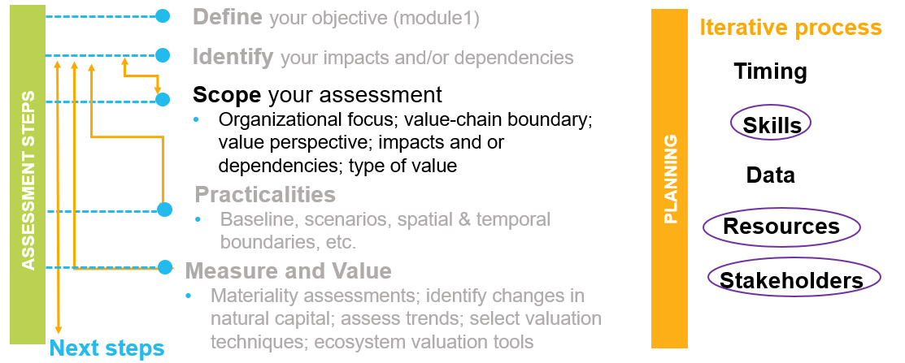
Concrete steps to undertaking a 1st natural capital assessment
Notes:
The following step is scoping an assessment. Based upon the business application you have chosen, you may decide to have a broad and shallow approach (i.e., assessing multiple impacts across the entire company or value chain) or you may choose a narrow and deep approach (i.e., fewer issues and a tighter scope with more detailed analysis).
The resources and skills required, and the degree of stakeholder involvement depend on the scope of your assessment.

Slide 71
Business application
See p. 29 of your workbook & p. 20 in the Natural Capital Protocol
Natural capital information can be used in plenty of ways. You need to decide what information you need and how it will be used.
Potential Business Applications
Assess risks and opportunities for the company or a department (new options for ecological product development, the risk associated with increased water stress, etc.)
Compare options e.g. choosing between flood solutions
Assess impacts on stakeholders, how are nearby communities impacted by different factory policies
Estimate total value and/or net impact
Communicate internally or externally
Source: Natural Capital Protocol
Notes:
A natural capital assessment provides information. Whilst this can be valuable in its own right, this means there are also numerous ways to use this information for further purposes.
The NCP focuses on using natural capital for decision-making, measurement and valuation, but it can also be used for disclosure and communication, or to help formulate strategy.
The best way for your company to use natural capital information is highly individual – think back to the challenges and risks you identified earlier in the training and consider how exactly how more information could help you meet these challenges.

Slide 72
Distribution of assessments across sectors
Multi-sector, 17%
Forest products, 14%
Food and beverage, 13%
Energy and utilities, 9%
Chemicals, 8%
Other, 20%
Total of 173 assessments
Notes:
Data from the Natural Capital Coalition Case Study Database
Presenter to give an overview of the pie chart presented on the slide. Presenter to explain that natural capital assessments have been undertaking in a variety of sectors, including forest products, food & beverage, energy and utilities, and chemicals. Next to Forest products, the Food & Beverage sector is the largest sector in terms of assessments.

Slide 73
Overview of current assessments in the F&B sector
NC or SHC
Organization type
Natural Capital or Multi-capital
Organization type
Total of 19 assessments
Notes:
Data from the Natural Capital Coalition Case Study Database
Presenter to give an overview of the pie charts presented on the slide. Presenter to explain that the majority of assessments carried out include only natural capital, and that very few assessments measure social and human capital without also measuring natural capital. Presenter to explain that the majority of companies carrying out assessments are businesses, with governments carrying out ¼ of all assessments and finance carrying out the fewest.

Slide 74
Business applications in numbers
F&B sector
Estimate total value and/or net impact, 34%
Assess risks and opportunities, 27%
Assess impacts on stakeholders, 13%
Integrate and mainstream natural capital into policy, 7%
Compare options, 5%
Create and support insights, 5%
Other, 9%
Assess risks and opportunities, 47%
Estimate total value and/or net impact, 32%
Assess impacts on stakeholders, 10%
Unspecified, 11%
Total of 19 assessments
Notes:
Data from the Natural Capital Coalition Case Study Database
Presenter to give an overview of the pie chart presented on the slide. Presenter to explain that the main purpose for carrying out assessments are to estimate total value/or net impact of/on natural, or social and human, capital. The next greatest application is to assess risks and opportunities for the companies carrying out the assessment, and the third biggest reason is to assess company impacts on stakeholders.

Slide 75



Assessments: Measure & Value
Refer to p. 30 of your workbook & p. 84 of the Natural Capital Protocol
To measure ≠ to value
To measure: determine the amounts, extent and condition in physical terms
  e.g. m3, tons, number of injuries, number of jobs
To value: estimate the relative importance, worth, or usefulness of natural / social / human capital to people (or to a business), in a particular context.
  Qualitative
  Quantitative
  Monetary
Costs and benefits to the business, and to society
Notes:
There are different ways of valuing – could be qualitative, quantitative and monetary
Important to note that monetary values without any context (i.e. accompanying quantification) are less meaningful!
The method you chose depends on which natural capital impact drivers or dependencies you wish to assess, the chosen value perspective (e.g. business, societal, or both), the ultimate objective of your assessment, and the time and resources available.
Monetary valuation: some find it difficult to accept or interpret monetary valuation of certain benefits (e.g. spiritual values). In such situations, special efforts may be required to explain the advantages and also to acknowledge the limitations of monetary valuation.
Advocates of natural capital are sometimes accused of ‘putting a price on nature’ or ‘pricing the priceless’, but in fact our core assertion is that prices have failed to reflect the true value of the natural world, and that the economic systems that we are using are broken.
We use the common definitions of price and value: Where price is ‘the quantity of one thing that is exchanged or demanded in barter or sale for another/the amount of money given or set as consideration for the sale of a specified thing’ and value as ‘The regard that something is held to deserve; the importance, worth, or usefulness of something i.e. “your support is of great value”. If something is not for sale, we do not describe it as having a ‘price’, but we may nevertheless recognise the value that it holds, and make decisions on this basis.

Slide 76
Ways of describing value
  Qualitative
  Quantitative
  Monetary
Qualitative valuation techniques are used to inform the potential scale of costs and/or benefits expressed through qualitative, non-numerical terms (e.g., increase in air emissions, decrease in social benefits of recreation)
Methods
Non-numerical
Opinion surveys
Deliberative approaches
Expert opinions
Relative valuation
Quantitative valuation techniques focus on numerical data which are used as indicators for these costs and/or benefits (e.g., changes in tons of pollutants, decrease in number of people benefitting from recreation).
Methods
Numerical
Structured surveys
Indicators
Multi-criteria analysis (MCA)
Monetary valuation techniques translate quantitative estimates of costs and/or benefits into a single common currency.
Methods
Numerical
Market and financial prices
Production function
Cost based approaches
Value transfer
Notes:
There are different ways of valuing – could be qualitative, quantitative and monetary
Important to note that quantitative data and how it is calculated is similar to what companies are used to in sustainability reporting.
Important to note that monetary values without any context (i.e. accompanying quantification) are less meaningful!
The method you choose depends on which natural capital impact drivers or dependencies you wish to assess, the chosen value perspective (e.g. business, societal, or both), the ultimate objective of your assessment, and the time and resources available.

Slide 77
Measure & Value in practice
Refer to p. 31 of your workbook &
p. 82 of the
Natural Capital Protocol
  Qualitative
  Quantitative
  Monetary
Trees sequester carbon
Soil organic matter (SOM) increases soil water infiltration
A rich diversity of plants, bacteria and animals provides a good habitat for bees
One hectare of forest sequesters 5 tonnes of CO₂-equivalents per year
An increase of 1% SOM equals an increase of 3 – 4 mm available water
Pollinators, including bees, flies, beetles and moths, help in the production of nearly 75 percent of crops and roughly 80 percent of all flowering plants.
One hectare of forest is worth €80,- in carbon sequestration a year.
An increase of 1% SOM could lead to postponing a sprinkler irrigation application or to not apply this at all, this could save €600/year
Pollinators contribute more than 24 billion dollars to the United States economy.
Notes:
Three examples of qualitative, quantitative and monetary valuation

Slide 78
Measure & Value in practice
Refer to p. 31 of your workbook &
p. 82 of the
Natural Capital Protocol
  Qualitative
  Quantitative
  Monetary
Valuation of pollination in kiwifruit
Step 05: Measure impact drivers and dependencies
What? Pollination by bees
How? Workshop
Step 06: Measure changes in the state of natural capital
What? Effectiveness of pollination
How? Expert judgement
Step 07: Value impacts and dependencies
What? Effectiveness of pollination
How? Relative valuation (low, medium, high)
Valuation of water consumption in rice production
Step 05: Measure impact drivers and dependencies
What? Water use
How? m³ water used
Step 06: Measure changes in the state of natural capital
What? Reduced water availability
How? Life Cycle Impact Assessment
Step 07: Value impacts and dependencies
What? Impact of water consumption
How? Quantitative – human health impact of water scarcity using DALYs per unit of water consumed
Valuation of fish stock losses due to fertilizer use
Step 05: Measure impact drivers and dependencies
What? Kilograms of Phosphorus in fertilizers applied
How? On farm data
Step 06: Measure changes in the state of natural capital
What? Change in number of species in water ecosystems due to changes in nutrient level in water (eutrophication)
How? Life Cycle Impact assessment
Step 07: Value impacts and dependencies
What? Loss of fish stocks
How? Market valuation
Notes:
• Qualitative valuation techniques
Step 05: Measure impact drivers and dependencies
What? Pollination by bees
How? Workshop
Step 06: Measure changes in the state of natural capital
What? Effectiveness of pollination
How? Expert judgement
Step 07: Value impacts and dependencies
What? Effectiveness of pollination
How? Relative valuation (low, medium, high)
• Quantitative valuation techniques
Valuation of water consumption in rice production
Step 05: Measure impact drivers
What? Water use
How? m³ water used
Step 06: Measure change in capital
What? Reduced water availability
How? Life Cycle Impact Assessment
Step 07: Value impacts
What? Impact of water consumption
How? Quantitative – human health impact of water scarcity using DALYs per unit of water consumed
• Monetary valuation techniques
Valuation of fish stock losses due to fertilizer use
Step 05: Measure impact drivers
What? Kilograms of Phosphorus in fertilizers applied
How? On farm data
Step 06: Measure changes in capitals
What? Change in number of species in water ecosystems due to changes in nutrient level in water (eutrophication)
How? Life Cycle Impact assessment (characterization factors)
Step 07: Value impacts
What? Loss of fish stocks
How? Market valuation
Note: If the monetary valuation is used, it should be clear whether the value used was market price only, as this can make a difference.

Slide 79
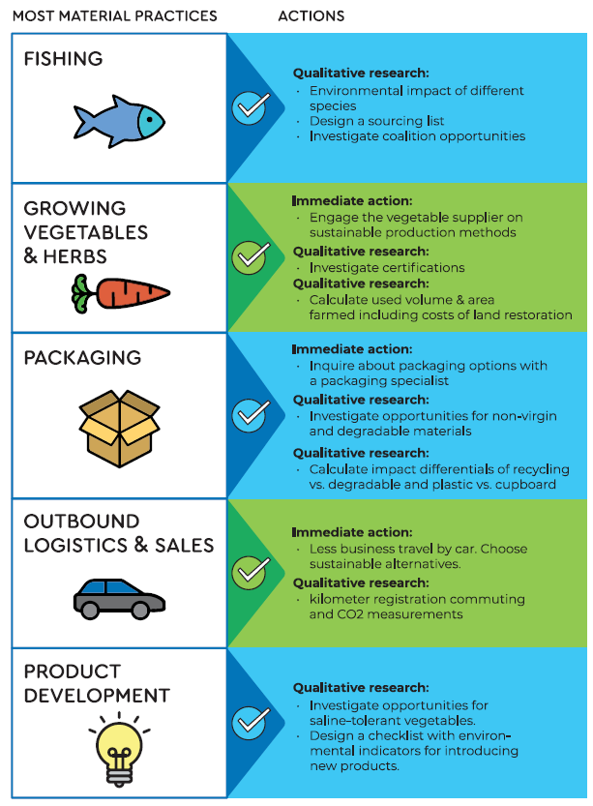
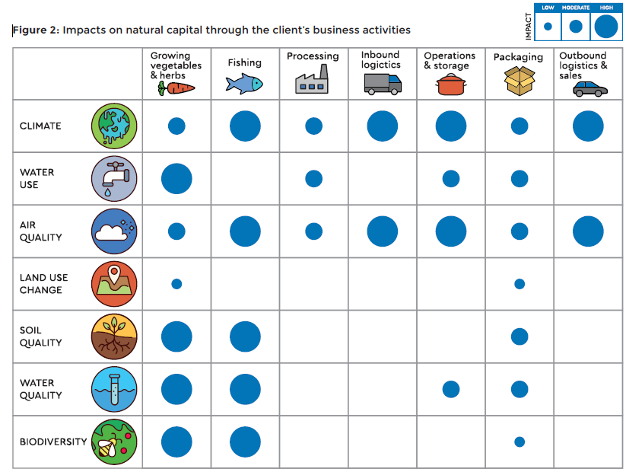
Example of a qualitative assessment from an SME in the fishery industry
Source: Accounting for a Better Planet - Nature^Squared
Notes:
This is an example of how you can conduct a qualitative assessment of your natural capital impacts and dependencies and how this can already translate into concrete. This slide only displays the impacts, but the same exercise was undertaken for dependencies too.
To complete the work, they discussed relative importance with different stakeholders and simply provided relative orders of magnitude, based on resources but also on influence on the issue.
From this, they were able to identify most material elements of their practices and then prioritise which actions to take.
One of the surprising insights for this company, a seafood producer, producing soups and burgers, was that they had a blind spot on the sourcing of vegetables, although they used a higher share of vegetables than actual seafood in many of their products.
This exercise can be repeated in consultation with your own employees and stakeholders. You don’t necessarily need to measure and value your impacts. This type of assessment can already be very informative without taking up a lot of time, expertise or budget. Again, it depends on what the objective is.
Case study Accounting for a Better Planet: http://www.nature-squared.org/wp-content/uploads/2020/04/case-study-accounting-for-a-better-planet.pdf

Slide 80
Why is monetary valuation useful and/or contentious?
Refer to p. 32 of your workbook &
p. 37-38 of the
Natural Capital Protocol
Useful | Contentious
Common unit of measure Can measure social preferences Used to determine overall value for money of a project (i.e. whether it should go ahead or not; do the benefits exceed the costs) Can be used to measure risks and mitigate them before these are quantified by others Can be used as a communication tool (internal and external) | Not everything can be quantified in monetary terms (e.g. biodiversity) Can be time consuming/ expensive depending on technique or approach used Need to avoid double counting Potential reputational impacts

Slide 81
Project ambition: scoping an assessment
Refer to p. 33-34 of your workbook & p. 42 of the
Natural Capital Protocol
Determine the organizational focus | Corporate / project / product
Determine the value-chain boundary | Upstream / direct operations / downstream
Specify whose value perspective | Business / society / both
Decide on assessing impacts and/or dependencies | Impacts / dependencies / both
Decide which types of value you will consider | Qualitative / quantitative / monetary
Source: Natural Capital Protocol
Notes:
The table shows the different components within the step 'scoping an assessment’.
Organizational focus: the part or parts of the business to be assessed (e.g., the company as a whole, a business unit, or a product, project, process, site, or incident). For simplicity, these are grouped under three general levels as below:
Corporate: assessment of a corporation or group, including all subsidiaries, business units, divisions, different geographies or markets, etc.
Project: assessment of a planned undertaking or initiative for a specific purpose, and including all related sites, activities, processes, and incidents.
Product: assessment of particular goods and/or services, including the materials and services used in their production.
Value-chain boundary: The part or parts of the business value chain to be included in a natural capital assessment. An assessment of the full lifecycle of a product would encompass all three parts.
Upstream (cradle-to-gate): covers the activities of suppliers, including purchased energy.
Direct operations (gate-to-gate): covers activities over which the business has direct operational control, including majority owned subsidiaries.
Downstream (gate-to-grave): covers activities linked to the purchase, use, re-use, recovery, recycling, and final disposal of the business’ products and services.
Value perspectives: the perspective or point of view from which value is assessed; this determines which costs or benefits are included in an assessment.
Business value: The costs and benefits to the business, also referred to as internal, private, financial, or shareholder value.
Societal values: The costs and benefits to wider society, also referred to as external, public, or stakeholder value (or externalities).

Slide 82
Identifying stakeholders
Refer to p. 36 of your workbook & p. 26-27 of the
Natural Capital Protocol
Examples of Internal Stakeholders: | Examples of External Stakeholders:
Shareholders (if applicable) | Shareholders (if applicable)
Senior executives and directors | Investors
Heads of sustainability, environment etc. | Suppliers
Human resources or auditing and compliance | Government, regulators, customers etc.
Employees and contractors | Experts (e.g. academics, engineers etc.)
Departments like finance, strategy, procurement, marketing, communications, reporting, public affairs, investor relations etc. | Community and other affected stakeholders (local residents, schools, other businesses, special interest groups, farmers etc.) Civil society (NGO, labor unions etc.)
Notes:
Various stakeholders may contribute significant insights into the assessment and its results.
Internal stakeholders may be able to provide useful insights. E.g. colleagues from procurement have great knowledge of the supply chain.
External stakeholder input can provide greater robustness and credibility to the results. Engaging with external stakeholders is certainly to be encouraged, bearing in mind that you may have to give some background on the basic concepts of a natural capital assessment.

Slide 83
Identifying target audience and obtaining buy-in
Refer to p. 36 in your workbook & p. 26-27
of the
Natural Capital Protocol
Why do you need to identify a target audience?
Creating buy-in
In order to help define your objective, you need to identify the target audience and understand what drives them
The target audience is the main user of the assessment output, this means that outputs must be written with them in mind
In order to help drive your project forward you will need to get internal buy-in this can be achieved by:
  Identifying individuals with an interest in the project and getting them involved
  Identifying where company operations may be vulnerable in terms of dependencies
  Identifying areas of opportunity that fit within the remit of department leaders in product development, etc.
  Demonstrating how the outputs of an assessment can help with decision making where investment decisions are currently being discussed
  Knowing how to adapt your language for the relevant department, to make options easy to understand
Notes:
Identifying the target audience and understanding what drives them is key in defining your objective as it will influence the way the assessment is conducted, the type of outputs to be delivered, and the desired outcomes.
Support from key external stakeholders can also help to strengthen internal buy-in and improve the quality of the assessment.

Slide 84

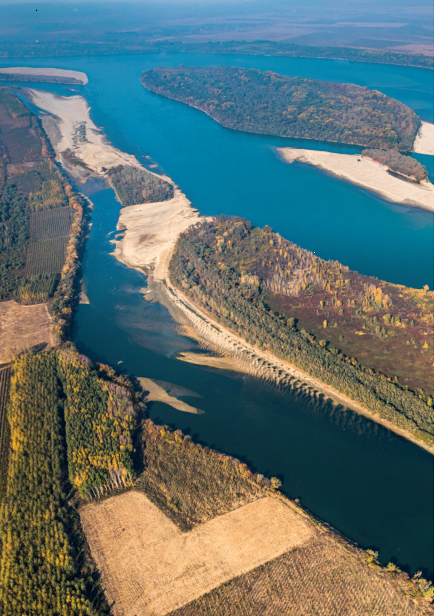
Business example –
Refer to p. 37 - 39 of your workbook
The Coca-Cola Company (TCCC) is the world’s largest beverage company.
The TCCC has a truly global presence, collaborating closely with 225 bottling partners worldwide in more than 200 countries.
Coca Cola Europe is the largest Coca-Cola bottler by revenue.
In 2007, the TCCC set an ambitious global water stewardship target with a view to become water neutral by 2020.
Source: Coca Cola Europe
Notes:
The Coca-Cola Company: The Coca-Cola Company (TCCC) quantified ecosystem services related to freshwater sources to better capture and communicate impacts of water community projects beyond replenishment.
Having invested a lot in water replenishment projects, TCCC was driven to understand the variety of benefits that these projects provide to people and society beyond water volumes only. A natural capital assessment was initiated to monetize the ecosystem services in order to identify opportunities and maximize impact. Together with their partners, they developed and piloted a methodology in seven of their European projects. While monetizing impacts was not always easy, the results were clear: water restoration projects can enhance a range of other ecosystem services. If done right, these benefits outweigh the original project investment in a limited period of time. The assessment helped TCCC progress on their natural journey.
https://naturalcapitalcoalition.org/wp-content/uploads/2016/07/Denkstatt_Natural_Capital_Accounting.pdf
Natural Capital Story of The Coca-Cola Company: https://wevaluenature.eu/node/304
Image source:
https://www.coca-cola.eu/news/supporting-environment/creating-natural-capital-through-nature-based-solutions

Slide 85

Business example –
Refer to p. 37 - 39 of your workbook
Started undertaking a natural capital assessment in 2019 to quantify ecosystem services from their freshwater programs.
The objective of the assessment is to increase the potential of Coca Cola’s replenishment programs by quantifying the ecosystem service benefits that arise from these programs. This may further enhance the impact of the renewed water strategy.
Source: Coca Cola Europe
Notes:
https://naturalcapitalcoalition.org/wp-content/uploads/2016/07/Denkstatt_Natural_Capital_Accounting.pdf
Natural Capital Story of The Coca-Cola Company: https://wevaluenature.eu/node/304

Slide 86
So what could the scope of work look like for
The Coca-Cola Company based on the information we have?
Refer to p. 39 of your workbook
Determine the organizational focus | Project (water projects)
Determine the value-chain boundary | Direct operations (bottling partners)
Specify whose value perspective | Society
Decide on assessing impacts and/or dependencies | Impacts
Decide which types of value you will consider | Quantitative and monetary (creating a better overview of the diversity of impacts)
Determine the organizational focus
Determine the value-chain boundary
Specify whose value perspective
Decide on assessing impacts and/or dependencies
Decide which types of value you will consider

Slide 87
Business example – The Coca-Cola Company
Refer to p. 38 of your workbook
Refer to p. 26-27
of the
Natural Capital Protocol
Target Audience: | Stakeholders:
Target Audience = main user of
the assessment output (i.e. those people that will read and use the output to make decisions)
Stakeholder = any individual, organization, sector or community with an interest or stake in the outcome of a decision or process
Natural Capital Impact:
The negative or positive effect of business activity on natural capital (e.g. water extraction)
Natural Capital Dependency:
Business reliance on or use of natural capital (e.g. pollination)

Slide 88
Who could the stakeholders and target audience be for The Coca-Cola Company ?
Refer to p. 38 of your workbook
Target Audience: | Stakeholders:
The Coca-Cola Company senior management | NGO implementation partners (WWF)
Shareholders committee | Local communities
Sustainability team | Bottling partners

Slide 89
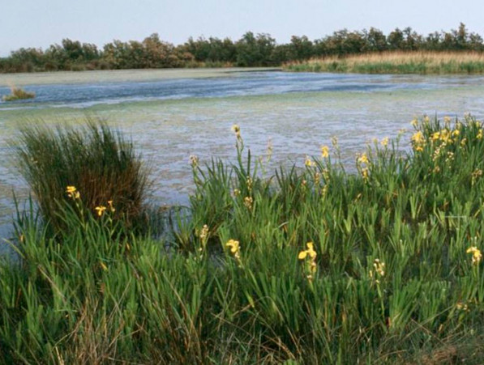
The Coca-Cola Company’ Natural Capital assessment
The natural capital assessments allowed TCCC to assess and communicate the variety of impacts arising from their water programs.
They are now planning to use the assessment as input for decision making and an important communication tool.
Source: Coca Cola Europe
Notes:
https://naturalcapitalcoalition.org/wp-content/uploads/2016/07/Denkstatt_Natural_Capital_Accounting.pdf
Natural Capital Story of The Coca-Cola Company: https://wevaluenature.eu/node/304

Slide 90
Reflections, scoping your assessment
Refer to p. 35 of your workbook
Individually reflect on the following questions in the context of scoping your own assessment:
What would the value-chain boundary be?
Would you assess impacts and/or dependencies?
Which types of value would you consider?
Is natural capital more of a risk or an opportunity?
→ The bottom line is that although carrying out a natural capital assessment is technical, it's also achievable.
Notes:
What would the value-chain boundary be?
Upstream
Direct operations
Downstream
Would you assess impacts and/or dependencies?
Impacts on your business (as a result of your impacts on natural capital)
Your impacts on society (as a result of your impacts on natural capital)
Your business dependencies (benefits that your business receives from natural capital)
Which types of value would you consider?
Qualitative
Quantitative
Monetary

Slide 91
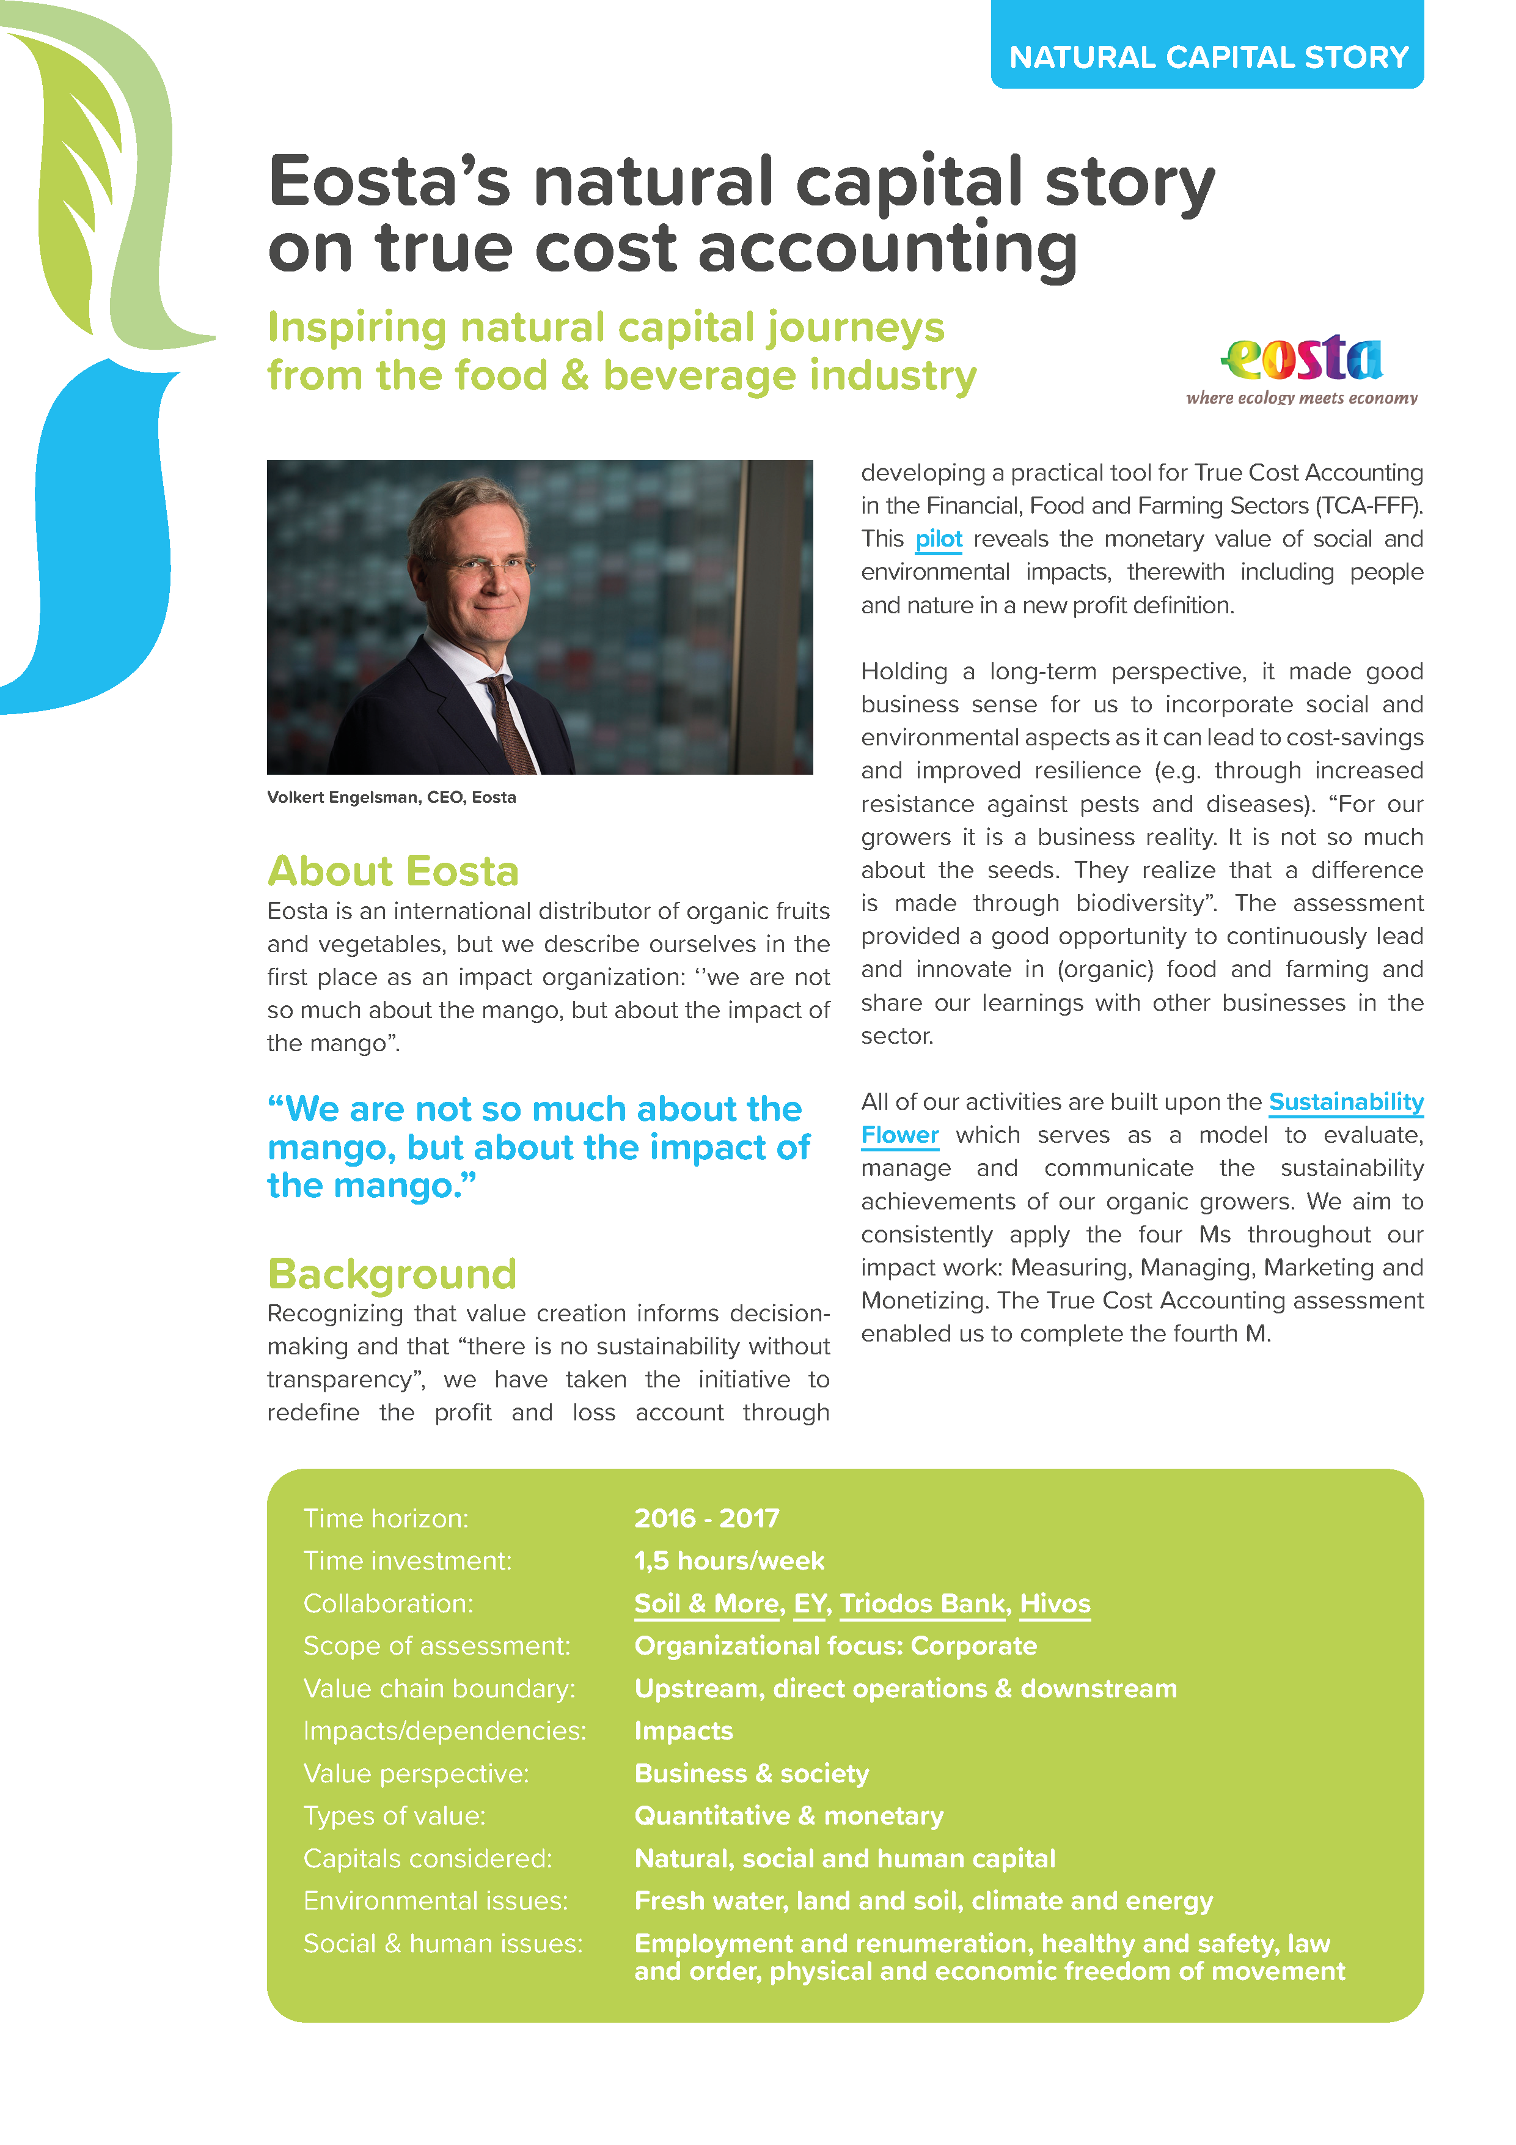



Natural Capital Stories
Notes:
Presenter to explain that companies are experimenting and learning. On the We Value Nature Media library, you can find inspiring examples of (F&B) companies who have undertaken a natural capital assessment, including practical information and tips and key lessons learned.
Eosta: a NL based, international distributor of organic fruits and vegetables. Eosta valued the true cost of various fruits and vegetables through developing an integrated profit and loss account of these products based on true cost accounting. It was the first Small and Medium sized enterprise (SME) in the food & agribusiness to do so.
To inform better and more sustainable decision-making, EOSTA decided to develop a practical tool for True Cost Accounting in the Financial, Food and Farming Sectors (TCA-TFFF) that includes environmental and social values for a range of products. By monetizing their impacts, EOSTA moved up along their natural capital journey towards full integration of natural capital into business decision making.
https://wevaluenature.eu/node/303
Metro: a leading international specialist in food wholesale. METRO AG compared the hidden costs and benefits of METRO’s Food Service Distribution (FSD) business model with those of its traditional wholesale stores by monetizing their impacts on the society and the environment. In 2015, METRO started rolling out their Food Service Distribution model next to their traditional model of direct buying (Cash & Carry). To understand whether this was a positive development, METRO initiated an assessment to assess how these different business models impact the society and the environment. With the support of Denkstatt, METRO conducted sustainability accounting and found that the new FSD model was inherently more sustainable, offering additional benefits for customers, the society and the environment, valued at € 60 per € 1000 of sales.
https://wevaluenature.eu/node/301
The Coca-Cola Company: The Coca-Cola Company (TCCC) quantified ecosystem services related to freshwater sources to better capture and communicate impacts of water community projects beyond replenishment.
Having invested a lot in water replenishment projects, TCCC was driven to understand the variety of benefits that these projects provide to people and society beyond water volumes only. A natural capital assessment was initiated to monetize the ecosystem services in order to identify opportunities and maximize impact. Together with their partners, they developed and piloted a methodology in seven of their European projects. While monetizing impacts was not always easy, the results were clear: water restoration projects can enhance a range of other ecosystem services. If done right, these benefits outweigh the original project investment in a limited period of time. The assessment helped TCCC progress on their natural journey.
https://wevaluenature.eu/node/304
Jeronimo Martins: a Portugal-based international group operating in the Food Distribution and Specialized Retail sectors. Jerónimo Martins applied the Natural Capital Protocol to measure and value the comparative life cycle societal impacts of PVC use and alternative plastic materials in packaging components.
The environmental performance of PVC in packaging was highlighted as a key issue which triggered Jerónimo Martins to further research its effects and their options for sustainable packaging. Jerónimo Martins carried out an in-house natural capital assessment. While challenged by the lack of data, the assessment helped build in-depth knowledge on the societal impacts of the use of PVC, and prepared the company for comprehensive future assessments. In 2019, a roadmap on eliminating PVC from Private Brand packaging was defined.
https://gulbenkian.pt/en/publication/the-natural-capital-protocol-challenge-jeronimo-martins/

Slide 92
Where are we in the learning objectives
The aim of today’s training is:
To understand how to identify natural capital impacts and dependencies that are important to your business
Acquire the necessary tools, resources and understanding to scope your own assessment
To be introduced to the key practical considerations and steps to take when undertaking a first natural capital assessment as well as some tools to help undertake an assessment
Notes:
The objectives for today are…

Slide 93
Agenda – 2 hour training
TO ADAPT
Time (xxx) | Session
15 | Welcome – Agenda, objectives, material & introductions
10 | Setting the scene and a brief re-cap on natural capital
5 | Engaging the supply chain on natural capital
5 | Identifying natural capital impacts & dependencies
30 | Group exercise
10 | Coffee Break
20 | Scoping an assessment – Key steps to take
15 | Practical considerations – Planning an assessment
20 | Optional: Case study presentation
10 | Wrap-up – Key take-aways, wrapping-up

Slide 94
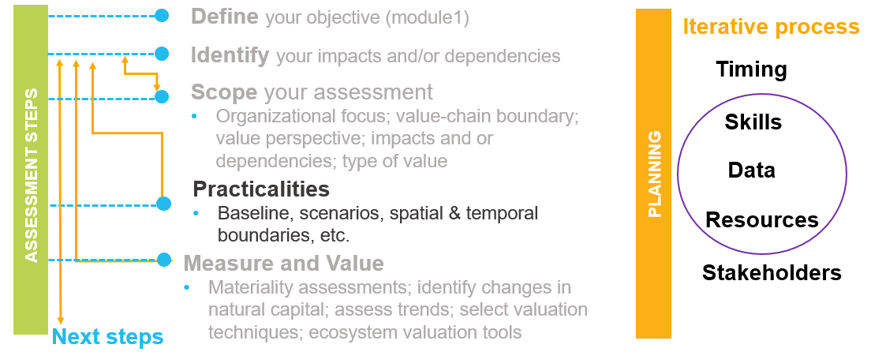
Concrete steps to undertaking a 1st natural capital assessment
Notes:
The following step is practicalities, which addresses technical issues and key planning issues.

Slide 95

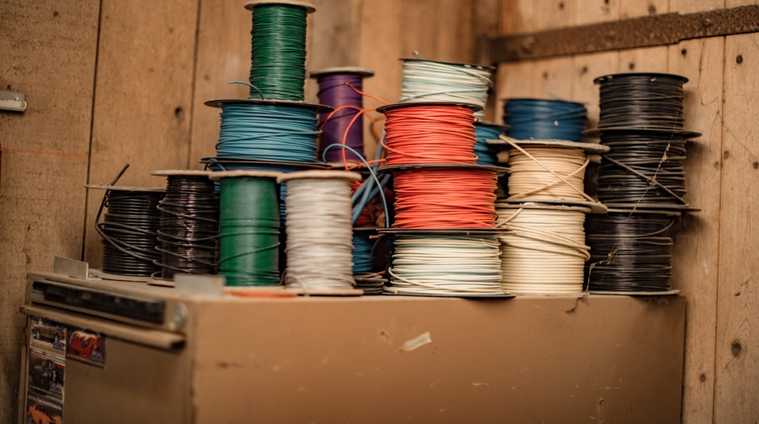
Practical considerations

Slide 96
Planning an assessment
Refer to p. 40 of your workbook & p. 41 of the
Natural Capital Protocol
Timescale: How quickly does the assessment need to be completed?
Funding/resources: What budget and human resources are available?
Capacity: What skills are available within the business to undertake an assessment?
Data availability and accessibility: What constraints on data are anticipated?
Stakeholder relationships: To what extent do you need to identify and establish relationships with stakeholders?
Notes:
Your answers to the scoping questions outlined in the slides before may need to be adjusted in light of planning and resource constraints, which will determine what scope is actually achievable. These constraints may also be considered as “critical success factors”:
Timescale
Funding/resources
Capacity
Data availability and accessibility
Stakeholder relationships

Slide 97
Other considerations
Refer to p. 40 of your workbook & p. 42 of the
Natural Capital Protocol
Baseline e.g. current conditions
Scenarios e.g. climate change based on published IPCC predictions
Spatial boundary e.g. 3 largest manufacturing facilities, 3 largest plantations in Kenya
What are the corporate boundaries (i.e. suppliers/ contractors)
Temporal boundary e.g. next 10 years
Notes:
Baseline: is the starting point or benchmark against which changes in natural capital can be compared.
Scenario: The concept of valuation is based on being able to compare outcomes and impacts across at least two scenarios: the baseline discussed above, and a chosen scenario that is being “valued”.
Spatial boundary: Establishing the spatial boundary means deciding what geographic area the assessment will consider. The answer depends on various factors, including the organizational focus, value-chain boundary, and chosen value perspective, which you will have already decided earlier.
Temporal boundary: Identifying a temporal boundary means determining an appropriate time frame for the assessment (i.e., over how many days, months, or years should impacts and/or dependencies be assessed and compared?). The assessment period should relate to your objective and correspond to the organizational focus and material impacts and/or dependencies under consideration.

Slide 98
Practical tips & success factors
Refer to p. 40 of your workbook
p.25 of your workbook
Define a clear purpose
Engage stakeholders
Address relevant issues, make your project tailor-made
Simple and accessible results
Develop clear recommendations and an action plan
→ Highlight insights rather than absolute numbers
Notes:
Some extra practical tips & success factors are..

Slide 99


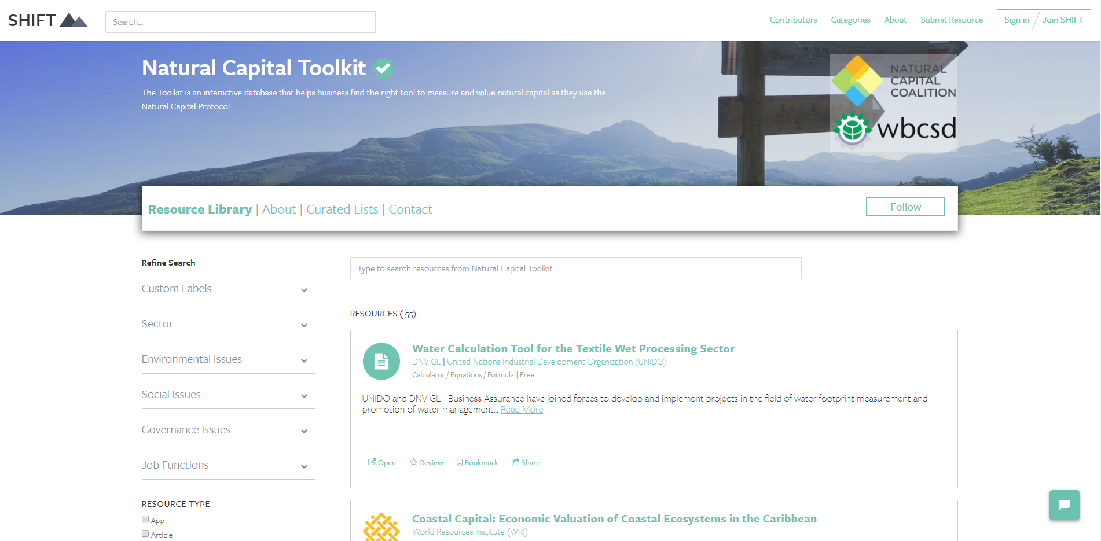
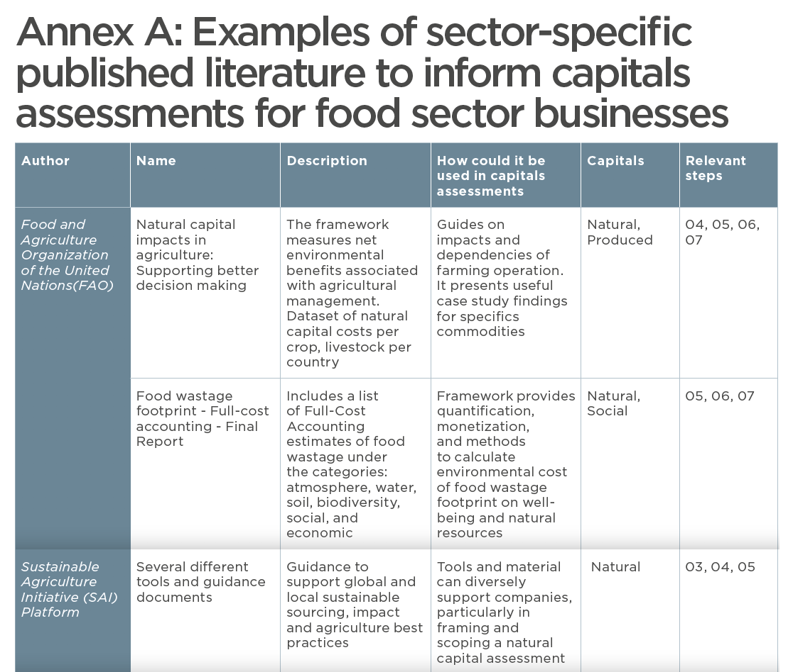

Useful tools & resources
Refer to p. 41 of your workbook
There are lots of useful tools out there. SHIFT.tools is a searchable repository of tools, including the Natural Capital Toolkit.
TEEBAgriFood Operational Guidelines for Business - Annex A
Notes:
The slide shows that there are many tools out there, many of which are freely accessible and readily available for companies to use and start assessing their natural capital impacts and dependencies.
Briefly explain SHIFT platform, that it is a searchable repository of tools. It is an interactive database for businesses to find the right tools(s) to assess their relationship with nature or ‘’natural capital’’. The SHIFT platform includes the Natural Capital Toolkit . Can give further background on the reason why this toolkit was transferred onto the SHIFT platform – to encourage standardization & harmonization of tools.
The TEEBagrifood Operational Guidelines for Business brings together the TEEBAgrifood Evaluation Framework and the Capitals Protocol. The guidelines:
• Provide context on why capitals are relevant to any business in the food system and how businesses benefit from them.
• Develop the business case for integrated capitals assessments in the food sector.
• Identify material impacts and dependencies on different capitals relevant to businesses across the value chain of the food sector.
• Use practical examples to demonstrate sector-specific business applications.
SHIFT.tools: https://shift.tools/
Natural Capital Toolkit: https://shift.tools/contributors/551
TEEBAgriFood: Operational Guidelines for Business : https://capitalscoalition.org/teebagrifood-operational-guidelines-for-business-launch/

Slide 100
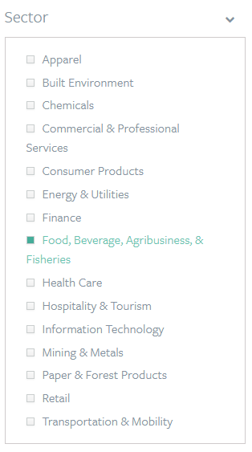
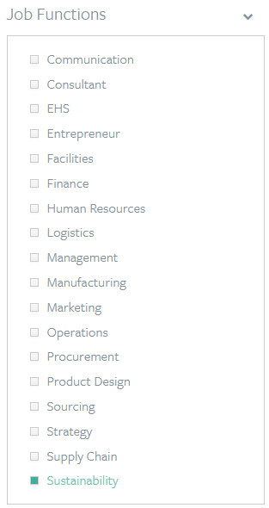
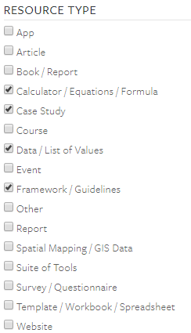

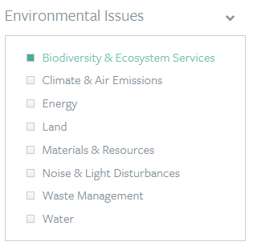
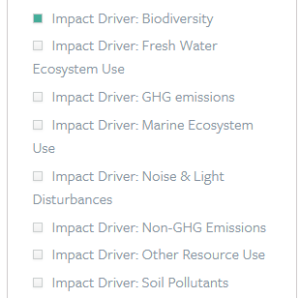
Natural Capital Toolkit example
F&B fishery company
Conduct a company-wide assessment on biodiversity
Sustainability team
Notes:
An example of how the platform works, providing a fictional scenario.
Conclusion is that:
There are no perfect answers!
The choice of tool will depend on various factors:
What is the objective / what are you trying to achieve? / What decision are you trying to inform? – Is it to inform business strategy? Business management? Or operating decision?
What is the scope? Are you looking at product, corporate level?
What perspective are you looking at? Business? Societal? Both?
How much resources do you have available to conduct the assessment?
How much information / data do you already have?
Will you need external help?
Etc.

Slide 101
Tools to Determine Impacts and Dependencies
Refer to p. 38 of your workbook
Refer to p. 42 of your workbook
ENCORE (Natural Capital Finance Alliance)
Impacts and dependencies at economic sector level – qualitative
SASB (Sustainability Accounting Standards Board)
Impacts at a sector level – qualitative
Natural Capital Protocol: Food and Beverage Sector Guide
Impacts and dependencies for the food and beverage sector – qualitative
TEEBAgriFood Operational Guidelines for Business
Impacts and dependencies across food value chains - qualitative, quantitative or monetary
I360X (Impact 360) ●
Impacts across all natural, human, social and financial capital – quantitative and qualitative
Corporate Ecosystem Valuation (CEV)
Impacts and dependencies on ecosystem services – quantitative and monetary
InVest ●
Dependencies – how do goods and services from nature sustain human life – modelling, monetary
Notes:
Presenter to point out that there are a lot of useful tools out there that businesses can use to determine their impacts and dependencies. The tools differ in their focus: impacts/dependencies or both, the types of natural capital they include (only water, biodiversity?), and the method of valuation (qualitative, quantitative, monetary). Qualitative valuation is often considered to be very important at the start of an assessment as it can give businesses a good understanding of where their main impacts and dependencies are and where additional information may be needed to inform decision-making. The black dots mark the tools that require more technical knowledge and that are more difficult to implement.
ENCORE (Natural Capital Finance Alliance): The aim of the project is to help financial institutions to better understand, assess and integrate natural capital risks in their activities. It helps measure impacts and dependencies in a qualitative way.
https://encore.naturalcapital.finance/en
SASB (Sustainability Accounting Standards Board): Focus on financially material information on environmental and social topics and the governance of those topics. By focusing on financially material issues, SASB aims to help companies around the world to report on sustainability topics that matter most to investors.
https://www.sasb.org/
Natural Capital Protocol: Food and Beverage Sector Guide: Guide specified to the Food & Beverage sector. Through a stepwise approach, the Guide helps F&B companies to determine their main impacts and dependencies.
https://naturalcapitalcoalition.org/natural-capital-protocol-food-and-beverage-sector-guide/
TEEB AgriFood Operational Guidelines for Business: Developed to support businesses in implementing the TEEBAgriFood Evaluation Framework, these Guidelines provide a practical way for businesses to understand and act upon their impact and dependency on natural, human, social, and produced capital.
https://naturalcapitalcoalition.org/wp-content/uploads/2020/08/DRAFT-TEEBAgriFood-Operational-Guidelines.pdf
I360X (Impact 360): The tool can be used to make a qualitative and quantitative assessment of the sustainability impacts on a range of capitals, including natural, social and human capital.
https://www.gistimpact.com/i360xn.php
Corporate Ecosystem Valuation (CEV): This first-of-its-kind framework enables companies to consider the actual benefits and value of the ecosystem services they depend upon and impact, giving them new information and insights to include in business planning and financial analysis.
https://www.wbcsd.org/Programs/Redefining-Value/Business-Decision-Making/Assess-and-Manage-Performance/Resources/Guide-to-Corporate-Ecosystem-Valuation
InVEST: InVEST is a suite of free, open-source software models used to map and value the goods and services from nature that sustain and fulfill human life. If properly managed, ecosystems yield a flow of services that are vital to humanity, including the production of goods (e.g., food), life-support processes (e.g., water purification), and life-fulfilling conditions (e.g., beauty, opportunities for recreation), and the conservation of options (e.g., genetic diversity for future use).
https://naturalcapitalproject.stanford.edu/software/invest

Slide 102
Tools to Determine Impacts and Dependencies
Refer to p. 42 of your workbook
ARIES ●
Dependencies – how does nature provide benefits to people – linking ecosystems and the human economy – modelling
Toolkit for Ecosystem Service Site-Based Assessment (TESSA)
Impacts on natural capital and ecosystem services of actual and potential changes at individual sites – qualitative and quantitative
Farm Sustainability Assessment
Impacts across environmental, social and business - applicable to all agricultural crops - qualitative and quantitative
The Cool Farm Tool
An assessment tool to measure impacts on greenhouse gases, biodiversity and water - quantitative
CROPWAT
Dependencies – calculating the required water supply for a variety of crops – quantitative
BioScope
Impacts on biodiversity – measuring major impacts on biodiversity arising from the supply chain - using the ReCipe method for Life Cycle Impact Assessment
Notes:
Presenter to point out that there are a lot of useful tools out there that businesses can use to determine their impacts and dependencies. The tools differ in their focus: impacts/dependencies or both, the types of natural capital they include (only water, biodiversity?), and the method of valuation (qualitative, quantitative, monetary). Qualitative valuation is often considered to be very important at the start of an assessment as it can give businesses a good understanding of where their main impacts and dependencies are and where additional information may be needed to inform decision-making. The black dots mark the tools that require more technical knowledge and that are more difficult to implement.
ARIES: ARIES redefines ecosystem services assessment and valuation in decision-making. The ARIES approach to mapping benefits, beneficiaries, and service flows is a powerful new way to visualize, value, and manage the ecosystems on which the human economy and well-being depend.
http://shift.tools/iframe/1377?
Toolkit for Ecosystem Service Site-Based Assessment (TESSA): Understanding the impacts on natural capital and ecosystem services of actual and potential changes in state at individual sites to promote better planning decisions and support biodiversity conservation and ecosystem service delivery. This toolkit is designed to provide practical guidance on how to identify which services may be significant at a site of interest, what data are needed to measure them, what methods or sources can be used to obtain the data and how to communicate the results.
http://tessa.tools/
Farm Sustainability Assessment (FSA): is a set of tools for food and drink businesses that want to assess, improve and validate on-farm sustainability in their supply chains. The tools enable effective and efficient supply chain collaboration right down to the level of the farmer.
https://saiplatform.org/our-value/what-we-do/#Programmes_and_Tools:
The Cool Farm Tool: An online greenhouse gas, water, and biodiversity calculator for farming (free for farmers)
https://coolfarmtool.org/coolfarmtool/
CROPWAT: CROPWAT is a decision support tool developed by the Land and Water Development Division of FAO. It facilitates the calculation of crop water requirements and irrigation requirements based on soil, climate and crop data. CROPWAT informs the development of irrigation schedules for different management conditions and the calculation of required water supply for varying crop patterns.
http://teebweb.org/wp-content/uploads/2018/11/Ch7.pdf
BioScope: Platform BEE's BioScope provides businesses with a simple and fast indication of the most important impacts on biodiversity arising from their supply chain. The focus is on climate change and agricultural land occupation as these are the two main impact drivers on biodiversity.
https://bioscope.info/

Slide 103
Ecosystem Quantitative Valuation: data sources
Refer to p. 43 of your workbook
Cross thematic
Ecoinvent – lifecycle Inventory Database on the environmental impact for thousands of products
AGRIBALYSE program – lifecycle Inventory Database of the main French agricultural products at farm gate
World Food LCA Database – high-quality emissions factors and environmental footprint data (including carbon, water, and land)
EFSA Comprehensive European Food Consumption Database – data on food consumption across Europe
Theme specific
IUCN Red List – list of threatened species
WWF Living Planet Report 2020 – trends in biodiversity
Eurostat – statistics on waste generation and treatment
The Marine Plastic Footprint – data on marine plastic leakage
EPA – air emissions
EMEP/EEA – European air pollutant emissions
WaterStat – statistics on water footprint
Greenhouse Gas Protocol – GHG calculation tools
Notes:
Ecoinvent: a life cycle inventory database. The ecoinvent database provides process data for thousands of products, helping you make truly informed choices about their environmental impact.
https://www.ecoinvent.org/
Agribalyse program: The AGRIBALYSE® program consisted in elaborating a database of Life Cycle Inventories (LCI) of the main French agricultural products at the farm gate.
https://www.ademe.fr/en/agribalyse-program
World Food LCA Database: The World Food LCA Database provides players across the agri-food value chain with high-quality emissions factors and environmental footprint data (including carbon, water, and land) to help them better understand the impacts of their products and bolster decision-making.
https://quantis-intl.com/metrics/databases/wfldb-food/
EFSA Comprehensive European Food Consumption Database: a source of information on food consumption across the European Union (EU). It contains detailed data for a number of EU countries. The database plays a key role in the evaluation of the risks related to possible hazards in food in the EU and allows estimates of consumers’ exposure to such hazards.
https://www.efsa.europa.eu/en/food-consumption/comprehensive-database
IUCN Red list: The International Union for Conservation of Nature’s Red List of Threatened Species is the world’s most comprehensive information source on the global conservation status of animal, fungi and plant species.
https://www.iucnredlist.org/
WWF Living Planet Report (2020): The Living Planet Report documents the state of the planet—including biodiversity, ecosystems, and demand on natural resources—and what it means for humans and wildlife.
https://www.worldwildlife.org/publications/living-planet-report-2020
Eurostat – waste: Eurostat produces regular statistics on waste generation and treatment for the whole economy and on specific waste streams.
https://ec.europa.eu/eurostat/web/waste
The Marine Plastic Footprint: a comprehensive framework to measure the inventory of marine plastic leakage, step-by-step and using a life-cycle perspective. It also offers generic data that can be used to calculate marine plastic leakage for a defined list of identified sources, including plastic waste, textile fibres, tyre dust, micro beads in cosmetics, and fishing nets.
https://portals.iucn.org/library/node/48957
EPA – air emissions: Emissions factors are tools for building emissions inventories, guiding air quality management decisions and developing emissions control strategies. This website provides current information on these tools and provides support for using them.
https://www.epa.gov/air-emissions-factors-and-quantification
EMEP/EEA: The EMEP/EEA air pollutant emission inventory guidebook is prepared by the UNECE/EMEP Task Force on Emissions Inventories and Projections (TFEIP) and published by EEA. The Guidebook provides a guide to European atmospheric emissions inventory methodologies and emission factors
https://www.eea.europa.eu/themes/air/links/guidance-and-tools/emep-eea-air-pollutant-emission
WaterStat: statistics on the water footprint. Part of the Water Footprinting - the Global Water Footprint Assessment Standard lays out the internationally accepted methodology for conducting a Water Footprint Assessment.
https://waterfootprint.org/en/resources/waterstat/
Greenhouse Gas Protocol: Greenhouse Gas Protocol provides the world's most widely used greenhouse gas accounting standards for companies.
https://ghgprotocol.org/calculation-tools

Slide 104
Ecosystem Monetary Valuation: data sources
Refer to p. 43 of your workbook
Cross thematic
Environmental Value Look-up (EVL) – monetary values for a range of environmental impacts
EU KIP-INCA – Datasets on monetary valuation of ecosystems and their services
De Groot, et al. (2012). Global estimates of the value of ecosystems and their services in monetary units. Ecosystem services, 1(1), pp.50-61 – monetary valuation of ecosystem services
Theme specific
The Economics of Ecosystems and Biodiversity (TEEB) –economic impacts of biodiversity loss
Ecosystem Services Valuation Database (ESVD) – monetary values of ecosystem services across all biomes
Social Cost of Carbon (SCC) – costs resulting from emitting one additional ton of GHG into the atmosphere
Social Value UK – database on social values, social return on investment, and cost-benefit analysis
Environmental Prices Handbook EU28 version – prices for the social cost of pollution (e.g. air, water, soil)
OECD Meta-analysis of Value of Statistical Life estimates – Mortality Risk Valuation estimates in Environment, Health and Transport policies
Notes:
EVL: The Environmental Value Look-Up (EVL) Tool is a searchable database which contains indicative monetary values for a range of environmental impacts.
https://shift.tools/search/full-text?q=evl%20tool
EU KIP-INCA: An integrated natural accounting system for ecosystems and their services and associated data sets is being developed by the Knowledge Innovation Project (KIP INCA).
https://ec.europa.eu/environment/nature/capital_accounting/index_en.htm
De Groot et al. (2012): This paper gives an overview of the value of ecosystem services of 10 main biomes expressed in monetary units.
https://www.sciencedirect.com/science/article/pii/S2212041612000101
TEEB: The aim of TEEB is to assess the economic impacts of biodiversity loss and to offer practical responses to ecosystem decline
http://teebweb.org/publications/teeb/
ESVD: The Ecosystem Services Valuation Database (ESVD) is a follow-up to the “The Economics of Ecosystems and Biodiversity” (TEEB) database which contained over 1,300 data points from 267 case studies on monetary values of ecosystem services across all biomes.
https://www.es-partnership.org/esvd/
Social Costs of Carbon: The SCC is a tool that estimates, in dollars, the economic damages that would result from emitting one additional ton of greenhouse gases into the atmosphere
https://www.rff.org/publications/explainers/social-cost-carbon-101/
Social Value UK: database of over 800 social value, SROI and cost benefit analysis report.
https://socialvalueint.org/resources/report-database/
Environmental Prices Handbook EU28 version – Environmental prices are prices for the social cost of pollution, expressed in Euros per kilogram pollutant. Environmental prices indicate the loss of economic welfare that occurs when one additional kilogram of the pollutant finds its way into the environment. Captured in a single monetary unit.
https://www.cedelft.eu/en/publications/2191/environmental-prices-handbook-eu28-version
OECD Meta-analysis of Value of Statistical Life estimates - It is increasingly common to include estimates of value of statistical life (VSL) in analyses of proposed policies that affect people’s mortality risks.The analysis is presented in the publication Mortality Risk Valuation in Environment, Health and Transport Policies.
https://www.oecd.org/env/tools-evaluation/env-value-statistical-life.htm

Slide 105
Ecosystem (Monetary) Valuation Tools
Refer to p. 44 of your workbook
 | ENCORE | NatCap checker | TESSA | CEV | ARIES | InVEST
Identifying new investments, markets, prices and products |  |  |  | ✓ | ✓
Managing risks | ✓ | ✓ | ✓ | ✓ | ✓ | ✓
Articulating environmental performance and costing environmental impacts |  |  | ✓ | ✓ | ✓ | ✓
Difficulty to implement | ● | ● | ●● | ●● | ●●● | ●●●
Notes:
ENCORE: The aim of the project is to help financial institutions to better understand, assess and integrate natural capital risks in their activities. It helps measure impacts and dependencies in a qualitative way.
https://encore.naturalcapital.finance/en
NatCap checker: The Natural Capital Checker (NatCap Checker) provides a self-assessment tool to enable users to assess, communicate and improve the level of confidence in their natural capital assessment.
https://capitalscoalition.org/events/natcap-checker-beta-launch-webinar/
TESSA: The Toolkit for Ecosystem Service Site-based Assessment (TESSA) is a rapid, low-cost, participatory valuation tool designed to be used by non-experts for assessing the benefits that people get from nature (ecosystem services).
http://tessa.tools/
CEV: This first-of-its-kind framework enables companies to consider the actual benefits and value of the ecosystem services they depend upon and impact, giving them new information and insights to include in business planning and financial analysis.
https://www.wbcsd.org/Programs/Redefining-Value/Business-Decision-Making/Assess-and-Manage-Performance/Resources/Guide-to-Corporate-Ecosystem-Valuation
ARIES: ARIES redefines ecosystem services assessment and valuation in decision-making. The ARIES approach to mapping benefits, beneficiaries, and service flows is a powerful new way to visualize, value, and manage the ecosystems on which the human economy and well-being depend.
http://shift.tools/iframe/1377?
InVEST: InVEST is a suite of free, open-source software models used to map and value the goods and services from nature that sustain and fulfill human life.
https://naturalcapitalproject.stanford.edu/software/invest
Note: some of these tools (e.g. ARIES and InVEST) require a lot of data and effort. But there are also less complicated tools (e.g. Encore and NatCap checker – but these are not monetary valuation tools)

Slide 106

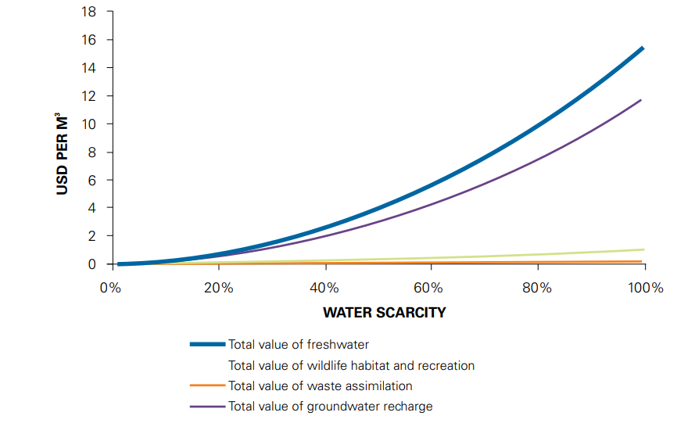

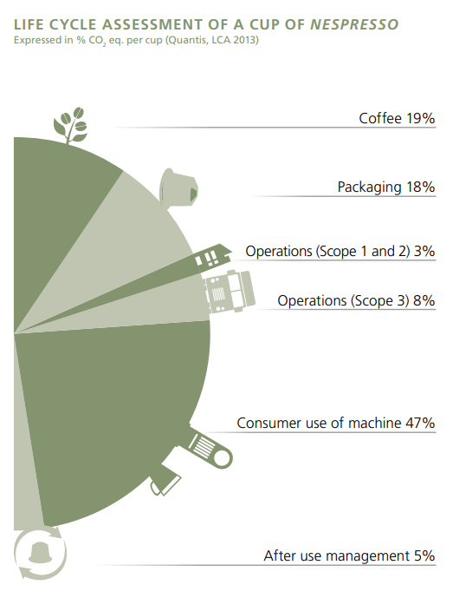



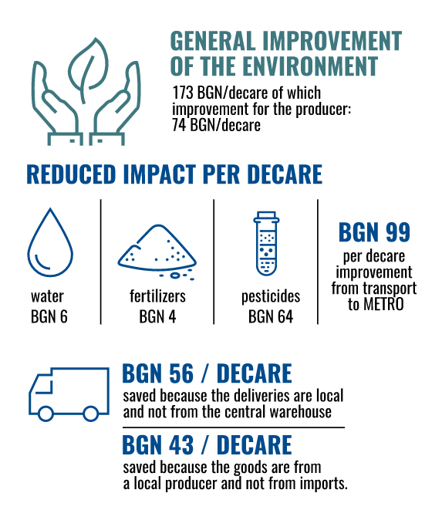
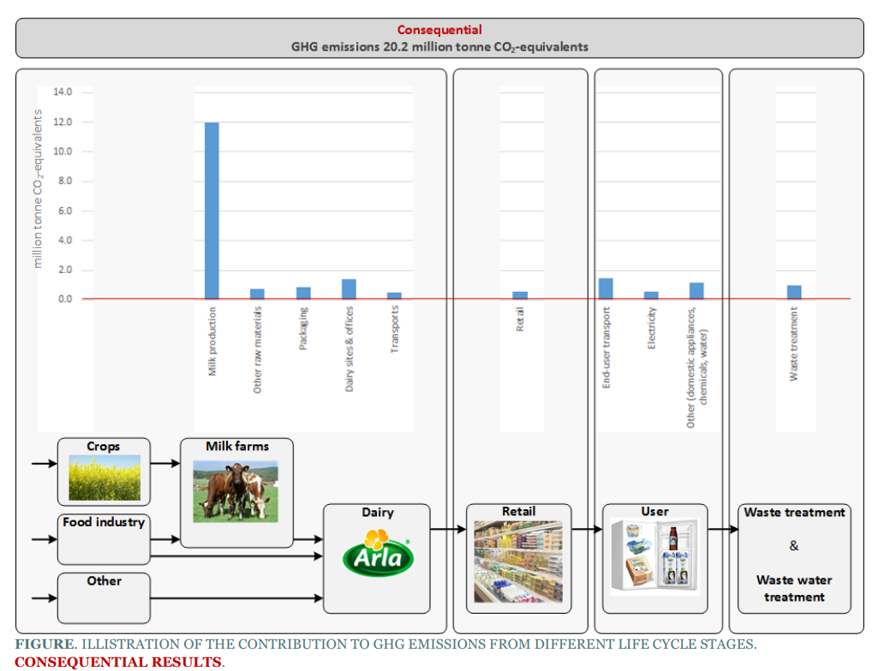
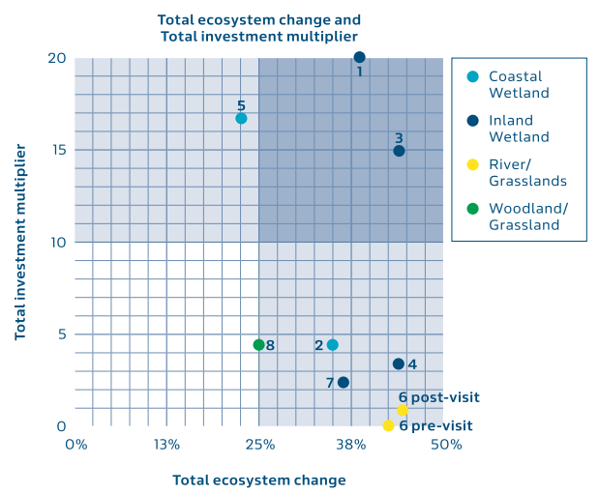
Companies are Experimenting & Sharing
Notes:
ATTENTION should talk through at least one of these with some information as to the use of the data and what it has helped the company to achieve!
Can ask after explaining this slide, what are participants’ corporate culture when it comes to this? What would their senior management team prefer?
Tru Fizz & YES Bank: YES BANK carried out the natural capital assessment for Trufizz. The overall nature and extent of business, and societal costs and benefits gives rise to significant concerns as according to the assessment done for the company, 98% of the potential revenue is at risk because of the water quantity risk. One of the key objectives of this assessment was to report and disclose the results with Trufizz’s stakeholders and increase engagement with them. This will be done both with external as well as internal stakeholders.
Arla: Arla Foods conducted an E P&L and found that the following impact categories were most significant: Global Warming (CO2, CH4, N2O), Respiratory inorganics (air emissions: particles, ammonia, NOx, SO2), Nature occupation (biodiversity). The results are calculated based on comprehensive data collection and life cycle assessments. The E P&L can help focusing on the most important impacts. Furthermore, the account can be used as a baseline to which different improvement options are evaluated.
Nespresso: Conducted a Life Cycle Assessment (LCA). Within LCA, Nespresso has chosen the carbon indicator to guide integrated and consistent actions on climate change. Nespresso today commits that every cup of Nespresso coffee, both for at-home and for professional customers, will be carbon neutral by 2022.
Metro & Denkstatt: Sustainability accounting using the Natural Capital and Social Capital Protocol. In Bulgaria, Denkstatt had assessed the benefits for the economy and the environment resulting from the Food Service Delivery (FSD) business model and the program “Nurtured with care in Bulgaria”. As part of the traditional delivery model of METRO AG, the customer buys from Cash & Carry stores. In the FSD model, professional customers make orders and METRO delivers from its central warehouse. One of the conclusions is that the chain has a positive impact on the environment, directing producers to more environmentally friendly agricultural practices.
Coca Cola & Denkstatt: The Coca-Cola Company has set an ambitious global water stewardship target, which includes protecting water resources, reducing water use, treating all process water and returning it to the environment in a clean state, and replenishing product-related water use by 2020, with the goal of water-neutral. Together with Denkstatt, an ecosystem services valuation (ESV) tool was developed and applied to 8 water replenishment projects. Most projects lead to high ecosystem change but generate a lower return on investment for the environment (lower right quadrant).

Slide 107
Where are we in the learning objectives
The aim of today’s training is:
To understand how to identify natural capital impacts and dependencies that are important to your business
Acquire the necessary tools, resources and understanding to scope your own assessment
To be introduced to the key practical considerations and steps to take when undertaking a first natural capital assessment as well as some tools to help undertake an assessment
Notes:
The objectives for today are…

Slide 108
Agenda – 2 hour training
TO ADAPT
Time (xxx) | Session
15 | Welcome – Agenda, objectives, material & introductions
10 | Setting the scene and a brief re-cap on natural capital
5 | Engaging the supply chain on natural capital
5 | Identifying natural capital impacts & dependencies
30 | Group exercise
10 | Coffee Break
20 | Scoping an assessment – Key steps to take
15 | Practical considerations – Planning an assessment
20 | Optional: Case study presentation
10 | Wrap-up – Key take-aways, wrapping-up

Slide 109

Presentation of case studies
COMPANY LOGO
COMPANY LOGO
COMPANY LOGO
Notes:
Speakers from different companies will be invited to the training to share their experience in integrating natural capital into their business decision-making processes.
Speakers will be encouraged to share:
Their experience
The solutions put in place
Challenges/barriers faced, how these were overcome and what would they do differently looking back
Collaboration with stakeholders involved in the process – who was key in supporting the solution, making it happen and perhaps also discussion around communications, how do you have to communicate differently e.g. if trying to convince risk management vs
During presentation of case studies, participants will be encouraged to take note of:
Challenges & barriers
Solutions, activities
Key stakeholders / enablers in the process
Encourage case studies speakers to also discuss how they would have done things differently.

Slide 110
Case study presentation from xyz
Refer to p. 46-51 of your workbook
Pay attention to the following elements while listening to the presentation:
Objective of assessment & process undertaken (incl. tools, methodologies adopted)
Barriers, challenges
and how overcame these
Decision-making, collaboration, next steps

Slide 111
Agenda – 2 hour training
TO ADAPT
Time (xxx) | Session
15 | Welcome – Agenda, objectives, material & introductions
10 | Setting the scene and a brief re-cap on natural capital
5 | Engaging the supply chain on natural capital
5 | Identifying natural capital impacts & dependencies
30 | Group exercise
10 | Coffee Break
20 | Scoping an assessment – Key steps to take
15 | Practical considerations – Planning an assessment
20 | Case study presentation
10 | Wrap-up – Key take-aways, wrapping-up

Slide 112

Wrap-up & next steps

Slide 113

Key take-aways / Closing word
Refer to p. 52 of your workbook
Business impacts and depends on nature
Identifying, measuring and valuing your natural capital impacts and dependencies helps make better and more informed decisions
The Natural Capital Protocol provides the framework to go through that process
There are many existing tools & resource: the one you choose depends on the objective & scope of your assessment
The first steps to assessing natural capital are to define your objective, identify your impacts and/or dependencies, and scope your assessment
113
Notes:
Business impacts and depends on nature
Identifying, measuring and valuing your natural capital impacts and dependencies helps make better and more informed decisions
The Natural Capital Protocol provides the framework to go through that process
There are many existing tools & resource: the one you choose depends on the objective & scope of your assessment
The first steps to assessing natural capital are to define your objective, identify your impacts and/or dependencies, and scope your assessment
ADDITIONAL BACKGROUND INFORMATION
How much will an assessment cost?
Some of the Protocol pilot testers - like our members Nestlé and Roche - estimated they spent about USD $50,000 on consulting services for their assessments over a six-month period. Some companies spend less, others spend more.
Dow, Kering and Natura have invested significantly more over a longer term, for in-depth assessments that contribute to their multi-year strategic ambitions
The Protocol can help companies navigate these kinds of situations by making sure the services required align with the assessment's objective.
Skills & data needed:
It's usually much more efficient to build on existing data that's readily available in-house, and the Protocol provides guidance on gathering and using that data too.
For example, many companies have data on their own GHG emissions, water, waste, and some also have results of product Life Cycle Assessments - this existing information can provide a really good starting point for a natural capital assessment. How applicable it is will depend on the objectives and scope of the assessment though, so it's important to find the balance between getting perfect data (e.g. from monitoring in the field) and using proxies that are not as accurate but can be more practical and still lead to better decisions.
Internal buy-in:
In many cases, natural capital assessments can be a bottom-up effort. Trying to drive natural capital assessments from sustainability, environment or health and safety departments is sometimes difficult, but nevertheless, the Protocol provides guidance on integrating the assessment into the business itself.
One way to facilitate engagement internally can be to show that "many companies are already doing natural capital assessments; they're just using different terminology and steps.
To support this engagement, it is important to look beyond those benefits that can be valued through the natural capital assessment itself, and acknowledge how a natural capital approach can motivate organizational change in support of broader business goals." This means that there will be more leadership from the top to better measure, value and then integrate natural capital into business.
The bottom line is that although carrying out a natural capital assessment is technical, it's also achievable. Not every assessment has to be a huge undertaking, so companies should start off with a scope that makes most sense to their situation. The Protocol will help you do this.
Finally, we must make sure the information obtained from the assessment is included in core business decision-making. This will ensure you have the best possible impact on your business, and on the environment.

Slide 114






Creating an inducive company environment for integrating natural capital
Refer to p. 54 of your workbook
Sustainability Manager
Chief Executive Officer
Chief Financial Officer
Integrating natural capital into business decision-making is a collaborative process.
Each person in a company has its own role to play in driving sustainability. Sometimes, i.e. in the case of SMEs, one person can embody different roles.
To empower your colleagues and managers and collaborate effectively, you need to be aware of the challenges and needs for each role.
Please visit WeValueNature’s digital media library, to find all action cards describing useful actions for a various roles & ways to engage others in the company on natural capital.
Procurement Officer
Marketing manager
Farmer
Notes:
Companies need to secure internal buy-in to get the green light for starting a natural capital assessement and to ensure that the results will be used in future decision-making proceses. Point out that under WeValueNature’s media library, participants can find persona actions cards for key roles within a company (e.g. CEO, CFO, sustainability manager, procurement manager, marketing manager, farmer), describing useful actions that he/she can take, the challenges and needs, and guidance for effectively engaging on the topic of natural capital.
All cards can be retrieved through: https://wevaluenature.eu/media-item/307

Slide 115
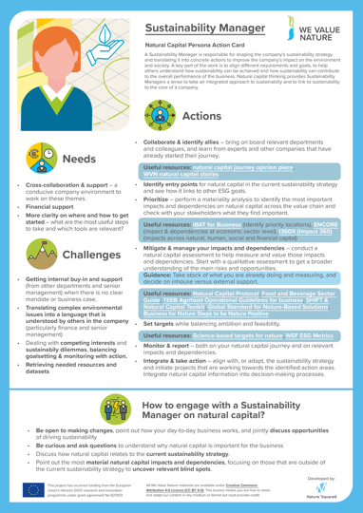





Creating an inducive company environment for integrating natural capital
Find a personas action card for each identified role through We Value Nature’s digital media library
Notes:
Sustainability Manager
Actions
Collaborate & identify allies
Identify entry points
Mitigate & manage your impacts and dependencies
Set targets
Monitor & report
Integrate & take action
Needs
Cross-collaboration & support
Financial support
More clarity on how and where to get started
Barriers
Getting internal buy-in and support
Translating complex environmental issues into a language that is understood by others
Retrieving needed resources and datasets
How to engage?
Be open to making changes
Be curious and ask questions
Discuss how natural capital relates to the current sustainability strategy
Point out the most material natural capital impacts and dependencies
CEO
Actions
Understand your company’s link to sustainability
Strategize and allocate resource
Governance
Set ambitious goals and targets
Develop and implement scalable solutions
Be vocal and challenge peers
Lead
Needs
Clear and concise messaging
Good understanding of the urgency and business case
Information translated into actionable options
Barriers
Understanding the complexities of sustainability
Limited time
Balancing responsibility for nature with responsibilities towards shareholders
How to engage?
Paint the overall picture of why NC is important to the company
Show how NC related to the current strategy
Indicate what other companies are already doinng
Ask for commitment, even when starting small
All cards can be retrieved through: https://wevaluenature.eu/media-item/307

Slide 116
Mentimeter closing questions
Refer to p. 53 of your workbook
What is your 1 key learning from the training?
Share 1 concrete next action you will take after this training
Notes:
Through Mentimeter, we will ask you to share:
2 key learnings that were most useful to you today,
1 concrete next step / activity you could take to move your company forward in the natural capital journey?

Slide 117
How to use Mentimeter
1
Go to www.menti.com
2
Enter this code: XXXXXX
3
Submit your answer

Slide 118



Eager to get started?
Check out NCC’s interactive training videos
Make use of WVN’s training resources
Notes:
The Natural Capital Coalition has recently launched a set of training videos that will guide you in an interactive way through a light natural capital assessment to explore just how much can be achieved with limited resources. Interested to learn more? Check out these videos here: https://naturalcapitalcoalition.org/protocol-training/
Link to WVN training resources: https://wevaluenature.eu/training-resources

Slide 119

Next steps that YOU can take
TO ADAPT
Download & familiarize yourself with the Natural Capital Protocol - Food and Beverage sector guide
Share training learnings & material with colleagues and your manager over coffee
Use & present the training slides to your team & manager – You want to find some allies!

Slide 120




We are here to help!
Next call:
Next training:
Deep-dive webinars
In-person training
Helpdesk calls
Virtual office hour/
Q&A
Online training
Train-the-trainer
Keep in touch & sign-up: wevaluenature.eu
Exchange with peers:
We Value Nature - Natural Capital uptake support group
Provide your feedback: Survey
We want to learn too – how have we helped?
120
Notes:
WHAT ELSE would you need? What support would you need?
Sign-up for in-person day training, t-t-t
If want support, need to fill out survey (Google form survey)
Refining training further, keen to know how have used this training and catch-up via call (if don’t want to, let us know)
https://wevaluenature.eu/

Slide 121


Slide 122
Disclaimer
Disclaimer
WVN F&B module 2 is a capacity building program released in the name of the WVN network. It is the result of a collaborative effort by WBCSD, Nature^Squared, Little Blue Research, Ltd. with input from an Advisory Board composed of experts on natural capital, businesses, NGOs, academic institutions, and others.
The training was tested with the WBCSD membership. It does not mean, however, that every advisory board member, and WBCSD member company agrees with every word. The WVN module 2 has been prepared for capacity building only and does not constitute professional advice. You should not act upon the information contained in the WVN module 2 training without obtaining specific professional advice. No representation or warranty (expressed or implied) is given as to the accuracy or completeness of the information contained in the WVN module 2 training and its translations in different languages, and, to the extent permitted by law, WBCSD, Nature^Squared, Little Blue Research, Ltd., members of the Advisory Board, their members, employees and agents do not accept or assume any liability, responsibility or duty of care for any consequences of you or anyone else acting, or refraining to act, in reliance on the information contained in this capacity building program or for any decision based on it.
Copyright © WVN
February 2021

