Slide 1
We Value Nature Module 2: Train the Trainer
Implementation Guide

Slide 2
Overview
Objective of the implementation guide
Contents
This implementation guide has been developed to aid trainers delivering the “We Value Nature” module 2 training on scoping a natural capital assessment.
The implementation guide includes a summarized set of tips and suggestions for engaging with training participants when presenting the course in person or virtually.
This implementation guide complements the speakers notes and facilitators notes templates that are provided for module 2.
This guide is split into the following sections:
An introduction to the business case for the course and the We Value Nature program
How to make use of the training material
Overview of module 2: what, why, how?
Tips for running module 2 successfully
FAQs
Appendix: acknowledgements and further resources

Slide 3
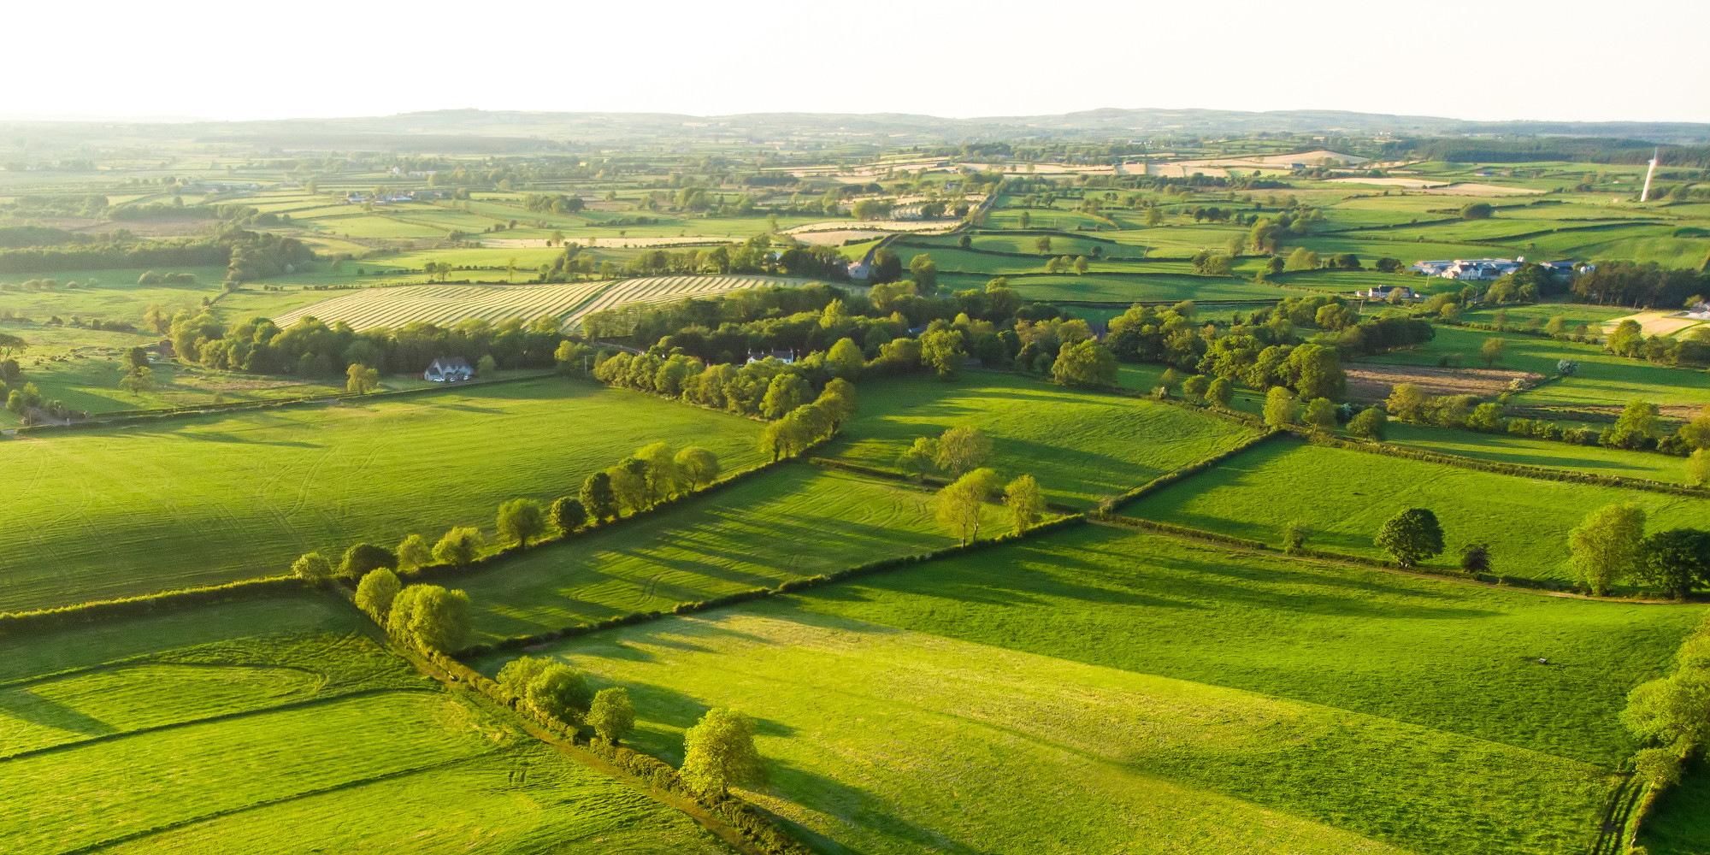
Introduction

Slide 4
Building business capacity to value nature in decision-making
WHY
WHAT
HOW
With COVID-19 disrupting economies and societies across the globe, there has never been a better time for businesses to assess their impacts and dependencies on natural capital and integrate the value of nature into decision-making processes. This also means that capacity building has a key role to play in order to ensure that businesses are equipped with the right tools, resources and knowledge to take necessary action.
The We Value Nature Campaign has put together an open learning platform with training material tailored to businesses from all sectors.
There are currently two training modules on natural capital which use the Natural Capital Protocol as a basis.
The training material include a slide deck, speaker notes, facilitator agenda, workbook, as well as accompanying exercises and infographics.
All training material is freely accessible through our training resources page.
Anyone is free to download, use and adapt the training material to best suit their respective context, following our guide on how to appropriately credit.
With the aim of making this material as suitable and useful as possible to a variety of audiences and situations, all training material has been adapted to different lengths: 1, 2 & 3 hours.
4

Slide 5
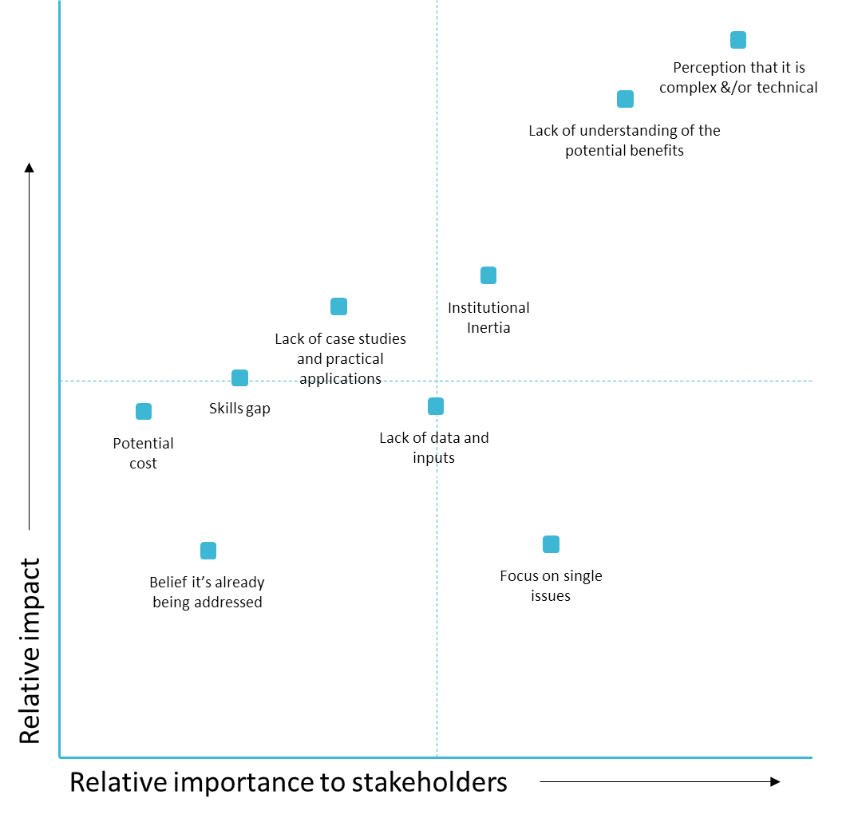
Addressing key barriers to natural capital uptake through training
New findings from We Value Nature Survey:
Perception that it is complex &/or technical
Lack of understanding of the potential benefits
Lack of regulatory frameworks
Institutional Inertia
Lack of standards (metrics, reporting etc.)
Lack of data and inputs
Focus on single issues
(In order of importance to stakeholders, 1 is highest)
Based on Coalition Annual review 2016 & 2017
Notes:
KB

Slide 6
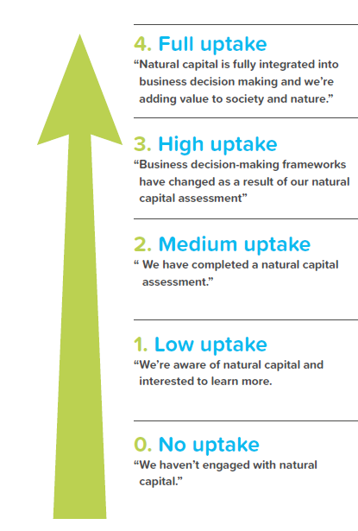
Typical barriers
Comprehensive
We Value Nature actions
Lack of regulatory frameworks
Lack of standards (metrics, reporting etc.)
Focus on single issues
Case studies on public/private policy
Input into NBS standard
Maturing
are influenced by natural capital assessments.
Lack of data and inputs
Lack of case studies and practical applications
Institutional Inertia
“Testimonial” case studies
More detailed, specific training
Developing
Uptake levels of natural capital approaches
Perception that it is complex &/or technical
Lack of understanding of the potential benefits
Introductory training
Simplified, curated communications
First steps
Just starting
Check out here our blog post on We Value Nature’s uptake pathway and how business can advance on its natural capital journey

Slide 7
A modular approach to training
Module 1.
Understanding natural capital and the relationships with business decision-making & risk management
Module 2.
Understanding the tools & resources needed to approach a first natural capital assessment
Module 3.
A deep-dive into natural capital valuation methods
Module 4.
Integrating natural capital to support decision-making
Food & Beverage sector-specific training material

Slide 8
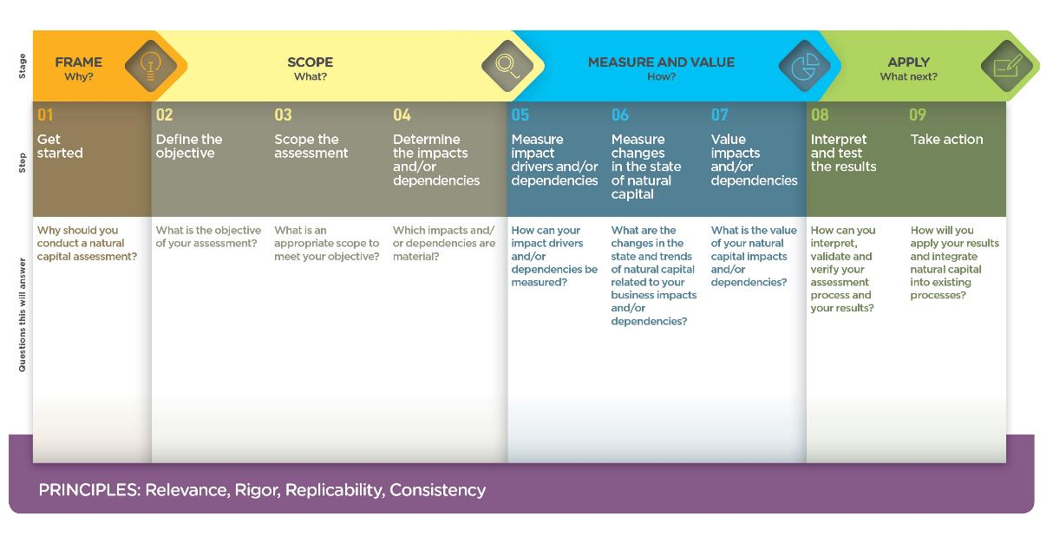
The Natural Capital Protocol as a basis for the training content
Module 1
Module 2
Introduced in module 2
Link to the Protocol here

Slide 9
The business case for assessing natural capital
The business case
Module 2 can help participants to:
Many natural capital risks and opportunities are becoming increasingly visible, and businesses needs a way to understand and manage these.
We Value Nature has produced practical training material on natural capital to help businesses better understand their relationship with nature, how to manage their impacts and dependencies, as well as integrate nature into decision-making.
Effectively managing natural capital impacts and dependencies can make companies more competitive, more resilient to shocks, more agile in a fast-changing world, and more likely to attract and hold customers and the best employees.
Understand their relationship with nature in a structured way
Mitigate risk and create opportunity
Increase their competitive advantage
Inform decisions that are important to their business
Recruit and retain staff
Improve relationships with regulators, banks, insurers and financial markets

Slide 10
How to make use of the training material

Slide 11
We Value Nature training is open
You are free to:
Share — copy and redistribute the material in any medium or format
Adapt — remix, transform, and build upon the material for any purpose, even commercial
Under the following terms:
Attribution — You must give appropriate credit, link to the licence & indicate if changes were made (but not suggest endorsement).
No additional restrictions — You may not legally restrict others from doing anything the license permits.
CC BY 4.0 Creative Commons Attribution 4.0 International
If any images are more restricted this is noted on caption.

Slide 12
How to attribute We Value Nature training materials
If you’re just using one or two slides you can use our attribution block:
View here an example of two training slides on natural capital risks & opportunities that have been adapted to focus on realities in India.

Slide 13
Full attribution
For training courses based on We Value Nature materials:
Include these three slides.
Give them a couple of minutes… please don’t skip over them.
Ensure that participants understand that original We Value Nature materials are available under an open license.
View here our best practice on how to appropriately credit.

Slide 14
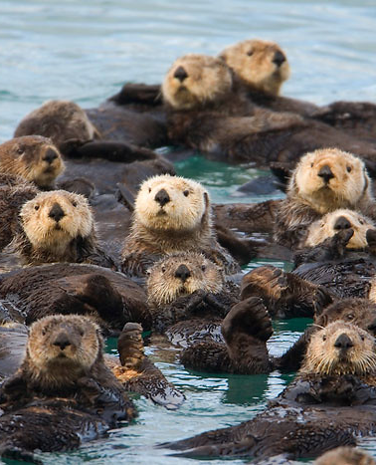
It’s good to share!
Let us know how you use the We Value Nature training materials.
How have you adapted them for your own training?
We will be pleased to share your news & resources with the We Value Nature community.
Share your remixed materials in our open media library
Training@wevaluenature.eu
@WeValueNature
smileycreek CC BY-NC-SA 2.0

Slide 15
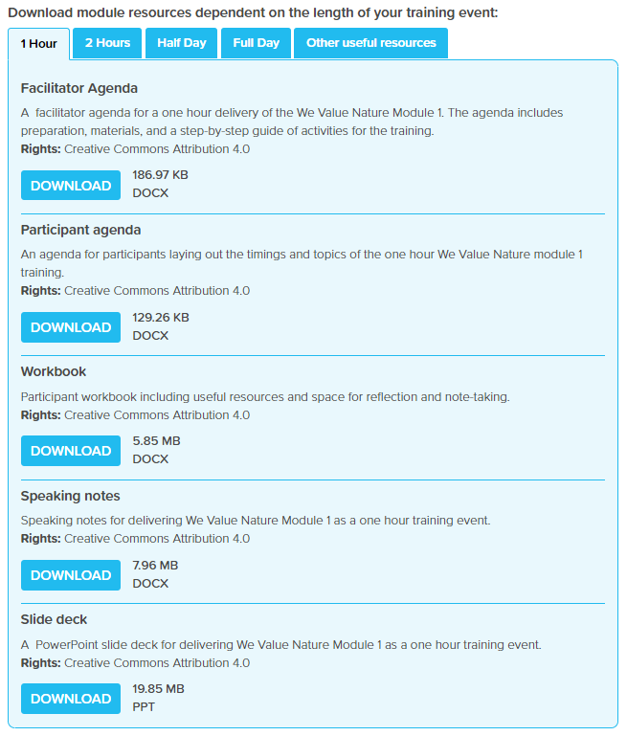
How can you adapt the length of the training?
You will find all the material adapted to different timing on We Value Nature’s training resources page!

Slide 16
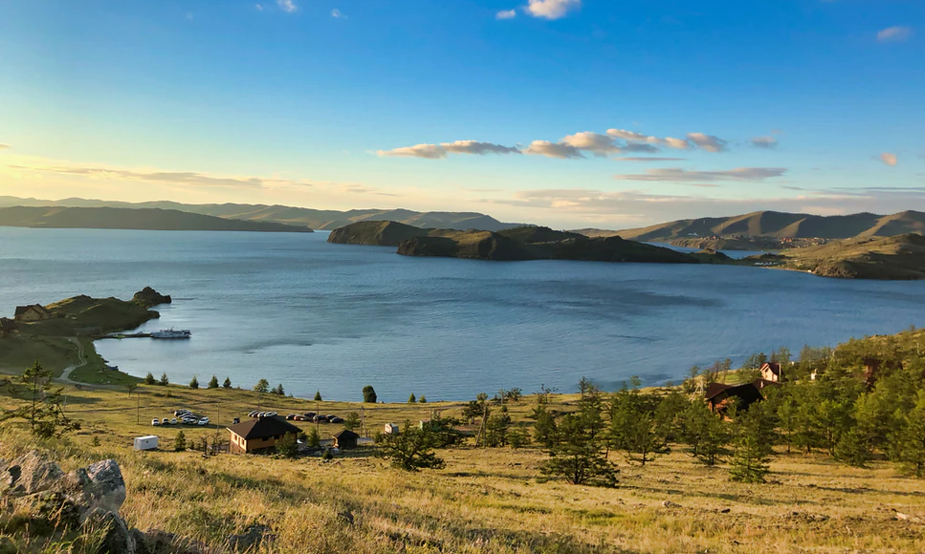
Module 2: course overview

Slide 17
Target audience
Who is the training for?
The We Value Nature module 2 training is an instructor-led training program designed to equip participants with the practical knowledge to begin scoping their own natural capital assessment
This module was designed for a business audience
Whilst the training is business focused, it is relevant to delegates from a wide range of different sectors, regions and levels of seniority. It is expected that all participants will have a general understanding of the relationship between business and natural capital, as outlined in the module 1 training or through their own experience.
The module 2 training is freely available on the We Value Nature’s website: https://wevaluenature.eu/article/how-approach-your-first-natural-capital-assessment

Slide 18
Learning objectives of module 2
The aim of We Value Nature’s module 2 training is:
To understand how to identify natural capital impacts and dependencies that are important to your business,
Acquire the necessary tools, resources and understanding to scope your own assessment,
To be introduced to the key practical considerations and steps to take when undertaking a first natural capital assessment as well as some tools to help undertake an assessment
To understand materiality assessments in the context of impacts and dependencies and how to undertake them
To introduce valuation following on from the brief overview provided in module one

Slide 19
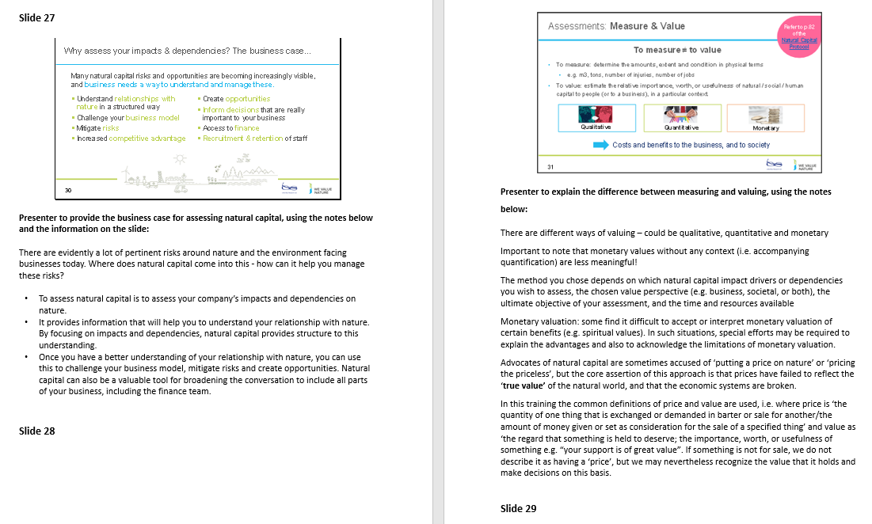
Training material available
Training deck
Presentation slides for each module for 1-, 2- and 3-hour sessions (with the option to be delivered virtually)
Speaker notes
Detailed notes accompanying the training deck for the facilitator to present from
Agenda (participant & facilitator)
Handout for the participants and the facilitators providing a session overview and timings as well as notes on how to run the sessions

Slide 20
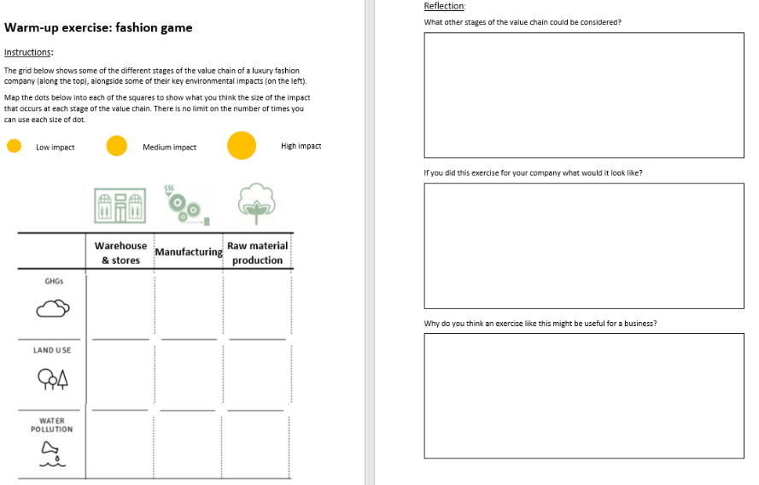
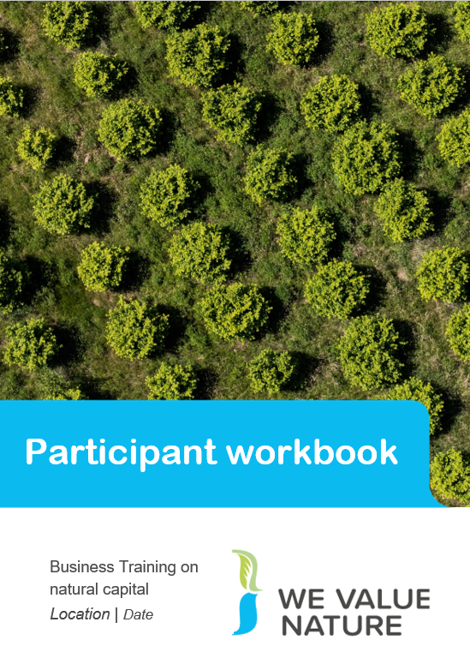
Training material available
Workbook
A handout for the participants with key definitions, diagrams and further information for those wanting to explore a topic. Also includes space to write reflections and responses to activities, as well as learnings for each section. This encourages active learning.
Pre-training warm-up exercise
A handout for the participants with some pre-training exercises and key definitions

Slide 21
Training material available
Note: the We Value Nature training was developed in English – however, the WBCSD team is actively looking for translation and implementation partners. If of interest, please get in touch with Katia (bonga@wbcsd.org)
Train the Trainer deck
Presentation slides for the module 2 3-hour session, with added tips and advice on how best to present the material
Train the Trainer implementation guide
An implementation guide to complement the training deck

Slide 22
Training material: course content
Key sections in the module 2 training include:
Setting the scene and a brief re-cap on natural capital – providing context into natural capital assessments and clarifying key definitions
The business case for assessing natural capital and common assessments – explaining the necessity of impact and dependency assessment in risk and opportunity management
Identifying your natural capital impacts and dependencies – providing case studies and examples of impacts and dependencies
Scoping an assessment – outlining the information and tools needed to prepare a natural capital assessment
Materiality – determining which impacts and dependencies are important to your business
Introduction to valuation – evaluating monetary valuation and providing insight into techniques
These topics vary slightly across the 1-, 2- and 3-hour training sessions:
For example, only the 2- and 3-hour sessions include sections on materiality and valuation

Slide 23
Training material: layout
Training layout
The module 2 training material has been developed in a way so that professionals with a good background in sustainability can deliver the course. We suggest that two facilitators present the training material
A specialist with a background in environment and sustainability
An experienced facilitator with a background in training and development
However, there are certain slides that require a specialist knowledge which have been identified. This is particularly focused on areas of the training that relates to environmental economics.
Facilitators should be familiar with running workshops
Facilitators should be able to tailor the training material according to their objectives and the experience of the participants – table 1 on the following page demonstrates ways in which facilitators may adjust the agenda of the material depending on the background of their participants.
Note that the training material is easily adapted – trainers can pick and choose the slides from the training which are most relevant for their session/context!

Slide 24
Training material: layout
Who are the sessions for?
Audience | Setting the scene | Business case | Impacts & dependencies | Scoping | Materiality | Valuation
General (no background) | R | R | R | R | O | O
General (some background) | R | R | R | R | R | O
Specialist | O | O | R | R | R | R
Senior management | R | R | R | R | R | O
CEO and Board | O | O | O | O | O | O
Table 1: recommendations as to which sections of the module suit different audiences
R – Recommended session
O – Optional session

Slide 25
Tips for running module 2

Slide 26
Legend
Throughout the training the trainer presentation deck, key tips and suggestions have been included. Each of the following pages provides specific information in relation to each tip category. Tip categories include:
Edit the content depending on the timing available for the training
Deliver the content in a way that is suited for in-person training
Deliver the content in a way that is suited for virtual training
Edit the content based on the participants background (e.g. experience, knowledge, sector)
Provide further examples or explanation
Adapt the content and add further contextualization based on the relevant sector/region
Background knowledge required to deliver content (e.g. in environmental economics)
Very important slides – do not miss out

Slide 27
Legend
The tips have been formatted depending on their content and use:
All tips on how to present and adapt the training material have been included in comment boxes throughout the slide deck:
The orange comment boxes: training tips related to content in the speaker notes
The blue comment boxes: new training tips that have been added specifically for the Train the Trainer module (i.e. not found in the speaker notes)
The legend for each slide can be found on the top right-hand side

Slide 28
Timings
These are tips on where and how to adapt the training material depending on your audience, objective and time available
Tailor the learning objectives and agenda to each session – depending on the time available. Note depending on the background of participants and session timings only certain objectives may be delivered
All reflections and knowledge checks are optional – whilst we recommend using these exercises to engage the audience, they can be missed out or shortened to accommodate the time you have for the session
Depending on the timing and participant knowledge of natural capital, it is possible to skip some of the theory surrounding natural capital (e.g. definitions like NC impact are included for audiences with little to no NC knowledge)
The coffee break in the material provides a natural point to split the training deck into different parts, e.g. it is possible to deliver this as 2 sessions.

Slide 29
Virtual or in-person
The next slides include tips on how to present the training material through different mediums (e.g. in-person or over a virtual webinar)
Variations across presentation media include:
The materials required for interactive components (e.g. post-it notes and markers if in-person)
The house rules (e.g. attendees will be asked to put themselves on mute when not speaking in a virtual session)
The introductions and ice breakers (e.g. talk on tables for in-person or talk on the chat for virtual)
The use of zoom breakout rooms versus table-based exercises.

Slide 30
In-person session
Group exercises
Limit groups to 3-4 at tables and ensure that all team members have time to quickly introduce themselves at the start of an exercise.
You will need to provide large scale or multiple print-outs for case study exercises for groups to work through making sure that instructions are visible to all participants in the room.
Limit discussions to a specific time period during exercises, reinforce this by letting participants know when they are halfway through their timings and at regular intervals
If possible, ensure that each table has access to a support person from the training team to help answer clarifying questions or take notes depending on the exercise.
To ensure that feedback sessions include all participants select one person to feedback key points after each exercise and vary this.
Where there is more time available you may wish to vary groups of participants in each exercises, so that they can network with more people and to ensure that all participants get the chance to work within different teams.

Slide 31
Virtual session
Group exercises
If using a feature that allows breakout rooms, try to assign groups in advance. Limit groups to 4-5 just in case some participants drop out of the training. Where a group has been affected significantly by the drop out rate re-assign breakout group members during the initial stages of the course. For more information, visit the FAQ’s on breakout rooms on Zoom
Ensure that participants have access to the instructions for the breakout room, through an online document or in a .pdf version of their workbook
During the breakout session it is possible to use a google document to capture participants thoughts, alternatively any other interactive collaboration software can be used for this purpose.
If possible, ensure that each table has access to a support person from the training team to help answer clarifying questions or take notes depending on the exercise
Limit discussions to a specific time period during exercises, reinforce this by letting participants know when they are halfway through their timings and at regular intervals
To ensure that feedback sessions include all participants select one person to feedback key points after each exercise and vary this.

Slide 32
Virtual session
Interactive software: Zoom
You can use Zoom to add question and answers to a live poll for virtual training
Creating a poll: Go to the Meetings page and click on your scheduled meeting. If you do not have a scheduled meeting, schedule a meeting now. From the meeting management page, scroll to the bottom to find the Poll option.
To enable polling: Sign into the Zoom web portal. In the navigation menu, click Account Management then Account Settings (if you are an account administrator) or Settings (if you are an account member). Navigate to the Polling option on the Meeting tab and verify that the setting is enabled. If the setting is disabled, click the toggle to enable it. If a verification dialog displays, choose Turn On to verify the change. Note: If the option is greyed out, it has been locked at either the Group or Account level, and you will need to contact your Zoom administrator.

Slide 33
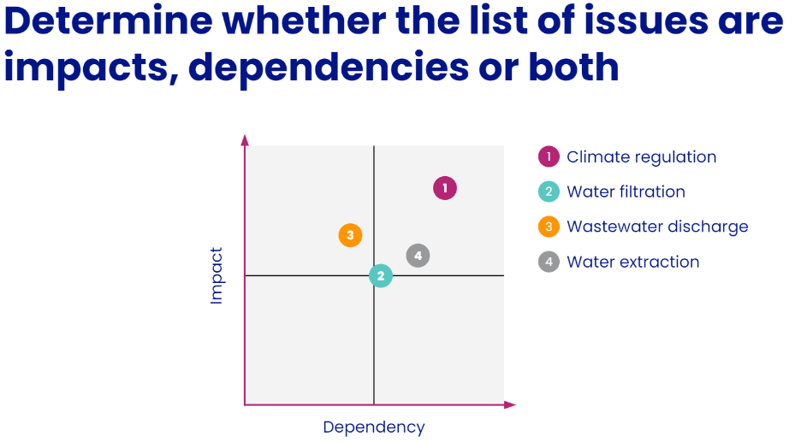
Virtual session
Interactive software: Mentimeter
You can use Mentimeter to take in-person polls and answer different types of questions – these include multiple-choice questions, open-ended written responses, graphs, cloud bubbles etc.
To set-up the poll: click Add. Enter a title and your first question. (Optional) Check the box to make the poll anonymous, which will keep the participant's polling information anonymous in the meeting and in the reports. Select whether you want the question to be single choice (participants can only choose one answer) or multiple-choice question (participants can choose multiple answers). Type in the answers to your question and click Save at the bottom. If you would like to add a new question, click Add a Question to create a new question for that particular poll.
Note: Mentimeter is a paid for service but allows the use of up to three questions using a free account.

Slide 34
Virtual session
Interactive software: Mentimeter
To enable polling: the host can create a presentation once signing up to Mentimeter. Questions and activities can be added to each slide of the presentation. Participants can answer the questions and interact with the presentation by typing a 6-digit code found at the top of the presentation into Menti.com. The host can either create a new share on Zoom to display the Mentimeter slides or download the Mentimeter plug-in for PowerPoint. To run this question, select question type when creating your presentation, and fill in the question and answers as directed.
During polling: the host will be able to see the results live. Once you would like to stop the poll, click End Poll. If you would like to share the results to the participants in the meeting, click Share Results. The results can be downloaded once the meeting has ended.

Slide 35
Tailoring the module to the audience
This slide includes tips for changing the content of the training material depending on the background and number of people attending the training
Understand your audience! In the introductory section (or even as a pre-training exercise) find out what experience and knowledge participants have in relation to natural capital – this will help inform the delivery of the presentation, helping to engage them during the module. This can be done as a survey or as an extra ice-breaker activity alongside the other introductions. Questions to consider include:
Do the participants come from a particular sector? Are they involved in sustainability and sustainable reporting as part of their job function? Have they completed the module 1 training?
Once you understand the background of participants, you can:
Tailor the agenda to reflect their experience
Adapt the knowledge checks to test their understanding and challenge them
Highlight the points and examples in the training material which are more relevant for them
Edit the reflections so that participants come away with new insight and realizations
Showcase sector or region-specific case studies which resonate with the group
Provide links and evaluations to tools which are more useful and practical
Expand and provide more detail on points of interest for the group being trained.

Slide 36
Using further explanations and examples
This slide includes tips where participants may benefit from the use of specific examples, elaborations or anecdotes
In providing the business case for assessing natural capital, draw on real-life examples of risk or opportunities to distinguish between the different types and highlight their relevance for participants
Draw on your own personal reasons for assessing impacts and dependencies in your business context
When outlining project ambitions to scope an assessment, give examples of the different categories to aid the participants’ understanding (e.g. examples of assessments where the organisational focus has been more corporate or product based and why this was chosen
Share examples of different types of external and internal stakeholders based on your experience of a project or based on a case study that you are familiar with
Provide examples of your experience of obtaining buy-in, or those for a case study that you are familiar with
In the reflection or knowledge check exercises, it may be useful to give example answers to the questions to help participants to engage with the exercise and understand the types of answer that can be provided
Elaborate on the valuation techniques used, providing your own reflections on which techniques were successful and those you do or do not use.

Slide 37
Adaptations and contextualisation
This slide includes tips for where adaptations to the material can be made (to make the content more region or sector specific) or further context added
When running the ‘setting the scene section’ of the training, update the context so that it is relevant to participants by highlighting the importance of natural capital assessments in a way that is region or sector specific
Update example videos and visuals throughout the course so that they are useful for the participants – where possible, make examples sector specific and home in on impacts and dependencies that are important to them
Change the databases referred to in terms of the use of natural capital assessment either in a region or across a sector so that training slides reflect the most recent findings and present results that are useful for the audience
Use the case studies as an example to showcase real-life natural capital assessments – where possible, include studies where speakers are available (internal or external) to elaborate further and answer specific questions
Depending on the objective of the training, adjust the case study exercises to focus on specific areas (e.g. it might be in the company's interest to consider dependencies more closely or address certain ecosystem services that play a larger role in a particular region or sector)
Tailor the tools presented to the participants (e.g. there may be some tools that are more useful for certain employee roles or certain regions)

Slide 38
Background knowledge required
This slide sets out tips for areas in the training where the presenter will need a background knowledge
For the introduction to valuation section the presenter must be able to:
Highlight the difference between measurement and valuation and talk through the different types of valuation: qualitative, quantitative and monetary.
Present the Total Economic Valuation model and be able to discuss examples of different types of value
Evaluate different valuation techniques and provide suggestions as when to use them depending on the context
Give practical tips and tools to tackle natural capital assessments in real life
Provide justifications and explanations for the answers to all case studies (e.g. justification as to why impacts are high, medium or low for specific contexts in which materiality has been ranked).
Be comfortable with the definitions to answer questions on these and why they are used
Explain different types of criteria for materiality assessments and how this can vary using different examples of criteria

Slide 39
Important slides
This slide includes tips on which parts of the module 2 material are important and/or necessary when giving the training:
Ensure that the audience are familiar with key definitions such as natural capital and ecosystem services – these will form the foundation of the scoping exercise (slides 21-27)
Make sure that the audience understand the importance of natural capital assessments and their applicability in business contexts (slides 29-33)
It is important for the audience to have a good grasp of the key factors to consider when scoping an assessment and the types of stakeholders that can be bought in as set out in (slides 61-62)
Additionally, it is useful for the participants to understand their target audience and the ways in which they can create buy-in to drive their projects forward (slide 63)
Generally, the most important parts of the training for the audience are the practical tips available that can help them put their assessment into action (78-83; 106-107)
Note: the references to the slide numbers correspond to the slides in the 3-hour deck – depending on whether you use the 1-, 2- or 3-hour deck, not all slides mentioned here will be relevant

Slide 40
Other tips
Agenda
The agenda can be modified depending on the time available. There are different options available for training duration i.e. 1-, 2- & 3- hours. Note that there are more complex case studies and material in the 3-hour module for participants with more of a background in natural capital. The 1-hour module does not include any notes on materiality or valuation

Slide 41
Using the facilitators notes
Equipment and set-up
Agenda
The facilitators notes outline the equipment and layout required for in-person and virtual sessions
These include resources that may be useful for carrying out interactive activities as well as the printed or virtual materials which should be provided such as a participant handbook, feedback forms and the training agenda
The facilitator notes can be used to show where one presenter can hand over to another for specific slides. In addition, the notes can be used to show which of the support team will help answer questions using the chat function in Zoom and/or how results of polls and how notes for the training will be taken.
The agenda in the facilitators notes outlines recommended timings for the 1-, 2- and 3-hour sessions, based on several piloted sessions of the training material
Whilst these can be adapted, the timings are a good indication of the amount of explanation and description required for different slides and exercises
The agenda allots time to a case study presentation – this provides the opportunity to showcase a speaker

Slide 42
FAQs

Slide 43
FAQs
Here are some of the most common questions we receive about our trainings and their related answers. We will continue to build this FAQ with further common questions.
Where have you sourced your definitions?
The vast majority of the concepts, infographics and illustrations used in the training material are coming from the Natural Capital Protocol which is a standardized framework for business to identify, measure and value its direct and indirect impacts and dependencies on natural capital.
How can I make use of your training material?
All We Value Nature materials are available under Creative Commons Attribution 4.0 Licence (CC BY 4.0). This licence means you are free to share and adapt our content in any medium or format but must provide credit. If you wish to provide a training yourself using our material you can either use the entire slide deck as it is or use only some of the slides that make most sense to your context and objectives. See our dedicated webpage for further information on how to appropriately attribute our material.

Slide 44
FAQs
Is the training material tailored to a particular business audience and sector?
Our modules 1 & 2 are adapted to any business sector and include practical examples and case studies from a variety of industries.
The module 1 training being an introduction to the concept of natural capital, it can be delivered to a wide audience ranging from sustainability team to CEO, risk management, finance, communication or procurement departments.
The module 2 training addresses the practicalities of undertaking a first natural capital assessment and will therefore be particularly useful to participants that play an active role in sustainability/environment in their organization. For this module, we recommend to either have an initial understanding of natural capital or to have taken part in We Value Nature's module 1 training as some sections require a bit of technical knowledge.

Slide 45
FAQs
Is there any sector specific training available?
We are currently adapting our modules 1 & 2 to be tailored to the food & beverage and finance sectors. All material will be made available on our training resources page next year (2021). If you wish to stay informed about this new material and related training activities, you can sign-up to our mailing list.
Can We Value Nature team provide a training for my organization / company and are there related costs?
The main purpose for including all our training material on our website is to encourage and enable anyone to deliver themselves a training using our material. If you wish to gain more insights into how to best deliver our material, we encourage you to take part in one of our train-the-trainer sessions (sign-up to our mailing list to be kept informed of future sessions) or listen to the recordings of previous sessions (refer to the Appendix section to access the recording links).
The We Value Nature team is always happy to support you, don't hesitate to get in touch with Katia for any questions on our trainings (bonga@wbcsd.org).

Slide 46
Appendix

Slide 47
Available recordings of our training modules
Business training module 1 recording
Train-the-trainer module 1 recording
Business training module 2 recording
Train-the-trainer module 2 recording

Slide 48
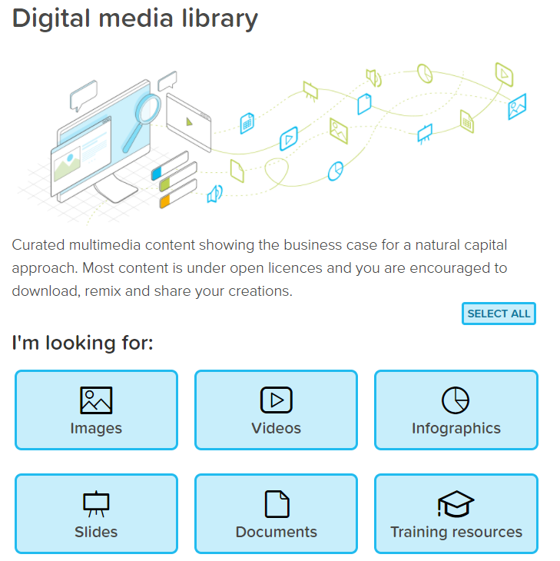
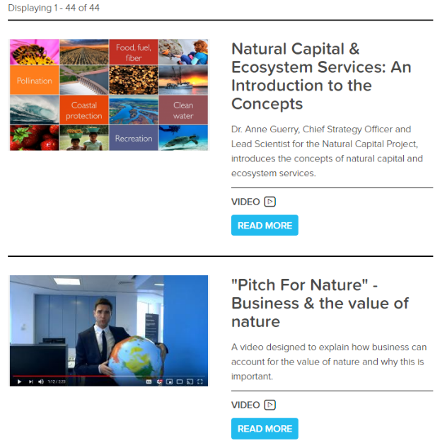
Supporting resources to your learning journey – Media library
We Value Nature’s open media library is a one stop shop to a variety of resources relating to nature in general and constitutes a valuable support to the open learning platform.

Slide 49
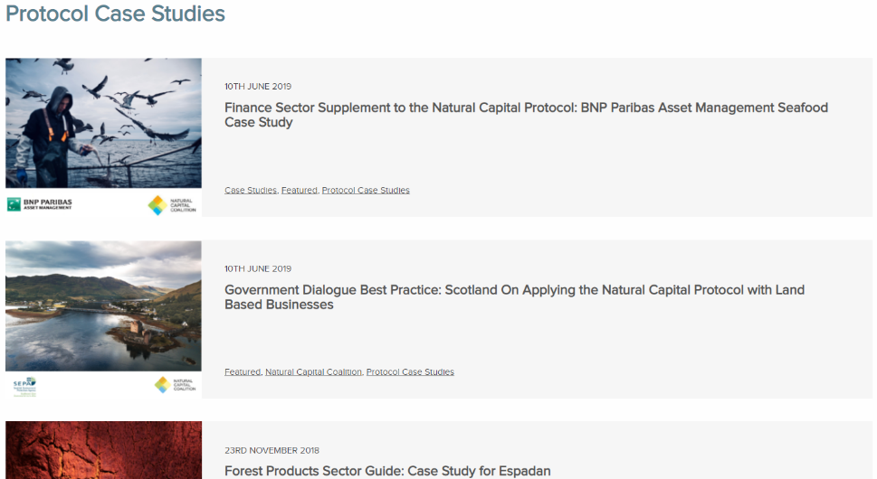
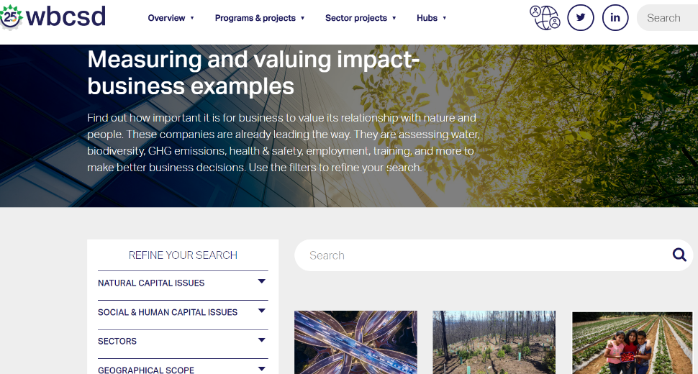
Supporting resources to your learning journey - Case Studies
Natural Capital Coalition’s case studies
Over 160 case examples
Variety of business sectors, and public sector
Examples of how companies have made use of the Natural Capital Protocol
WBCSD’s business examples page
Nearly 60 business examples
Variety of business sectors
Examples of how companies have conducted a natural, social/human capital assessment

Slide 50
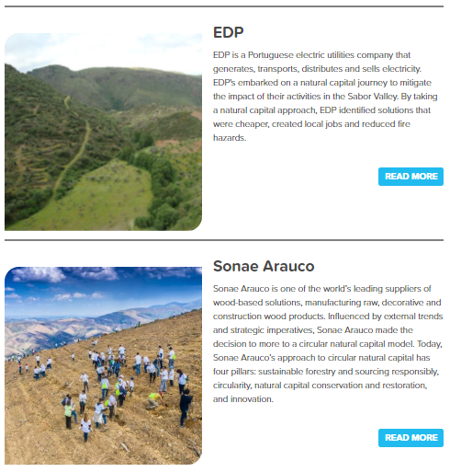
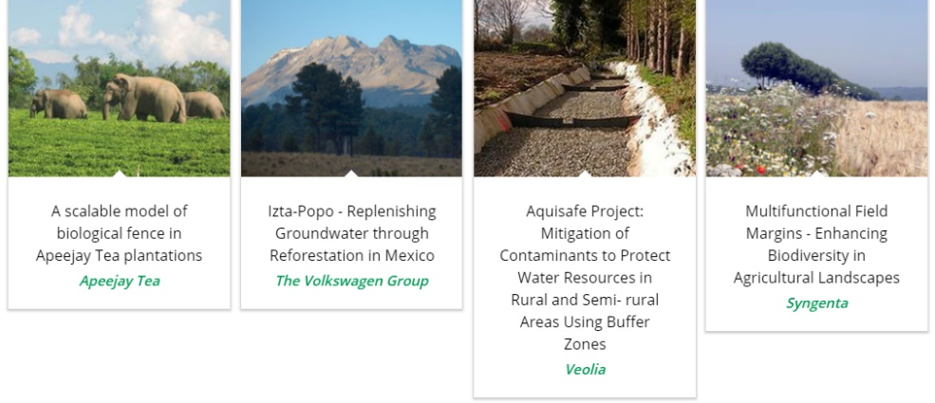
Supporting resources to your learning journey - Case Studies
We Value Nature’s business stories
3 recent business stories relating to natural capital
Variety of business sectors
EDP, Sonae Arauco & Grupo Argo sharing their natural capital journey
Natural infrastructure for business platform
16 business case studies
Variety of business sectors
Examples of how companies have conducted a natural, social/human capital assessment
Case study library

Slide 51
Further resources
Natural capital protocol
NCP page with option to download in different languages https://naturalcapitalcoalition.org/natural-capital-protocol/
Protocol application program to support businesses as they apply NCP https://naturalcapitalcoalition.org/natural-capital-protocol/protocol-application-program/
NCP executive summary: natural capital primer https://naturalcapitalcoalition.org/wp-content/uploads/2016/07/NCC_Primer_WEB_2016- 07-08.pdf
Biodiversity guidance by Natural Capital Coalition https://naturalcapitalcoalition.org/biodiversity/ Natural capital coalition annual review 2017 https://naturalcapitalcoalition.org/natural-capital-an-annual-review/
Social and Human Capital Protocol
SHCP document https://social-human-capital.org/wp-content/uploads/2020/01/Social-Human-CapitalProtocol_26.02.19.pdf
We Value Nature Training Resources
ALL resources (Module 1 and Module 2) https://wevaluenature.eu/training-resources
Module 2 https://wevaluenature.eu/training-resources/module-2
Business Ecosystem Training (BET) https://www.wbcsd.org/Programs/Redefining-Value/Business-Decision-Making/Assess-and-Manage-Performance/BET/Business-Ecosystems-Training
Little Blue Research
Main website https://www.littleblueresearch.com/
Ecosystems knowledge network
Network aiming to equip people to deliver wellbeing and prosperity through a healthy natural environment, applying the ecosystem approach https://ecosystemsknowledge.net/
WEF Covid Platform Platform
Mobilising stakeholders to foster resilience and protect livelihoods/ galvanize global business community for collective action https://www.weforum.org/platforms/covid-action-platform
Useful links

Slide 52
Further resources
Useful links
Business Biodiversity Platform
Main website https://ec.europa.eu/environment/biodiversity/business/index_en.htm
Tools
Shift platform http://shift.tools/
Encore tool https://encore.naturalcapital.finance/en
SASB Tool https://www.sasb.org/
Natural capital coalition sector guides https://naturalcapitalcoalition.org/sector-guides/
I360X Tool https://www.gistimpact.com/i360xn.php
The Cool Farm Tool https://coolfarmtool.org/
Software
Mural interactive software https://www.mural.co/
Mentimeter https://www.menti.com/
Case studies
Natural capital coalition case studies https://naturalcapitalcoalition.org/category/case-studies
Grupos Argos case study VAS https://sostenibilidad.argos.co/en/Value-Added-Statement-to-Society-VAS
Hugo Boss case study https://group.hugoboss.com/fileadmin/media/pdf/sustainability/2017-05- 31_2nd_White_Paper_EIV.pdf
Haagen-Dazs case study video https://www.haagendazs.us/save-the-honey-bees
WBCSD business examples https://www.wbcsd.org/Programs/Redefining-Value/Business-Decision-Making/Assess-andManage-Performance/Measuring-and-valuing-impact-business-examples
WBCSD film series examples https://www.wbcsd.org/Programs/Redefining-Value/Business-Decision-Making/Assess-andManage-Performance/Resources/Natural-Capital-a-short-film-series

Slide 53
Module 2 training development – Acknowledging contributors
We Value Nature’s module 2 training is based on the Natural Capital Protocol and WBCSD’s BET training material.
Module 2 training content and material was developed in collaboration with Little Blue Research Ltd.
The training material has been reviewed by and tested with a group of 10 businesses from a variety of sectors as well as delivered as a test trial to nearly 90 participants representing businesses, NGOs, consultancies as part of WBCSD’s virtual event series.
Finally, 12 experts from the Advisory Board have provided their input into the training material.
Notes:
KB

Slide 54
About We Value Nature
Working with the Natural Capital Coalition and supported by the European Commission (€2 million funding), We Value Nature is collaborating with businesses, networks and platforms to mainstream natural capital approaches and adopt the Natural Capital Protocol.

Slide 55
Contacts
Don’t hesitate to get in touch with us!
For any questions relating to training:
Training@wevaluenature.eu
For general inquiries:
info@wevaluenature.eu
Keep in touch & sign-up: wevaluenature.eu
Exchange with peers:
LinkedIn Group

Slide 56
Disclaimer
Disclaimer
WVN module 2 is a capacity building program released in the name of the WVN network. It is the result of a collaborative effort by WBCSD, Little Blue Research, Ltd. with input from an Advisory Board composed of experts on natural capital, businesses, NGOs, academic institutions, and others.
The training was tested with the WBCSD membership. It does not mean, however, that every advisory board member, and WBCSD member company agrees with every word. The WVN module 2 has been prepared for capacity building only and does not constitute professional advice. You should not act upon the information contained in the WVN module 2 training without obtaining specific professional advice. No representation or warranty (express or implied) is given as to the accuracy or completeness of the information contained in the WVN module 2 training and its translations in different languages, and, to the extent permitted by law, WBCSD, Little Blue Research, Ltd., members of the Advisory Board, their members, employees and agents do not accept or assume any liability, responsibility or duty of care for any consequences of you or anyone else acting, or refraining to act, in reliance on the information contained in this capacity building program or for any decision based on it.
Copyright © WVN
October 2020
56

